Slide 1
Introductory Pandas
Nikolaj Wochnik, Eric Nelson
Team Wochson CSMS
CS506 Spring 2025

Slide 2
Agenda
Package Installation & Importing
Basic Pandas Functions
Read Files (CSV)
Data Manipulation
Visualization
Machine Learning/Models

Slide 3
Installing Packages
Pandas
Matplotlib
Seaborn

Slide 4
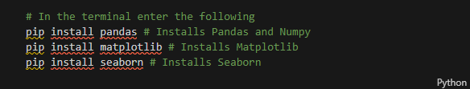
Installation Code
In the Terminal (ctr `)

Slide 5
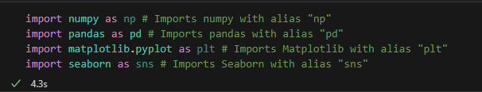
Import Libraries
In a code cell

Slide 6
Data Structures
Series - data structure created from one dimensional array
Dataframe - data structure created from two dimensional arrays

Slide 7
Series

Slide 8
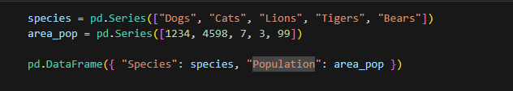
DataFrame

Slide 9
Reading Files
Data Frames Created from CSV Files

Slide 10
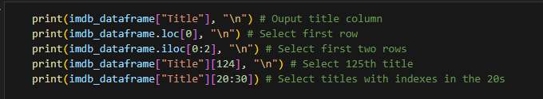
Access Data
Column name, Index, Range

Slide 11
Manipulate Data
Ranges, Formulas

Slide 12

Add & Remove

Slide 13
Missing Data

Slide 14
Data Visualization
Pandas Plotting
Matplotlib
Seaborn

Slide 15
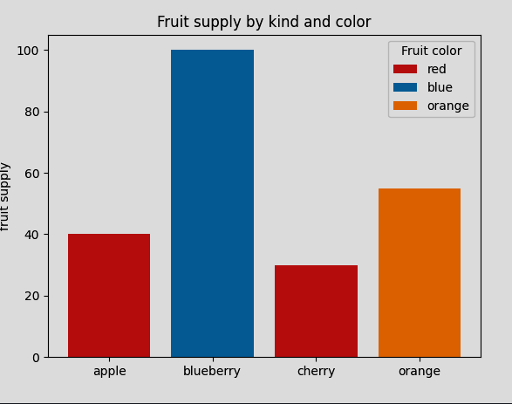
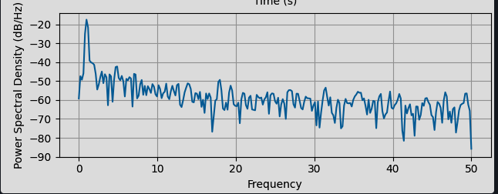
Chart Types
Bar Chart
Line Chart

Slide 16
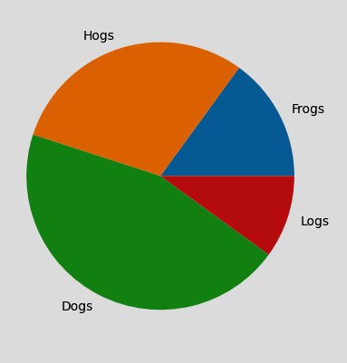
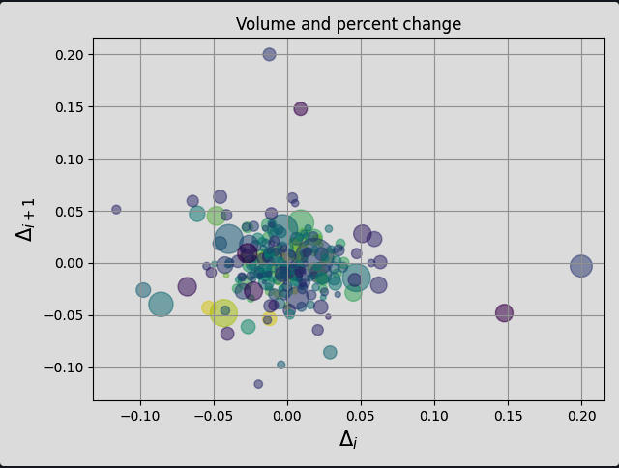
Chart Types
Pie Chart
Scatter Plot

Slide 17
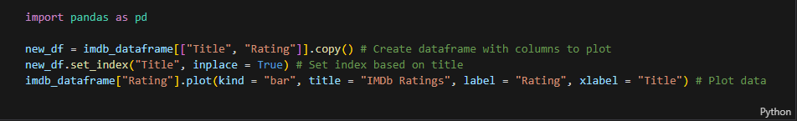
Pandas Plotting

Slide 18
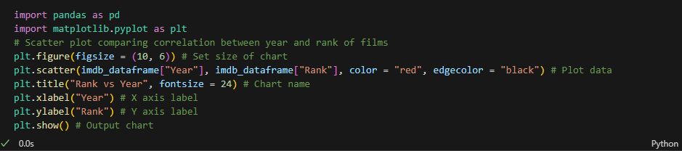
Matplotlib

Slide 19
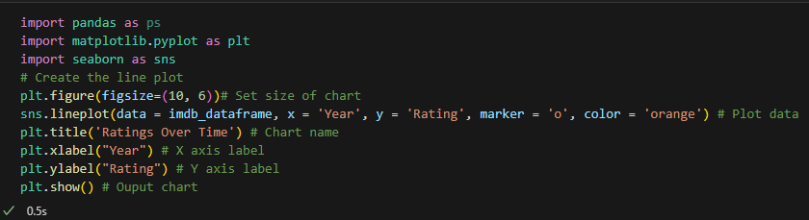
Seaborn

Slide 20
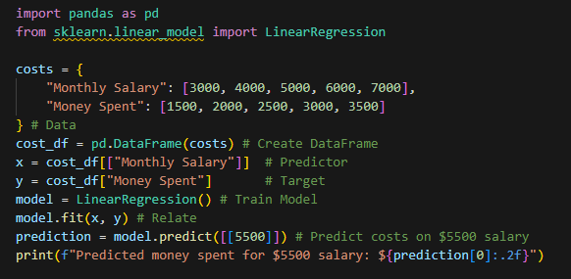
Supervised Learning
Linear Regression

Slide 21
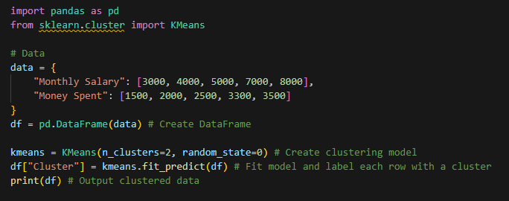
Unsupervised Learning
Clustering

Slide 22
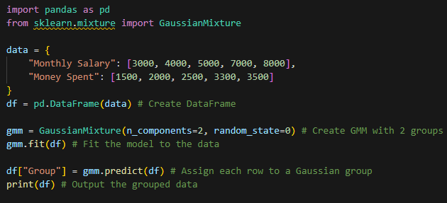
Gaussian Mixture Models

Slide 23
Model Selection
Train-Test Split
Cross Validation

Slide 24
References
McKinney, W. (2023). Pandas installation guide. Pandas Documentation https://pandas.pydata.org/pandas-docs/stable/getting_started/install.html
Hunter, J. D. (2023). Matplotlib installation guide. Matplotlib Documentation. https://matplotlib.org/stable/users/installing.html
Waskom, M. L. (2023). Seaborn installation guide. Seaborn Documentation. https://seaborn.pydata.org/installing.html
McKinney, W. (2023). Pandas data structures: Series and DataFrames. Pandas Documentation. https://pandas.pydata.org/pandas-docs/stable/dsintro.html
McKinney, W. (2023). read_csv() documentation. Pandas Documentation. https://pandas.pydata.org/pandas-docs/stable/reference/api/pandas.read_csv.html
McKinney, W. (2023). DataFrame operations. Pandas Documentation. https://pandas.pydata.org/pandas-docs/stable/reference/api/pandas.DataFrame.html
McKinney, W. (2023). Accessing data in Pandas. Pandas Documentation. https://pandas.pydata.org/pandas-docs/stable/getting_started/10min.html#accessing-data
Hunter, J. D. (2023). Matplotlib documentation. Matplotlib Documentation. https://matplotlib.org/stable/contents.html

Slide 25
Hunter, J. D. (2023). Matplotlib gallery. Matplotlib Documentation. https://matplotlib.org/stable/gallery/index.html
Waskom, M. L. (2023). Seaborn documentation. Seaborn Documentation. https://seaborn.pydata.org/
McKinney, W. (2023). Pandas plotting guide. Pandas Documentation. https://pandas.pydata.org/pandas-docs/stable/reference/api/pandas.DataFrame.plot.html
Pedregosa, F., Et al. (2021). Supervised learning. Scikit-learn Documentation. https://scikit-learn.org/stable/supervised_learning.html
Pedregosa, F., Et al. (2021). Unsupervised learning. Scikit-learn Documentation. https://scikit-learn.org/stable/unsupervised_learning.html
Pedregosa, F., Et al. (2021). Gaussian mixture models (GMM). Scikit-learn Documentation. https://scikit-learn.org/stable/modules/mixture.html#gaussian-mixture
Furlan, R. (2020, September 24). A guide to model selection in machine learning. Towards Data Science. https://towardsdatascience.com/a-guide-to-model-selection-in-machine-learning-bbe9b2cba5d7

Slide 26


Q&A

