Slide 1
Introduction to Scikit-Learn & Its Applications
Nikolaj Wochnik
Team Wochnik CSMS
CS506 Spring 2025

Slide 2
Agenda
Understand SciKit-Learn Core Functionality
Work with Built-in Databases
Apply Preprocessing Techniques
Perform Model Selection and Evaluation
Build ML Pipelines
Implement Supervised Learning Models
Implement Unsupervised Learning Models
Visualize Model Results and Performance

Slide 3
What is SciKit-Learn?
An open-source Python ML library
Built on NumPy, SciPy, and Matplotlib

Slide 4
Key Features
Simple interface
Efficient tools
Built-in datasets
Extensive docs & support
Integration with Pandas/Numpy

Slide 5
Installing Packages
SciKit-Learn
Matplotlib
Seaborn
Joblib
Keras
Tensorflow

Slide 6
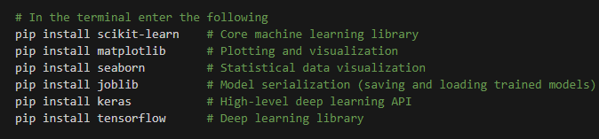
Installation Code
In the Terminal (ctr `)

Slide 7
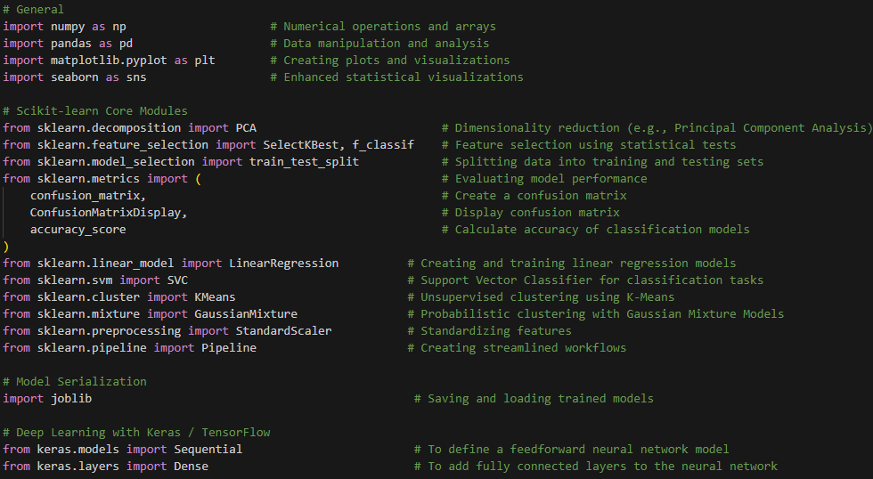
Import Libraries

Slide 8
Datasets
Built-in
iris
wine
External
fetch_openml()
Pandas/NumPy

Slide 9
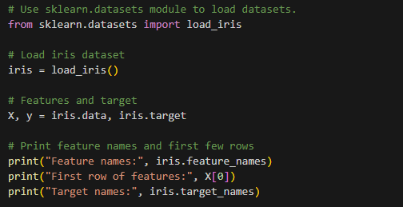
Dataset Use Case

Slide 10
Preprocessing
Used to clean and transform data:
Techniques:
Scaling: StandardScaler
Encoding: OneHotEncoder
Imputation: SimpleImputer
Feature Generation: PolynomialFeatures

Slide 11
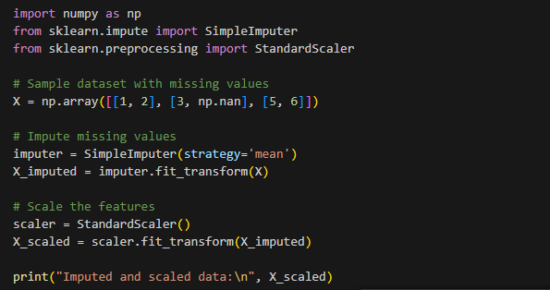
Preprocessing Use Case

Slide 12
Model Selection
Used to:
Choose Best Model
Tune Hyperparameters
Validate with Cross-validation.
Model Types:
Classification
Regression
Clustering

Slide 13
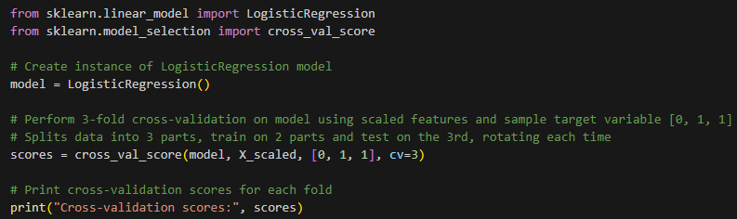
Model Selection Use Case
Cross-Validation

Slide 14
Pipelines
Structure ML Workflows
Cleaner Code
Prevent Data Leakage
Facilitate Hyperparameter Tuning
Types:
Basic
Column Transformers
Nested

Slide 15
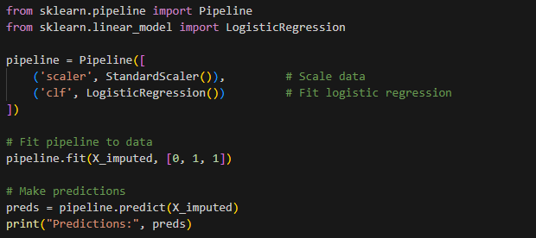
Pipeline Use Case

Slide 16
Supervised Learning
Trained on Labeled Data
Predict Outcome Based on Past Data
Automate Decision Making
Solve Practical Problems
Types:
Regression
Classification

Slide 17
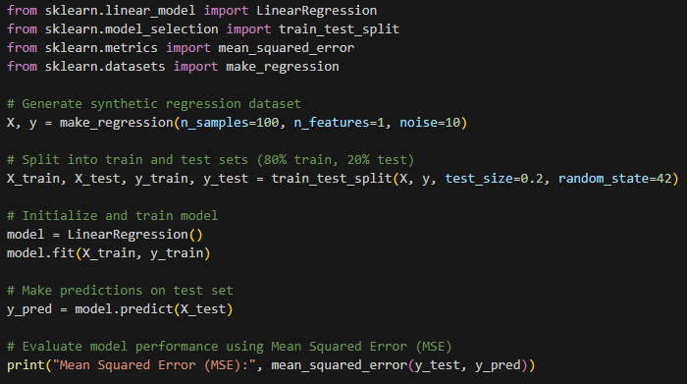
Supervised Learning Use Case

Slide 18
Unsupervised Learning
Not Trained on Labeled Data
Pattern Recognition
Recommender Systems
Types:
Clustering
Dimensionality Reduction
Anomaly Detection

Slide 19
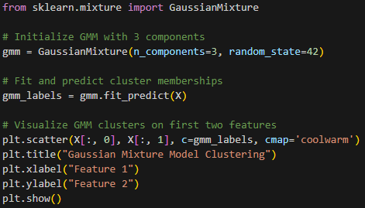
Unsupervised Learning Use Case

Slide 20
Visualization
Plots
Matploblib
Seaborn
Analyze Predictions
Diagnose Strengths & Weaknesses
Guide Tuning
Types:
Confusion Matrix
Decision Boundary

Slide 21
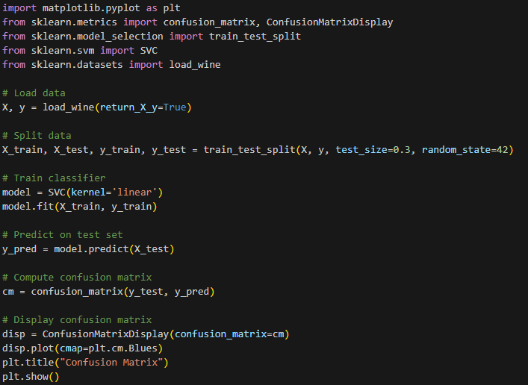
Visualization Use Case

Slide 22
Advanced topics
Dimensionality Reduction
Feature Engineering
Model Deployment

Slide 23
Real-World Applications
Supervised Learning
Medical Field
Unsupervised Learning
Marketing / E-commerce
Preprocessing
Banking Systems
Pipelines
End to end ML Projects

Slide 24
References
Chollet, F. (2018). Deep learning with Python . Manning Publications.
Jolliffe, I. T., & Cadima, J. (2016). Principal component analysis: A review and recent developments. Philosophical Transactions of the Royal Society A: Mathematical, Physical and Engineering Sciences, 374(2065), 20150202. ht86df7e3c2697d3fce7e7f3a5a5933e42-Paper.pdf tps://doi.org/10.1098/rsta.2015.0202
Scikit-learn contributors. (2023). sklearn.decomposition.PCA — scikit-learn 1.2.2 documentation. https://scikit-learn.org/stable/modules/generated/sklearn.decomposition.PCA.html
Guyon, I., & Elisseeff, A. (2003). An introduction to variable and feature selection. Journal of Machine Learning Research, 3, 1157–1182. http://jmlr.org/papers/v3/guyon03a.html
Scikit-learn contributors. (2023). sklearn.feature_selection.SelectKBest — scikit-learn 1.2.2 documentation. https://scikit-learn.org/stable/modules/generated/sklearn.feature_selection.SelectKBest.html
Sculley, D., Holt, G., Golovin, D., Davydov, E., Phillips, T., Ebner, D., Chaudhary, V., Young, M., Crespo, J.-F., & Dennison, D. (2015). Hidden technical debt in machine learning systems. In Advances in neural information processing systems (Vol. 28). https://papers.nips.cc/paper/2015/file/

Slide 25
Code Source References
Scikit-learn:
Pedregosa, F., et al. (2011). Scikit-learn: Machine learning in Python. Journal of Machine Learning Research, 12, 2825–2830. http://jmlr.org/papers/v12/pedregosa11a.html
Matplotlib:
Hunter, J. D. (2007). Matplotlib: A 2D graphics environment. Computing in Science & Engineering, 9(3), 90–95. https://doi.org/10.1109/MCSE.2007.55
Keras/TensorFlow:
Abadi, M., et al. (2016). TensorFlow: A system for large-scale machine learning. 12th USENIX Symposium on Operating Systems Design and Implementation (OSDI ’16), 265–283. https://www.usenix.org/system/files/conference/osdi16/osdi16-abadi.pdf

Slide 26


Q&A

