Slide 1
Introduction to PyTorch
Nikolaj Wochnik
Team Wochnik CSMS
CS506 Spring 2025

Slide 2
Agenda
Understand PyTorch’s Core Functionality
Work with Tensors
Loading & Preprocessing with torchvision.datasets
Build Neural Networks with torch.nn.Module
Train Neural Networks with Autograd
Evaluate and Visualize Models

Slide 3
What is PyTorch?
Open-source deep learning library by Meta AI
Combines NumPy-like syntax with GPU support
Used in CV, NLP, RL, etc.

Slide 4
Key Features
Dynamic Computation Graphs
GPU Acceleration
Automatic Differentiation w/ autograd
Modular Design w/ torch.
Built-in Datasets & Transforms
Pythonic and Interoperable

Slide 5
Installing Packages
torch
torchvision
matplotlib
numpy

Slide 6
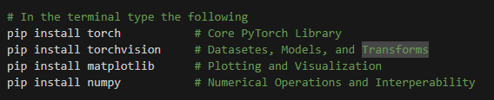
Installation Code
In the Terminal (ctr `)

Slide 7
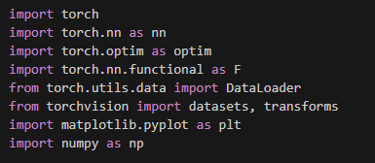
Import Libraries

Slide 8
Tensors
Fundamental data structure in
PyTorchSupports multi-dimensional arrays
Enables GPU acceleration & autograd

Slide 9
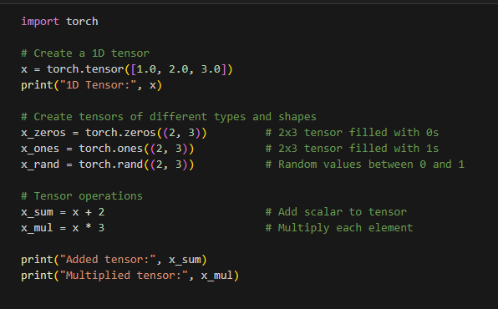
Tensors Use Case

Slide 10

GPU Acceleration
.to('cuda') moves tensors/models to GPU
Significant speedups in training
Check with torch.cuda.is_available()

Slide 11
Loading Datasets
Provides standard datasets like MNIST, CIFAR-10
Returns (image_tensor, label) pairs
Easy integration with Data Loader
Can be combined with transforms for preprocessing

Slide 12
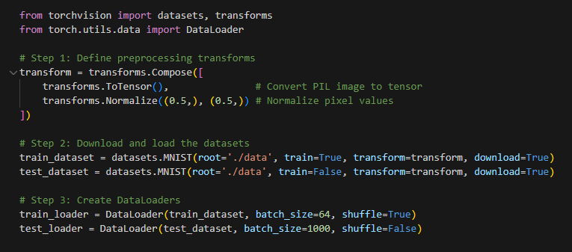
Data Loading Use Case

Slide 13
Data Transforms
Preprocessing steps applied to each sample
Convert images to tensors with ToTensor()
Normalize for stability, augment to generalize
Chain steps using transforms.Compose()

Slide 14
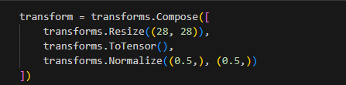
Transform Pipeline

Slide 15
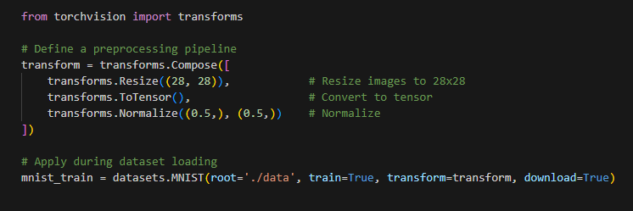
Transform Use Case

Slide 16
Neural Network Basics
Layers: input → hidden → output
Activation functions (ReLU, Softmax)
Used for classification, regression, etc.

Slide 17
Building Models w/ torch.nn
Inherit from nn.Module
Define layers in __init__
Specify forward logic in forward()

Slide 18
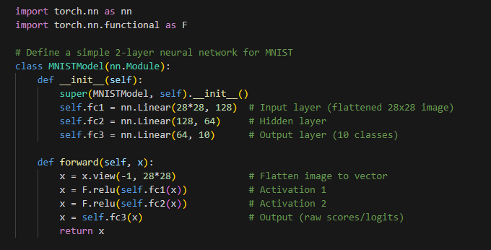
torch.nn Use Case

Slide 19
Training with autograd
Track ops for gradient computation
Use loss.backward()
Update weights with optimizer

Slide 20
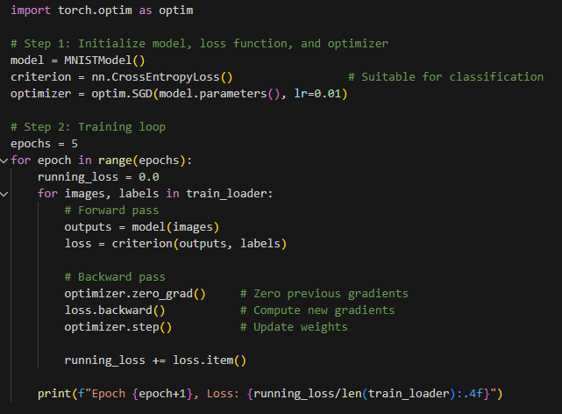
autograd Use Case

Slide 21
Model Evaluation
Use test set for generalization check
Turn off gradients with torch.no_grad()
Calculate accuracy or other metrics

Slide 22
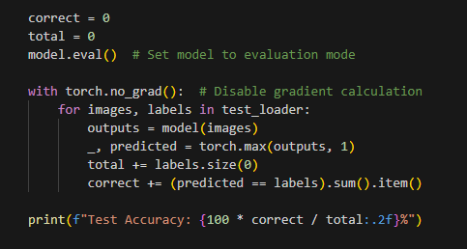
Evaluation Use Case

Slide 23
Visualization
Use matplotlib to display image predictions
Helps interpret model behavior
Spot misclassified examples

Slide 24
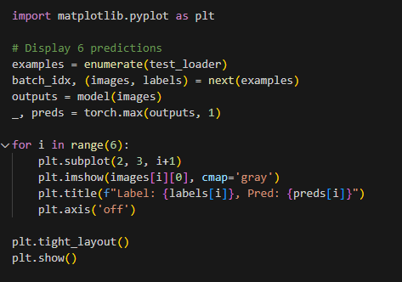
Visualization Use Case

Slide 25
Conclusion & Next Steps
Build, train, and evaluate neural networks
Use tensors, loaders, modules, autograd
Explore CNNs, new datasets, advanced optimizers

Slide 26
References
Paszke, A., Gross, S., Massa, F., Lerer, A., Bradbury, J., Chanan, G., ... & Chintala, S. (2019). PyTorch: An imperative style, high-performance deep learning library. Advances in Neural Information Processing Systems, 32, 8026-8037. https://arxiv.org/abs/1912.01703
Goodfellow, I., Bengio, Y., & Courville, A. (2016). Deep learning. MIT Press. https://www.deeplearningbook.org/
LeCun, Y., Cortes, C., & Burges, C. J. C. (1998). The MNIST database of handwritten digits. http://yann.lecun.com/exdb/mnist/
Torchvision contributors. (2023). torchvision.datasets — PyTorch 2.0.1 documentation. https://pytorch.org/vision/stable/datasets.html
Torchvision contributors. (2023). torchvision.transforms — PyTorch 2.0.1 documentation. https://pytorch.org/vision/stable/transforms.html
Paszke, A., et al. (2017). Automatic differentiation in PyTorch. NIPS Autodiff Workshop. https://openreview.net/pdf?id=BJJsrmfCZ
PyTorch. (2023). PyTorch documentation. https://pytorch.org/docs/stable/index.html
________________________________________

Slide 27
Code Source References
PyTorch:
Paszke, A., et al. (2019). PyTorch: An imperative style, high-performance deep learning library. Advances in Neural Information Processing Systems, 32, 8026-8037. https://arxiv.org/abs/1912.01703
Matplotlib:
Hunter, J. D. (2007). Matplotlib: A 2D graphics environment. Computing in Science & Engineering, 9(3), 90–95. https://doi.org/10.1109/MCSE.2007.55
NumPy:
Harris, C. R., et al. (2020). Array programming with NumPy. Nature, 585(7825), 357-362. https://doi.org/10.1038/s41586-020-2649-2

Slide 28


Q&A

