Slide 1
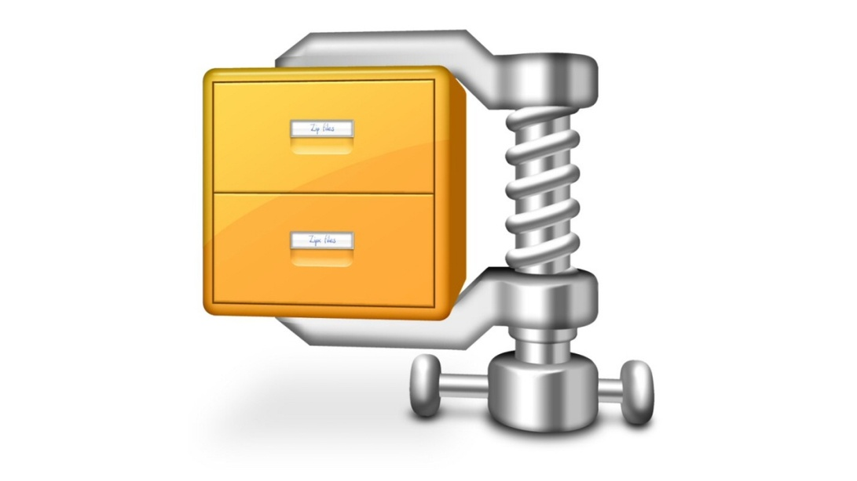

Disable x86
Unity 2018
27 MO
15 MO
Use NET.2
Native IL2CPP
7 MO
No optim

