Slide 1

Services
Rest Client
Exercice App

Slide 2
Hexagonal Architecture
Infrastructure
Client
Application
API Web Adapter
Domain
InputPort
Usecase
Model
Usecase
OutboundPort
InputPort
Calculator Service
Stats Web Adapter

Slide 3
Tests
Exploratory (Postman *API)
Functional (Postman *FunctionnalTests)
Integration (Junit *IntegrationTests)
Unit (Junit *Tests)
leboncoin-dev-hiring-exercise.json
ExerciseApplicationTests
FizzbuzzUseCaseTests
FizzbuzzApiControllerTests

Slide 4
Git Branches
main
feature-fizzbuzz
feature-fizzbuzz-prod
feature-fizzbuzz-prod-bonus

Slide 5
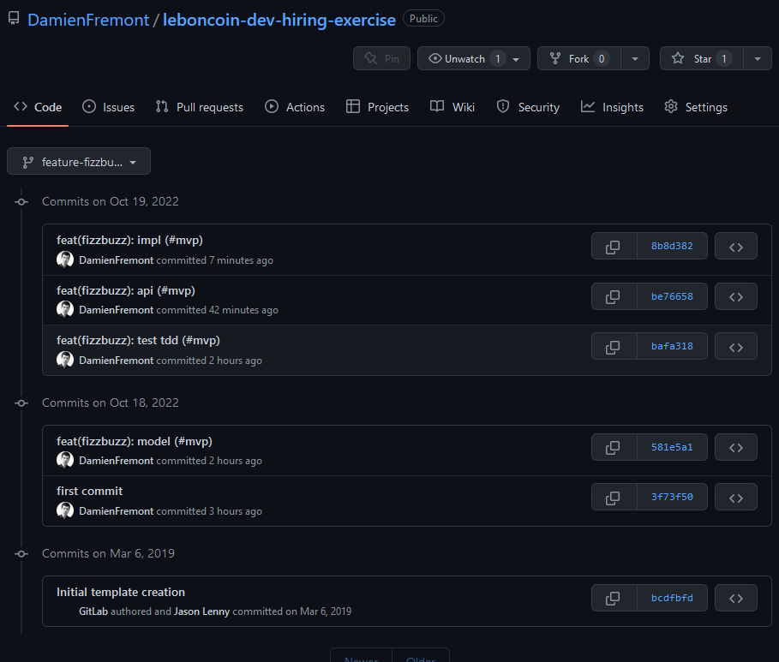

Slide 6
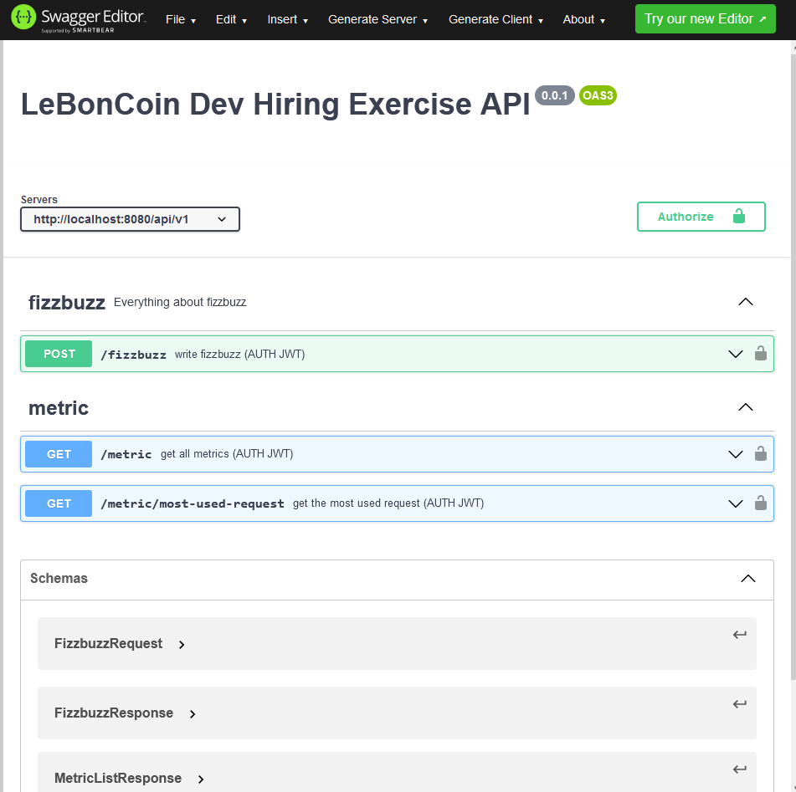

Slide 7
