Slide 1


Slide 2

1890
1890
1890
1890
1890
1890
1890
1890
1890
1890
1890
1890

Slide 3

MUZEUM
CARDS LINE
PLAY
PLAY
OPTIONS
COLLECTION

Slide 4
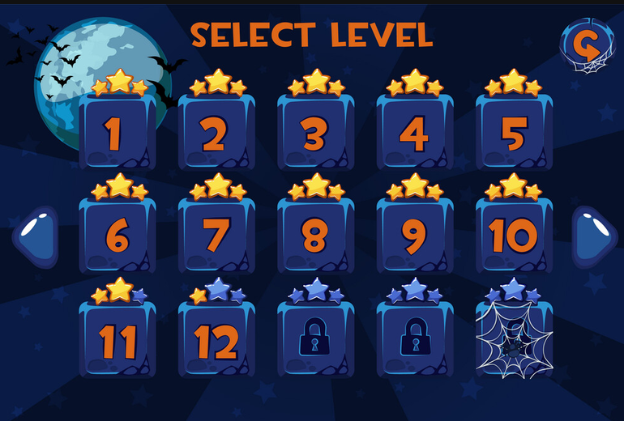
SELECT LEVEL
X
1
2
3
?
?
<<
?
?
?
?
?
>>
?
?
?
?
?

