Slide 1


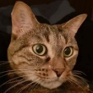











S
#img-script.py TXT=‘blabla…’
IMG=‘bla.jpg’ …
A
B
C
D
E
F
social-bot-@frimoussethecat-post-pics.py

Slide 2





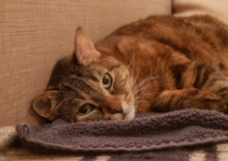

S
#vid-script.py TXT=‘blabla…’
IMG=‘bla.mp4’ …
A
B
F
social-bot-@frimoussethecat-post-vids.py

Slide 3


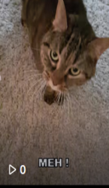

S
#sho-script.py TXT=‘blabla…’
IMG=‘bla.mp4’ …
A
social-bot-@frimoussethecat-post-shorts.py

Slide 4
/runtime
SikulixIDE
/standalone
social-bot-…-post-pics.py
social-bot-…-post-vids.py
social-bot-…-post-shorts.py
/platform
app-start
insta-post-pic
tw-post-pic
fb-post-pic
…
file-upload
tw-post-vid
fb-post-vid
…
/ platform/*.sikuli/*
win-run-btn.png
fb-post-btn.png
tw-post-btn.png
…
Components Diagram

