Slide 1
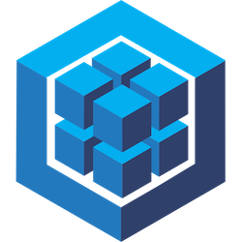



Sequelize + NodeJS + ReactJS + MaterialUI

Slide 2




















CODE
BUILD
INFRA
RUN
APP
DATABASE

