Slide 1

Project Defence
10/30/20 – GOUNOT Damien – gounot@et.esiea.fr

Slide 2
Reminders & project overview
Maze Solver (Maze textfile as a parameter)
Being able to validate a Maze textfile
Being able to create a Maze textfile
Should use bit to bit manipulation
BONUS : optimal pathfinding

Slide 3
Project Phases
File validation
Outline
External segments
File generation
Filling maze
Segment breaking
Display
Inside
Inside breaking
Maze
IA
Random directoin
Spawn / Exit
Path
Put invisible wall
Move IA
somes check

Slide 4
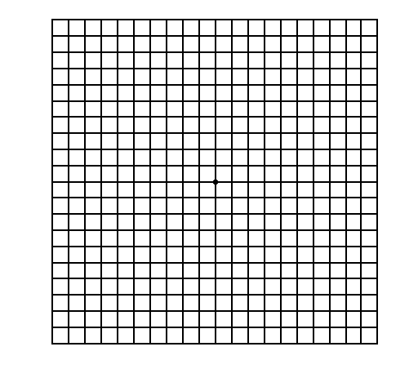
File Validation
External Wall validation
External rectangles
Every inside square

Slide 5
Maze Generation
Full Maze (every possible wall)
Brake external segment
Inside break

Slide 6
Display
Each cell is represent as a 3*3 matrix
Parse every row and column
For each cell, print row #i , for 0 <= i <= 2

Slide 7
Maze Solving
Select rand direction
If there is no wall
If no invisible wall on next cell
Put invisible wall and move to next cell
Else
Check if it’s dead end
If it’s dead end
Put invisible wall (now double) and move to next cell
Else
Check if IA is traped
Imagine…

Slide 8
Thank you ! - Demo
10/30/20 – GOUNOT Damien – gounot@et.esiea.fr

