Slide 1
Creating a video game
By: Johnathan and micky

Slide 2
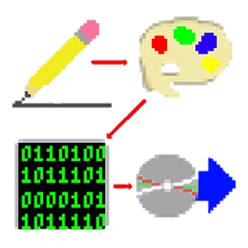
The 4 steps to creating a video game:
Design (Micky/John)
Creating a concept for the game, and working on the finer details
Creating Graphics/Assets (Micky)
Creating Graphics, Sounds, Levels, etc.
Programming (John)
Coding the game on the computer
Distribution (We really didn’t worry about this)
Distributing the game to players

Slide 3

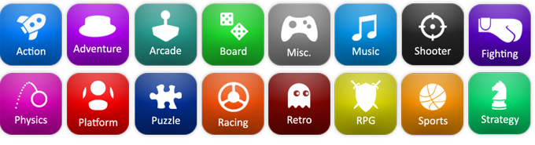
Step 1: Game design
This is where you’ll de coming up with the concept for your game. Brainstorm!
Keep in mind:
Genre (what type of game you’re making), Name (the name of your game), Goal (What the player is trying to do), Competition (How you’ll be graded), Unique Qualities (What makes your game yours)
Who’s doing what, what language you are programming in, when you want the game to be done, what platform is your game for
Video Game Genres

Slide 4


Step 2: Graphic/Asset creation (micky)
You need:
A computer to do your work on
An image creation utility, we used Piskel
A way to share the images with your group/creator – we used GitHub

Slide 5
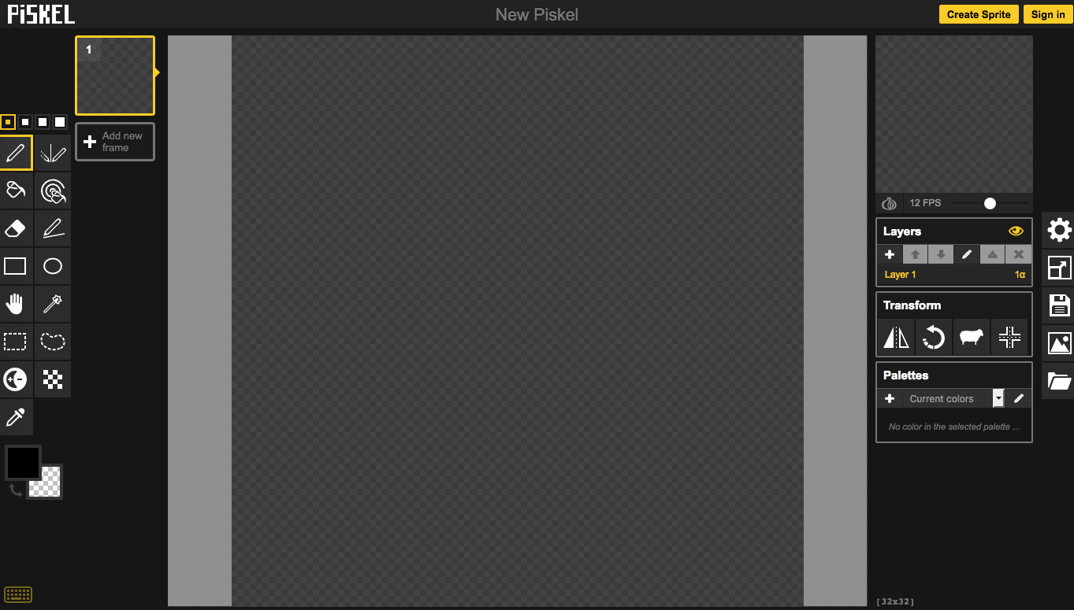
Step 2.1: an introduction to piskel
The screen is split up into separate areas:
The Canvas, or where you draw your images
The Toolbox, which stores your tools, and sizing options
The Picture Editing Options, where you edit the properties of your image

Slide 6
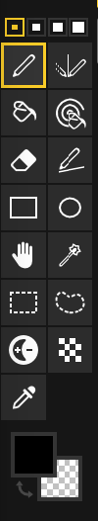
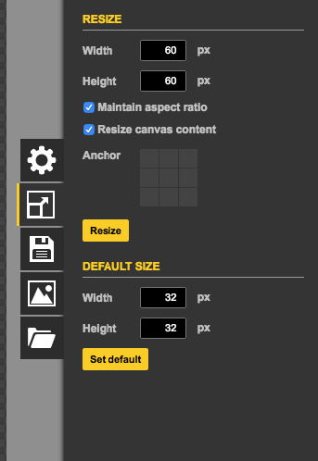
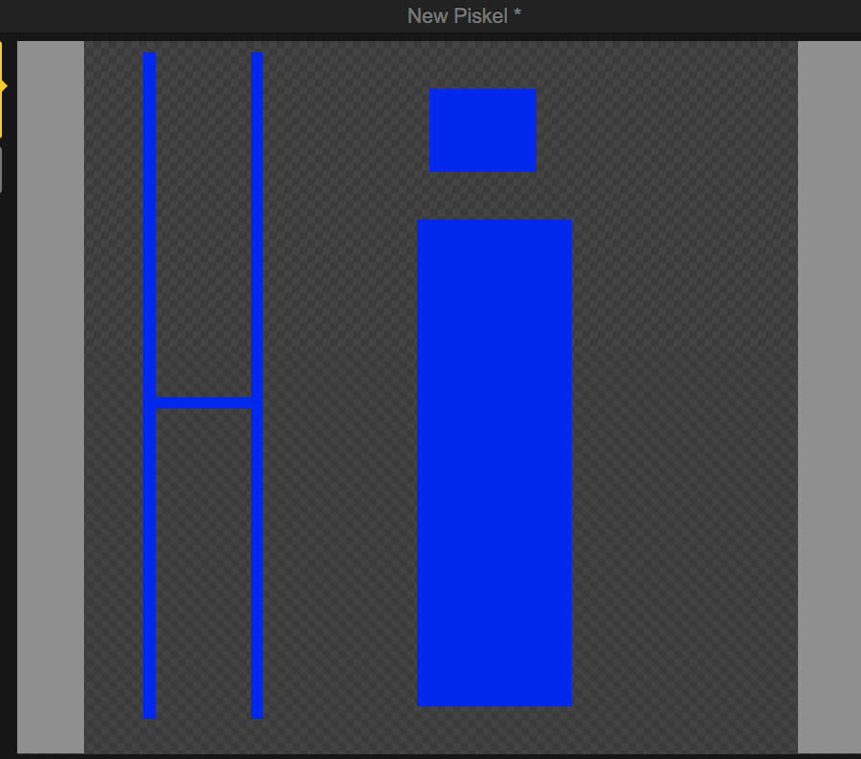
Step 2.3: How to draw
Resize the image to the correct resolution, (the cars are 60*60, tracks are 1280*720)
Create a Pallet with all of the colours that you will need.
Select the tool that you will use for drawing.
Click on the canvas to draw
Use you sense of detail to colour each pixel by itself
Export your image as an .png file to put in the code

Slide 7
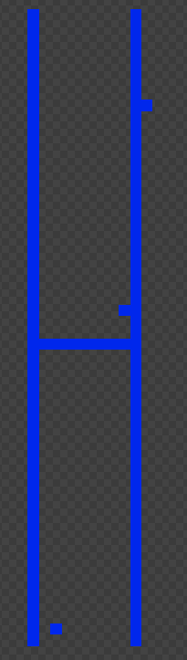

Step 2.4: things to keep in mind
Always save you images so you don’t lose them
Control-Z is undo
Always keep the background transparent
If you miss a single pixel, it can ruin your whole image!
DON’T mix up the two paint bucket tools!
Make sure that everything is consistant

Slide 8
Step 2.5: Learn by example
Let’s draw an image!

Slide 9



Step 3: Programming (john)
You need:
A programming language– we used Python and Pygame
A “code writer” – any text editor will work (such as Notepad), but we used both GEdit and Atom
A way to share code between team members (Optional for solo projects) - we used GitHub
A way to run the code (usually an install of the programming language) – we downloaded Python from their official website
A computer to do all of this on
Great! Now let’s get coding!

Slide 10

Step 3.1: an intro to python and Pygame
Wait? Python AND Pygame?
Think of Python as a series of books, you have the base set for basic stuff, but by adding extra “side” , or “Modules”, you can add extra content
Python is the language, Pygame is a module
What you’ll need to know about Python:
Variables – EVERYTHING is a variable is programming!
Functions and Loops – So you can have the game do a loop, until its Game Over
If, else, and math statements – Programming is basally all you giving formulas to the computer
Image, Text, and Graphic manipulation – So you can actually see the game
Modules – Working with ”extensions” to Python

Slide 11
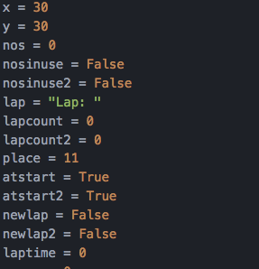


Step 3.2: Variables
Variables are similar to the ones you do in math
4 main types of variables :
Strings - Hold text
Integers – Hold non-decimal numbers
Floats – Hold decimal numbers, but may be not be precise
Boolean – True/False Variable
Example uses of variables in our code:
score – The Player’s Score
curspeed – The player’s current speed
x - The player’s current x position
rotater - The car’s angle
Currentcar – The car that the player is using

Slide 12


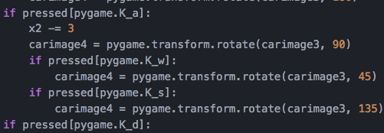
Step 3.3: if, else, and math in python
If statements:
If statements let you control what is happening in your program
Only do something if conditions are met
For example, if pressed[pygame.K_UP]: speed up
Else statements:
Else statements mean do something if the if statement is not met
Math (all shapes and forms):
You can and need to do math in Python, for everything from current speed, to the current angle
Just type the math in, and apply to a variable – its that easy!
-=, +=, *=, or /= mean to apply to the same variable
Example uses: curspeed += caraccellation, rotater += 2,

Slide 13
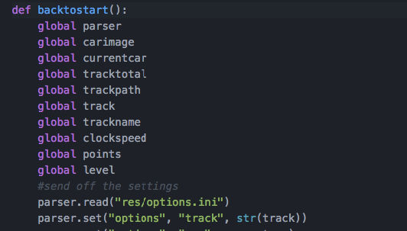
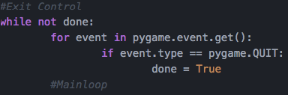
Step 3.4: Functions and loops
Functions:
Functions are a way of setting aside some lines of code (like ending the game), and using it later
Code you put in a function can be replayed when you call it
Use def functionname(): to create a function. Indented code is “in the function”
Use functionname() to call this code
Examples of this: sendtomain():, def backtostart():
The Main loop:
The main loop is the part of your code that will repeat over and over, for example the racing engine
This is usually accomplished by having a variable that represents being “done” or “not done”, and quitting the program when the variable = “done”
See the picture for an example of this

Slide 14
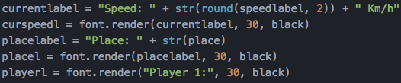

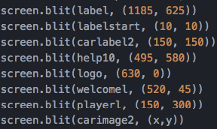
Step 3.5: image, text, and displaying graphics
Displaying Images
Displaying images takes two steps, loading the image, and blitting (or drawing) it.
Loading the image uses the pygame.image.load command.
Biltting uses the screen.blit command
Displaying Text
Just like images, text also takes the two steps, Rendering and Blitting
Rendering uses the font.render command
Blitting is the same as images
Object Manipulation
There are ways to manipulate your displayed objects:
Pygame.rotate rotates your images
Use variables to show where to place the image/text

Slide 15
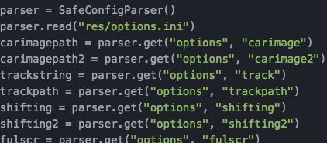
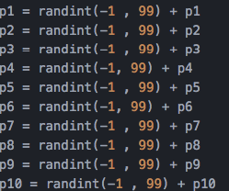
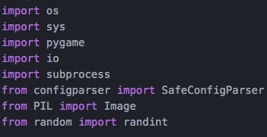
Step 3.6: Working with modules (Pygame, PIL, etc.)
There are many more modules in Python than just Pygame
Some examples : Pygame, ConfigParser, PIL (Python Image Library), Random
Import modules:
At the top of your code
Use the “import” command
Using modules:
Module specific commands are run using the format : modual.command.
Examples : pygame.image.load, random.randint, pygame.display.flip
The python documentation has a lot of resources in this case (docs.python.org)

Slide 16
Step 3.7 : some other things to remember
In Pygame, you need to set up your window!
and (replace ESCAPE with the key you want) do key detection
Use to render the screen
Bug test A LOT! Bugs creep into your code very easily.

Slide 17
Step 3.8: Learn by example
Let’s do some programming!

Slide 18
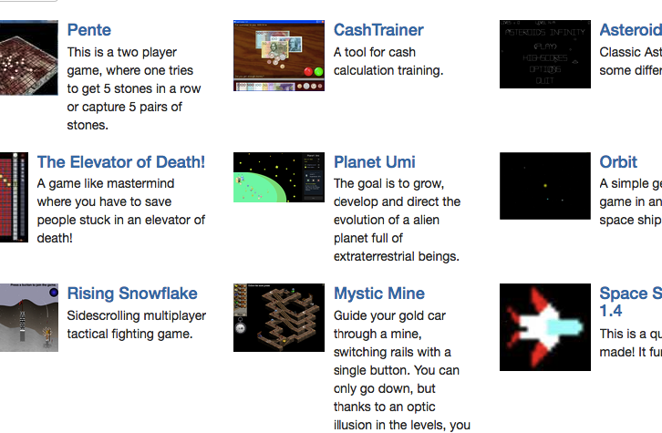
Step 4: Distribution
This is the easiest step of making your game. (in our opinion)
There are several platforms for releasing your game on the internet:
GitHub : You can release your software on the development platform
Pygame’s website: They have a place for uploading your games
Your own website : Pretty self-explanatory
You can also release your game in real life
Give your game to a friend, or someone else on a usb, or CD for them to try out!
Some games on www.pygame.org

Slide 19
There, you’re done!
Now, lets show you what we did!

