Slide 1

28/04/2024 Computer Science And System Engineering
WELCOME
Smart Receipt Management &
Extraction
Supervise by honorable Nivede Issur
CST3990 – Undergraduate Individual Project

Slide 2
28/04/2024 Computer Science And System Engineering
TABLE OF CONTENTS
1.Background
2.Research
3.Methode / implementation
4.Problem encounter
5.Testing
6.Evaluation
7.Conclusion

Slide 3







28/04/2024 Computer Science And System Engineering
1.Background
Logging receipt
Manual labor (human resource consuming)
High ecological impact
Time consuming
Objective
Receipt extraction capacity
Provide analytics
Storing capacity

Slide 4








28/04/2024 Computer Science And System Engineering
2.Literature Review
Object detection
Text Extraction
Mobile Development
Azure Computer vision API
VS
Google Cloud Vision API
YOLO Image detection v5
Flutter
React Native
Custom Convolutional Neural Network
(Wu, 2018).
Tesseract OCR

Slide 5
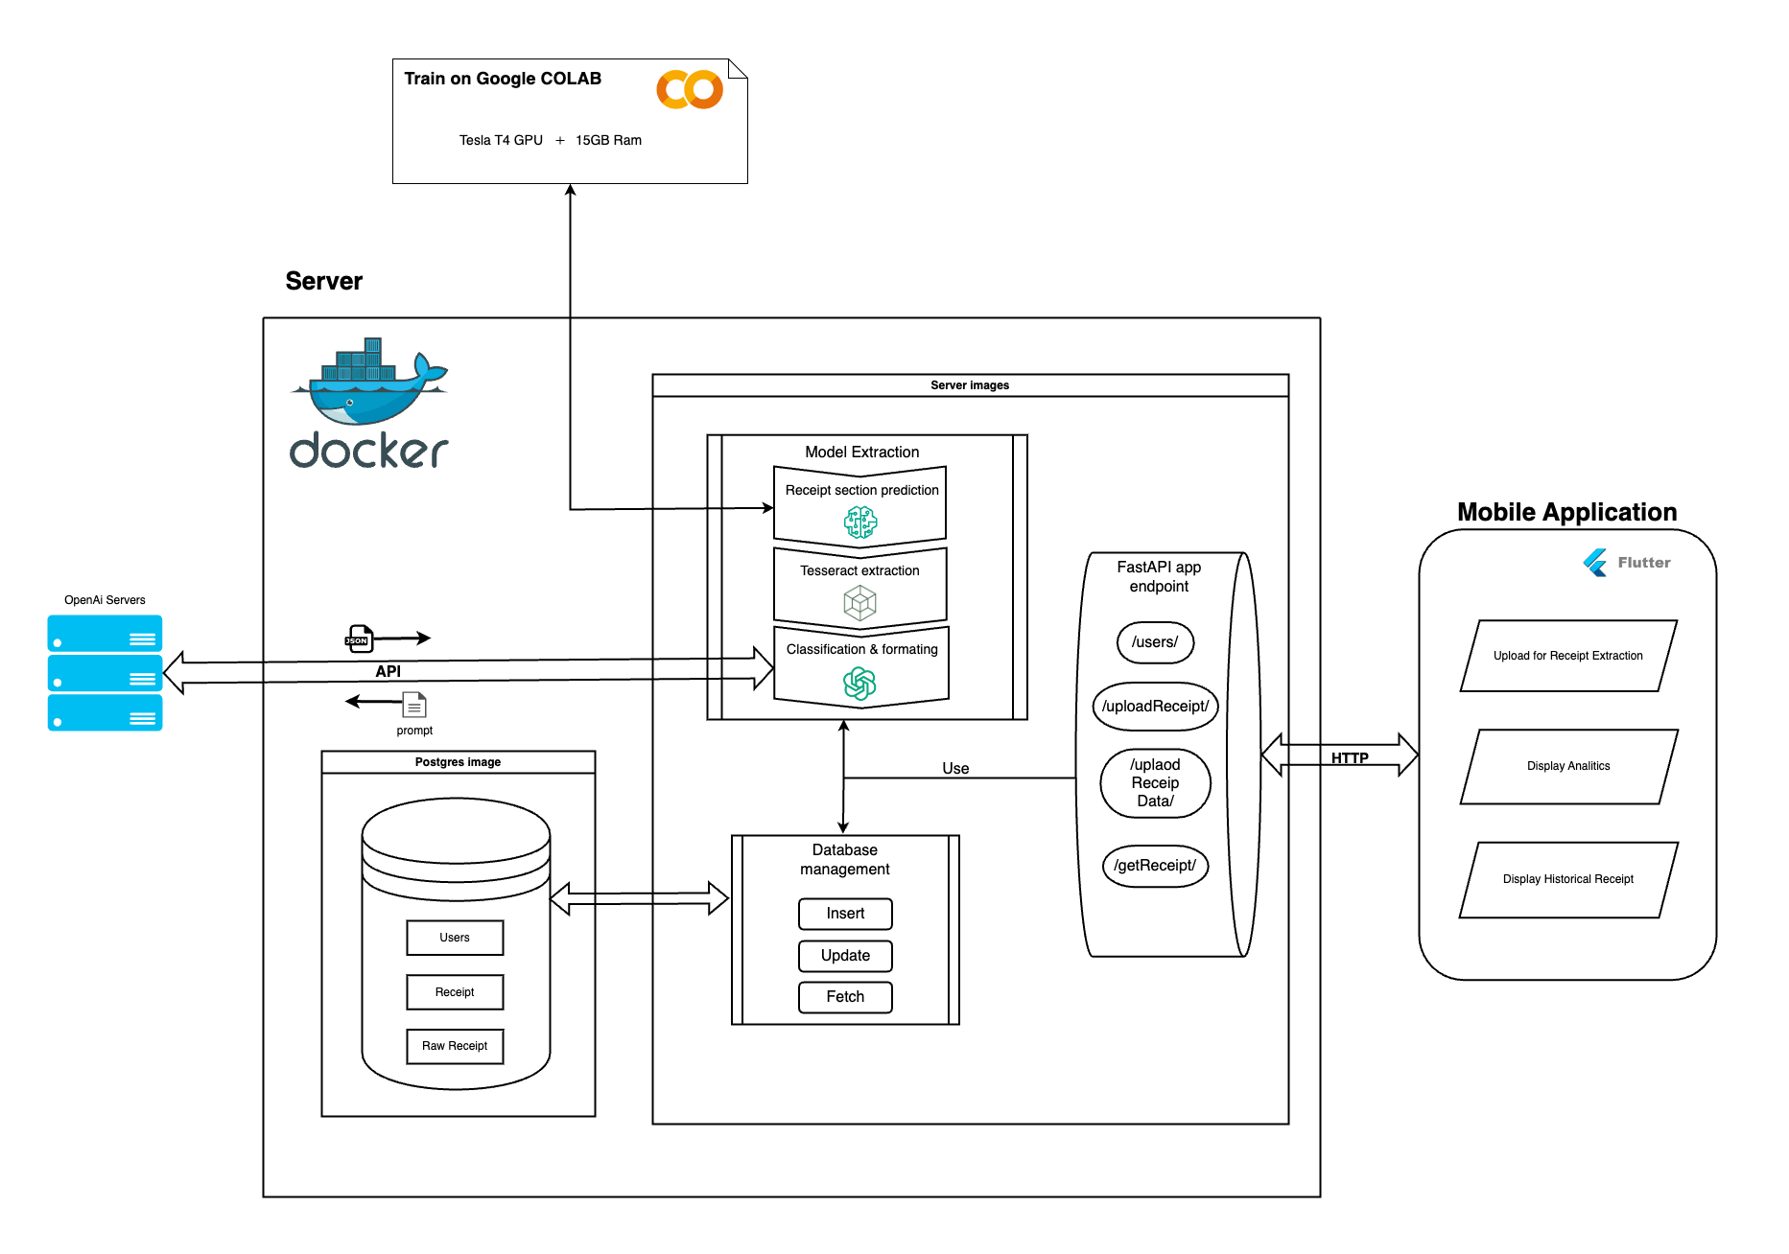
3. Implementation

Slide 6

28/04/2024 Computer Science And System Engineering
4. Problem Encounter
Classification / Formatting
Local Server Deployment
Problem
Solution
Problem
Solutions
Complex task
Complex task
Chatgpt
Rebuilding app with private IP
Limited resources
Computational restriction
Powerful comprehension power
Computational restriction
Limited resources
Computational restriction
Deploy on server with public IP
Limited resources

Slide 7
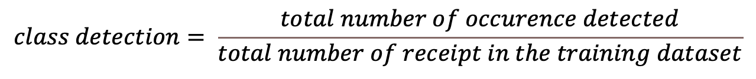
28/04/2024 Computer Science And System Engineering
5.Testing
Model Evaluation methodology
System Unit Testing
Server
/getReceipt/
/uploadPicture/
/uplaodReceiptData/
True element area
Enpoint well behavior
Prediction area
UNION
Mobile application
$$class accuracy= \frac{area of union between prediction and label}{total number of receipt−number of receipt not detected}$$
Well Display
Correct Execution
Error Management
Classes
Widgets
Pages
$$class detection= \frac{total number of occurence detected}{total number of receipt in the training dataset}$$

Slide 8
28/04/2024 Computer Science And System Engineering
6.Evaluation
High detect and accuracy :
Commun placement
Easely recognizable
Class | Number of occurrences not detected | Class detection | Class accuracy
Shop Information | 1 | 94% | 96%
Total | 2 | 88% | 86%
Item Purchase | 0 | 100% | 81%
Date | 4 | 77% | 86%
Low detection & low accuracy :
Large variaty amoung different receipt type
High detection :
Easely detected in list format
Low accuracy :
Large area of class
variating size (easely miss detected)
Overall :
Class detection 89%
Class accuracy 87%
Low Detection & low accuracy :
Large variaty of placement amoung receipt

Slide 9


28/04/2024 Computer Science And System Engineering
7. Conclusion
Summary :
Server implementation
Dockerized endpoints & database
Mobile application Implementation
User gateway to system
Unit testing to ensure well behavior from features
Working receipt section detection model
Work To Do :
Increase dataset size and variety
Deploy backend on a server
Research other technologies for classification/formatting
Rework Mobile application User-Interface

Slide 10
Artefact
Demonstration

