Slide 1
Reimbursement Reverse Engineering
From Damien Teran, Sidney Land, and Yasmine Scotland
12/8/25

Slide 2
Problem Statement

Slide 3
Our Approach

Slide 4
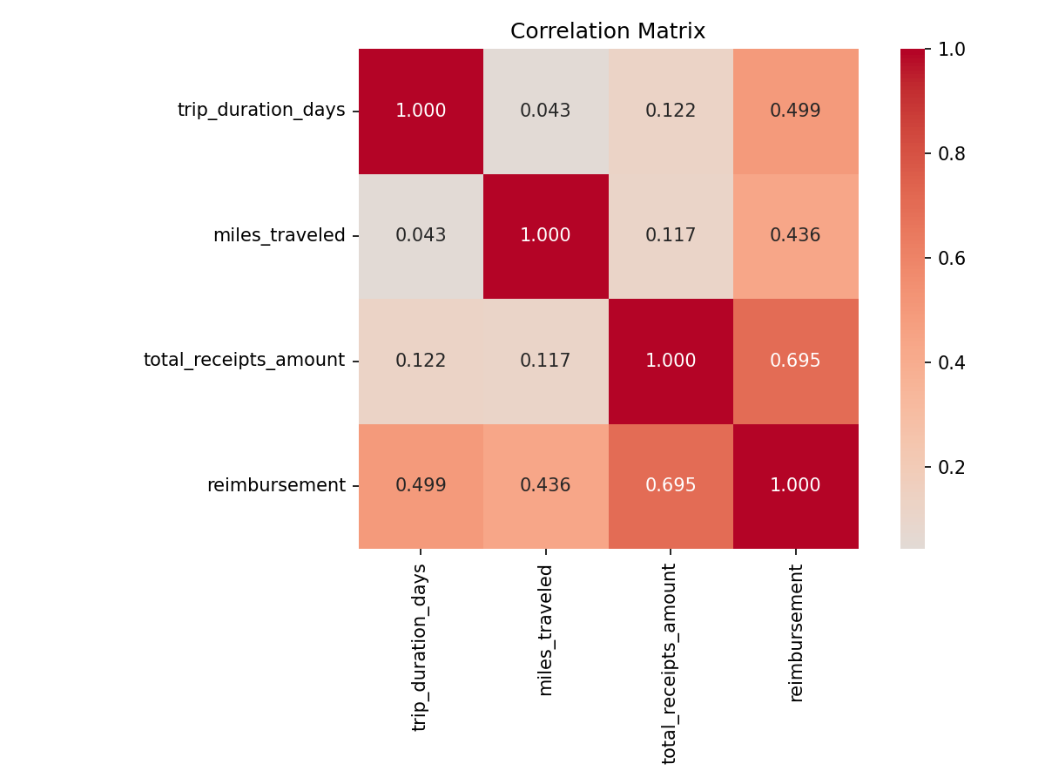
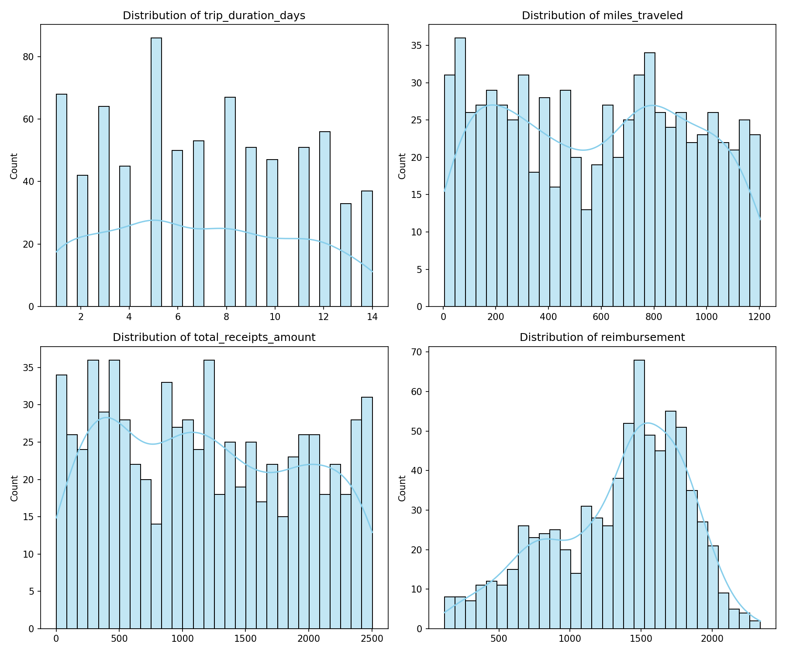
Data Insights

Slide 5
Feature Engineering

Slide 6
Model Development

Slide 7
Results

Slide 8
Business Logic Discovered

Slide 9
Recommendations

Slide 10
Conclusion & Next Steps

Slide 11
End

