Slide 1
REDUCING ACCESS TO LETHAL MEANS (BOOKLET PREVIEW)
Amira Abdulhafid and Oluwadamilare Adekunle
July 14th, 2026

Slide 2
BOOKLET OUTLINE
Firearm Safety
- What Firearm Safety Means
- Ways to Make Firearms Safer at Home
- How to Start the Conversation
Suffocation Safety
- What Suffocation Means
- Why This Is Important
- Ways to Reduce Risk
- If You Notice Someone Struggling
What "Lethal Means" Are
- Why this is important
Medication & Opioid Safety
- What Poisoning Means
- Why Medication Safety Is Important
- Ways to Keep Medications Safe
- Helpful to know
Talking About Suicide & Mental Health
- Why Talking Helps
- How to Ask Someone If They’re Struggling
- How to Be Supportive
Creating a Safer Community
- What We Can Do Together
- When You Need Help
Notes:
(Going from left to right, up to down) (The booklet was created in a u-shape manner with the intention that the page following it would be laid on top, making it a mini book like what you are holding / what is currently being held.

Slide 3
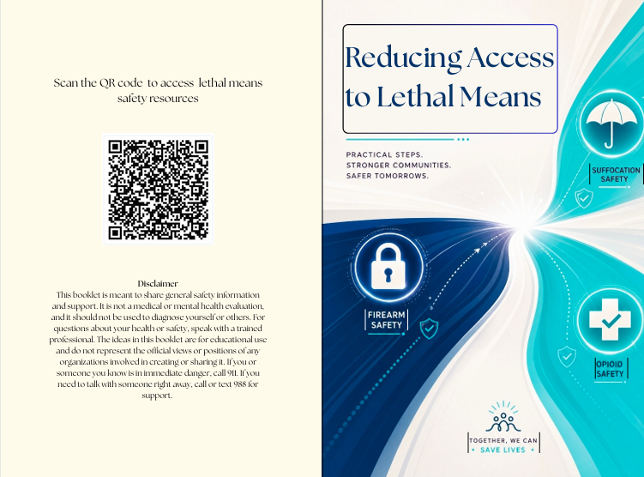
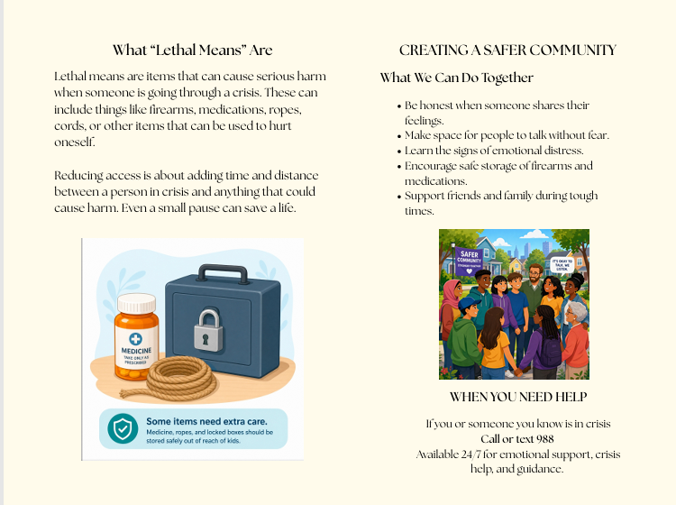
ENGLISH VERSION (LANDSCAPE)
Notes:
8 1/2 x 11 but turned horizontally

Slide 4
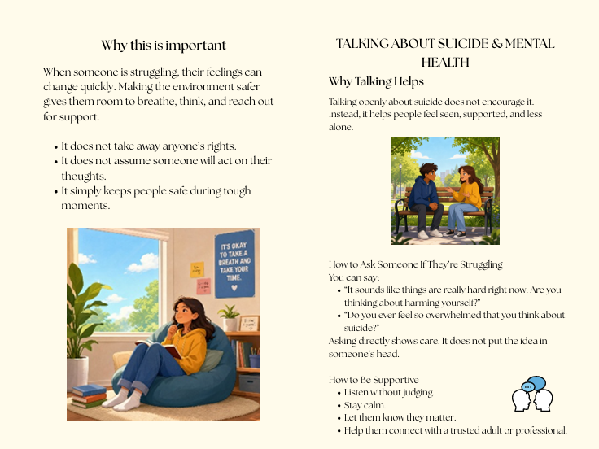
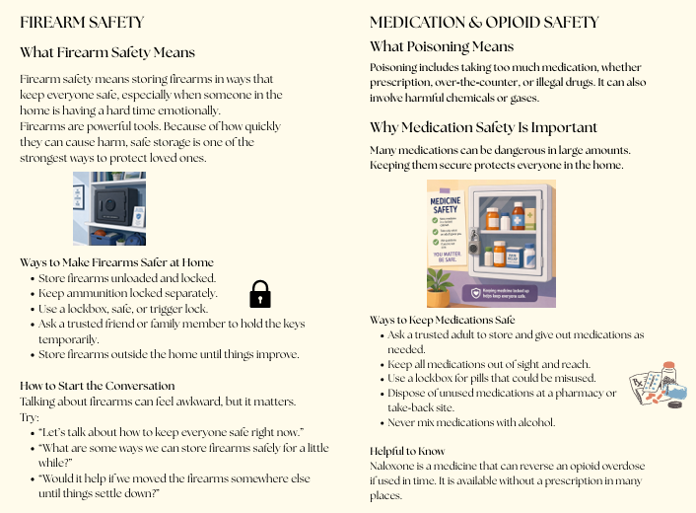
ENGLISH VERSION (LANDSCAPE)

Slide 5
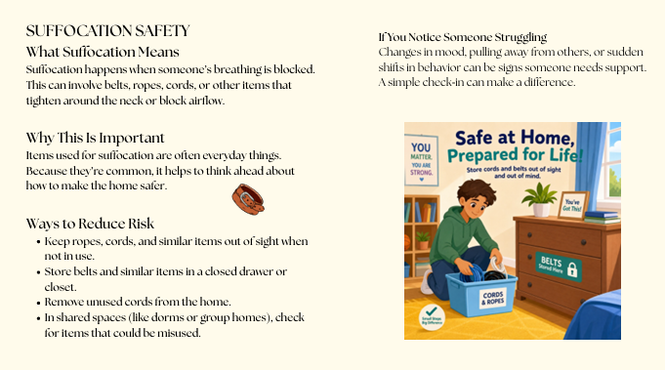
ENGLISH VERSION (LANDSCAPE)

Slide 6
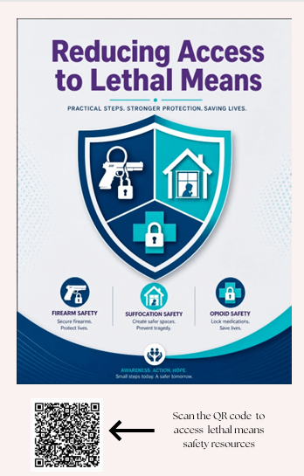
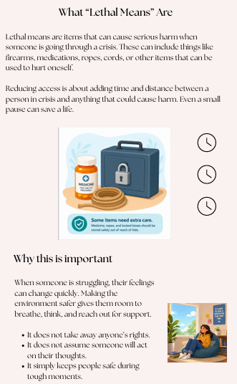
ENGLISH VERSION (PORTRAIT)
SAMPLE
Notes:
Mention size - 8 1/2 x 11 booklet (vertically)

Slide 7
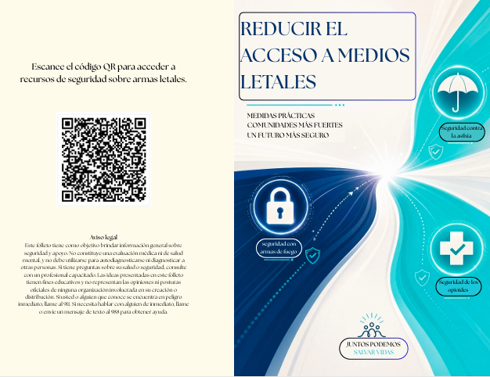
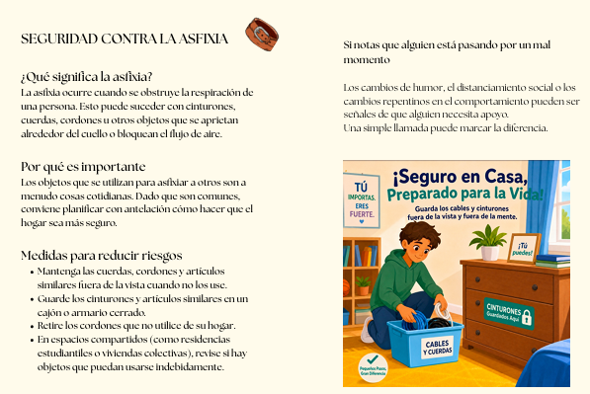
TRANSLATED VERSIONS (SPANISH)
SAMPLE

Slide 8
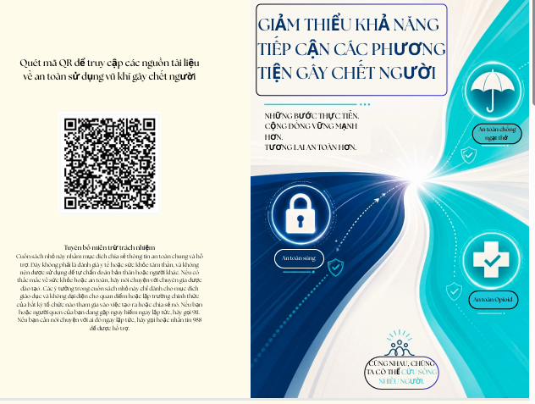

TRANSLATED VERSIONS (VIETNAMESE)
SAMPLE

Slide 9
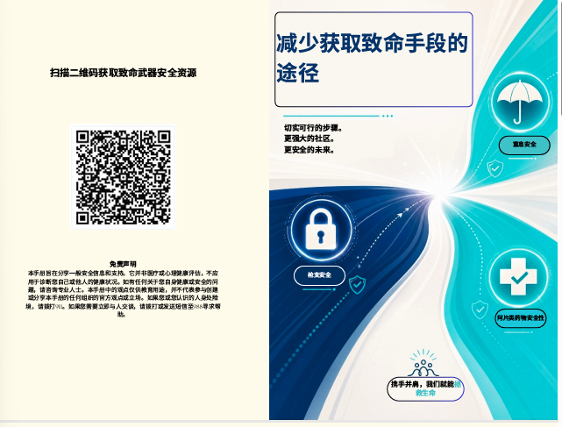
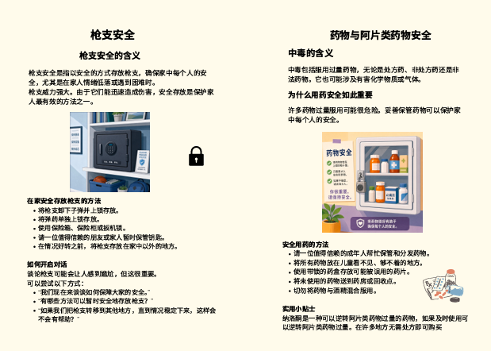
TRANSLATED VERSIONS (CHINESE)
SAMPLE

Slide 10
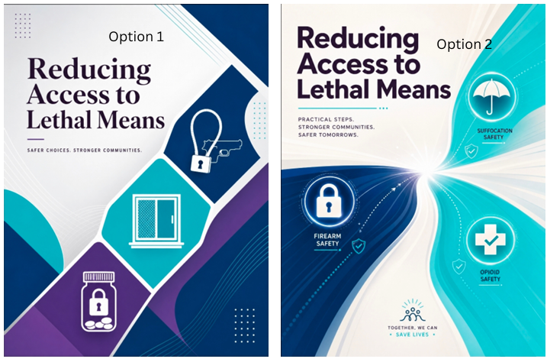
BOOKLET COVER OPTIONS

Slide 11
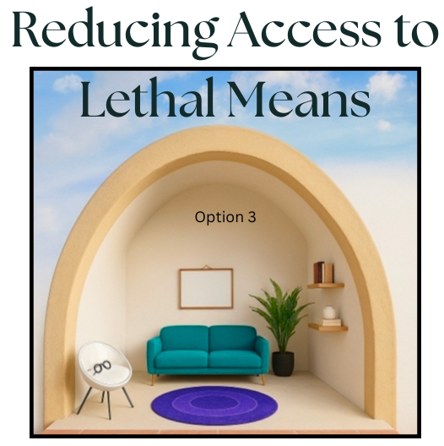
BOOKLET COVER OPTIONS

Slide 12
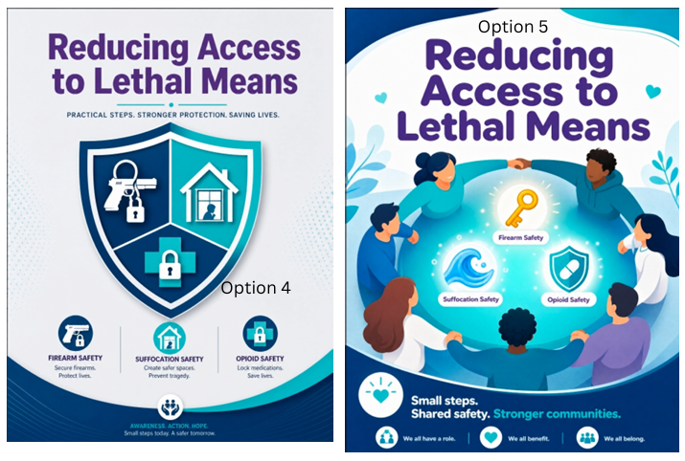
BOOKLET COVER OPTIONS

Slide 13

BOOKLET COVER OPTIONS

Slide 14
Thank You
Q & A

