Slide 1

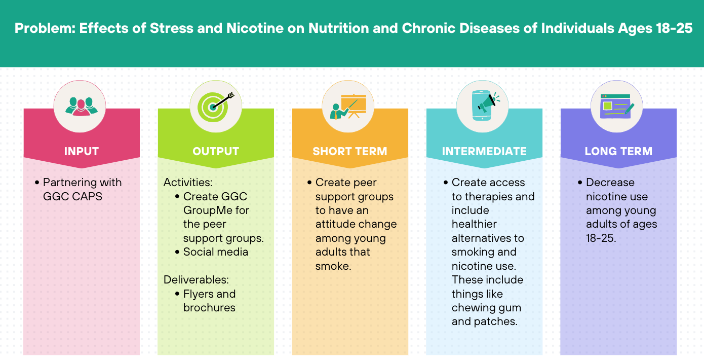
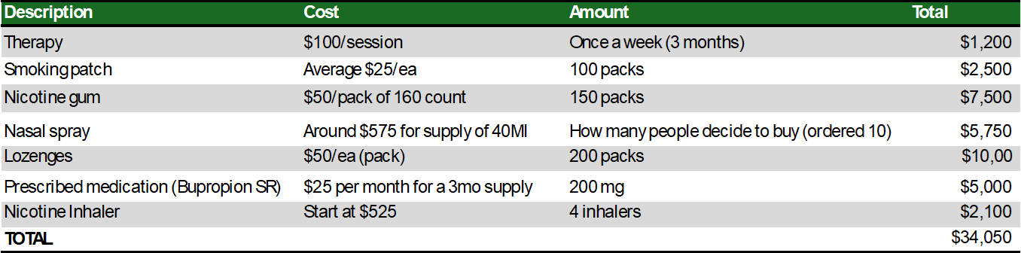
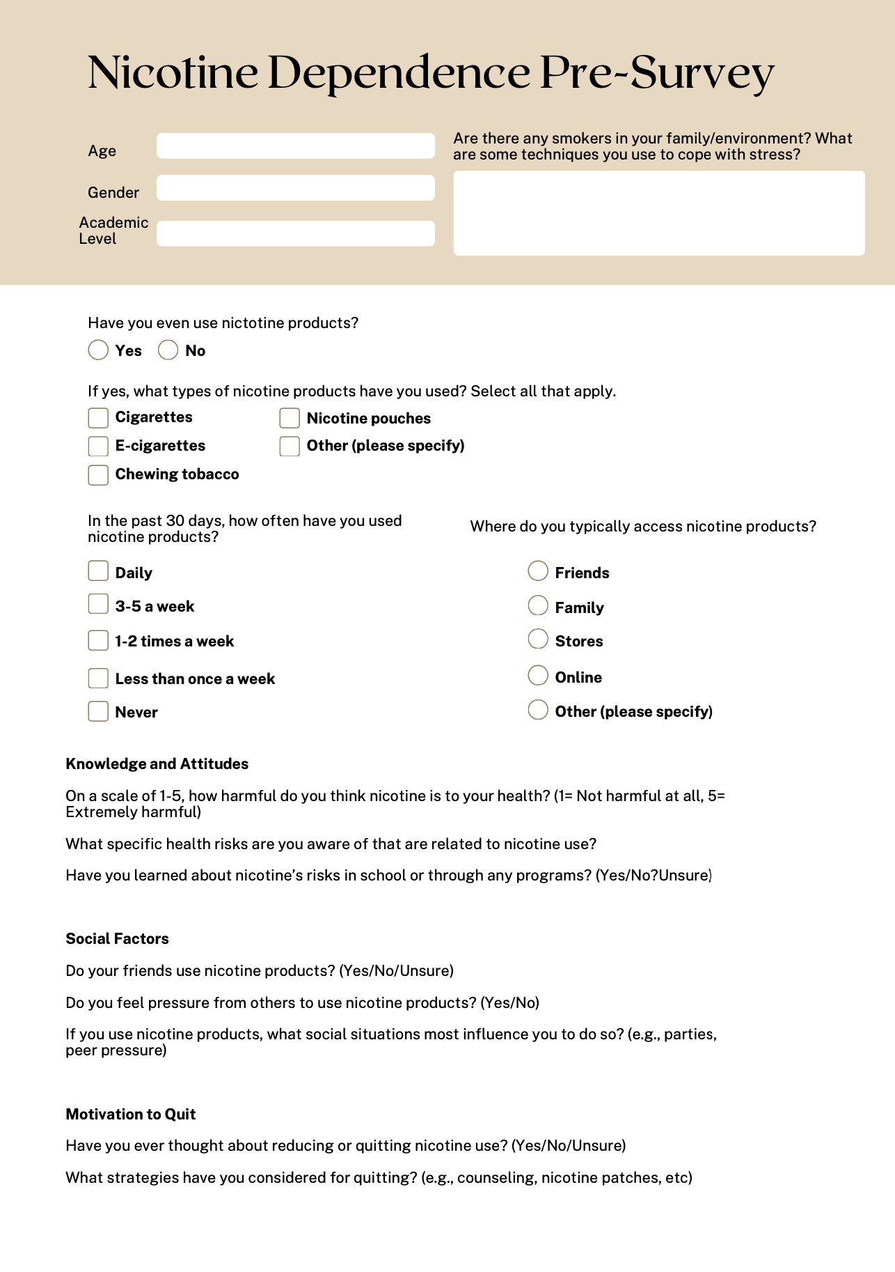
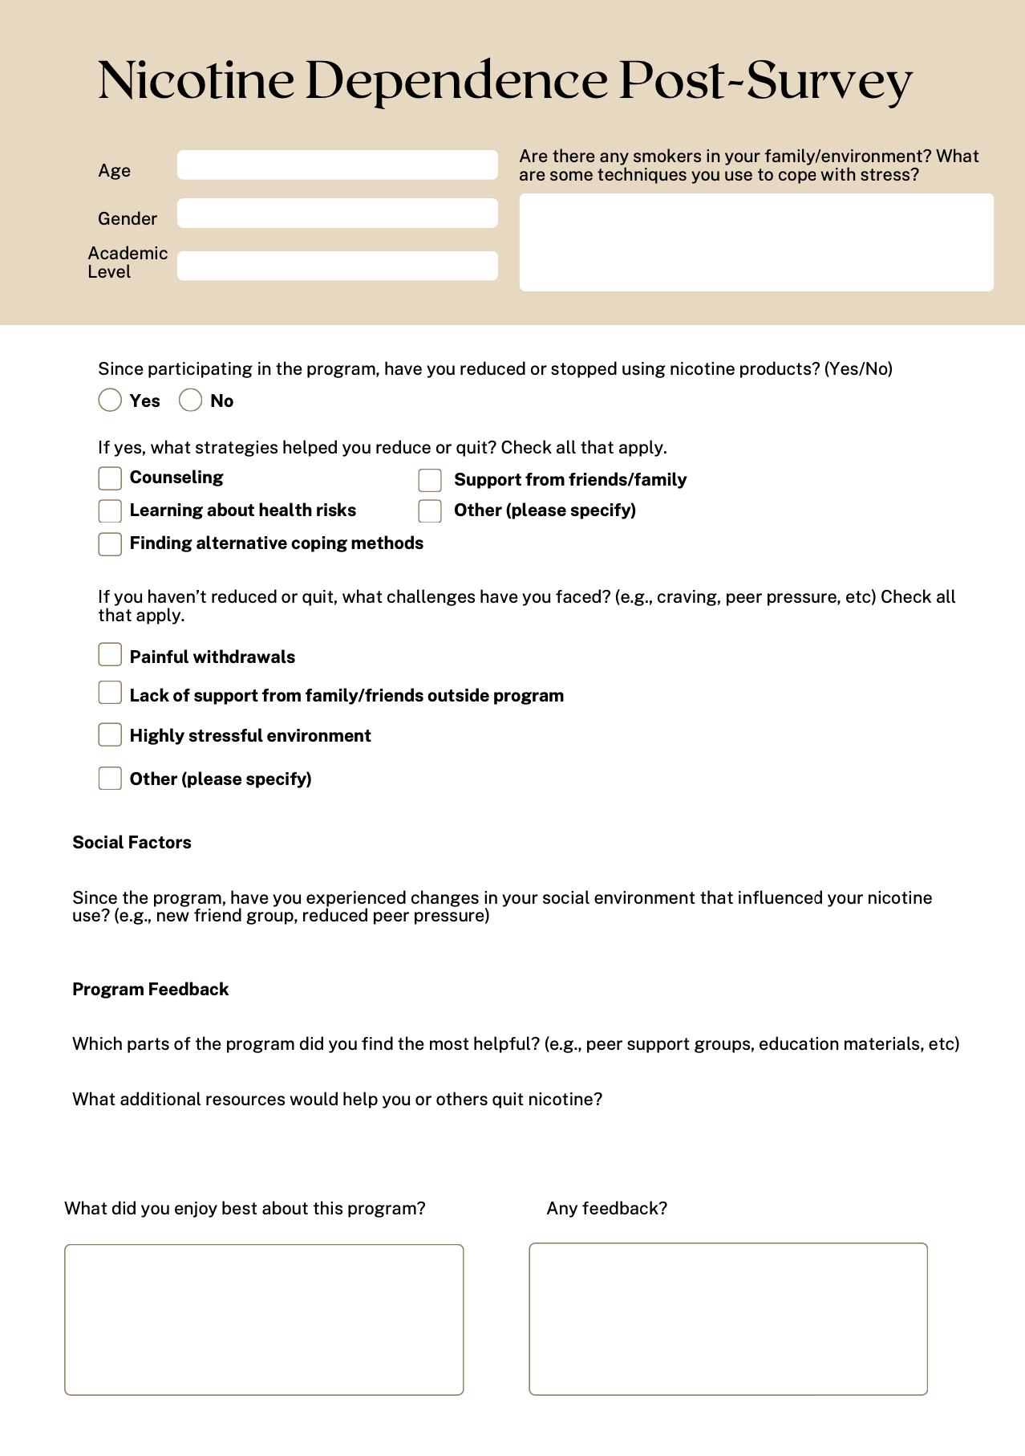


Effects of Stress and Nicotine on Nutrition and Chronic Diseases of individuals Ages 18- 25 Years
Damilare Adekunle, Sumeja Atalov, Xue-Jin Chen, Hilsa Lizardo, Joceline Pardo-Rodriguez
School of Health Sciences , Georgia Gwinnett College, Lawrenceville, GA 30043
ABSTRACT
The aim of this systematic review is to explore the impacts of stress and nicotine products on nutrition and chronic diseases in individuals aged 18–25, with a particular focus on college students. Their correlation with psychological health, physical health, and various lifestyle factors has become a critical area of study. Stress is strongly correlated with nicotine use, particularly in young adults experiencing heightened levels of stress. Reports from organizations such as the National Institute on Drug Abuse (NIDA) and the National Institutes of Health (NIH) highlight the growing trend of vaping among this population. Surveys also reveal that while nicotine use may provide temporary relief, it ultimately exacerbates agitation, depression, and health risks, including chronic diseases such as stroke, lung cancer, and fertility issues. This review compiles findings from various studies, highlighting interventions to minimize nicotine use. Comprehensive intervention programs featuring institutional therapies with SMART goals and support systems offer potential for reducing harmful behaviors and improving stress management. The review aims to demonstrate how targeted efforts can help young adults develop healthier coping mechanisms, reduce significant health risks, and promote smoke-free lifestyles. By synthesizing evidence, this review underscores the importance of addressing nicotine use and stress among young adults to achieve better health outcomes.
Keywords: Chronic Disease, Nutrition, Stress, Nicotine, Vaping, College Students
RESULTS
Assessing the reduction in nicotine use by using the post surveys to measure the success rate is crucial to collect results of the intervention. Evaluating changes in the students’ behavior and attitudes, determining effectiveness of the peer groups and educational materials as well as analyzing the engagement with resources and reports is needed at the end of the intervention.
Research shows that consuming nicotine can negatively impact nutrition such as suppressing appetite and leading to nutrient deficiencies. These nutrient deficiencies then cause individuals to have increasing cravings of unhealthy and high fat foods.
Chronic illnesses are also a major effect of nicotine usage, these include cardiovascular damage, respiratory problems, as well negatively impacting brain development. This is especially important when focusing on young adults who are in college because negatively impacting brain development as this age could also affect productivity throughout their life.
Secondhand smoking also comes into play since there are detrimental effects to that as well. Secondhand smoking increases the risk of respiratory illnesses as well as other health issues such as increased risk of hear disease and lung cancer.
INTRODUCTION
EVIDENCE-BASED INTERVENTION
This study explore the impacts of stress and nicotine products on nutrition and chronic diseases among individuals aged 18–25, with a focus on college students. Smoking, vaping, and substance use has an increasing prevalence in young adults, correlating with mental, physical, and lifestyle factors. Stress is strongly linked to nicotine use, with young adults aged 18–25 being the main users. Reports from the National Institute on Drug Abuse (2020) illustrate a rise in vaping among college students and non-university individuals from 2017 to 2019, with higher rates observed in students (6% vs. 8% in 2017 to 22% vs. 18% in 2019). Additionally, different biomarkers indicating cardiovascular risks have been discovered in cigarette and e-cigarette users (NIH, 2022). Surveys by Truth Initiative (2021) reveal that 44% of young adults who vape report symptoms such as agitation and anxiety, while 40–90% experience a sense of authority when they stopped. The CDC (2024) emphasizes that smoking-related illnesses affect over 16 million Americans, with nicotine as a prominent contributor, posing further risks like low birth weight in pregnant college students (CDC, 2025; Regan et al., 2021). This study demonstrates the benefits that may come from supporting interventions that focus on reducing the use and effects of vaping.
The review begins with an introduction, followed by a methods section detailing the process of evaluating the effectiveness of identified articles. It synthesizes evidence arranged into methodological thematic categories and discusses proposed interventions to reduce harmful behaviors like vaping and nicotine use. The presentation aims to determine whether comprehensive intervention programs, such as institutional therapies with SMART goals, improve nutritional outcomes and reduce the risk of chronic diseases among college students aged 18–25 over one to three years.
Creating access to therapies such as behavioral treatments like counseling and learning strategies in which counselors would help individuals overcome nicotine cravings and how to cope with them.
Therapies would also be combined with nicotine replacement theory (NRT), which are healthier alternatives to nicotine that help reduce cravings and withdrawal.
During the peer support groups, we would offer activities such as establishing personal goals and tracking the progress as well as celebrating when those achievements have been reached. We would also do relaxation techniques that introduce ways of managing stress and cravings such as breathing exercises or meditations.
To engage with the community and especially with students on campus, we would create a GGC GroupMe for the peer support groups and reach a larger audience by also going on social media and talking about peer support groups and therapies.
MATERIALS AND METHODS
These databases included MEDLINE Complete, CINAHL Complete, Public Health Database (ProQuest), ScienceDirect, and GALILEO. Some of these databases require institution logins, such as EBSCO login.
The articles we got from just researching the title of our topic was about 8,535. When we added the filters to the articles, for instance key words and specifying we wanted the articles in English, we got a total of 4,232.
We screened the articles and had about 35 that were eligible for our study and chose to go with 18 articles that are currently included in the review.
DISCUSSION
Psychosocial Factors and Substance Use
These are psychological and social elements that explain reasons for participating in detrimental actions such as smoking. Wattick et al. (2021) explored psychosocial factors associated with e-cigarette use among young adults at an Appalachian university, finding that stress reduction, taste, attempts to quit cigarettes, and peer influence were the main motivators. Equally, Stewart et al. (2023) examined risk factors for substance use across different life stages through longitudinal studies and large-scale surveys, identifying themes such as family dynamics, peer pressure, mental health, and life stressors.
Early-Onset Substance Use and Health Implications
In the context of early drug use and health repercussions, Wang et al. (2021) examined early substance use and health repercussions in 19,270 individuals with hypertension, using data from the National Survey on Drug Use and Health. Early onset of drug use was shown to increase the risk of chronic diseases and other conditions.
Substance Use and Behavioral Health
Fagan et al. (2021) found a link between sugar-sweetened and caffeinated beverage consumption and smoking/vaping behaviors in Canadian adolescents, while Jacobs et al. (2025) found significant associations between substance use, eating disorders, and OCD among college students, with cis-gendered female students at higher risk.
Tobacco Use and Mental Health
For mental health, Seo et al. (2024) analyzed several participants to examine the connection between mental health and heated tobacco product (HTP) use and found higher stress levels and mental health problems among tobacco users, especially HTP users. Consequently, Çeti̇nkaya et al. (2024) investigated nicotine addiction and perceived stress and found a small positive connection between nicotine addiction and perceived stress. Gender is also shown to have a greater effect on addiction, with higher nicotine addiction among male students.
Vaping and Health Behaviors
In assessing vaping and health behaviors due to its prevalent intake, Lorensia et al. (2021) found that student smokers had significantly lower lung function than non-smokers, though physical activity levels did not differ. In a parallel manner, Tawba et al. (2024) revealed greater psychological distress among e-cigarette users, suggesting a correlation between vaping and mental illness, and advocated for longitudinal studies and health education campaigns.
Impact of Tobacco on Chronic Diseases
Warren et al. (2006) assessed the impact of tobacco on young people's health, revealing high tobacco use and secondhand smoke exposure among students aged 13-15 years, with higher susceptibility found in never-smokers in the upcoming years. Schmitz et al. (2003) found that nicotine-dependent smokers reported poorer quality of life, greater disability, and higher rates of mental disorders. Moreover, Yang (2023) explained that tobacco smoking, and air pollution contribute to chronic diseases affecting both physical and mental health. Kechter et al. (2022) also explored young adults' perceptions of vaping, finding it linked to disordered eating behaviors and calling for public health responses. Consequently, Niebuur et al. (2023) found that multiple chronic diseases were associated with reduced physical activity and higher smoking rates.

