Slide 1


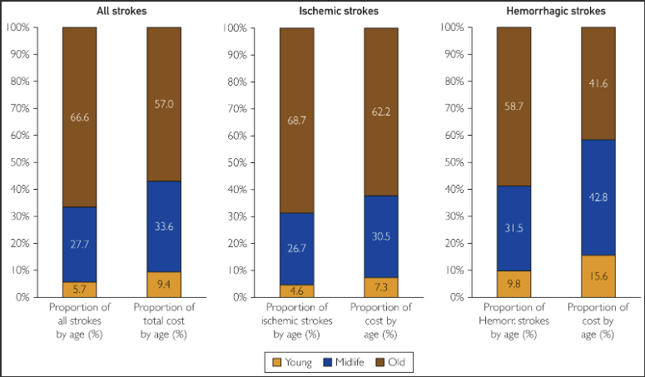
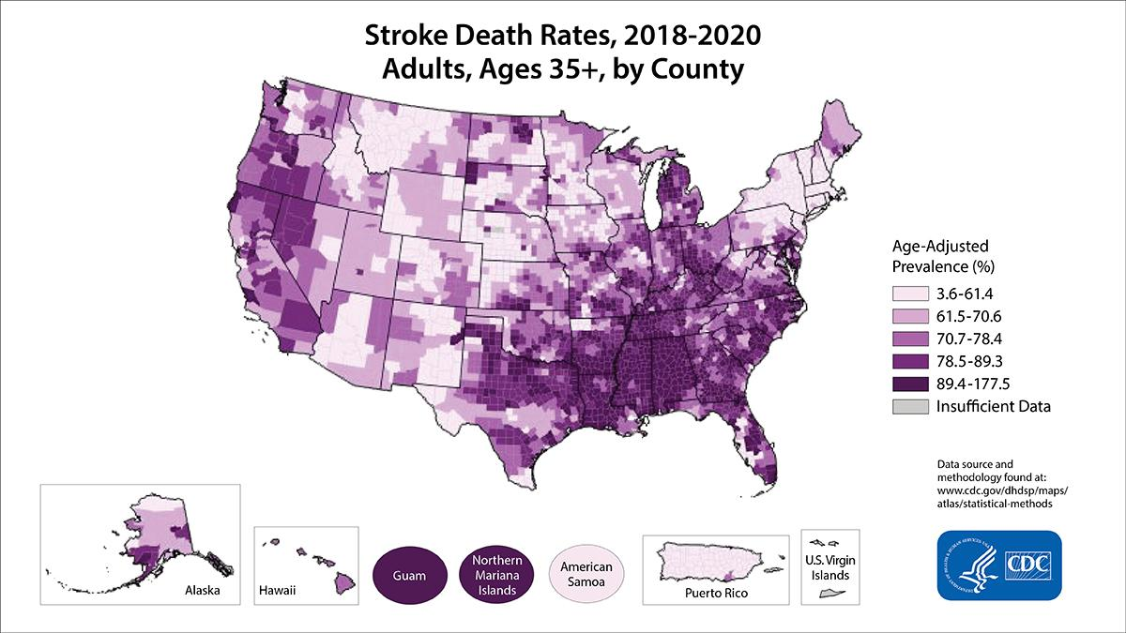
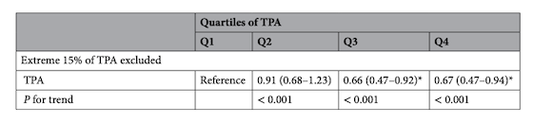
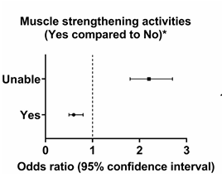
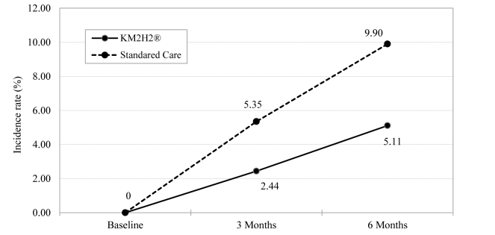
The Effect of Regular Physical Activity on the Risk of Developing Stroke
Damilare Adekunle, Bryan Banos, Ashley Blain, Shruti Mittal, Judy Raju
INTRODUCTION: Stroke is classified as one of the second to third primary causes of death worldwide and ranked as the fifth cause of death in the U.S. Nearly 800,000 individuals are affected yearly, with 600,000 of those individuals experiencing it for the first time, while 87% of strokes are ischemic. The cost of this condition and death rates on each age group can be seen in Fig. 1 and Fig. 2. This poster focuses on analyzing and determining whether physical activity (PA) reduces the risk of developing stroke.
MILL’S CANONS: Researchers have developed criteria for determining whether a factor is causal for an outcome, e.g., whether physical activity decreases the risk of stroke. For instance, the US Department of Health, Education, and Welfare reported 9 criteria (1964). These criteria stem from the works of great thinkers such as A.B. Hill, 1965, and J.S. Mill, 1843. Ultimately, these criteria can be condensed into six guidelines, often referred to as Mill’s Canons (Dishman,et al, 2013; Celentano & Szklo, 2019). These guidelines, further described, are Temporality, Consistency, Strength of Association, Dose Response, Plausibility and Independence.
TEMPORALITY shows that the factor (physical activity, PA) precede the outcome (diminished incidence of stroke). Morovatdar et al, 2021, in a cohort study of 395 cases of stroke, showed that the inactive were, on average, 6 years younger when their first stroke occurred compared to those who were more physically active. (60.7 ± 15.5 vs. 67.0 ± 13.2; p < 0.001).
Fig. 4. Increasing TPA leads to lesser risk of stroke.
Fig. 1. Contribution of young, midlife, and older adults in stroke and cost burden in United States.
BIOLOGICAL PLAUSIBILITY addresses “how” PA might lower the risk of stroke. Zheng et al, 2019, showed that supported biological plausibility by demonstrating that Tai Chi helps lower the risk of stroke and CVD by enhancing blood flow and lowering blood pressure. In their RCT study, 68 out of 133 participants practiced Tai Chi, while 65 engaged in regular exercise. Both groups had better blood flow and lower blood pressure after 12 and 24 weeks of “training.”
Fig. 2. Death rates from stroke among ages 35+ by county in the United States.
CONSISTENCY indicates that through numerous studies, the identical or similar factor should lead to the same outcome. The meta-analysis by Wendel-Vos et al. (2004), observed 31 studies on physical activity and stroke reduction risk to demonstrate consistency. Results showed active occupational workers had a lower ischemic stroke risk (RR=0.57, 95% CI: 0.43, 0.77) than inactive ones.
DEFINITIONS: A stroke occurs when blood circulation to the brain gets blocked (ischemic) and causes bleeding in the brain (hemorrhagic); ischemic is far more common (~90%). Odds ratio and relative risks are attempts to quantify chance of one thing occurring versus another, given a set of circumstances.
INDEPENDENCE is exhibited when all factors are known and can be identified but only the factor that is being manipulated has a different impact than the other factors to affect the outcome on its own. Gong et al, 2015, showed independence in their RCT of 450 participants. In comparing standard hypertensive care
vs. care that emphasized more PA (KM2H²), those in
PA group were much less likely to have a
stroke at 3- and 6-months follow-up (see Fig. 5).
The incidence of an MI and hypertension
was also reduced.
STRENGTH OF ASSOCIATION denotes an impactful change on the result(s) when the factor or intervention is altered. Ghozy et al. (2022), with a large sample size (102,578), depicted strength of association in the form of odds ratio, showing about a 20 – 60% reduction in stroke when PA is done. Fig. 3 is an example of such benefits.
SUMMARY AND CONCLUSION: The goal was to examine the association between physical activity and the risk of developing stroke. The significance of addressing Mill's Canons criteria results in these six studies is that the relationship is real. Additionally, the findings reviewed so far, and the substantial evidence revealed that physical activity can reduce the risk of stroke.
Fig. 3. Odds ratio showing effects of physical activity (e.g., muscle strength activity) on stroke occurrence.
DOSE-RESPONSE is when the factor (whether increasing or decreasing) facilitates a change in outcome, clearly demonstrated with at least three levels of the intervention or factor. Jang et al. (2024), in a study of 13,036 participants, displayed dose-response for PA. Fig. 4 shows that higher levels of total PA (TPA) were related to a lower risk of stroke.
Fig. 5. Statistical difference between KM2H2 program + standard care or standard care on stroke and heart attack incidence.
REFERENCES: American Stroke Association. (2019). Hemorrhagic Strokes (Bleeds). Www.stroke.org; American Stroke Association. https://www.stroke.org/en/about-stroke/types-of-stroke/hemorrhagic-strokes-bleeds. American Stroke Association. (2024). Ischemic Strokes (Clots). American Stroke Association; American Heart Association. https://www.stroke.org/en/about-stroke/types-of-stroke/ischemic-stroke-clots. Boehme, A. K., Esenwa, C., & Elkind, M. S. V. (2017). Stroke Risk Factors, Genetics, and Prevention. Circulation Research, 120(3), 472–495. https://www.ncbi.nlm.nih.gov/pmc/articles/PMC5321635/. Celentano, D.D. and Szklo, M. 2019. Gordis Epidemiology, 6th Ed. (pp 276-280). Elsevier. Dishman, R.K., Heath, G.W., and Lee, I (2013). Physical Activity Epidemiology, 2nd edition (p. 35). Human Kinetics. Feigin, V. L., Stark, B. A., Johnson, C. O., Roth, G. A., Bisignano, C., Abady, G. G., Abbasifard, M., Abbasi-Kangevari, M., Abd-Allah, F., Abedi, V., Abualhasan, A., Abu-Rmeileh, N. M., Abushouk, A. I., Adebayo, O. M., Agarwal, G., Agasthi, P., Ahinkorah, B. O., Ahmad, S., Ahmadi, S., & Ahmed Salih, Y. (2021). Global, regional, and national burden of stroke and its risk factors, 1990–2019: A systematic analysis for the global burden of disease study 2019. The Lancet Neurology, 20(10), 795–820. https://doi.org/10.1016/s1474-4422(21)00252-0. Ghozy, S., Zayan, A. H., El-Qushayri, A. E., Parker, K. E., Varney, J., Kallmes, K. M., Morsy, S., Abbas, A. S., Diestro, J. D. B., Dmytriw, A. A., Shah, J., Hassan, A. E., & Islam, S. M. S. (2022). Physical activity level and stroke risk in US population: A matched case-control study of 102,578 individuals. Annals of clinical and translational neurology, 9(3), 264–275. https://doi.org/10.1002/acn3.51511. Gong, J., Chen, X., & Li, S. (2015). Efficacy of a Community-Based Physical Activity Program KM2H² for Stroke and Heart Attack Prevention among Senior Hypertensive Patients: A Cluster Randomized Controlled Phase-II Trial. PLOS ONE, 10(10), e0139442. https://doi.org/10.1371/journal.pone.0139442. Hill, A.B., 1965. The Environment and Disease: Association or Causation? Proceedings of the Royal Society of Medicine. 58: pp. 295-300. Hui, C., Tadi, P., & Patti, L. (2024). Ischemic stroke. National Library of Medicine; StatPearls Publishing. https://www.ncbi.nlm.nih.gov/books/NBK499997/. Jiang, C., Chen, T., Xiang, J., & Pang, Y. (2024). Association between physical activity levels and stroke risk among Chinese adults aged 45 and over based on CHARLS. Scientific Reports, 14, 31739. https://doi.org/10.1038/s41598-024-81919-5. Khaku, A., & Tadi, P. (2023). Cerebrovascular disease. PubMed; StatPearls Publishing. https://www.ncbi.nlm.nih.gov/books/NBK430927/. Khan, S. U., Khan, M. Z., Khan, M. U., Khan, M. S., Mamas, M. A., Rashid, M., Blankstein, R., Virani, S. S., Johansen, M. C., Shapiro, M. D., Blaha, M. J., Cainzos-Achirica, M., Vahidy, F. S., & Nasir, K. (2021). Clinical and Economic Burden of Stroke Among Young, Midlife, and Older Adults in the United States, 2002-2017. Mayo Clinic Proceedings: Innovations, Quality & Outcomes, 5(2), 431–441. https://doi.org/10.1016/j.mayocpiqo.2021.01.015. Mill, J.S., 1843. A system of logic, ratiocinative and inductive, being a connected view of the principles of evidence and the methods of scientific investigation. Volume 1, pp. 1-580. John W. Parker. Morovatdar, N., Di Napoli, M., Stranges, S., Thrift, A. G., Kapral, M., Behrouz, R., Farzadfard, M. T., Andalibi, M. S. S., Oskooie, R. R., Sawant, A., Mokhber, N., & Azarpazhooh, M. R. (2021). Regular physical activity postpones age of occurrence of first-ever stroke and improves long-term outcomes. Neurological Sciences, 42(8), 3203–3210. https://doi.org/10.1007/s10072-020-04903-7. National Heart, Lung and Blood Institute. (2023, May 26). Stroke - What Is a Stroke? Www.nhlbi.nih.gov. https://www.nhlbi.nih.gov/health/stroke. NIH. (2016, December). How many people are affected by/at risk for stroke? Http://Www.nichd.nih.gov/. https://www.nichd.nih.gov/health/topics/stroke/conditioninfo/risk. Szumilas, M. (2010). Explaining Odds Ratios. Journal of the Canadian Academy of Child and Adolescent Psychiatry, 19(3), 227. https://pmc.ncbi.nlm.nih.gov/articles/PMC2938757/. US Department of Health, Education and Welfare, 1964. Smoking and Health: Report of the Advisory Committee to the Surgeon General. Washington, DC: Public Health Service. Wendel-Vos, G. (2004). Physical activity and stroke. A meta-analysis of observational data. International Journal of Epidemiology, 33(4), 787–798. https://doi.org/10.1093/ije/dyh168. Zheng, G., Zheng, X., Li, J., Duan, T., Ling, K., Tao, J., & Chen, L. (2019). Effects of Tai Chi on cerebral hemodynamics and health-related outcomes in older community adults at risk of ischemic stroke: A randomized controlled trial. Journal of Aging and Physical Activity, 27(5), 678–687.https://doi.org/10.1123/japa.2018-0232. Centers for Disease Control and Prevention. (2024). Stroke facts. Stroke; CDC. https://www.cdc.gov/stroke/data-research/facts-stats/index.html

