Slide 1
Household Income & Spending Survey
Findings ahead of the new healthcare product launch

Slide 2
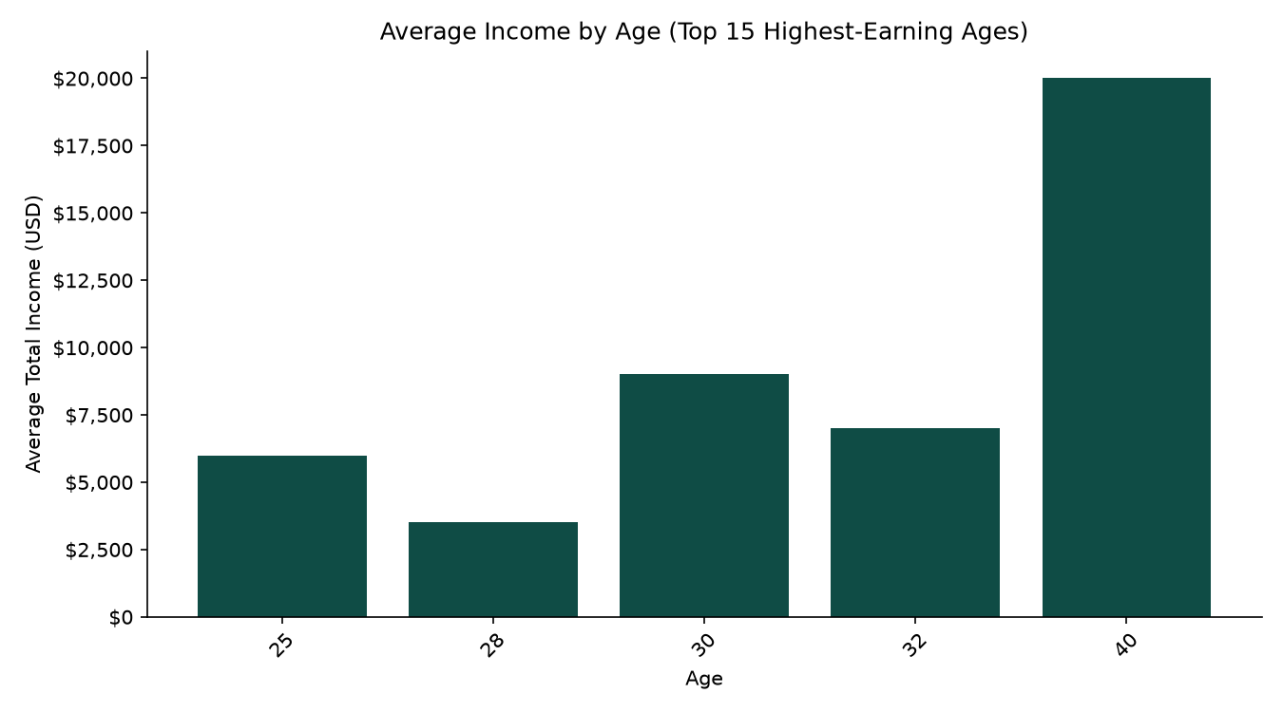
Ages With the Highest Income
Average total income by respondent age

Slide 3
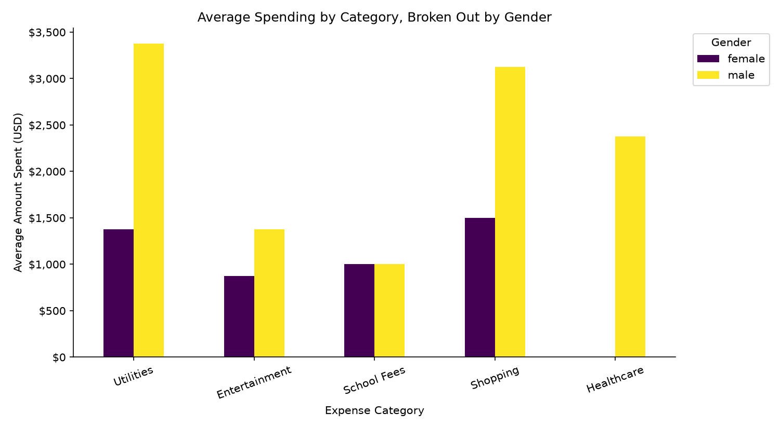
Spending by Category, by Gender
Average amount spent per expense category, broken out by gender

Slide 4
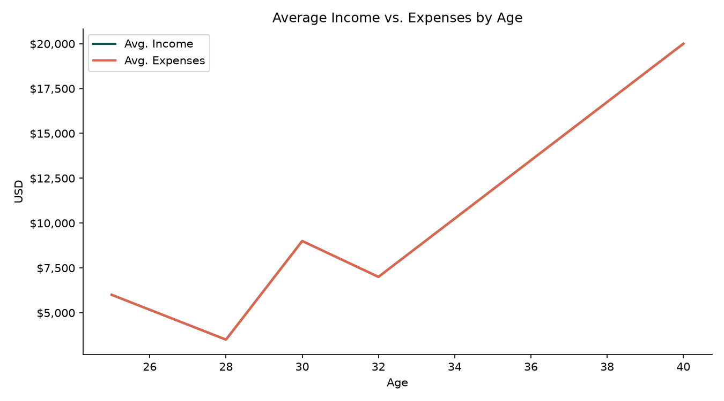
Income vs. Expenses by Age
Disposable income context for the healthcare product launch

