Slide 1
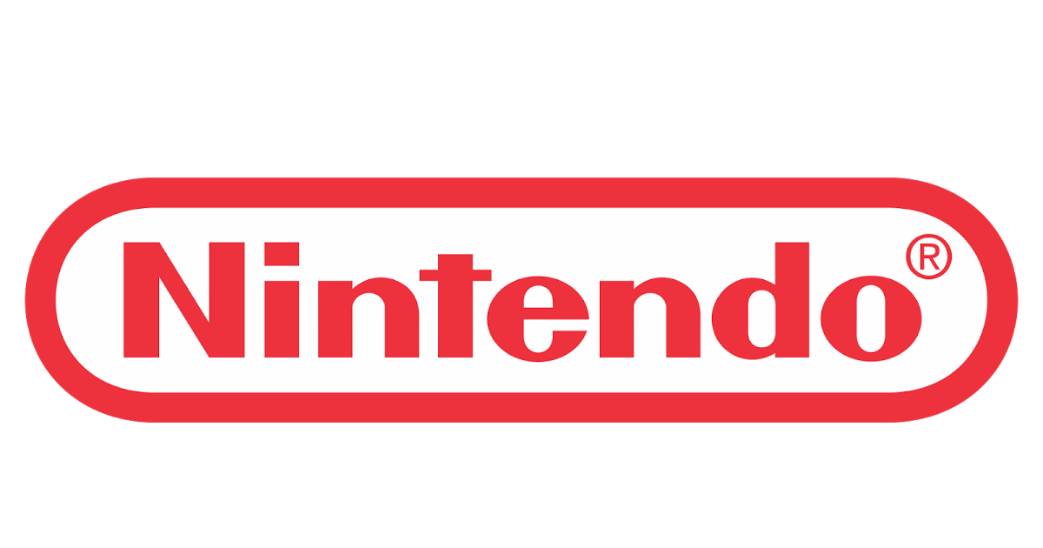
NINTENDO SEQUEL DECISION
ANALYSIS
CEO PROPOSAL
Oluwadamilola Owolabi, Kosi Okeke

Slide 2
FINDING THE NEXT PROFITABLE GAME SEQUEL ?
Why the Trouble ?
  Choosing which videogame IP gets sequels can be risky and inconsistent
Why this Matters ?
  A failed sequel to an IP can lead to loses of $50M - $150M in sunk development and Marketing cost (Houlikan Lokey, 2024)
Proposal:
  Our data driven model could improve sequel decision accuracy by 15% - 20%, adding ~$40M in annual revenue
Other Benefits includes:
  Improvement in fan loyalty, increase industry market share, optimization of IP Lifespan. (GDC, 2023)

Slide 3
WHY WE NEED THIS ?
Revenue:
  Sequels are proven to outsell original IPs by 200- 300% (Wikipedia – Sequel Economics).
Industry Position:
  Releasing sequels on time, can strengthen Nintendo’s Market dominance in the AAA game space. (Newzoo, 2024).
Customer Loyalty:
  Established franchises built on sequels build stronger customer loyalty and commitment, hence yielding stable profits. (ESA, 2023).

Slide 4
DIVING DEEPER INTO THE PROBLEM
Current sequel approval process is largely based on guesswork.
The cost of developing AAA game sequels on popular IPs can exceed $200M (Houlihan Lokey, 2024).
Missed sequel opportunities risk losing market share to industry competitors like Sony and Microsoft (Ampere Analysis, 2024).

Slide 5
OUR PREDICTIVE MODEL
Used MSRP (Dekudeals), price history (DekuDeals), critic/user ratings (Metacritic), and genre trends (DekuDeals) to Predict the Possibility of a successful sequel for a Videogame title.
Predicts success with ~85% in Model accuracy.
Maximizes Return-on-Investment for videogame sequels that are decided based on this model

Slide 6
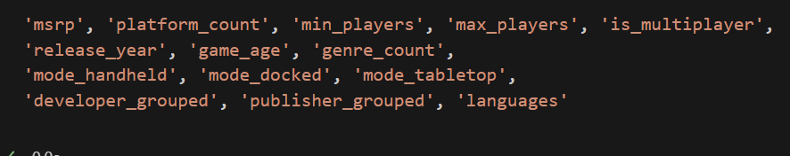
MODELING RESULTS
Accuracy for our model is ~84%.
Key Variables:
  Current MSRP Price
  Publisher and Developer data.
  Player counts
  Other relevant features.
Business Translation: Our sequel-prediction model is 84% accurate in identifying whether a game should get a sequel based on current IP price, publisher-developer data and number of players among customers.

Slide 7
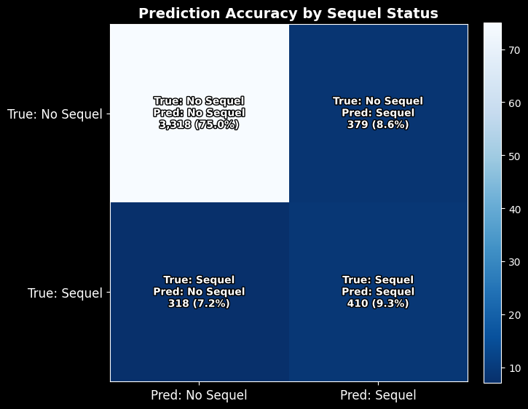
PREDICTION ACCURACY BY SEQUEL
“Our predictive model correctly predicts 75% of videogame title sequels that would not yield profit and captures 9.3% of true sequel-worthy titles, while keeping wrong sequel selections to 8.6%.”

Slide 8
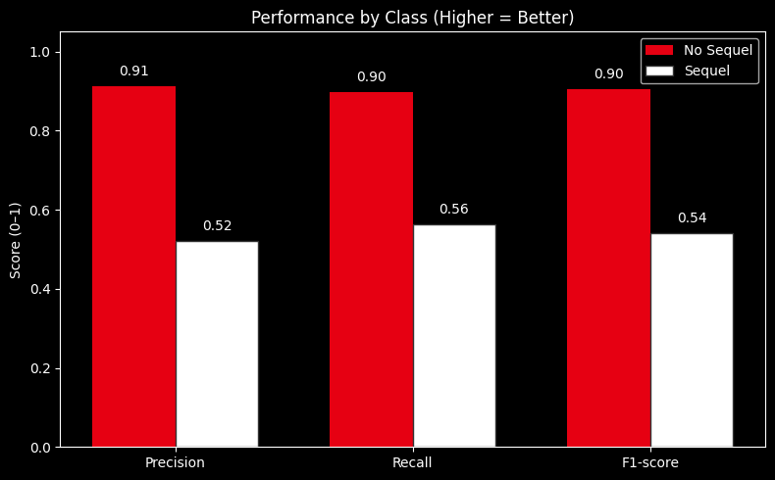
PERFORMANCE BY CLASS
“The model is very strong at avoiding risky sequels (over 90% across all metrics) but less consistent at spotting the next big hit, meaning further tuning could boost sequel detection.”

Slide 9
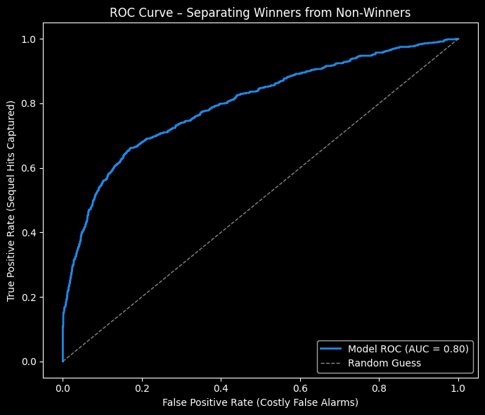
ROC CURVE SEPERATING GOOD FROM BAD IPS
“With an AUC score of 80%, the model performs beyond random guessing, giving us a solid method to separate good and bad future IP sequels.”

Slide 10
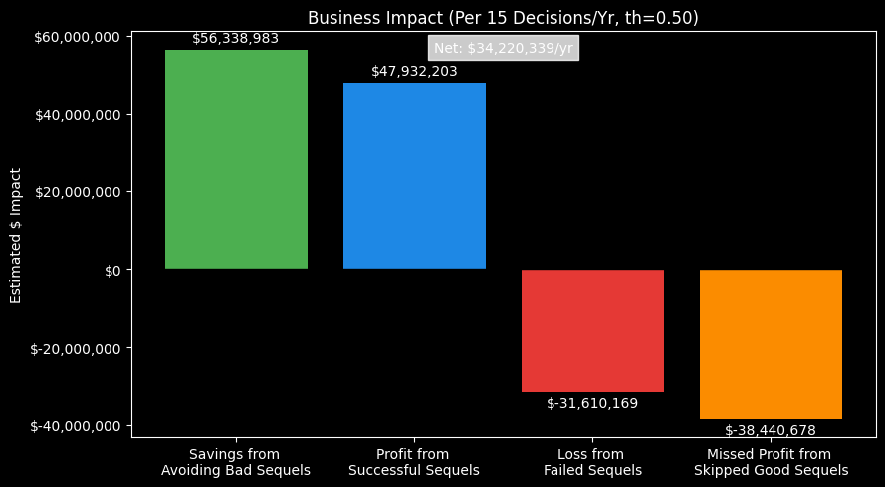
BUSINESS IMPACT SUMMARY
“If this model is applied in the decision-making process of sequels, it could yield the Nintendo company $34M annually by avoiding risky videogame investments and correctly investing in profitable titles..”

Slide 11
RESOURCE AND COSTS
Materials
  AWS cloud compute & GPU training (~$50K/year) (AWS Pricing Calculator).
Personnel:
  1 Data Scientist - $25k (Glassdoor)
  1 Data Analyst - $14k (Glassdoor)
  1 Product Manager- $23k (Glassdoor)
  Timeline: 8–10 weeks for pilot deployment.
Estimated Cost:
  Total Estimated Personnel Cost: ~$62K
  ~$112K - $115k (well under 2% of potential annual gain).

Slide 12
TL:DR
Why This Will Work:
Uses real world Nintendo-specific sales, price and review data combined with proven industry predictors (GDC, 2023).
Other Value:
  Less financial
  Faster greenlight process of profitable title sequels
  Stronger market advantage compared to competitors.

Slide 13
POSSIBLE RISKS & MITIGATIONS
Risk:
  Consumer preferences shift unexpectedly.
Mitigation:
  Train scalable model based on new market data.
Risk:
  Over-reliance on automation.
Mitigation:
  Rely on expert review on predictions to greenlight decisions.

Slide 14
REFERENCES
AWS. (2025). AWS Pricing Calculator. Amazon Web Services, Inc. Retrieved from https://calculator.aws/#/
Glassdoor. (2025). Average salaries for Data Scientist, Data Analyst, and Product Manager in the United States. Retrieved from https://www.glassdoor.com/Salaries/index.htm
Statista. (2024). Revenue of Nintendo worldwide from fiscal 2009 to 2024. Retrieved from https://www.statista.com/statistics/324139/nintendo-net-sales-worldwide/
Statista. (2024). Global video game market value from 2020 to 2027. Retrieved from https://www.statista.com/statistics/292056/video-game-market-value-worldwide/
Newzoo. (2024). Global Games Market Report. Newzoo B.V. Retrieved from https://newzoo.com/insights/trend-reports/global-games-market-report
Metacritic. (2025). Game ratings and reviews database. Retrieved from https://www.metacritic.com/game/
IGN. (2024). The importance of sequels in modern gaming. Retrieved from https://www.ign.com/articles/video-game-sequels-importance

Slide 15
QUESTIONS AND FEEDBACK

