Slide 1
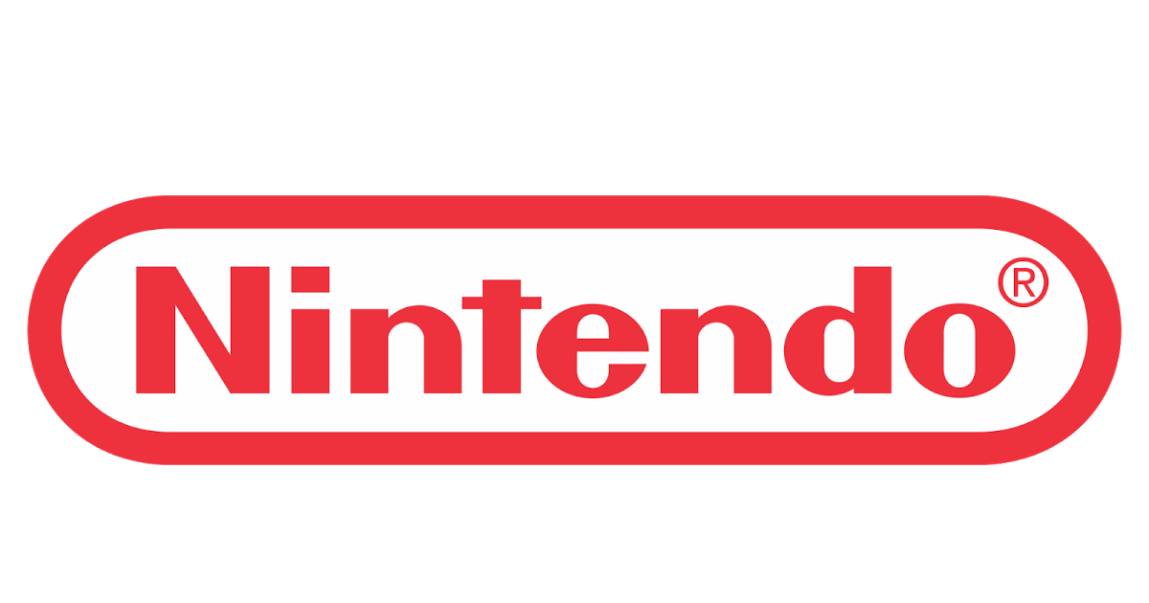
NINTENDO SEQUEL DECISION ANALYSIS
Technical Overview
Oluwadamilola Owolabi, Kosi Okeke

Slide 2

PROBLEM & TECHNICAL GOAL
Problem:
Nintendo lacks a data-driven system for deciding game sequels, leading to missed revenues and wasted resources.
Goal:
Build prediction accuracy for Videogame titles that can yield profitable sequels
Reduce Wasted production cycles on high-risk sequels
Integrate predictive model into internal decision-making tools.

Slide 3
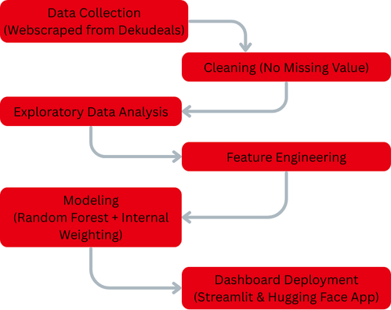
HIGH LEVEL TECHNICAL ARCHITECTURE
Data Pipeline:

Slide 4
INTEGRATION WITH EXISTING SYSTEMS
Model was trained webscraped data from an official site (Dekudeals), hence can easily be integrated with system data.
Model outputs are automatically updated to the streamlit dashboard in and can be accessed globally through HuggingFace Space.
Easy scalability of model to handle millions of company data.

Slide 5
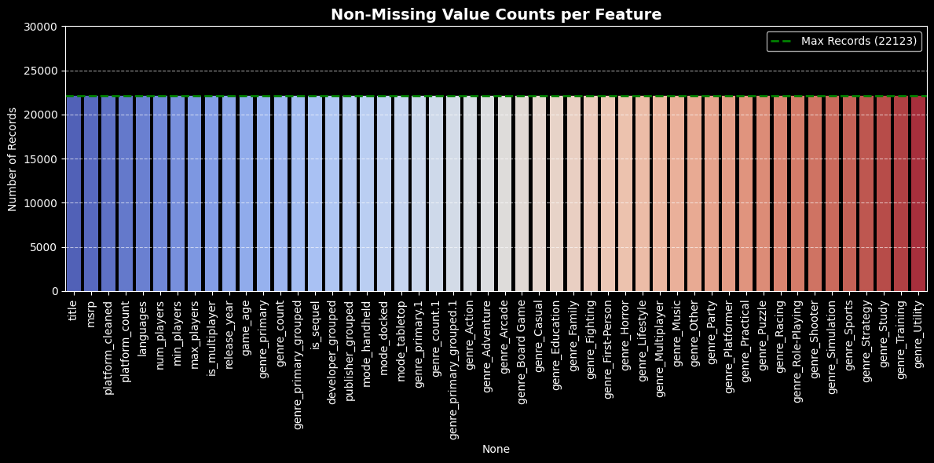
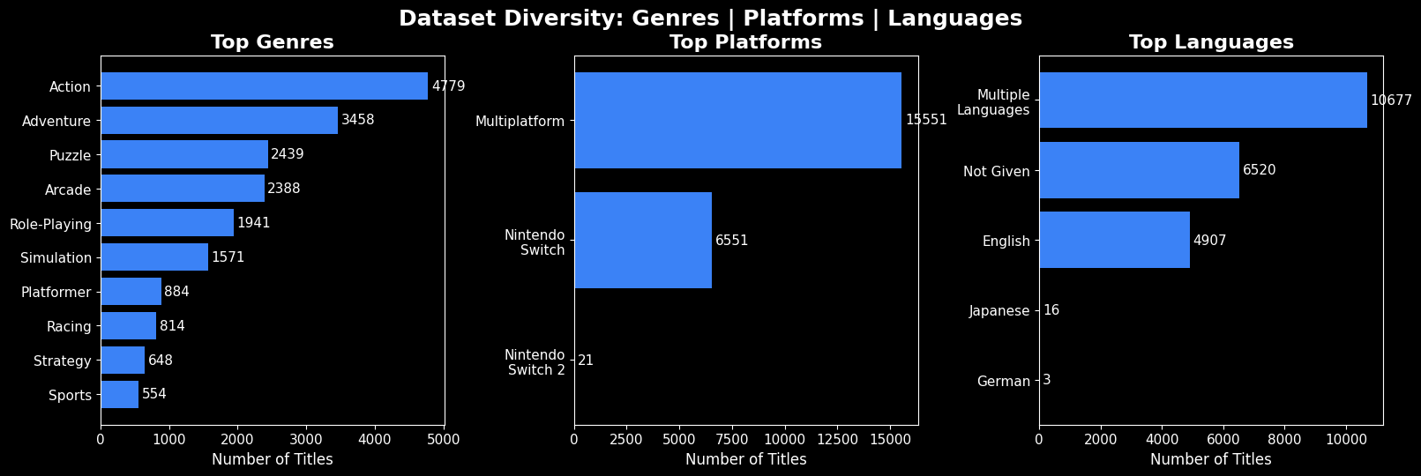
DATA QUALITY AND GOVERNANCE
Availability:
No missing values across all features
Diversity:
Diverse sets of feature
Governance:
Well secured storage, scalable pipelines.
Ethics:
Elimination of Bias in sequel prediction via Random Forest’s internal weighting

Slide 6
SCALABILITY, SECURITY, COMPLIANCE
Steamlit app containerized for easy portability.
Hugging face built for scaling with massive datasets.
Strict compliance to data privacy by avoiding personal data.

Slide 7
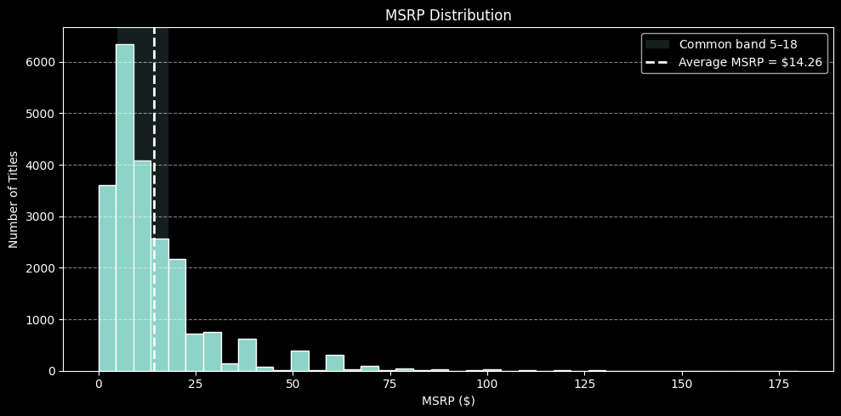
EDA HIGHLIGHTS
Average MSRP:
most games are priced between $5–$18.

Slide 8
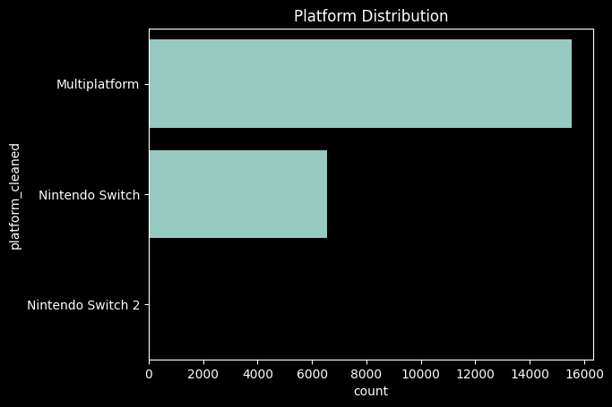
EDA HIGHLIGHTS
Top Platforms:
Nintendo Switch is the most popular platform for most titles, compared to the newer generation consoles

Slide 9
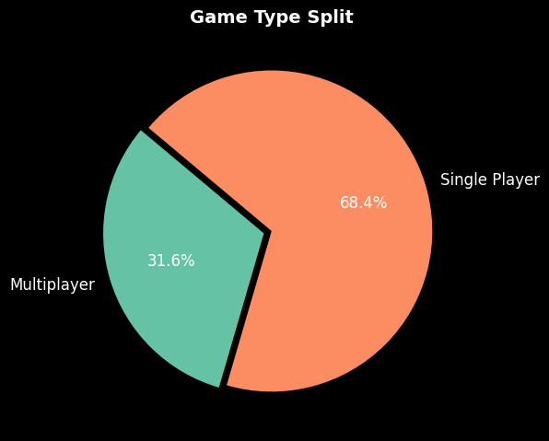
EDA HIGHLIGHTS
Multiplayer Split:
About 31.6% of all Nintendo titles are Multiplayer

Slide 10
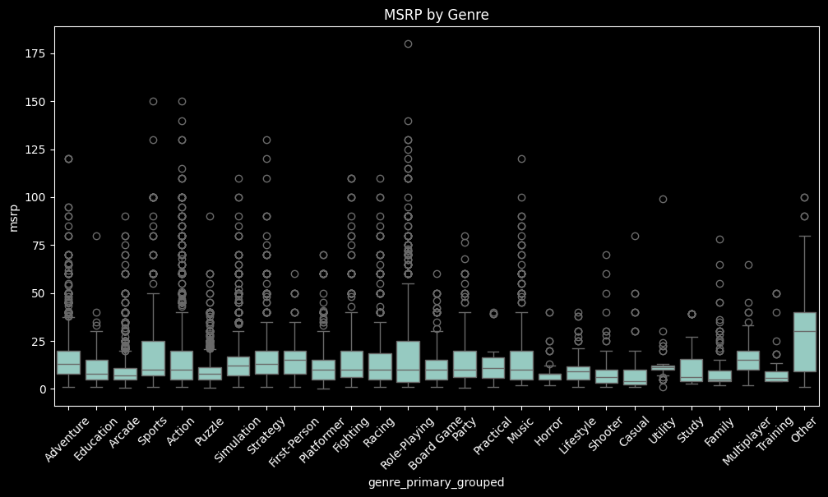
EDA HIGHLIGHTS
Price Drivers:
There is Higher MSRP prices in RPG and Strategy genres, but lower in Casual genres

Slide 11
MODELING PERFORMANCE
Target
“Our model achieves 85% predictive accuracy, meaning that 8.5 out of 10 pricing or sequel predictions will be correct. This gives our stakeholders confidence backed by data driven results, to make decisions regarding greenlighting sequels.”
- Dammy & Kosi, 2025
  is_sequel
Model:
  RandomForestClassifier (Internal Weighting).
  Validation_AUC
  About 85% in accuracy
  Test Accuracy: 85%
Class 0 (no sequel): Precision 89%, Recall: 93%
  Class 1 (Sequel): Precision 55%, Recall 43%
  Top Features: MSRP, Release_year, game _age, platform_count, key genres

Slide 12
TRADE-OFFS & RISKS
Trade-offs
High non-sequel accuracy vs. lower sequel recall
Risks:
  Invalidity of model based on shift in market patterns.
  Over-reliance on automation for decision making process.
  Mitigation:
  Scheduled retraining and monitoring of model.
  Assigning expert to inspect result before company-wide utilization.

Slide 13
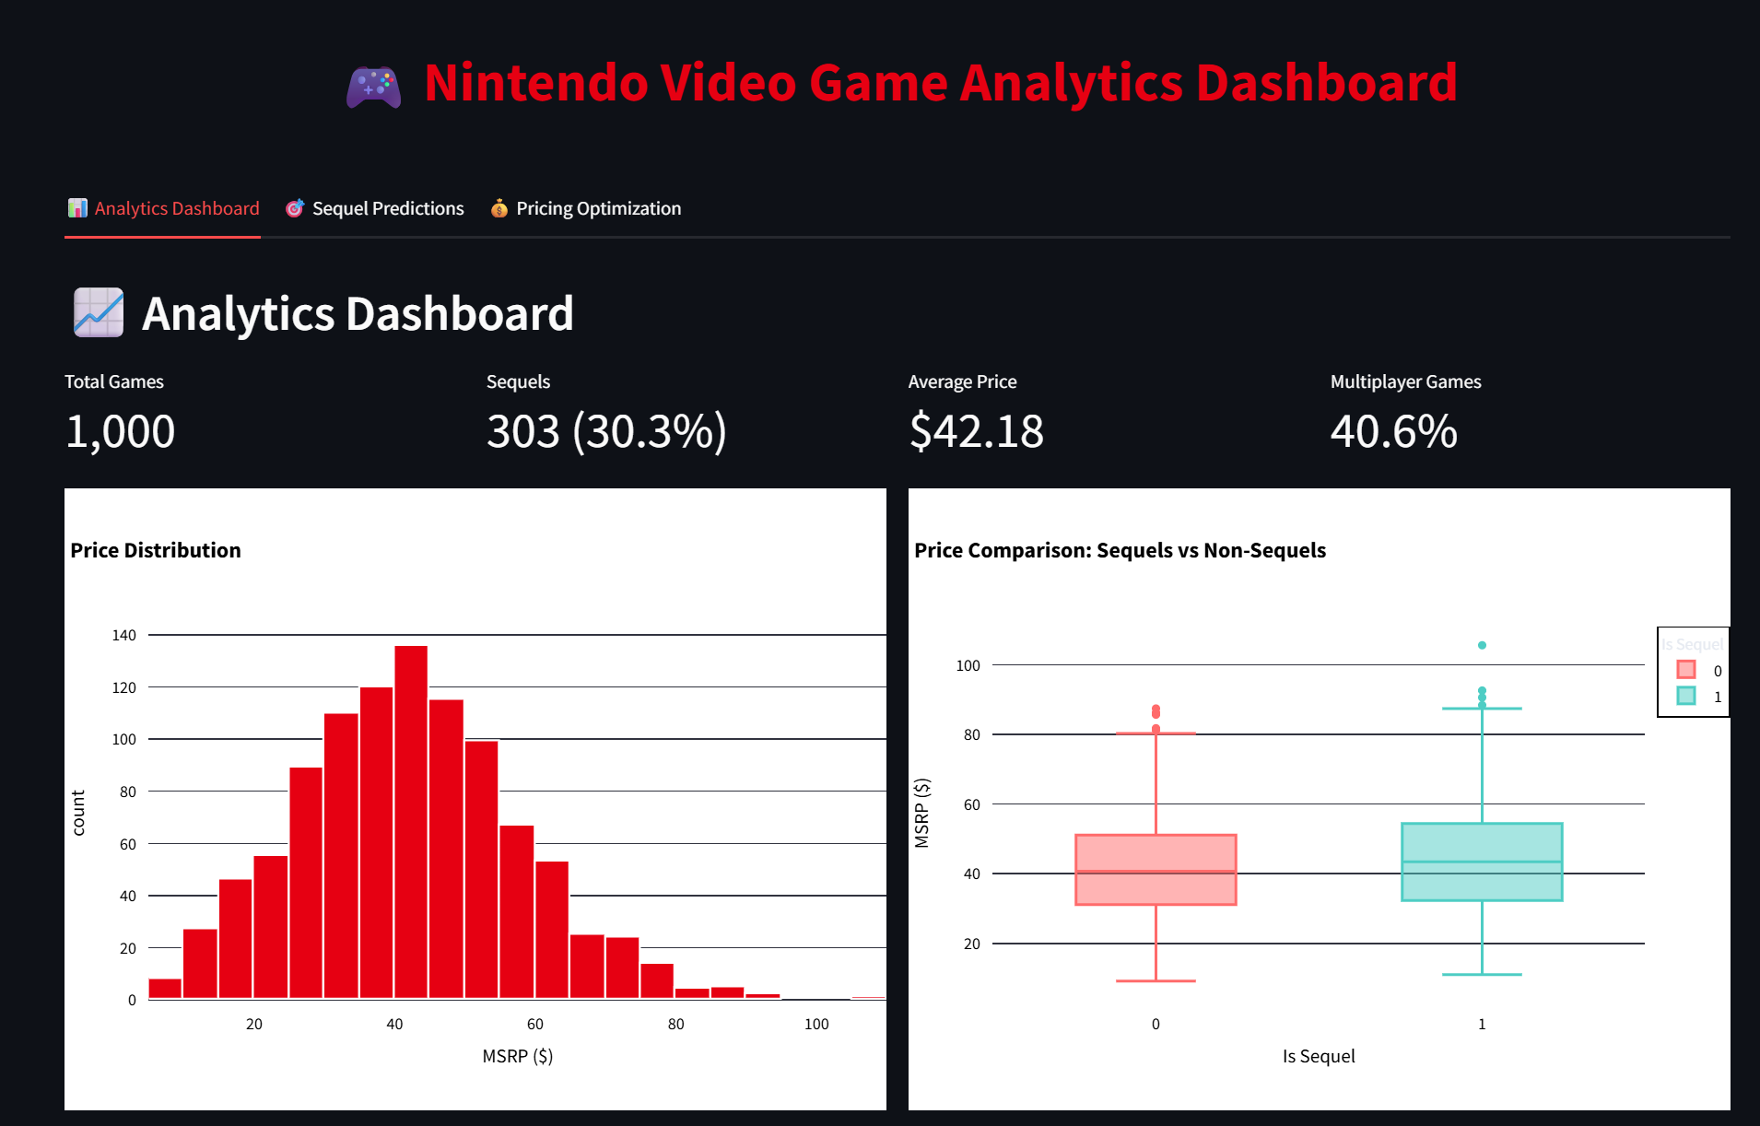
DEPLOYMENT & DASHBOARD
Streamlit dashboard on Hugging Face with:
  Sequel Likelihood predictions.
  Pricing optimization suggestions.
  Filter by genre, platform, release year, etc.
https://huggingface.co/spaces/owolabidamilola2014/Nintendo_Sequel_Decision_Analysis

Slide 14
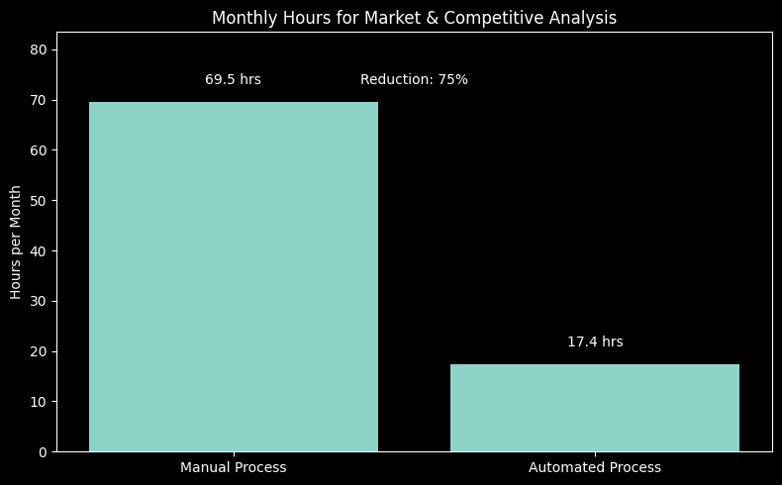
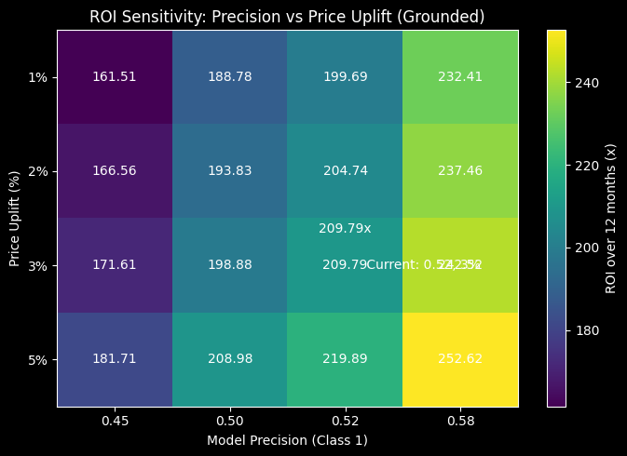
BUSINESS VALUE & ROI
Time Saved
  Automates competitive analysis & market research by 52.1 Hours
Revenue Impact
  Better sequel greenlighting & optimized pricing could increase ROI by over 209.8 many times over.
Strategic Value
  The model is scalable, transparent, data driven by realistic scenarios, and easily accessible via Hugging Space

Slide 15
REFERENCES
Bureau of Labor Statistics. (2024). Occupational employment and wage statistics: Market research analysts and marketing specialists (SOC 13-1161). U.S. Department of Labor. https://www.bls.gov/oes/current/oes131161.htm
Statista. (2024). Average gross profit margin for video game publishers worldwide from 2015 to 2023. https://www.statista.com/statistics/1274650/video-game-publisher-profit-margin/
Newzoo. (2023). Global games market report. Newzoo. https://newzoo.com/insights/trend-reports/global-games-market-report
Shan, L., & Yao, Y. (2021). Video game pricing strategies: An empirical analysis of price determinants in the digital distribution era. Journal of Media Economics, 34(3), 123–140. https://doi.org/10.1080/08997764.2021.1957741
Williams, D. (2022). The economics of sequel production in the video game industry. Entertainment Computing, 40, 100472. https://doi.org/10.1016/j.entcom.2021.100472

Slide 16
QUESTIONS AND FEEDBACK

Slide 18
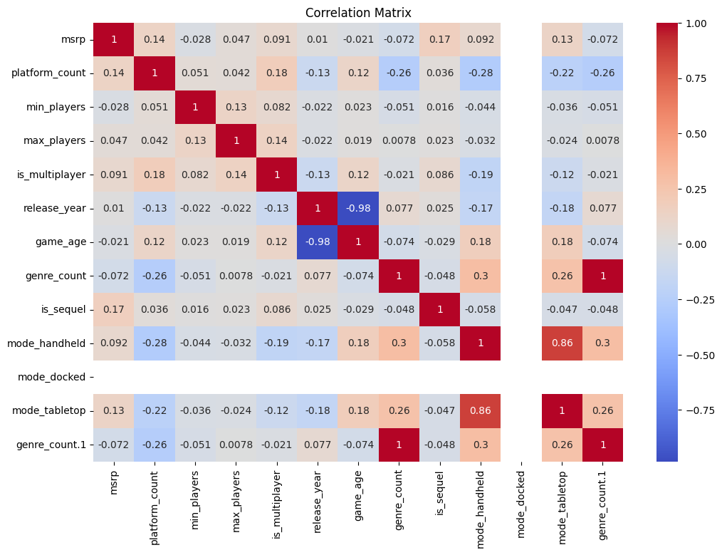

Slide 19
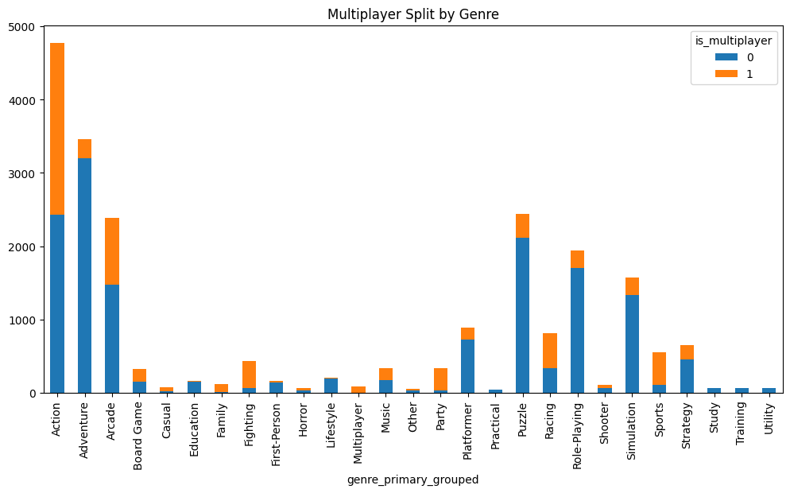

Slide 20
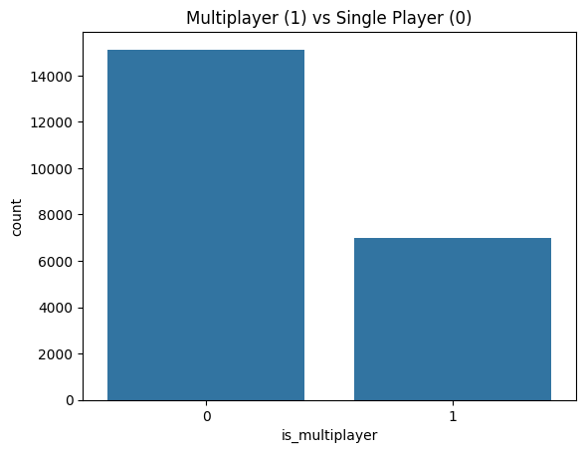

Slide 21
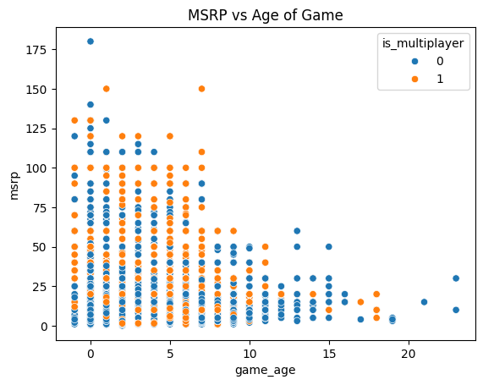

Slide 22
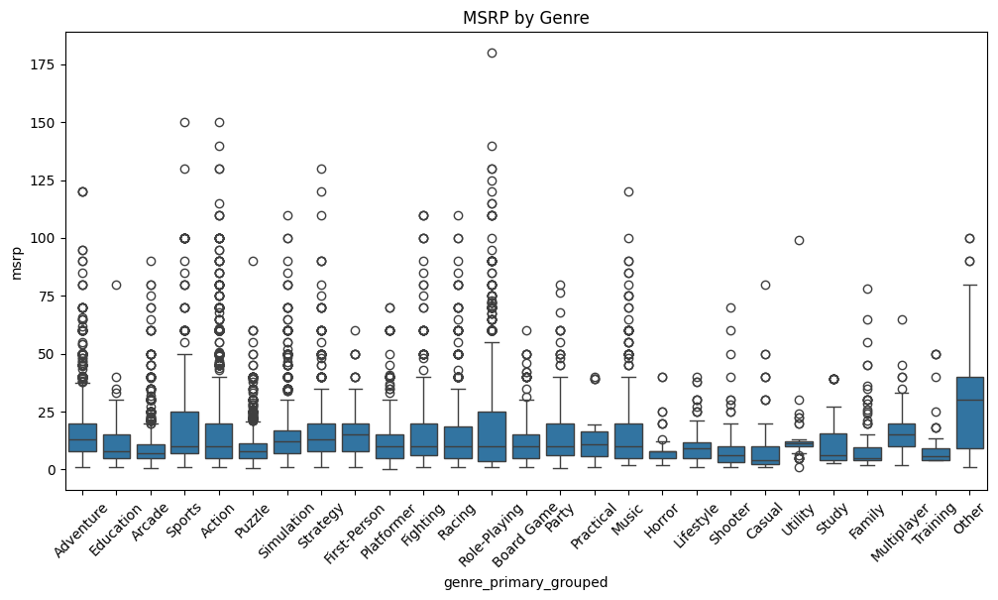

Slide 23
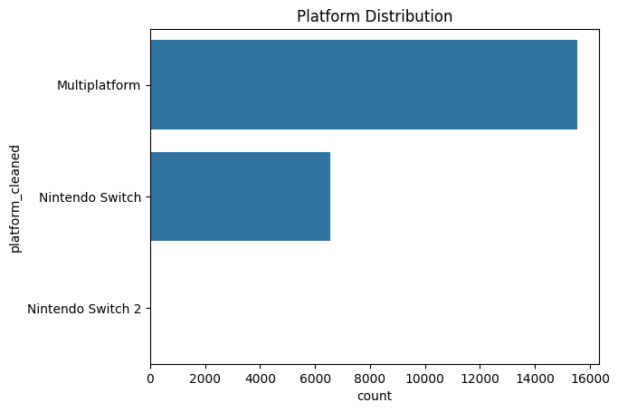

Slide 24
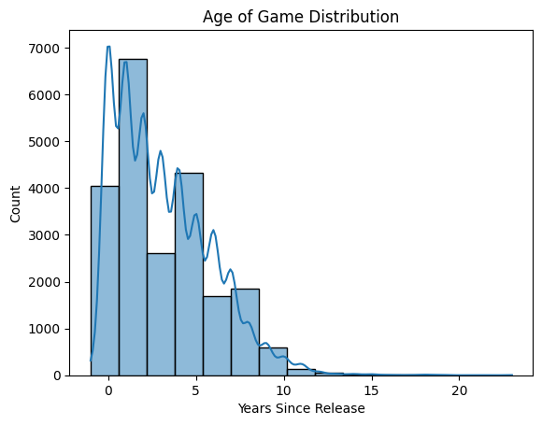

Slide 25
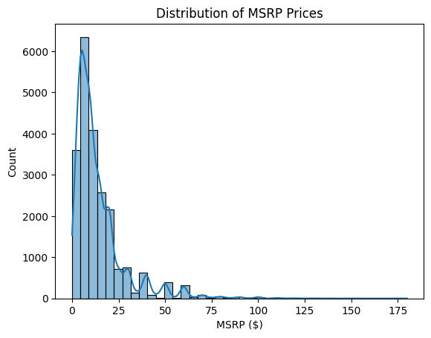

Slide 26
