Slide 1
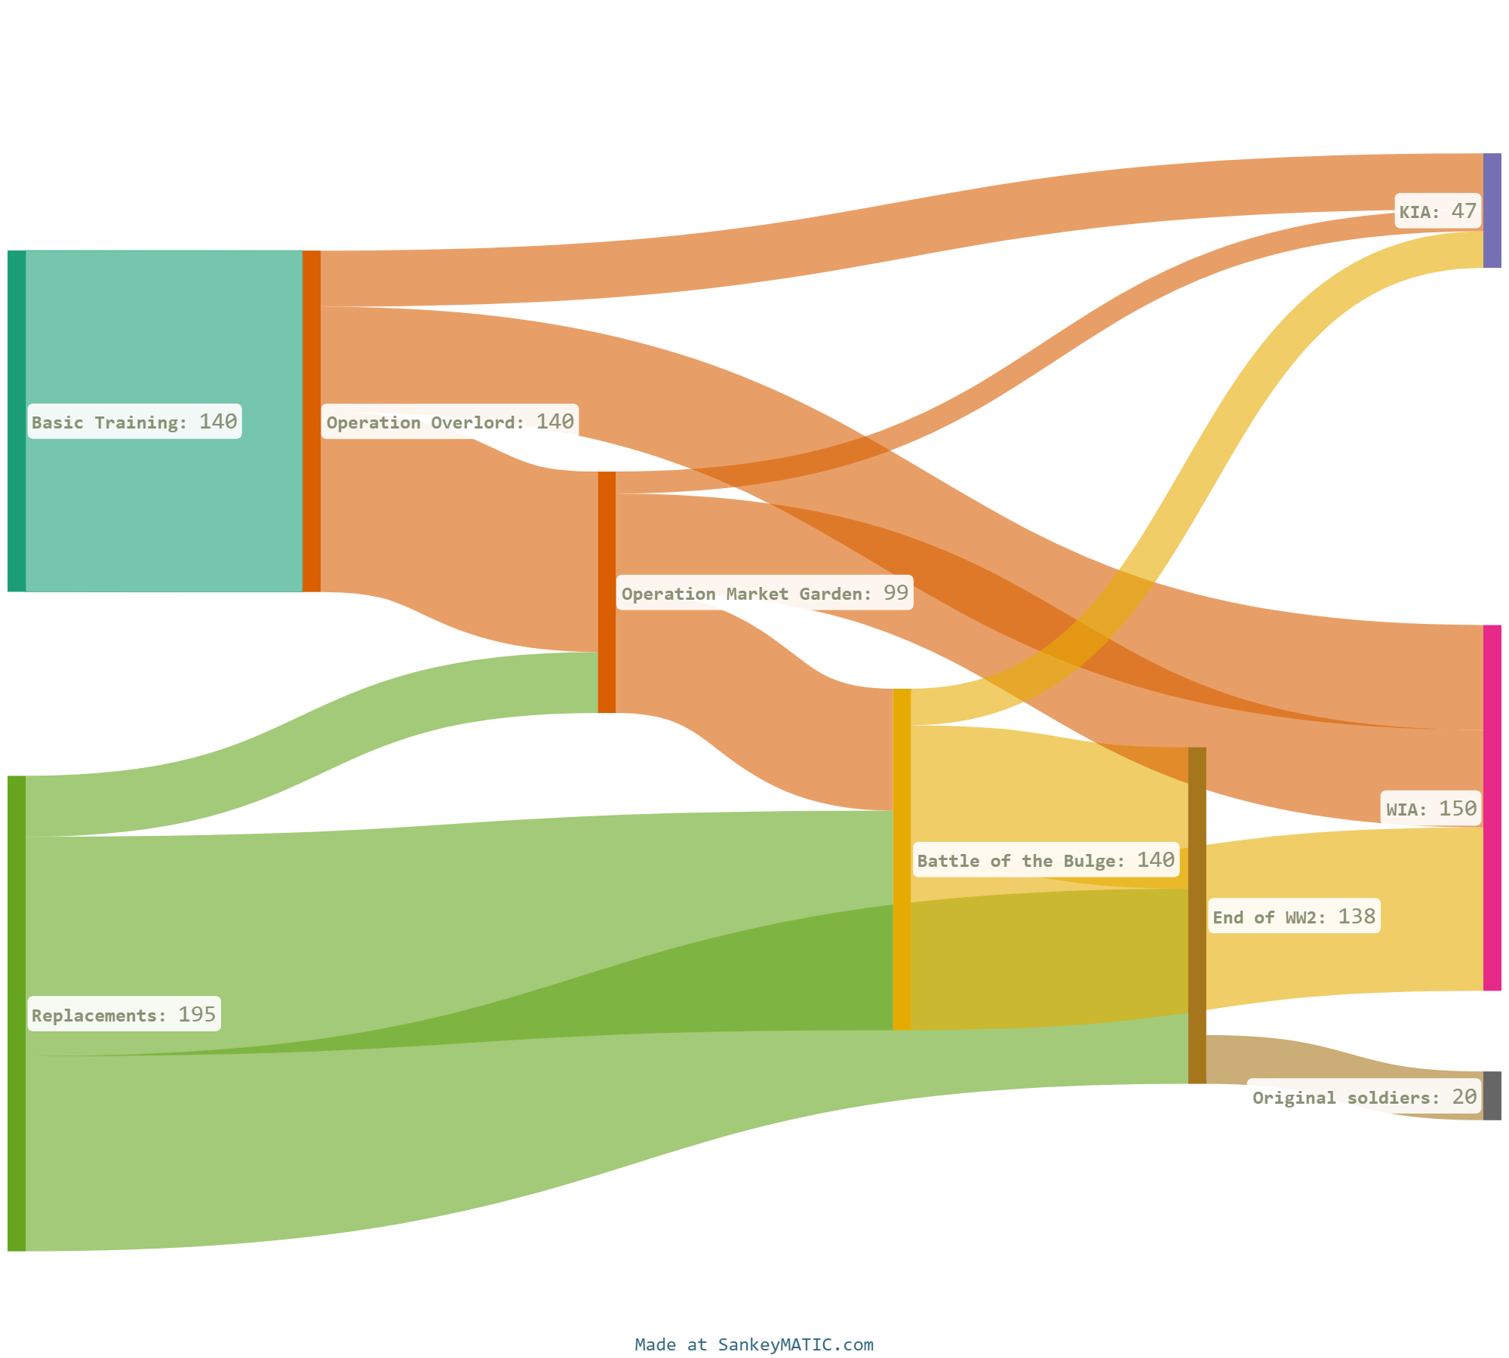
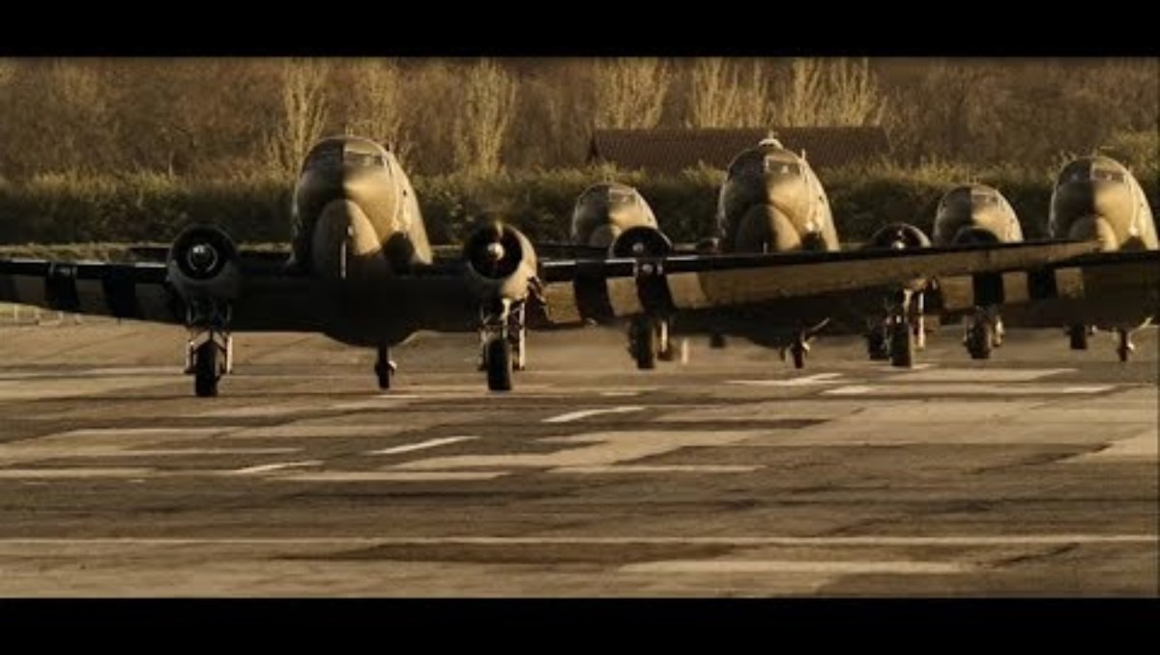
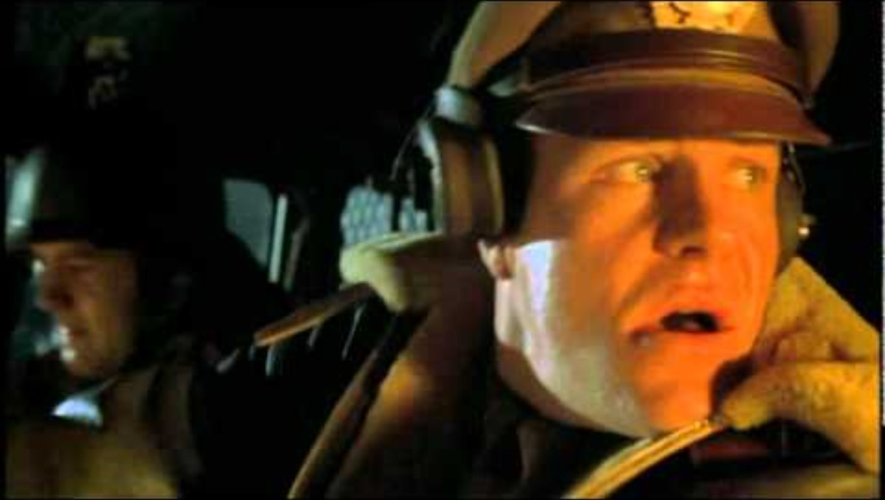
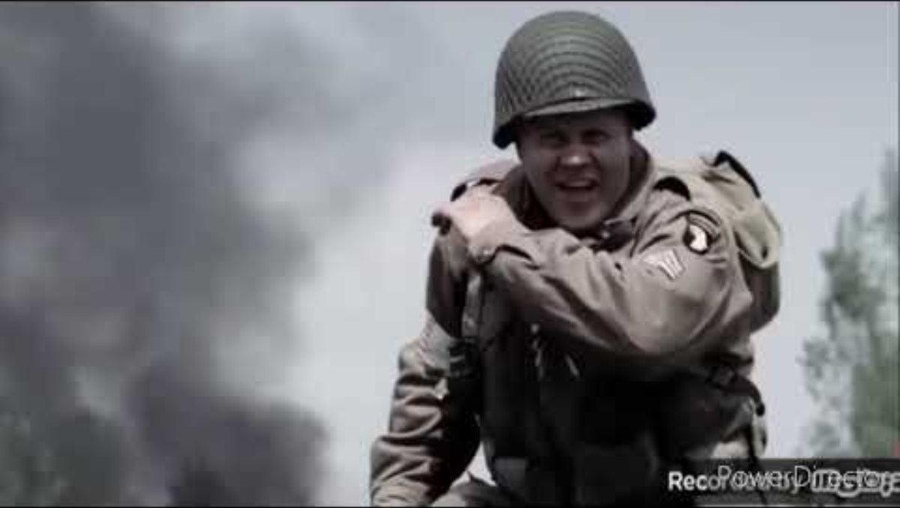
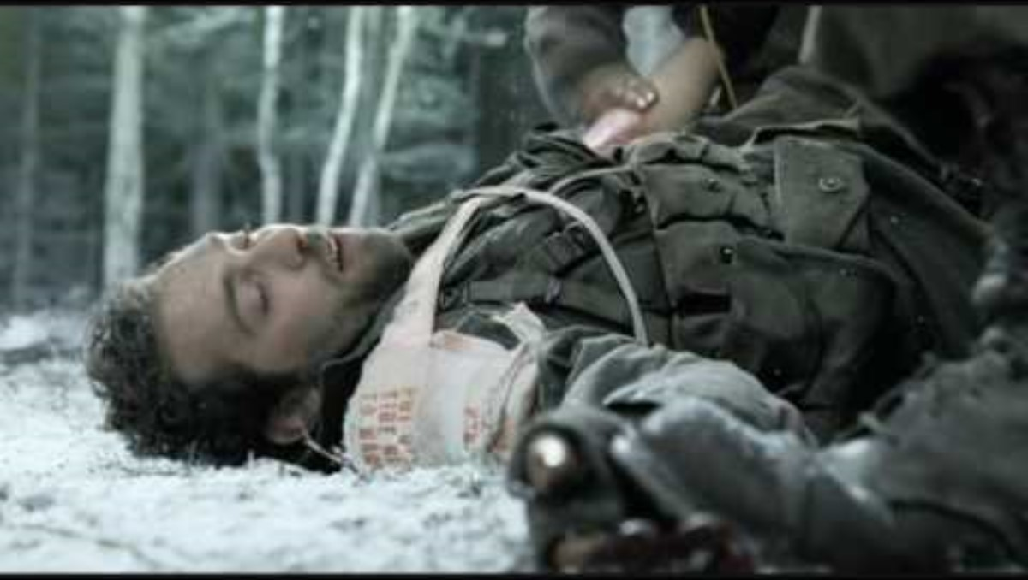
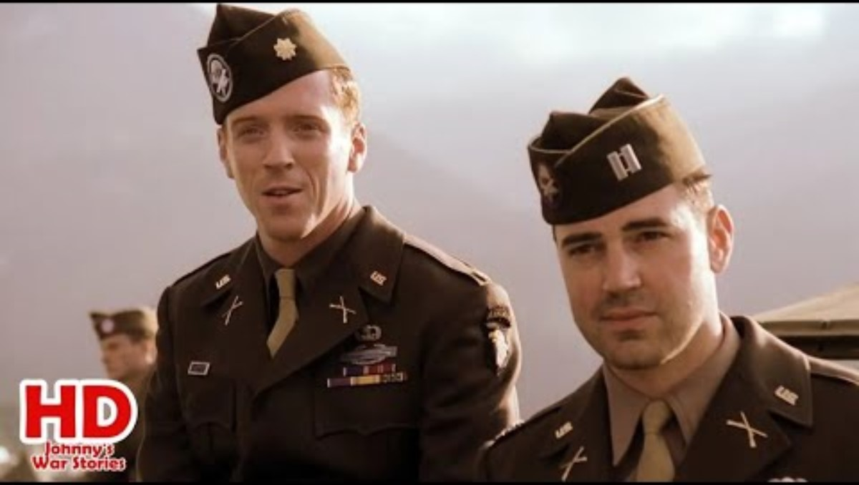
MORTALITY JOURNEY OF THE MEN OF EASY COMPANY, 506TH INFANTRY REGIMENT FROM BASIC TRAINING TO END OF WWII
Source: https://en.wikipedia.org/wiki/E_Company,_506th_Infantry_Regiment_(United_States)#Company_commanders

