Slide 1

Olist Store Analysis

Slide 2
Presented By Group- 6
1) Kamal Dudekula
2) Gayathri Mooram
3) Damini Khachane
4) Babusingh Degavath
5) Manoj Banuka

Slide 3








Introduction
02 KPIs
Agenda
01
03 Dashboard and SQL Queries
04 Insights & Recommendation
05 Conclusion

Slide 4
Introduction
The Olist Store Analysis project aims to analyze customer purchasing patterns and payment statistics on an E- commerce platform, Olist.
This project covers several key performance indicators(KPI’s) such as weekday vs weekend sales, payment statistics, delivery time, and customer behaviour .
The Analysis is based on nine csv files,which are cleaned and manipulated to extract valuable insights.

Slide 5
KPI’s
Weekdays and weekend payment statistics
Payment Type with review score 5
Average numbers of delivery days taken for pet shop Average price and payment value of sao paulo city
Average shipping days vs review scores

Slide 6
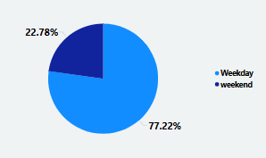
Weekday vs Weekend payment statistics
The analysis of payment statistics based on weekday vs weekend provides an the understanding of the buying behavior of customers.
The analysis reveals that a significant portion of our customer base prefers online payment methods. Additionally, weekday sales outperform weekend sales.
To enhance weekend sales performance, strategic initiatives such as targeted advertising campaigns, diverse promotional activities, and incentivized discounts may be implemented.
These efforts aim to attract and engage weekend shoppers effectively, ultimately bolstering sales figures during this period.

Slide 7
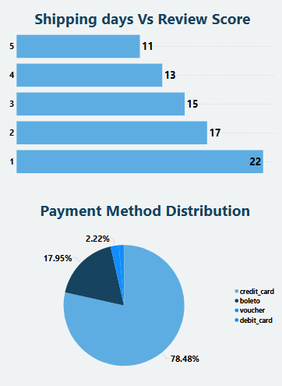
Payment Type with review score 5
This KPI examine the number of orders with a review score of 5 and payment type as credit card.
This helps in understanding customer satisfaction levels and payment preferences. Olist can use this information to Implement loyalty programs specifically tailored for credit card users with high review scores.
Offer exclusive discounts, early access to sales, or VIP perks to incentivize repeat purchases and foster long-term customer relationships.

Slide 8
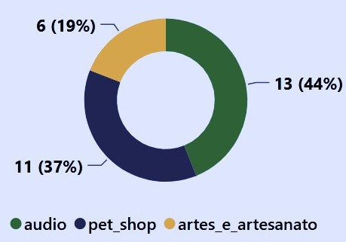
Average numbers of delivery days taken for pet shop
This KPI exmine the average number of days taken for order_delivered_customer_date for pet_shop.
It helps Olist to do Streamline logistics and supply chain management processes to reduce delivery times.
Negotiate shorter lead times with suppliers, optimize warehouse operations, and implement efficient delivery routes to expedite order fulfillment.
Establish regional warehouses strategically located near high-demand areas to minimize transit times and enable faster deliveries.

Slide 9
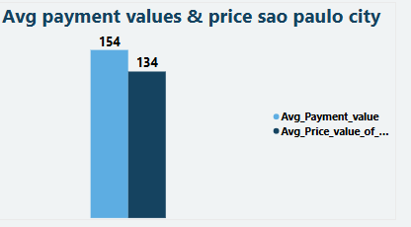
Average price and payment value of sao paulo city
This KPI examining the average price and payment values among customers in São Paulo city provides insights into the spending behaviors characteristic of this particular region.
Analyze pricing strategies to ensure that products are competitively priced within the São Paulo market. Conduct market research to understand pricing trends and consumer preferences, and adjust pricing accordingly, Introduce new products or services that align with the preferences and purchasing power of São Paulo customer.

Slide 10
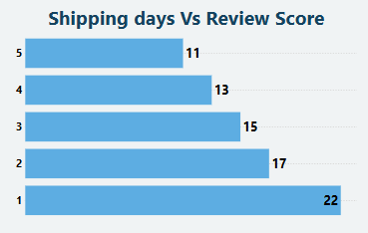
Average shipping days vs review scores
This KPI evaluates the correlation between shipping duration and review rating.
It helps to understand delivery time and customer satisfaction. Olist can use this information to improve shipping and delivery processes to reduce transit times across all review score categories

Slide 11
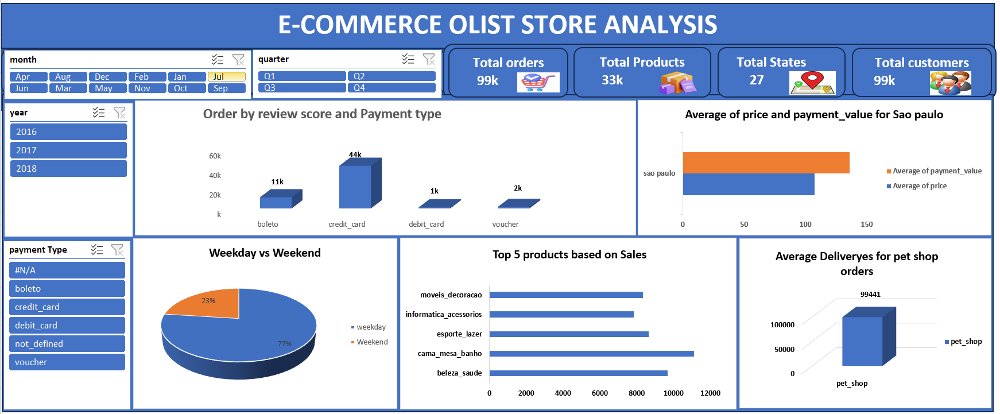
Excel Dashboard

Slide 12
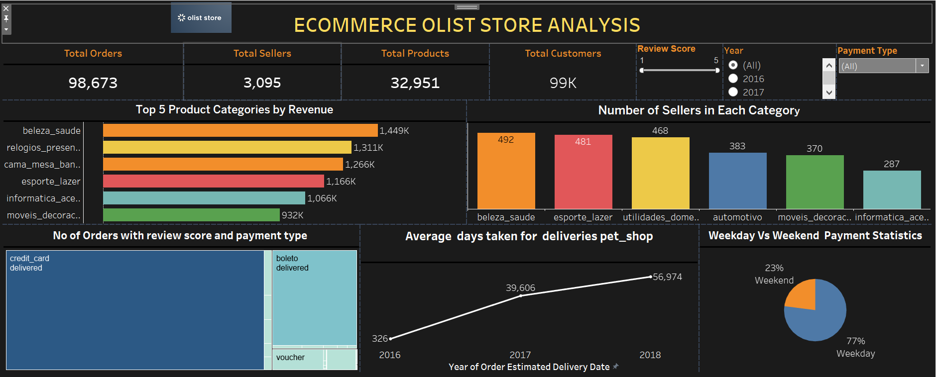
Tableau Dashboard

Slide 13
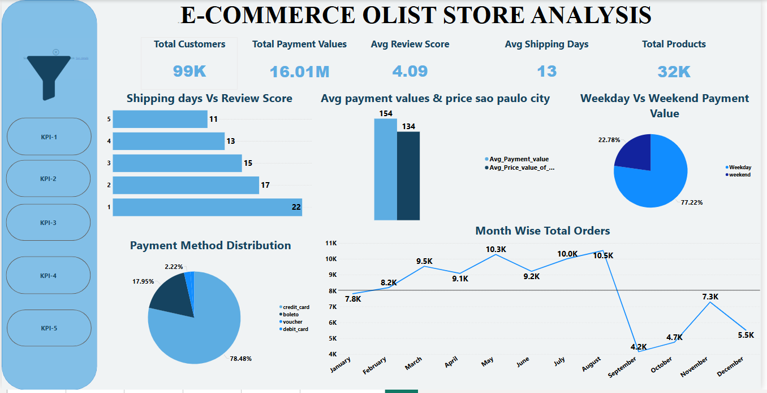
Power-Bi Dashboard

Slide 14
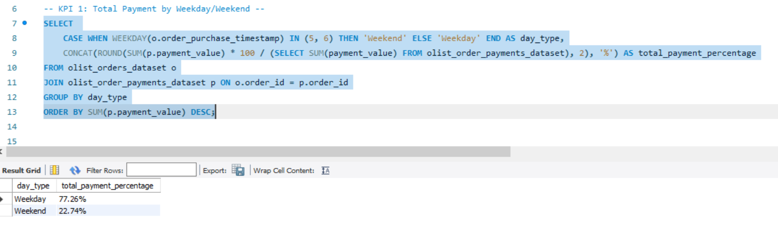
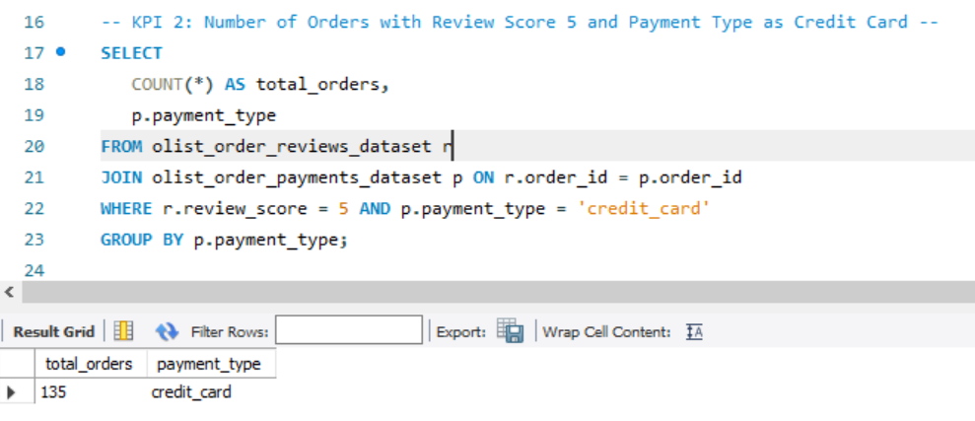
SQL QUERIES

Slide 15
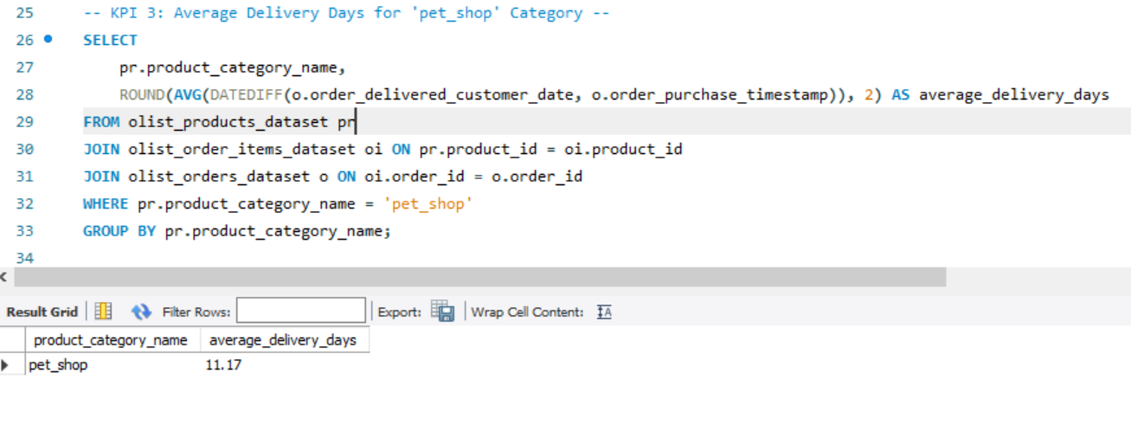
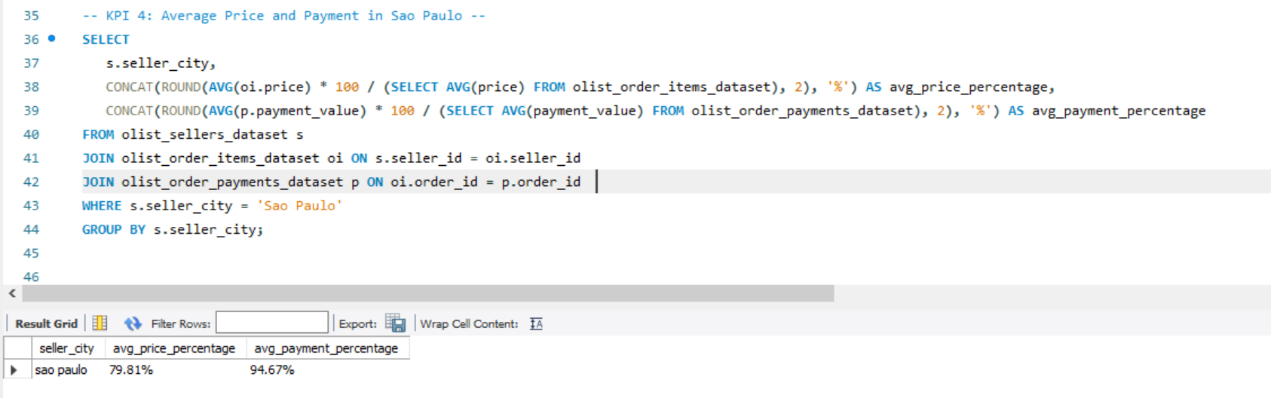
SQL QUERIES

Slide 16
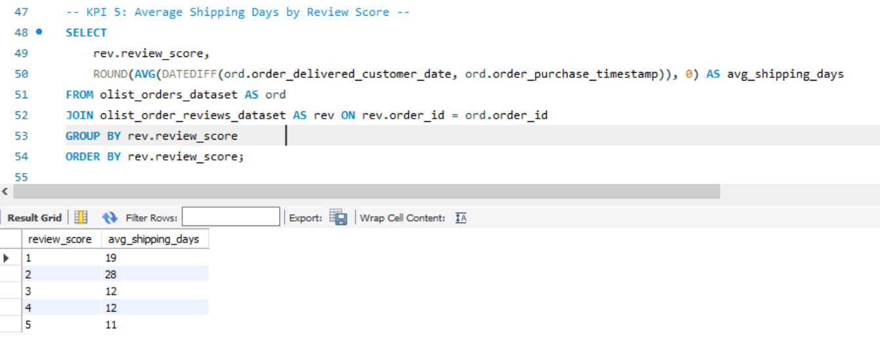
SQL QUERIES

Slide 17
Insights
Olist E-commerce has 99,440 total orders, with 89,940 successfully delivered.
The company has a 90% delivery success rate, indicating good fulfillment but room for improvement in
the 10% undelivered orders.
The average product rating is 4.09 stars, with some categories rated as high as 4.67 stars and as low as 2.5 stars.
1-star reviews rank third in distribution, suggesting potential product quality issues in some categories.
Delivery performance impacts review scores, with delayed deliveries potentially leading to lower ratings.
Delivery Optimization: Reducing delivery times can improve review scores and customer satisfaction.
Customer Retention Strategies: Implement loyalty programs to retain high-value customers.
Quality Control Measures: Strengthen vendor quality assurance to minimize negative reviews and returns.
Customer Preferences: Focus on high-performing product categories to drive revenue growth.
Product & Service Improvements: Address low-rated product categories and investigate the causes behind 1-star reviews.
Marketing Optimization: Target provinces with high sales and customer engagement for future campaigns.

Slide 18
Recommendations
Check that all products are of good quality by regularly inspecting them and the suppliers who provide them. This ensures customers get what they expect and are happy with their purchases.
Work on getting orders to customers quicker and more reliably. This means finding good delivery partners and making sure everything runs smoothly so customers don't have to wait long for their stuff
Pay attention to what customers are saying, especially if they're not happy. Use their feedback to fix any problems and make things better for everyone
Show off positive reviews and ratings from happy customers to let others know how great your products and service are.
This helps attract more customers and keep them coming back.

Slide 19
Summary
Overall, regular monitoring of customer reviews, real- time tracking of fleet performance, together with proper shipment tracking and communication system can improve Olist's delivery and supply chain performance and ensure customers are highly satisfied with the service.

Slide 20
Conclusion
Studying how customers behave and pay for things using the Olist Store Analysis project gives us useful information. By looking at these details, Olist can find ways to make things better and create ads that target specific groups of people.
As a data analyst, I have used Excel, Power BI and Tableau to clean and manipulate the dataset and create meaningful visualizations. This project serves as a great example of how data analysis can help businesses make informed decisions.

Slide 21


