Slide 1

HIGH CLOUD AIRLINES ANALYTICS
Presented By: Group No.05
Nikhil Prakash Gokhale
Ami Jayant Lade
Vanshika Malhotra
Indrajit Chowdhury
Kamal Dudekula
Gayathri Mooram
Damini Jitendra Khachane

Slide 2

Contents
Introduction
Objective
Business Overview
Data Model challenges
KPI’s Analysis
Dashboards
Excel Dashboard
Tableau Dashboard
Power BI Dashboard
SQL Query
Recommendation
Conclusion

Slide 3
Introduction
To revolutionize the airline industry through data-driven insights and optimization.
High Cloud Airline, a leading player in the aviation sector, has been at the forefront of providing seamless air travel experiences.
Established with a commitment to excellence, High cloud has consistently set industry standards in terms of reliability, safety and customer satisfaction.
Extensive network of routes spans across regions, connecting people and cultures, making High Cloud a preferred choice for millions of travelers globally.
High Cloud embraces innovation and modern technology to enhance operational efficiency and stay at the forefront of the aviation landscape.

Slide 4

Objective
To gain a comprehensive understanding of
“High Cloud Airlines” operations through data analysis. This will involve investigating load factors, identifying top carrier names based on passenger preference, analyzing popular routes, and exploring other key metrics. Additionally
The project focuses on boosting operational efficiency by Optimizing flight operation, reducing delays, and improving on-time performance. The ultimate goal is to provide actionable recommendations that can enhance operational efficiency and profitability.

Slide 5


Business Overview
In today’s competitive airline industry, data analysis plays a critical role in optimizing operations and maximizing profitability. By harnessing the power of data, High Cloud Airlines can gain valuable insights into various aspects of its business, allowing them to make data-driven decisions that can lead to
Improved load factor
Enhance Passenger Experience Optimized resource allocation Data- Driven Decision Making

Slide 6

Data Model challenges
Throughout our analysis, we encountered various challenges in handling the data. Overcoming these challenges is crucial for accurate insights.
Data Volume: Managing and Processing large datasets efficiently.
Data Quality: Ensuring accuracy and reliability of the data.
Complex Relationships: Establishing connections between different data points.
Errors and Duplicates: Cleaning data to fix incorrect values and remove duplicates.
Outliers: Flagging and handling unusual data for accuracy.

Slide 7




KPI’s Analysis
Date Fields (Year, Month, Quarter, etc.):
Identify seasonal trends and busiest periods for better planning.
Spot weekday vs. weekend travel patterns to allocate resources effectively.
Load Factor Percentage (Yearly, Quarterly, Monthly):
Monitor seat utilization efficiency.
Highlight underutilized periods for improvement or cost reduction.
Load Factor by Carrier:
Compare carrier performance in seat utilization.
Identify top-performing and underperforming carriers.
Top 10 Carriers by Passengers:
Reveal most popular carriers.
Focus on improving customer experience for less-preferred carriers.
Top Routes (From-To City):
Highlight busiest routes for better scheduling and resource allocation.
Identify routes with growth potential or need for additional flights.
Load Factor: Weekends vs. Weekdays:
Understand leisure vs. business travel trends.
Optimize pricing strategies for weekends and weekdays.
Flight Search Filter (Source to Destination):
Analyze popular routes and demand patterns for better route planning.
Flights by Distance Groups:
Identify demand for short-haul, medium-haul, and long-haul flights.
Optimize aircraft allocation and explore new opportunities.

Slide 8
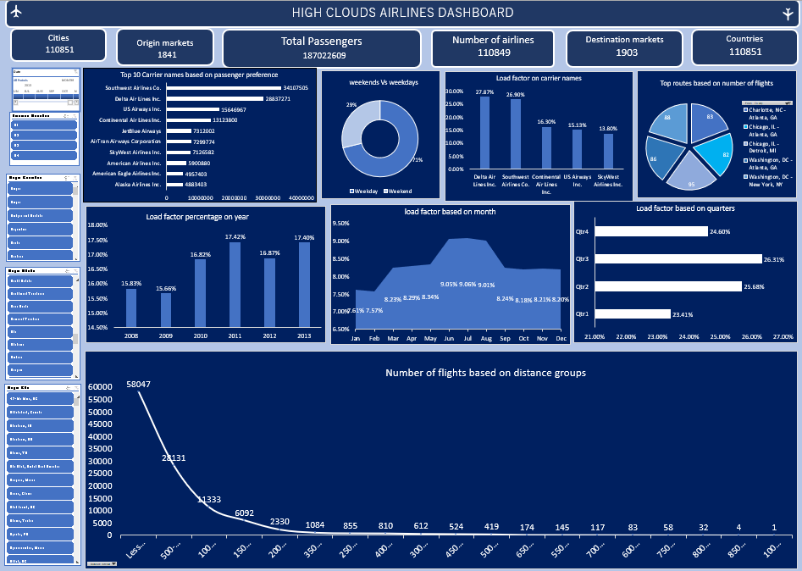
Excel Dashboard

Slide 9
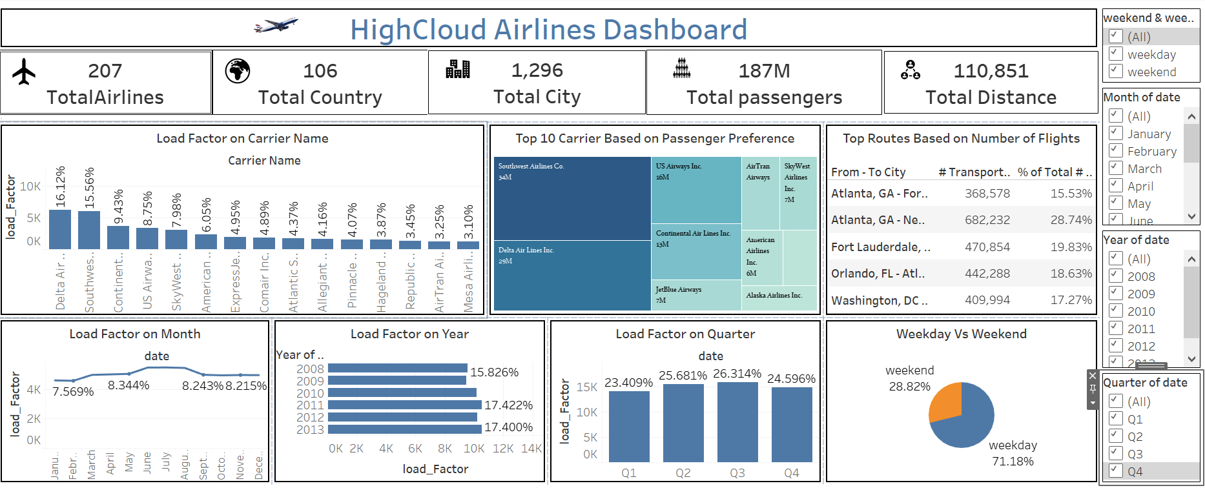
Tableau- Dashboard

Slide 10
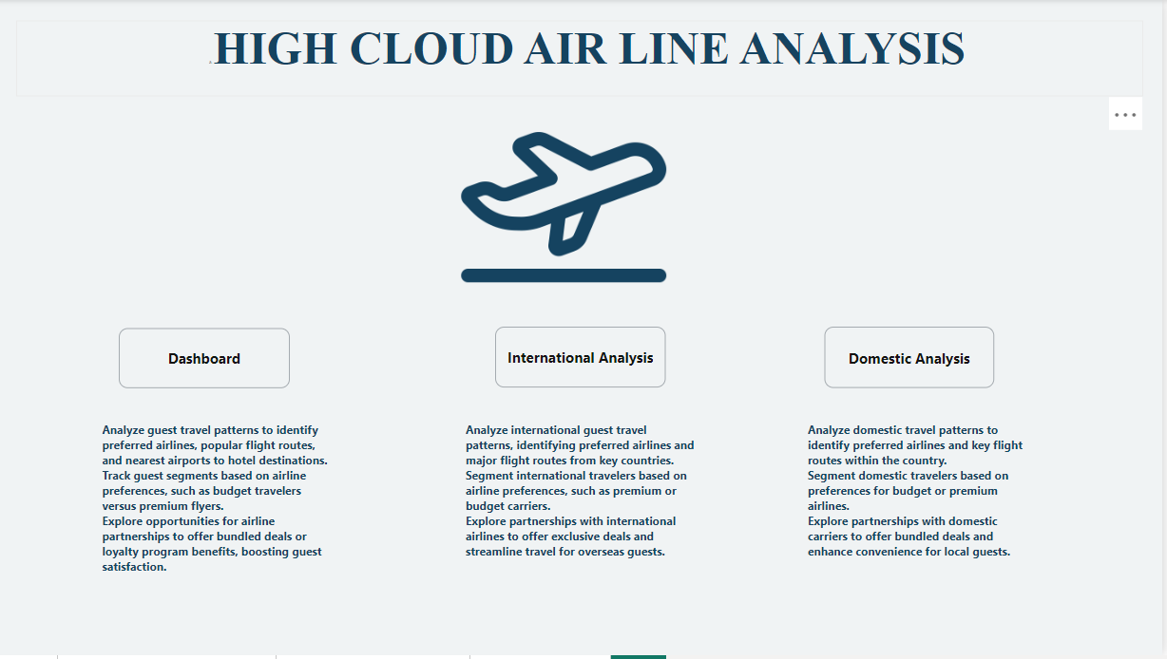
Power BI – Dashboard 1

Slide 11
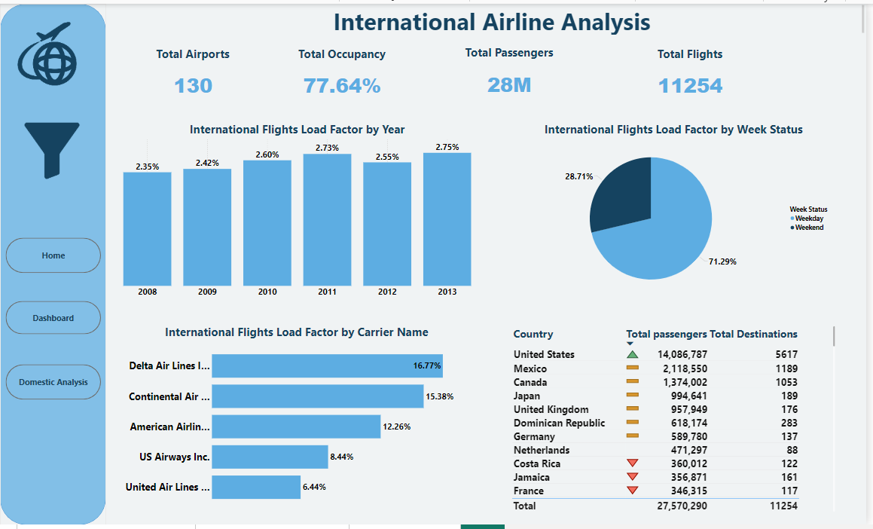
Power BI –Dashboard 2

Slide 12
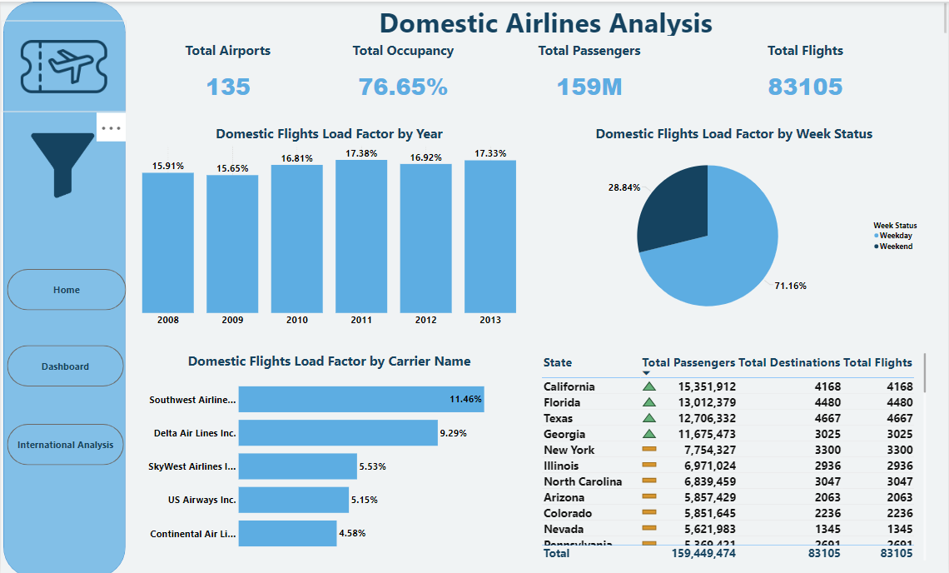
Power BI –Dashboard 3

Slide 13
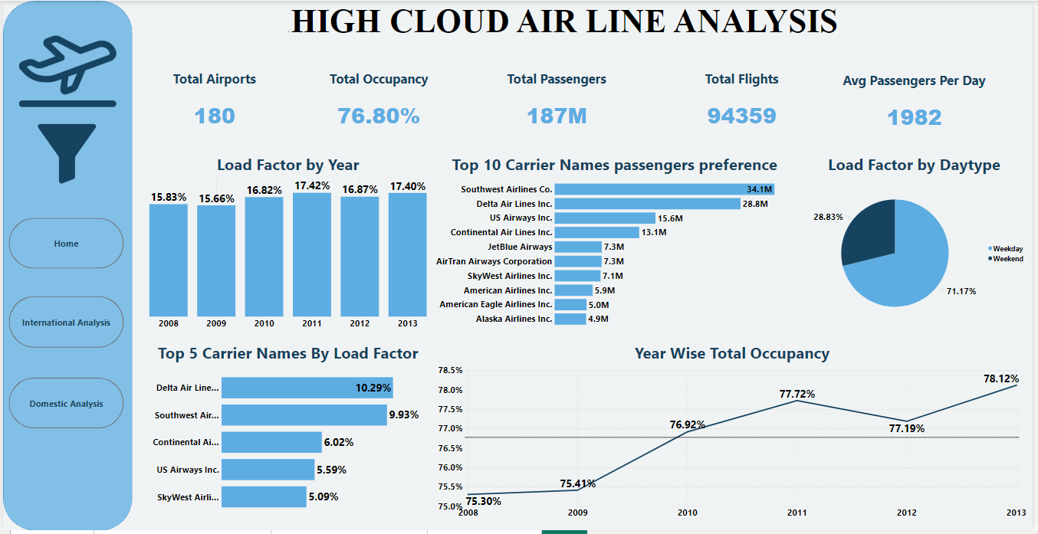
Power BI –Dashboard 4

Slide 14
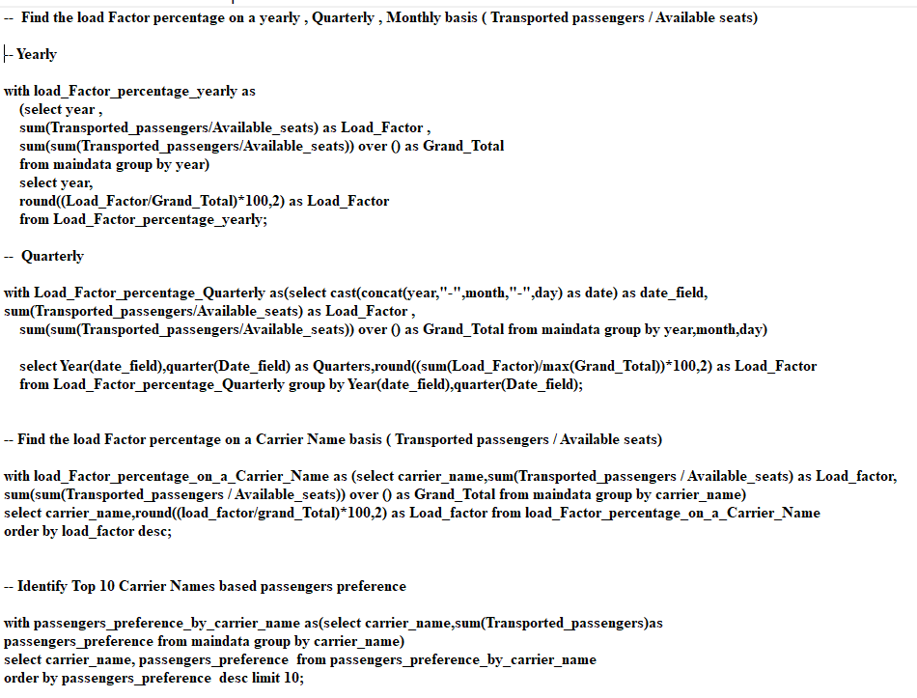
MYSQL- Queries

Slide 15
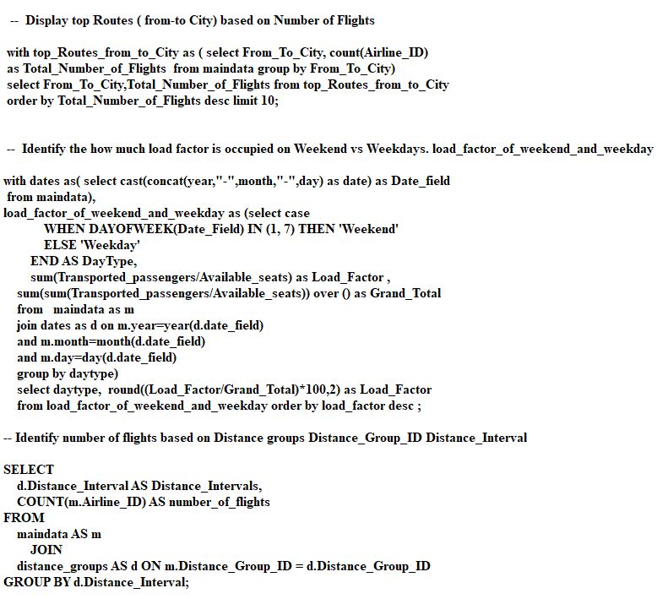
MYSQL- Queries

Slide 16

Recommendation
Optimize Fight Routes: Utilize insights from up routes and flights to Optimize schedule and resource allocation.
Enhance Load Factor: Leverage load factor analysis to identify trends and implement strategies for increased efficiency.
Strategic Carrier Partnership: Collaborate with top carriers to maximize passenger transportation and enhance overall performance.
Resource Allocation: Allocate resources strategically based on flight schedules and passenger volume data. This ensures efficient operation and minimizes wait times at airports with high passenger traffic.

Slide 17
Conclusion
High Cloud Airlines empowers the aviation industry with actionable insights, foresting efficiency, and strategic decision-making. The presented KPIs offer a glimpse into the vast potential for improvement and growth within the industry. By harnessing the power of data, we can drive positive changes, ensuring a bright future for High Cloud Airlines and its partners in the aviation sector.

Slide 18

Thank You

