Slide 1
CSC 532 · MACHINE LEARNING
Explainable Network
Intrusion Detection
Using Machine Learning
Damini
Notes:
Hello everyone. My name is Damini, and my project is called Explainable Network Intrusion Detection Using Machine Learning. The goal was to build a system that can automatically detect whether network traffic is safe or malicious and explain why it made that decision.

Slide 2
Presentation Overview
01
Problem Definition
02
Dataset & Preprocessing
Why ML for intrusion detection? Project goals.
CIC-IDS2017 · 78 features · cleaning pipeline.
03
Methodology
04
Results & Benchmarking
Logistic Regression · Random Forest · XGBoost.
Accuracy, F1, ROC-AUC, confusion matrices.
05
Explainability with LIME
06
Conclusion & Future Work
Per-prediction feature explanations.
Key takeaways and next steps.
Notes:
Here is a quick overview of what I will cover: the problem, the dataset, my methodology, the results, explainability with LIME, and finally my conclusion.

Slide 3
Problem Definition & Dataset
THE CHALLENGE
CIC-IDS2017 DATASET
Problems:
Source
Canadian Institute for Cybersecurity, UNB
✗ Network traffic is too fast & large for manual inspection
Files
8 CSV files (weekday traffic)
✗ Rule-based IDS miss novel or evolving attack behavior
Rows
268,048 (after 10% chunk sampling)
✗ ML models are often black boxes — hard to trust or audit
Features
78 numeric flow-level features
Project Goals:
Task
Binary classification (Benign vs Attack)
✓ Binary classify flows: Benign (0) or Attack (1)
Benign
219,486 flows (81.88%)
✓ Compare Logistic Regression, Random Forest & XGBoost
Attack
48,562 flows (18.12%)
✓ Add LIME explainability to each prediction
Attack Types
DoS, DDoS, PortScan, Botnet, WebAttack…
Notes:
The core problem is that network traffic is too large and fast for anyone to inspect manually. Traditional rule-based systems also fail to catch new types of attacks. On top of that, most machine learning models are black boxes, they give you an answer but no reason.
My project solves this using the CIC-IDS2017 dataset from the Canadian Institute for Cybersecurity. I loaded 8 CSV files containing real network traffic. After cleaning, removing duplicates, fixing missing values, and sampling 10% per chunk to manage memory, I ended up with 268,048 rows and 78 features. I converted all the original attack labels into a simple binary target: 0 for Benign and 1 for Attack. About 82% of the data was benign and 18% was attack traffic.

Slide 4
ML Pipeline & Methodology
Load
& Clean
Encode
& Split
Scale
(LR only)
Tune
(GridSearchCV)
Train
& Evaluate
8 CSVs · 50k-row chunks
Drop dupes & NaN · float32
›
Binary label · 80/20
Stratified split
›
StandardScaler
for Logistic Regression
›
3-fold CV · F1 metric
30k-row sample
›
Full training set
Test metrics + LIME
Logistic Regression
Random Forest
XGBoost ★ Best
Best C = 10.0
200 trees · depth=None
lr=0.2 · depth=4 · n=200
Baseline · Scaled features
min_samples_leaf=2
subsample=0.8
CV F1: 0.8263
CV F1: 0.9923
CV F1: 0.9954
Notes:
My code had main five steps: load and clean, encode and split, scale, tune, then train and evaluate.
I trained three models. Logistic Regression was my baseline. Random Forest was the first ensemble model. And XGBoost was the third. For tuning, I used GridSearchCV with 3-fold cross-validation, using F1-score as the metric because it balances precision and recall, both of which matter in security.

Slide 5
Model Evaluation & Benchmarking
XGBoost (Best Model)
99.91%
99.55%
99.95%
99.75%
Accuracy
Precision
Recall
F1-Score
Full Benchmark Comparison
Model
Accuracy
Precision
Recall
F1-Score
ROC-AUC
Logistic Regression
93.31%
73.67%
98.19%
84.18%
0.9859
Random Forest
99.88%
99.59%
99.75%
99.67%
0.9999
XGBoost ★
99.91%
99.55%
99.95%
99.75%
1.0000
★ XGBoost missed only 5 attack flows out of 9,712 in the test set — the lowest false-negative count of all models.
Notes:
XGBoost was the best model by every metric. It achieved 99.91% accuracy, 99.55% precision, 99.95% recall, and a perfect ROC-AUC of 1.0. Most importantly, it missed only 5 attack flows out of 9,712 in the test set. That is critical in intrusion detection because a missed attack is far more dangerous than a false alarm. Logistic Regression had decent recall but too many false positives. Random Forest was strong but XGBoost was best overall.

Slide 6
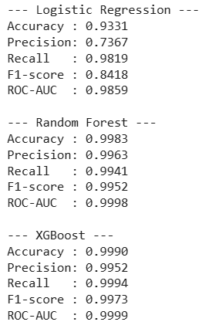
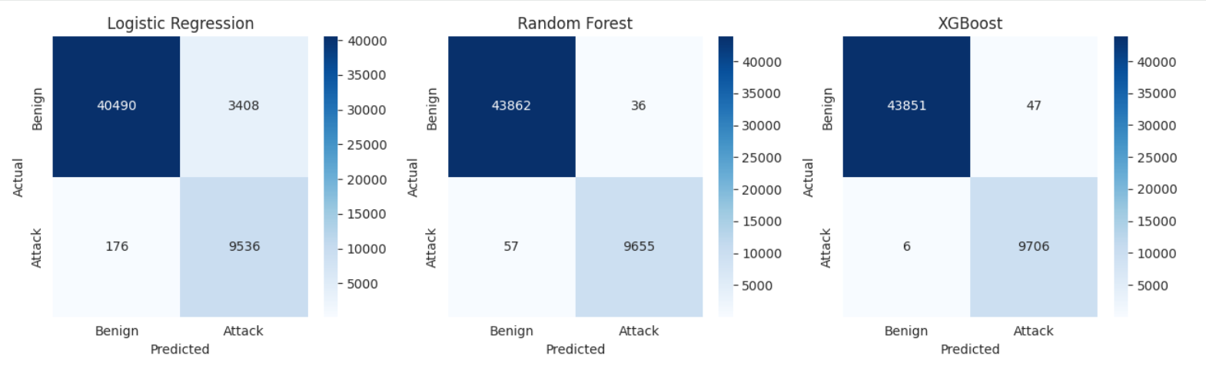
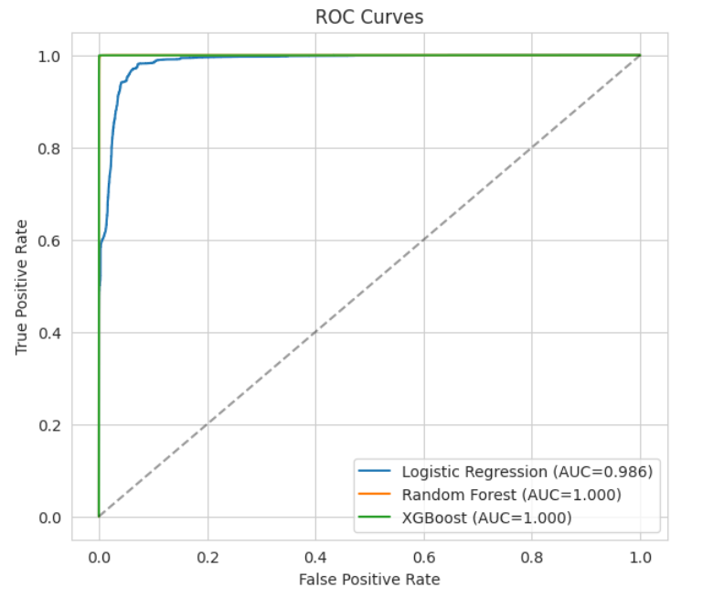
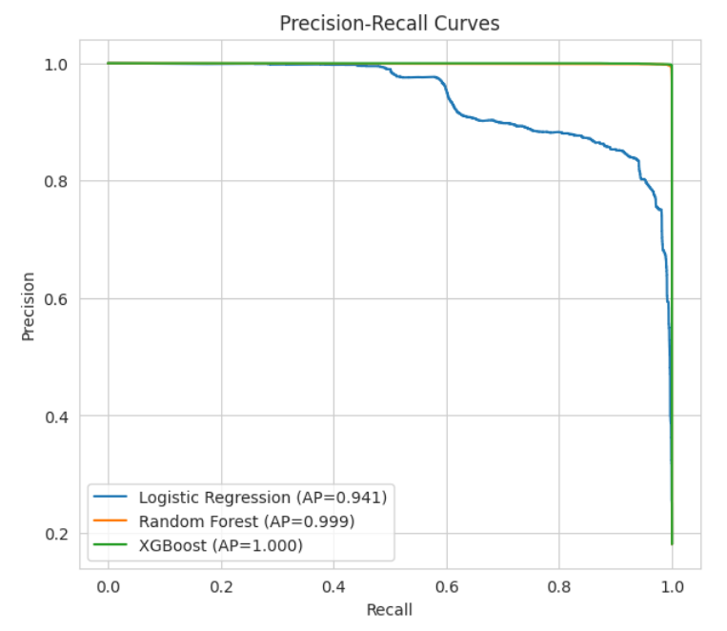
Model Evaluation & Benchmarking

Slide 7
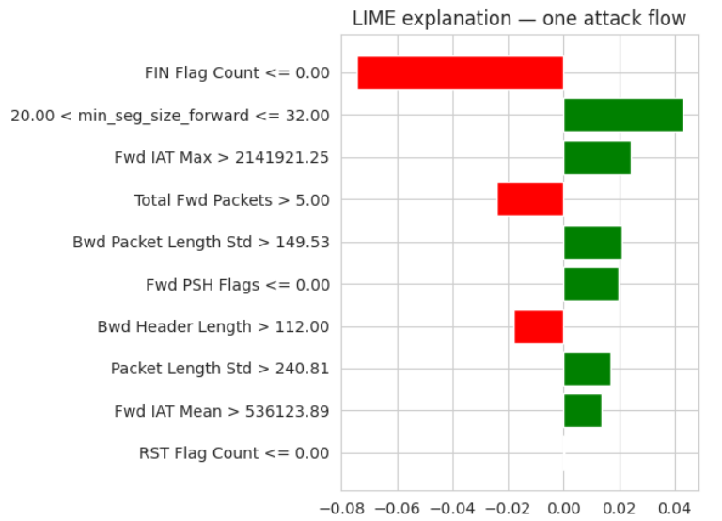
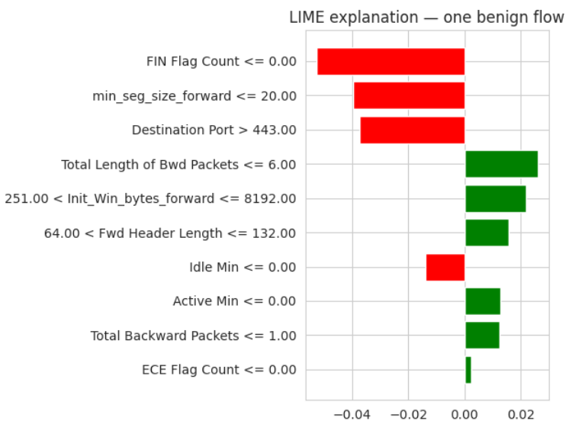
Explainability with LIME
LIME (Local Interpretable Model-Agnostic Explanations) explains one prediction at a time by revealing which feature ranges pushed the model toward Attack or Benign.
⚠ ATTACK FLOW (p = 1.0000)
✓ BENIGN FLOW (p = 0.0003)
Notes:
I used LIME (Local Interpretable Model-Agnostic Explanations) to explain individual predictions. LIME shows which features pushed a prediction toward Attack or Benign, and by how much.
For an attack flow, features like a high Fwd IAT Max and large min segment size pushed the model toward Attack. For a benign flow, features like low FIN Flag Count and a high Destination Port pushed it toward Benign. This gives a security analyst a clear, readable reason for every decision.

Slide 8
Conclusion & Future Work
★ XGBoost: 99.91% accuracy · only 5 missed attacks · ROC-AUC = 1.0
◈ Packet length & timing features are the most discriminative signals
Thank
You!
◉ LIME provides reviewable, per-prediction explanations for analysts
Future Work
Damini
→ Run on full CIC-IDS2017 dataset (no sampling) with more memory
→ Multi-class classification to predict exact attack type
→ Cross-dataset validation for generalization testing
→ Compare LIME vs SHAP for explanation stability
→ Build a live dashboard: class label + probability + LIME explanation
Notes:
To wrap up: machine learning can classify network traffic with very high accuracy, and LIME makes those predictions understandable. XGBoost was the winner, missing only 5 attacks in over 53,000 test samples.
For future work, I would like to run this on the full dataset without sampling, try multi-class classification to identify the exact attack type, and build a live dashboard that shows the prediction, probability, and LIME explanation together.
Thank you.

