Slide 1
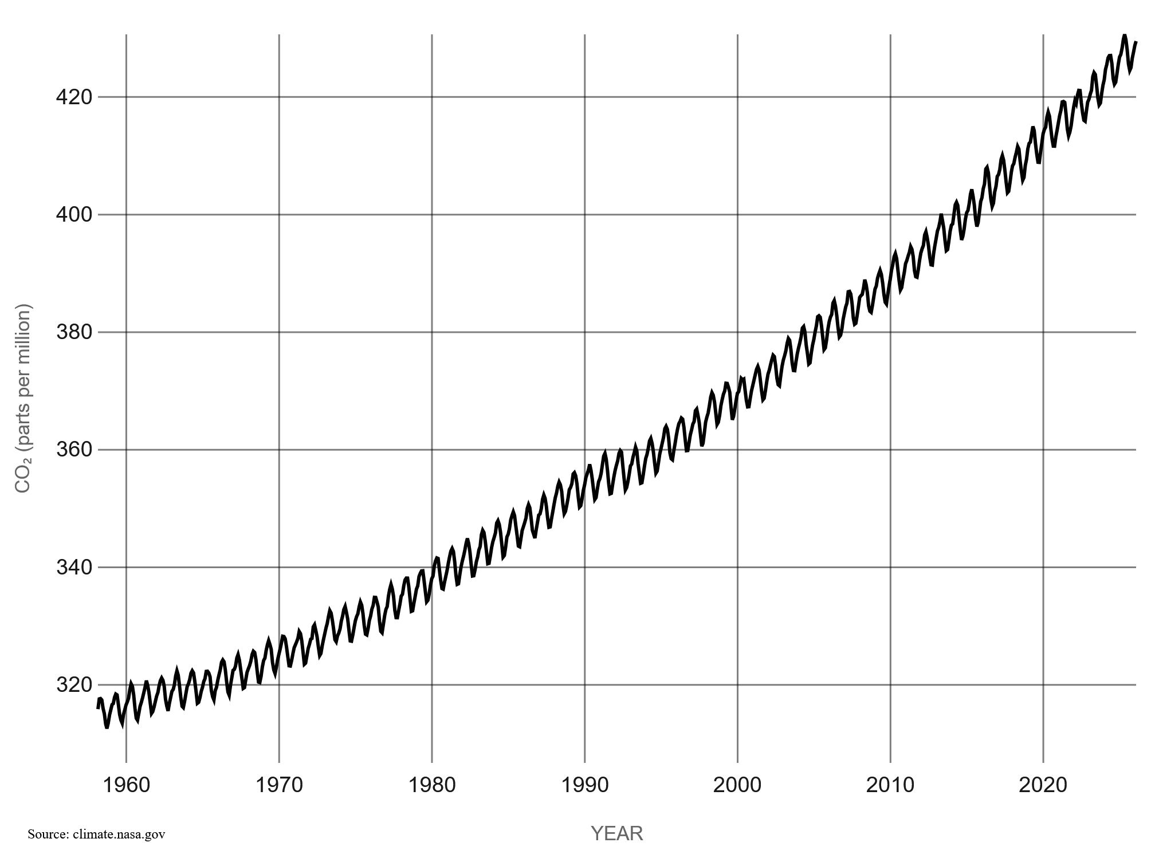
Workplace Air Quality
Monitoring
An IoT Solution using ESP32 & LoRa
CO2 concentration in the atmosphere over the years, in parts per million.
LoRa
SCD41
https://science.nasa.gov/earth/explore/earth-indicators/carbon-dioxide/
IoTeam 2026

Slide 2
PROBLEM
CO₂ Buildup
Temperature
Humidity
A CO2 level above 1,000 ppm inside buildings is an indicator of bad air quality¹ and can cause mild discomfort.
5000ppm is the maximum threshold for a 8hr exposure².
There is no agreement on exact thresholds, different guidelines are present³.
Deviations from the 20–24°C optimal range can reduce productivity and physical comfort for prolonged occupancy.
The 40–60% RH range is considered optimal for human comfort.
Spanish government guidelines for building ventilation
UK’s HSE guidelines for workplaces
ISPRA presentation on radon and indoor air quality

Slide 3
APPROACH
Why This Demands an IoT Solution
Continuous Sensing
Real-Time Alerting
Remote Aggregation
Automated 24/7 monitoring across multiple rooms simultaneously. Human intervention not needed (except for programmed battery recharging).
Crossing thresholds repeatedly alerts the central building management system.
LoRa uplink sends readings to a central server for logging, dashboards, and building-wide analytics.
Edge Intelligence
Ease of installation
Affordability
The device can issues pre-alerts before an unsafe CO² threshold is reached, even if there is no connection to a central server.
The devices are fully battery operated and LoRa allows for reliable connections over long distances.
Low component cost makes deployment practical even for large facilities.

Slide 4
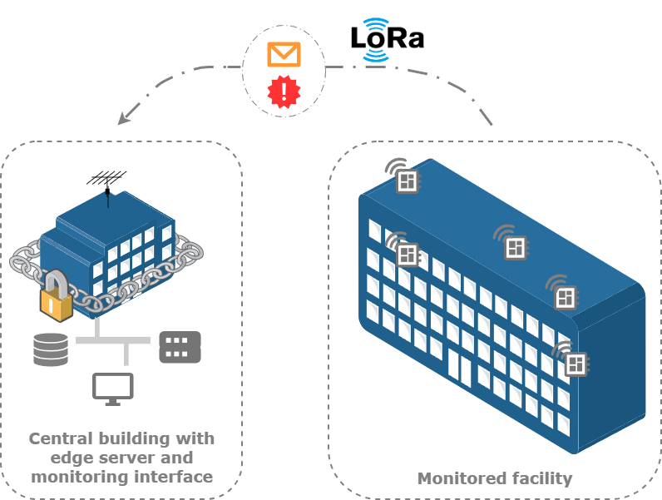
APPROACH
Example deployment

Slide 5
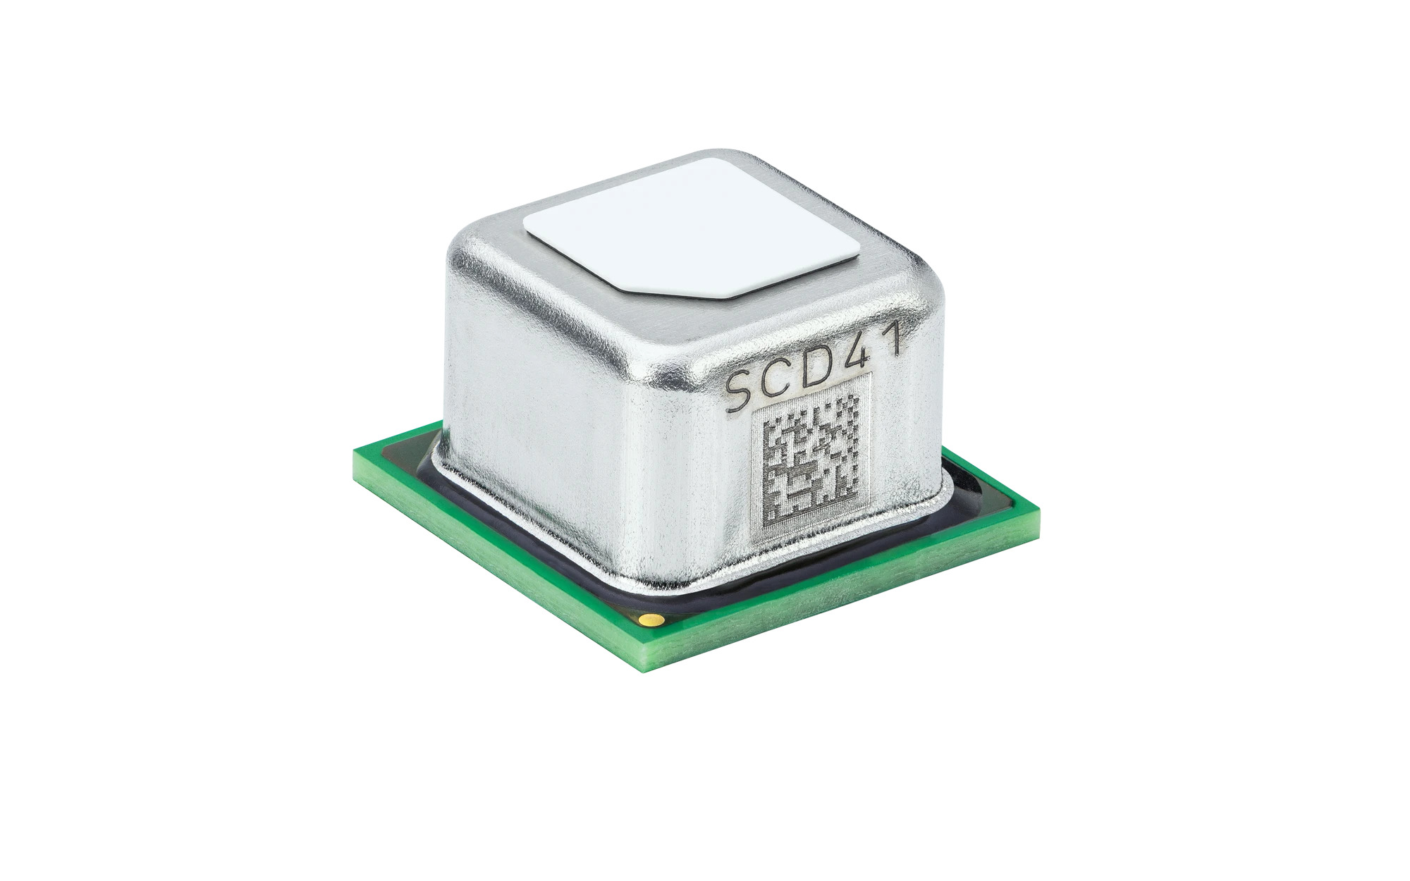
SENSOR
Sensirion SCD41
Data Transmitted
CO₂ Range
400 – 5,000 ppm
CO₂
Parts per million (ppm)
Temperature
−10°C to +60°C (±0.8°C)
Temperature
°C — comfort indicator
Humidity
0–100% RH (±6% RH)
Humidity
% RH — comfort and air quality indicator
Interface
I²C
Timestamp
Power Consumption
Adjustable via software
Node ID
Device identifier for multi-room deployments.
Battery
Estimated battery voltage
Sensirion’s SCD41 datasheet

Slide 6
INTELLIGENCE
Data Processing
On-Device (ESP32S3)
Server-Side Analytics
Data visualization
Time-series storage
Provide simple analytics on air quality on the device’s screen (on user’s demand).
Historical plots of CO₂, temp, humidity per room and per node.
Simple status updates
Occupancy detection
Air quality values mapped to easily understandable color and sound cues.
Link CO₂ levels to room occupancy. Automatically activate air ventilation or AC where necessary.
Pre-alert logic
Multi-node dashboard
If projected trend crosses safety threshold within a certain time → issue pre-alert.
Building-wide overview with per-node status.
Adaptive sampling
Sampling frequency is higher when CO₂ levels are above the optimal range, otherwise sampling frequency is greatly reduced to save power.

Slide 7
ACTUATORS
LED Array and sound cues
Buzzer — Audible Alarm
GREEN LED
< 800 ppm
Snooze
Air quality is good — no action needed.
Button press silences alarm for a configurable period to prevent alarm fatigue. The use of this feature is notified to the central server.
AMBER LED
800–1,200 ppm
Pre-Alert Tone
Intermittent pattern played before crossing the danger threshold. Distinguishable from full alarm.
Ventilation recommended.
>>> 1,200 ppm for a prolonged amount of time
Full Alarm
RED LED
Continuous tone when CO₂ exceeds danger threshold (close to 5000ppm). Different from the pre-alert tone and should induce urgency. An alert message is sent to the central server.
Ventilation strongly recommended.

Slide 8
CONSTRAINTS
Latency
Bandwidth
▸ LoRa throughput is low (0.3 – 50 kbps) but sufficient for the task.
▸ The indoor sensors cannot be too far (<2km) from the central building with the LoRa receiver, unless a LoRa signal repeater is installed.
The monitored issue doesn’t require low latency.
▸ The measured phenomenon is slow (RH, temperature and CO₂ variations).
▸ If a danger threshold is reached, the device itself can react by alerting the users.
Sampling Frequency
Power Consumption
▸ CO2, RH and temperature dynamics are slow.
▸ The SCD41 supports 4 operation modes:
high performance (5 sec sampling period), low power (30 sec sampling period), idle single shot, power cycled single shot.
▸We aim for low power, or idle single shot (once every 5 mins) and change to adaptive mode (every min) if threshold is crossed.
Most important constraint, given that there is no way to harvest energy from the environment.
▸ Change battery every 3 months.
Error Rate: Aim is to reduce FPR such that is it close to 0, to prevent habituation to false alarms.

Slide 9
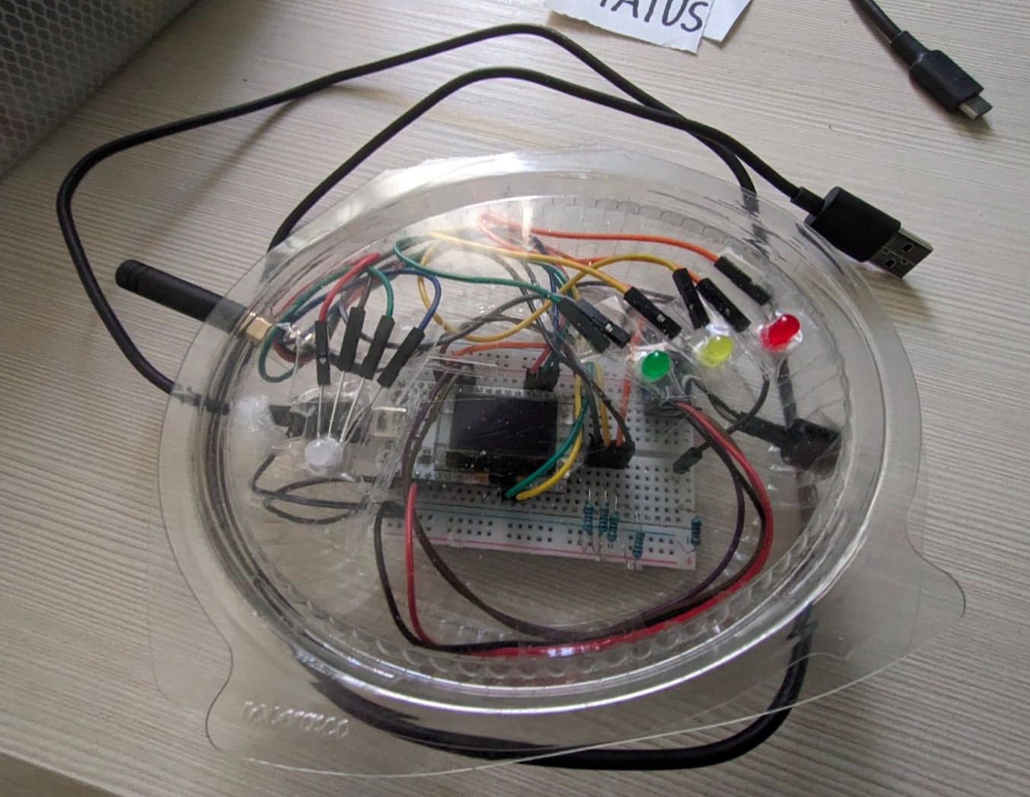
Workplace Air Quality
Monitoring
2nd Delivery – 10/04/2026
IoTeam 2026

Slide 10
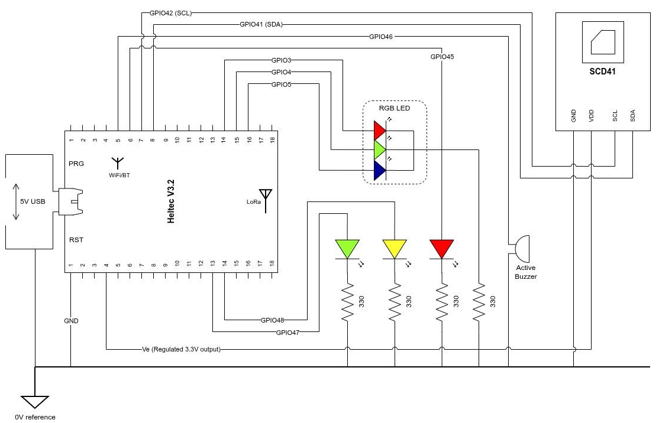
CIRCUIT

Slide 11
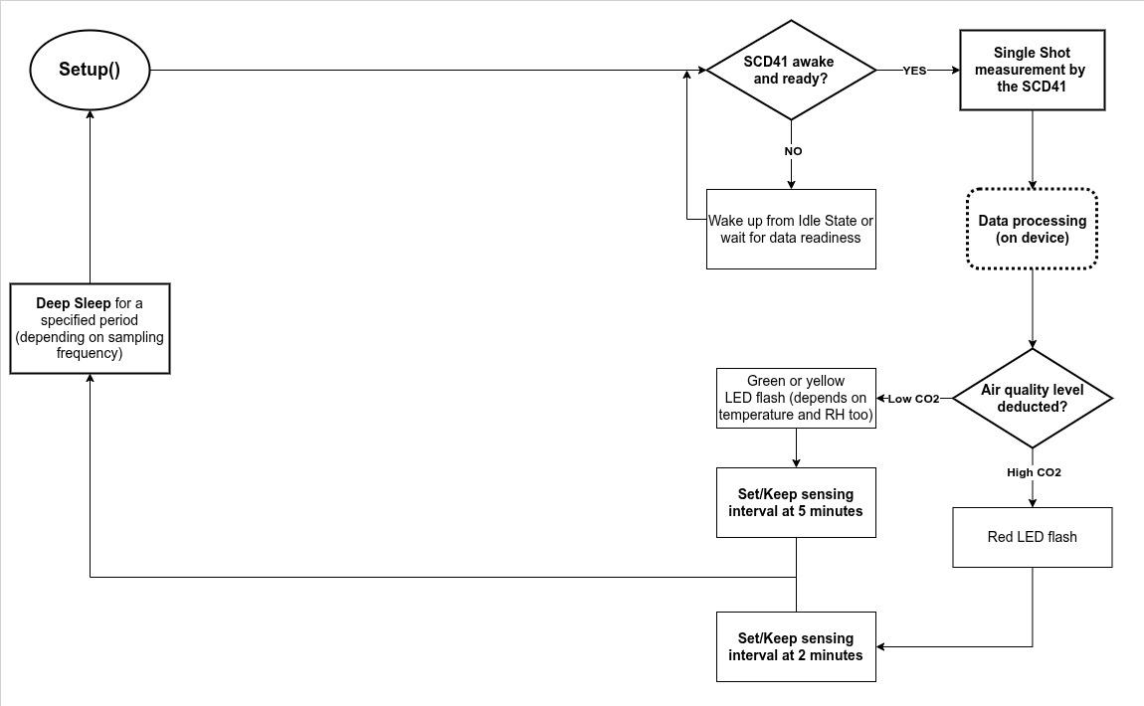
HIGH LEVEL PROGRAM

Slide 12
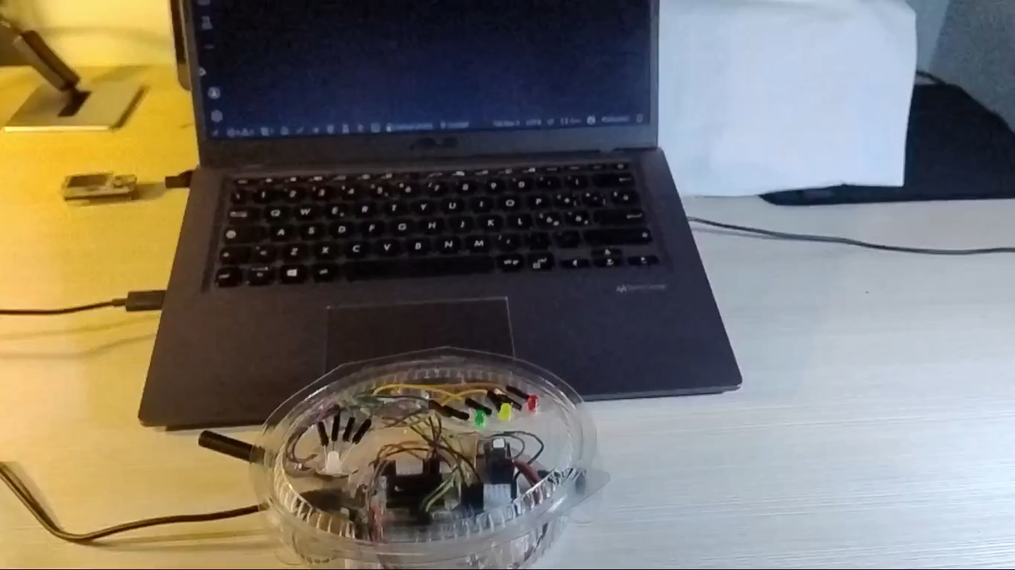
VIDEO

Slide 13
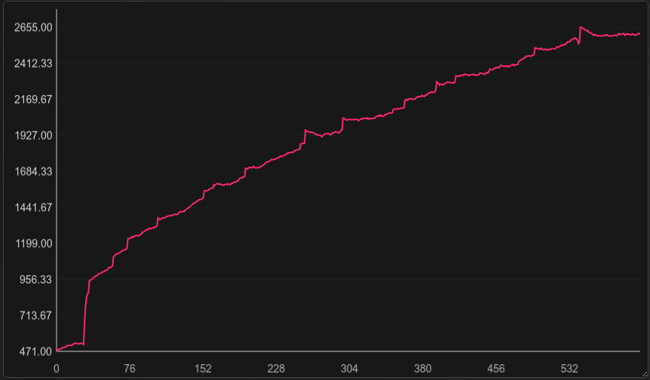
EXPERIMENT
CO₂
The sensor is exposed to fresh air from outside.
Then the sensor is deployed inside a room, with two people; the room’s door and windows are kept closed for the experiment duration.
The experiment duration was about 5 hours.
The interval between samples is 30 seconds.
Samples

Slide 14
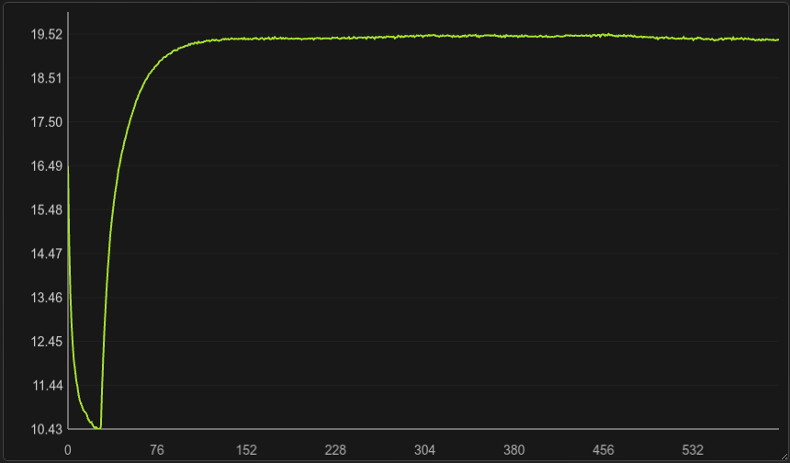
EXPERIMENT
Temperature (Celsius)
The sensor is exposed to fresh air from outside
Then the sensor is deployed inside a room, with two people; the room’s door and windows are kept closed for the experiment duration
The experiment duration was about 5 hours
The interval between samples is 30 seconds.
Samples

Slide 15
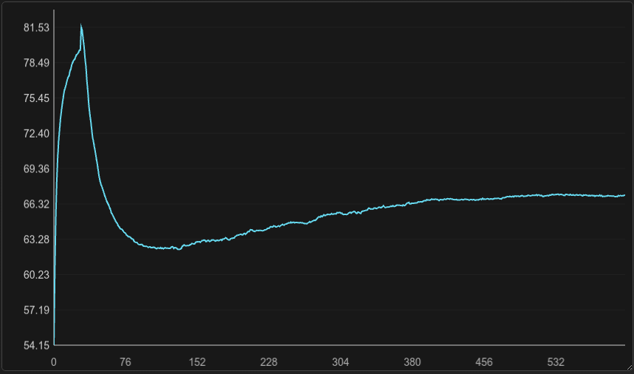
EXPERIMENT
Relative Humidity (100%)
The sensor is exposed to fresh air from outside
Then the sensor is deployed inside a room, with two people; the room’s door and windows are kept closed for the experiment duration
The experiment duration was about 5 hours
The interval between samples is 30 seconds.
Samples

Slide 16
CONSTRAINTS (updated)
Power usage
False alarm prevention
Latency
At least 3 months of autonomous operation with a 3000 mAh LiPo battery.
Every time the system wakes up, it performs the following tasks:
Wake up the SCD41 and ask for a measurement
Light Sleep for 5 seconds during the measurement
Transmit the data with LoRa.
Go back to Deep Sleep
The SCD41’s CO2 measurements have strange peaks, filtering of those values is needed, otherwise false pre alarms will happen.
Even though the observed phenomenon is slow, the need to filter and average measurements to prevent false alarms, increases latency considerably.
When a VERY High CO2 concentration event verifies, the sensor needs to react within 10 minutes (buzzer).

Slide 17
Final Notes
The current prototype operates the SCD41 in two modes:
5 minute sampling interval, at 1,67% duty cycle (5 seconds of sampling and 295 seconds idling); on the datasheet, it is reported that the sensor requires 0,45 mA on average in this mode.
2 minute sampling interval, at 4,16% duty cycle (5 seconds of sampling and 115 seconds idling).
Every time a sample is taken, the board has to wait in light sleep for at least 5 seconds (about 1mA required on average).
When the internal buffer of measurements is full, the device transmits all the data at once.

Slide 18
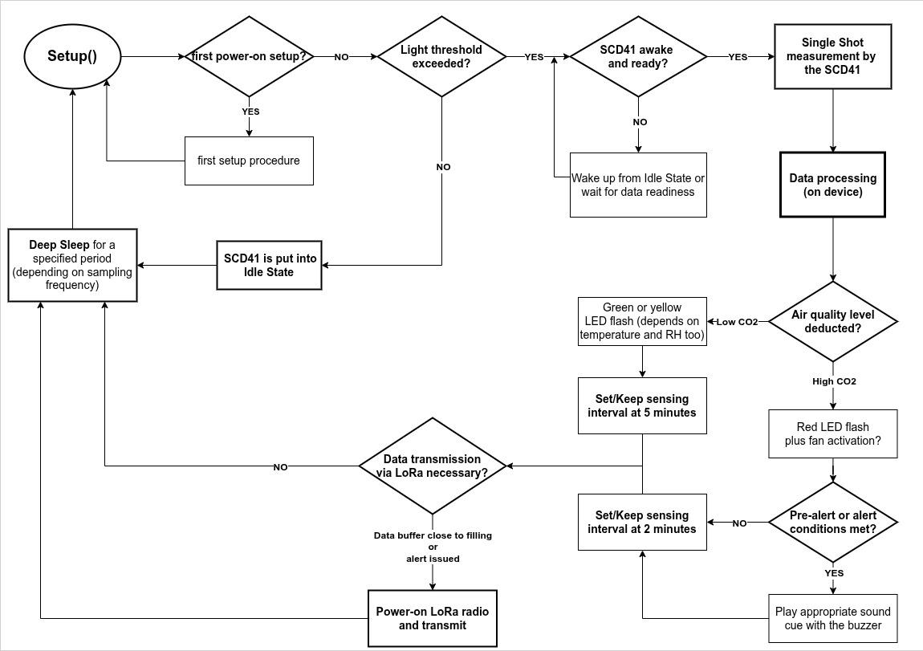
NEXT STEPS (on device)

