Slide 1
Metaheuristic optimization
Yann MENSAH, Damir SAGDULLIN, Léo LAIOLO

Slide 2


Introduction

Slide 3




Summary
Problem description
Dataset
Solution
Performances

Slide 4



Problem description
S
=

Slide 5



Dataset
Projection into Cartesian coordinates
(lat, lon)
(x, y)

Slide 6
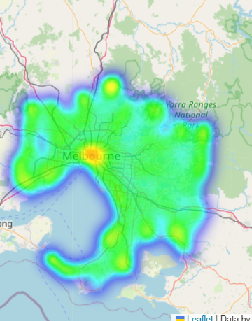
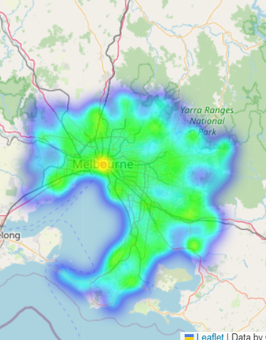
Dataset
131 312 users : Melbourne metropolis
95 562 sites : Australia
kd-tree + filter by coverage
9 229 sites : Melbourne metropolis
Users Heatmap
Sites Heatmap

Slide 7
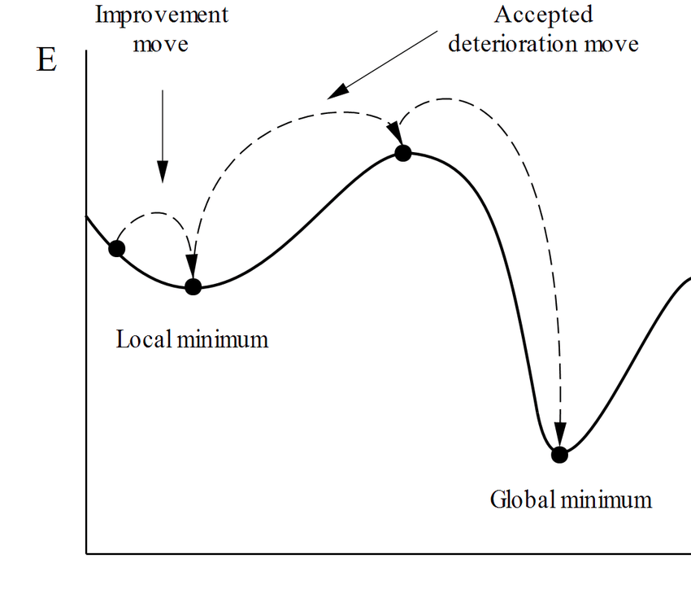
Solution
Simulated Annealing

Slide 8
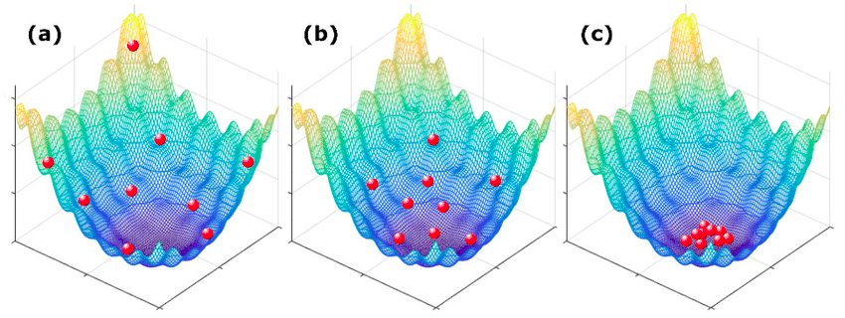
Solution
Multi-Objective Firefly Algorithm

Slide 9
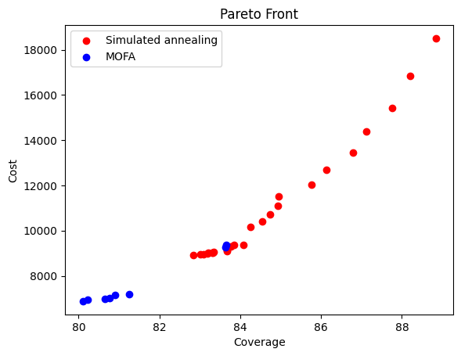
Performance

Slide 10
Performance
Solutions
Pareto metrics
Algorithm | Cost range | Coverage range | Number of solutions
SA | [9000, 19000] | [82, 89] % | 20
MOFA | [6500, 9000] | [80, 84] % | 6
Algorithm | Efficiency | Contribution | Dominating solutions
SA / MOFA | 15 | 67 % | 5
MOFA / SA | 5 | 33 % | 2

Slide 11

Conclusion
S
=
Simulated Annealing
Multi-Objective Particle Swarm Optimization

Slide 12
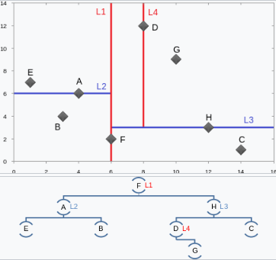
Annex : k-d tree example

