Slide 1
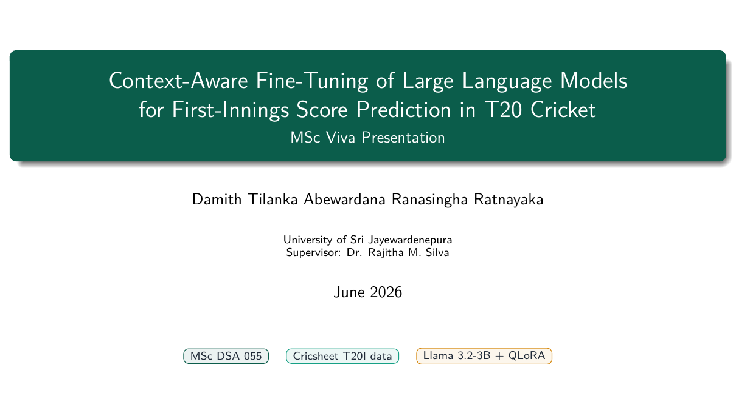
Notes:
Good morning, and thank you for this chance to defend my thesis. My name is Tilanka Ratnayaka. Over the next fifteen minutes I will present my MSc DSA work on using a small open-source language model to predict T20 first-innings scores during a match. My main question is simple: can a 3-billion-parameter Llama model, fine-tuned with QLoRA on text prompts about the match state, predict the final score well from any point in the innings? I will cover the motivation, the method, the results, and the contributions, then open the floor to questions.

Slide 2
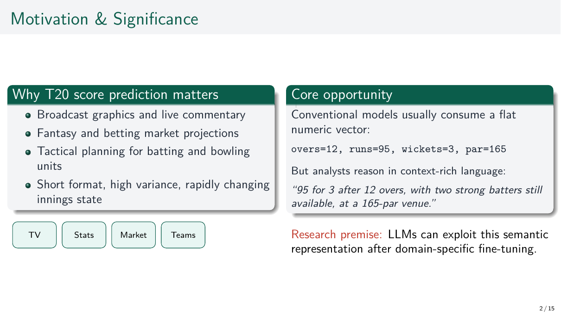
Notes:
Twenty20 is the most popular and most commercial form of cricket. It drives TV broadcasts, fantasy games, betting markets, and team tactics. A good live score prediction must combine four things at the same time: the venue, the strength of the remaining batters, the momentum of the last few overs, and whether the powerplay is over. Older models use only numbers, so they lose the rich context that human analysts naturally use. Large language models are built to read this kind of text directly. That is the gap this thesis fills. The next slide breaks it into six clear research objectives.

Slide 3
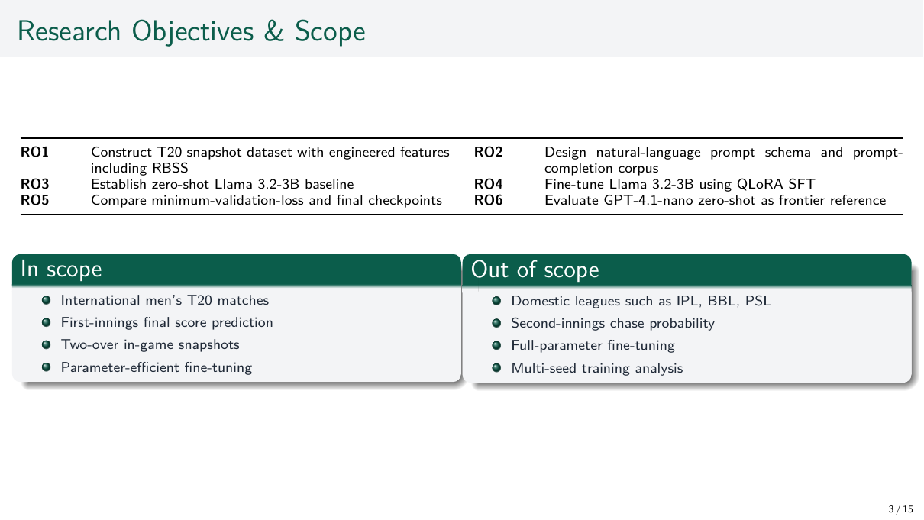
Notes:
The six research objectives line up directly with chapters three, four, and five of the thesis. RO1 builds the dataset and the RBSS feature. RO2 designs the prompt. RO3 sets the zero-shot Llama baseline. RO4 runs the QLoRA fine-tune. RO5 compares two checkpoints. RO6 benchmarks against GPT-4.1-nano. I kept the scope narrow on purpose: men's international T20 only, first innings only, and QLoRA instead of full fine-tuning. This keeps every comparison fair and every limitation clear. The next slide shows how these objectives flow through the pipeline.

Slide 4
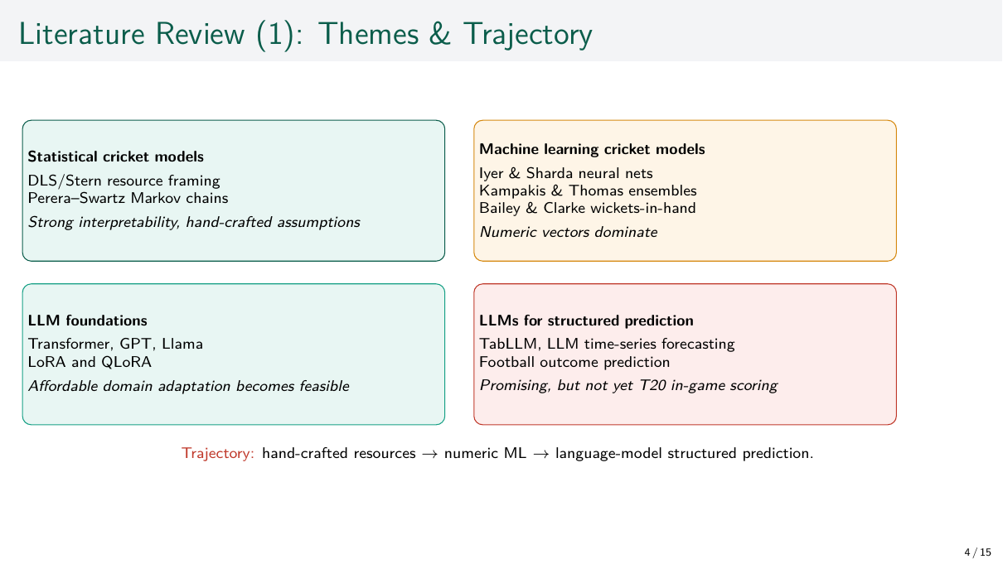
Notes:
Instead of listing papers one by one, I group the literature into four streams. The first is statistical cricket models like Duckworth–Lewis and Perera–Swartz, which treat scoring as a resource problem with hand-built features. The second is machine learning on cricket — work by Iyer, Kampakis, and Bailey — which improved accuracy but still used number-only inputs. The third is the technical chain that made fine-tuning cheap: the transformer, GPT, Llama, LoRA, and QLoRA. The fourth is LLMs applied to structured prediction, like TabLLM and football-outcome work. Each stream adds a piece, but none combines them for live T20 scoring. The next slide makes that gap explicit.

Slide 5
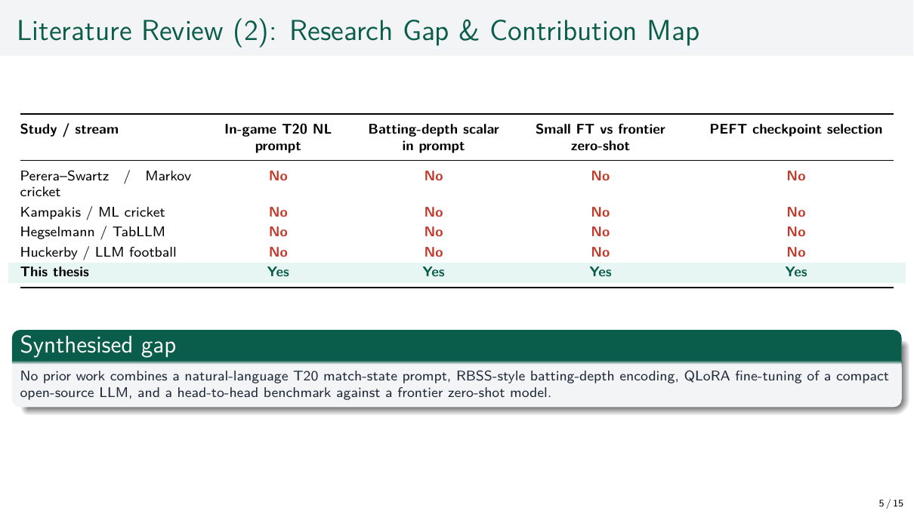
Notes:
This slide defends the novelty of the work. The four columns show four gaps in the literature: a text prompt for live T20 state, a weighted batting-depth feature like RBSS, a direct comparison of a small fine-tuned model against a frontier model, and a checkpoint-selection study for PEFT in sports. Every earlier work ticks at most two of these. My work is the only row that ticks all four. The contribution is this exact combination, not any single column on its own. The methodology section that follows shows how each column was built in code.

Slide 6
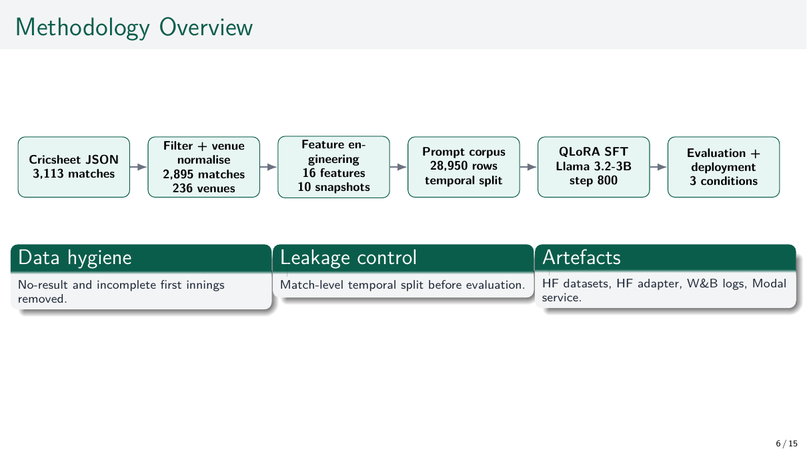
Notes:
Everything that follows fits inside this five-stage pipeline, and every artefact is public. Cricsheet gives 3,113 raw match files. After filtering and cleaning the venue names, 2,895 matches and 236 venues remain. Feature engineering builds sixteen numbers at each of ten two-over snapshots, giving 28,950 prompt and answer pairs. The data is split by date: training up to end of 2024, validation in the first half of 2025, and testing from mid-2025 onwards. This split happens before training, which is the most important guard against data leakage. QLoRA fine-tunes on a free Kaggle T4 GPU in under six hours. Three models are then compared on the same metrics, and the system is deployed using Modal, Gradio, and React on Azure.

Slide 7
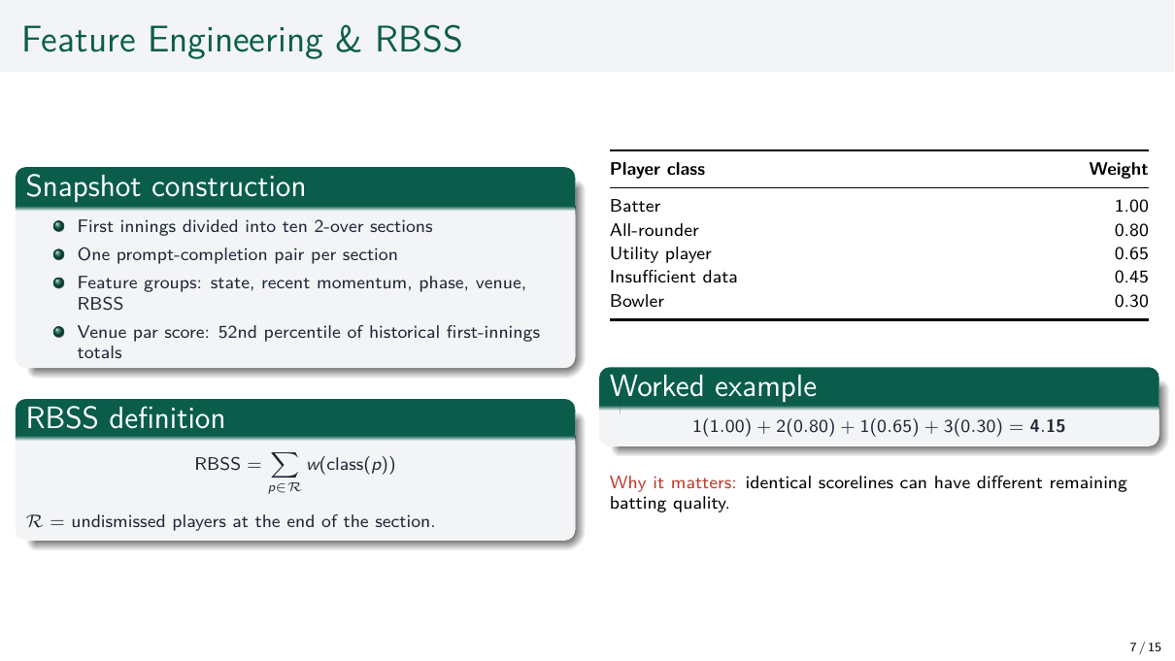
Notes:
RBSS — the Remaining Batting Strength Score — is the most novel idea in the thesis. The reasoning is simple. Two matches can have the same score but very different batters still to come. The remaining batting quality changes what the final total can be. RBSS captures that quality, not just the number of wickets left. Every player is placed in one of five groups based on their past role, with rounded weights from 1.0 for a top batter down to 0.3 for a pure bowler. Bowlers are not zero because they can score at the end. The example shows how a part-collapsed lineup becomes a single number, 4.15, which is then carried into the prompt on the next slide.

Slide 8
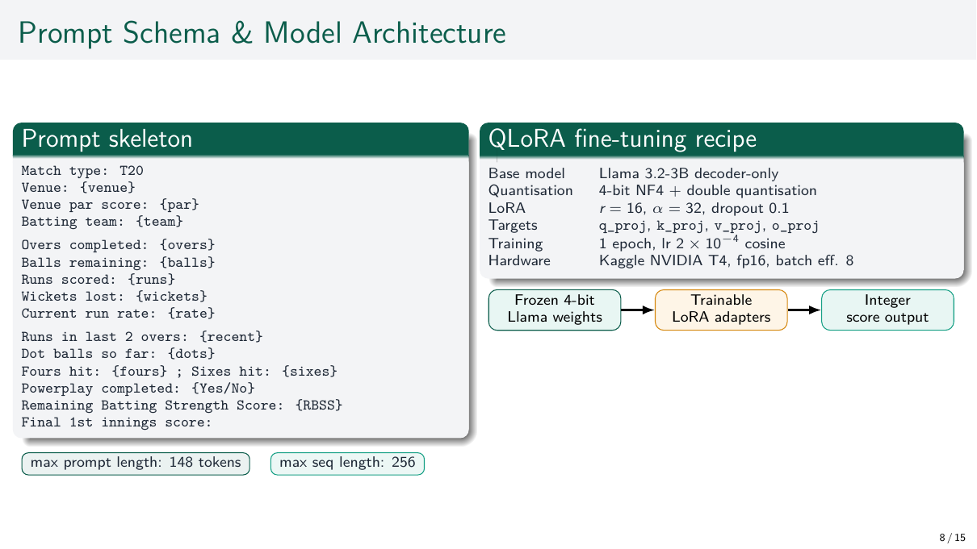
Notes:
On the left is the prompt. It lists the venue, par score, batting team, overs, balls, runs, wickets, run rate, last two overs of runs, dot balls, fours, sixes, the powerplay flag, the RBSS, and ends with "Final 1st innings score:". The prompt is at most 148 tokens; the full sequence is at most 256. The answer is a single number, which keeps the output simple to read. On the right is the model. The base is Llama 3.2-3B in 4-bit form. LoRA adapters of rank sixteen are added to the attention layers only. Training runs for one epoch on a free Kaggle T4 GPU in under six hours. Being able to reproduce all of this on consumer-grade hardware is itself part of the contribution.

Slide 9
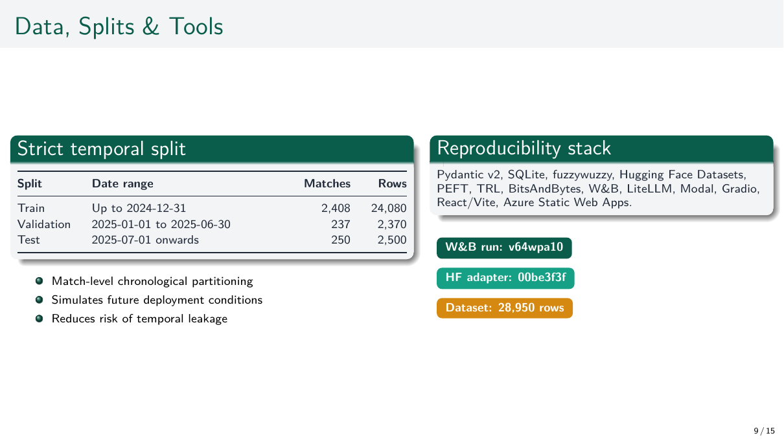
Notes:
The table on the left shows about 24,000 training rows, 2,400 validation rows, and 2,500 test rows, split strictly by match date. The reason for a date-based split is to mimic real deployment: the model learns from past matches and predicts future ones, never the other way round. The tools on the right are standard but worth noting: Pydantic for schema checks, fuzzywuzzy for cleaning venue names, Hugging Face for the dataset and adapter, TRL for fine-tuning, BitsAndBytes for quantisation, Weights and Biases for tracking, Modal for serverless inference, and Bicep with GitHub OIDC for Azure deployment. Every artefact is pinned to a fixed revision so the results can be reproduced exactly.

Slide 10
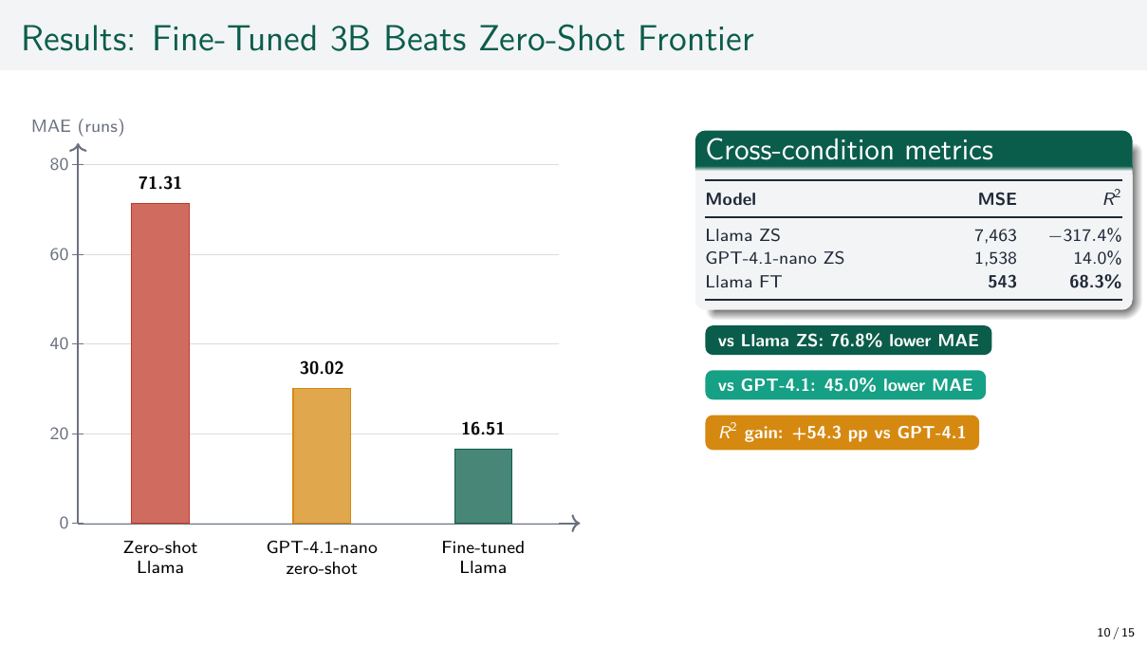
Notes:
This is the headline result of the thesis. Zero-shot Llama 3.2-3B is unusable: an MAE of 71.3 runs and an R² of minus 317 percent — worse than just predicting the average. Zero-shot GPT-4.1-nano is better at 30 runs MAE and 14 percent R², but it still misses the acceleration in the final overs. The fine-tuned 3B Llama at step 800 reaches an MAE of 16.5 runs and an R² of 68.3 percent. That is a 77 percent drop in MAE compared to zero-shot Llama, a 45 percent drop compared to GPT-4.1-nano, and a 54-point gain in R². A small open-source model, once fine-tuned, clearly beats a much larger frontier model on this task.

Slide 11
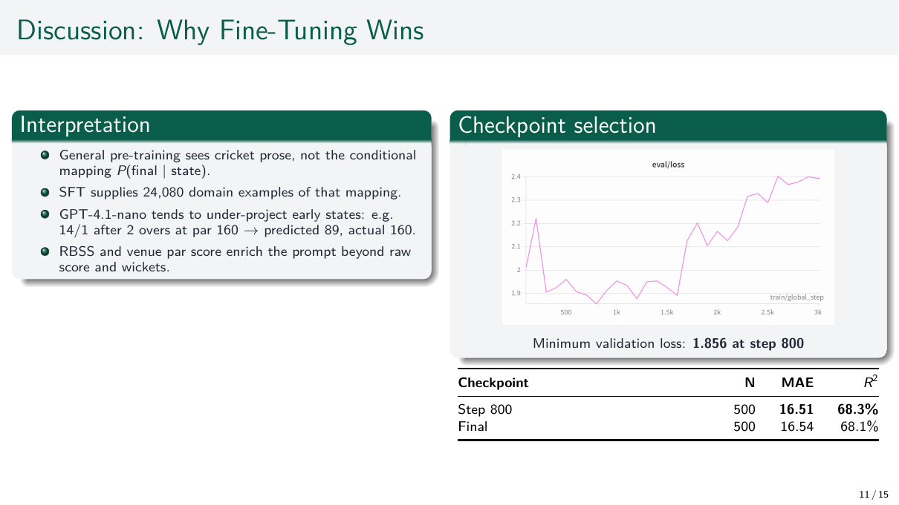
Notes:
This slide makes two points. The first is why fine-tuning wins. General pre-training has seen cricket text but not the link between a mid-innings state and the final total. Fine-tuning teaches that link directly, which is why a smaller model can learn a job that a larger one cannot do in zero-shot. The eval-loss curve from W&B shows this clearly, with the lowest point at step 800. The second point is the checkpoint study. At 200 test examples the metrics are noisy and disagree. At 500 examples the step-800 checkpoint wins on all three metrics. This supports a simple rule: pick the checkpoint with the lowest validation loss. It is a small but useful methodological lesson.

Slide 12
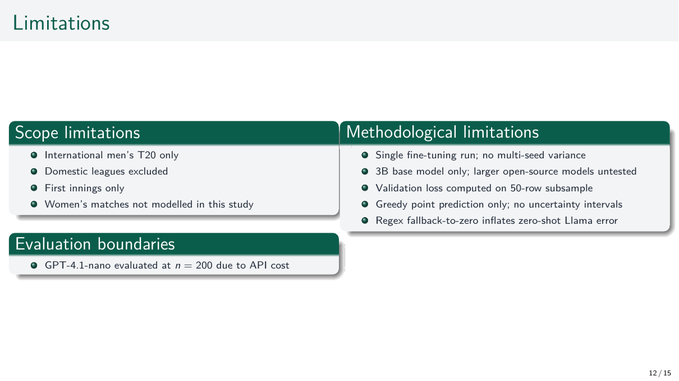
Notes:
These are honest constraints, grouped into method and scope. On the method side: a single training run with no multi-seed variance, only the 3B base model, validation loss computed on just 50 rows, single-point predictions with no uncertainty range, and 4-bit inference instead of full precision. On the scope side: only men's international T20, no domestic leagues, no women's matches, and GPT-4.1-nano tested on only 200 examples because of API cost. Most of these come from working within a free hardware and API budget, not from methodological mistakes. Several lead directly into the future-work plans on the next slide.

Slide 13
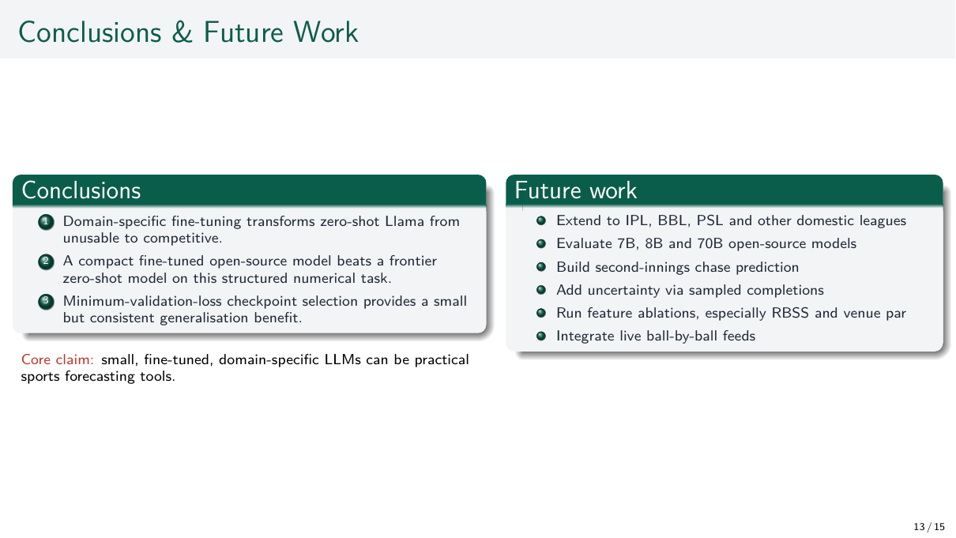
Notes:
The thesis closes with three conclusions, matching chapter six. First, fine-tuning turns an unusable zero-shot Llama into a strong predictor. Second, a small fine-tuned open-source model beats a frontier zero-shot model on this kind of numerical task. Third, the checkpoint with the lowest validation loss generalises better than the final checkpoint at proper test size. So the contributions are at once empirical, methodological, and practical: a full pipeline, a new feature, a prompt design, a fine-tuned model, and a deployment template. The future-work items — domestic leagues, larger models, second-innings prediction, uncertainty, feature ablation, and live feeds — are each scoped tightly enough to be a follow-up MSc or short paper.

Slide 14
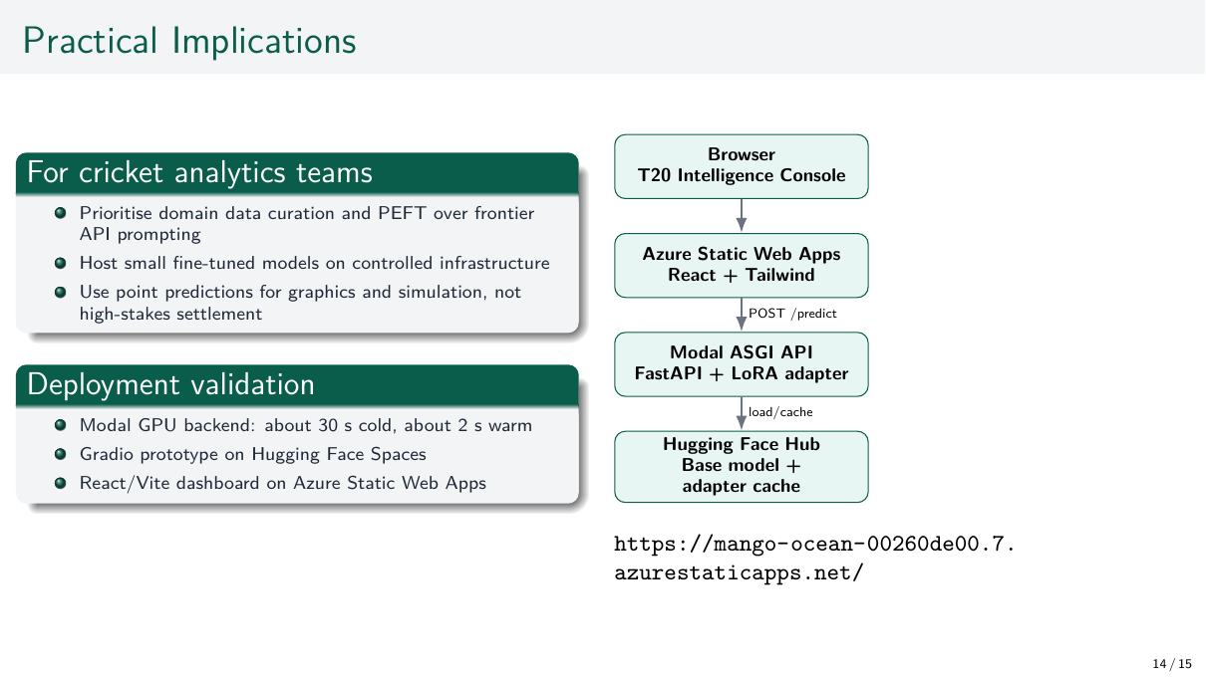
Notes:
The thesis is shipped, not just simulated. The deployment has three tiers. The model runs as a serverless GPU service on Modal — about thirty seconds cold start, two seconds warm — called by a single HTTP request, and billed only when running. A Gradio space on Hugging Face gives a public prototype interface for quick tests. The production dashboard is a React app on Tailwind, deployed to Azure Static Web Apps using Bicep and GitHub OIDC, so no long-lived secrets are stored. The same template can be reused for any small-LLM sports product. Because the design is cost-engineered, the live demo runs publicly with almost no recurring cost. The link on the slide opens it.

Slide 15
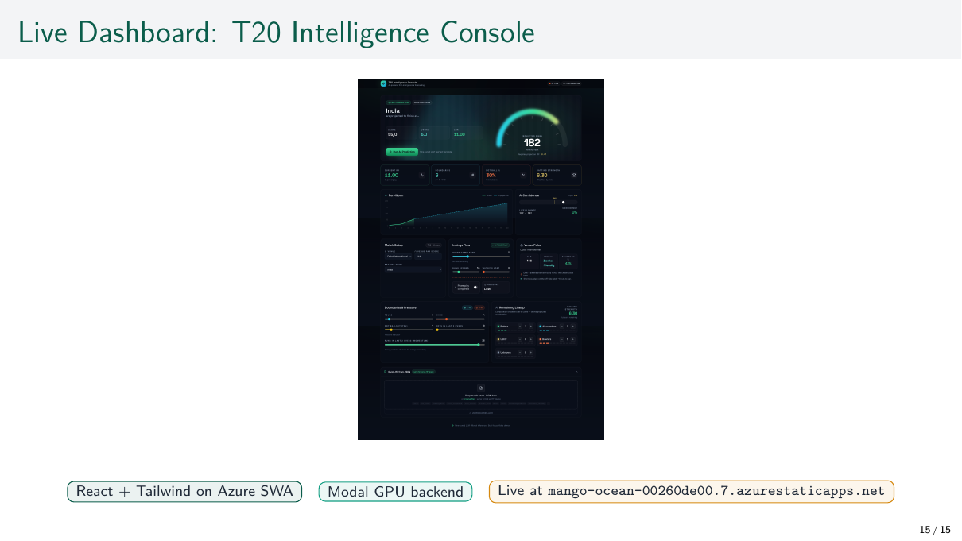
Notes:
This is a screenshot of the live T20 Intelligence Console. It is the production-style dashboard that calls the fine-tuned model in real time. The user enters the match state on the left, the prediction is returned by the Modal backend in about two seconds when warm, and the result is displayed alongside the venue par score and other context. The point of showing this slide is to demonstrate that the work is fully deployed, not just measured in a notebook. The same architecture would generalise to any small-LLM sports forecasting product, and the entire stack runs at near-zero recurring cost on free hosting tiers.

Slide 16
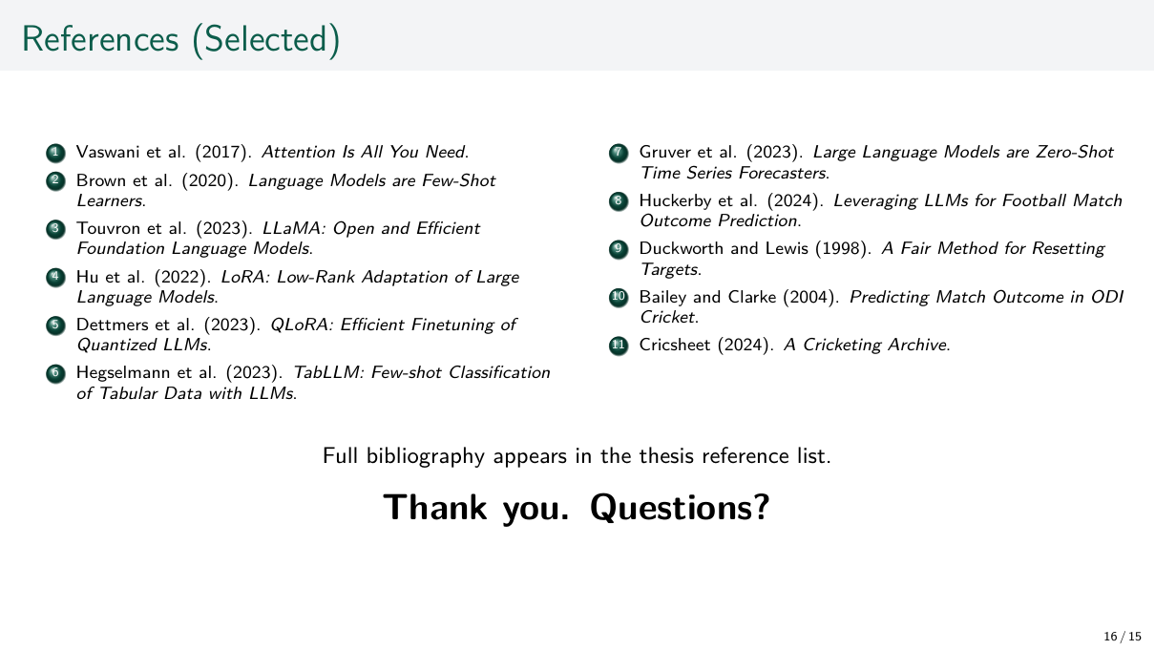
Notes:
The full bibliography is in the thesis. This slide lists the works most likely to come up in questions, grouped by theme. Hu's LoRA and Dettmers' QLoRA are the basis of the fine-tuning recipe. Brown's GPT-3, Touvron's Llama, and Vaswani's transformer are the LLM foundations. Hegselmann's TabLLM, Gruver's time-series work, and Huckerby's football LLM are the closest application precedents. Duckworth–Lewis and Bailey–Clarke anchor the cricket modelling tradition. The link opens the thesis PDF and the live deployment. Thank you for your attention — I am happy to take questions.

