Slide 1

Capstone1: RAG Chatbot ve Summarization Projesi
DS08 Team- DA8116-Ayşegül, DA8119-Emre, DA8120-Damla, DA8133-Esra, DA8141-Ezgi

Slide 2
RAG Chatbot (Retrieval Augmented Generation) and Summarization
What is Retrival Augmented Generation (RAG)?
RAG is a technique for augmenting LLM knowledge with additional data.
Building AI applications that can reason about private data or data introduced after a model’s cutoff date, you need to augment the knowledge of the model with the specific information it needs. The process of bringing the appropriate information and inserting it into the model prompt is known as Retrieval Augmented Generation (RAG).
LangChain has a number of components designed to help build Q&A applications, and RAG applications more generally.

Slide 3
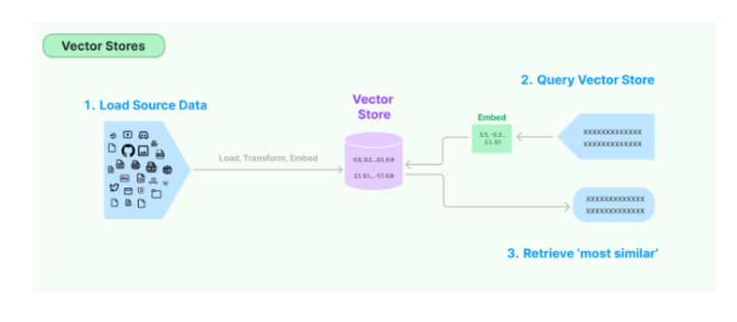

Langchain Applications
What is Langchain?
LangChain is a framework used to develop new and powerful applications in the fields of natural language processing (NLP) and artificial intelligence. It specifically facilitates the integration of language models (LLMs - Large Language Models) with other data sources, tools, and systems to create more complex and customized applications.

Slide 4
Key Features and Applications of LangChain
Document Querying and Information Retrieval
Chaining
Tools and Actions
Memory Management
Learning and Adaptation

Slide 5
Advantages of LangChain
Flexibility: It can be integrated with different data sources, tools, and systems.
Modularity: Its chaining and modular structure makes complex NLP tasks easier.
Customizability: It can be easily customized with different models and workflows.
Upgradability: Models and systems can be continuously developed and updated.

Slide 6
RAG (Retrieval-Augmented Generation) Chatbot
RAG (Retrieval-Augmented Generation) Chatbot is an AI model that combines natural language processing and retrieval techniques. RAG allows language models to retrieve information from knowledge bases or databases, enabling them to generate more accurate and comprehensive responses. This approach is especially effective when large language models (LLMs) have limited or outdated information.

Slide 7
How RAG Chatbots Work?
1. Query Ingestion
A user interacts with the chatbot by posing a question or information request, such as "What is the highest mountain in the world?«
Retrieval Phase (One of the most important part)
The chatbot searches a predefined dataset, document collection, or knowledge base based on the user's query. The goal is to find the most relevant and appropriate documents or text fragments.
This process is typically carried out using techniques like vector search or keyword matching. Vector search uses embedding methods that represent texts as high-dimensional vectors to find semantically similar ones.

Slide 8
How RAG Chatbots Work?
3.Generation Phase (Second important part)
The relevant documents or text fragments obtained from the retrieval phase are provided as input to a language model (e.g., GPT).
The language model generates a complete response to the user’s question based on these inputs. The model creates a natural language response by using the context from the underlying data and integrating the information.
4.Response Delivery
The chatbot presents the generated response to the user. This response is based on both the content retrieved in the information retrieval phase and the language model’s own knowledge base

Slide 9
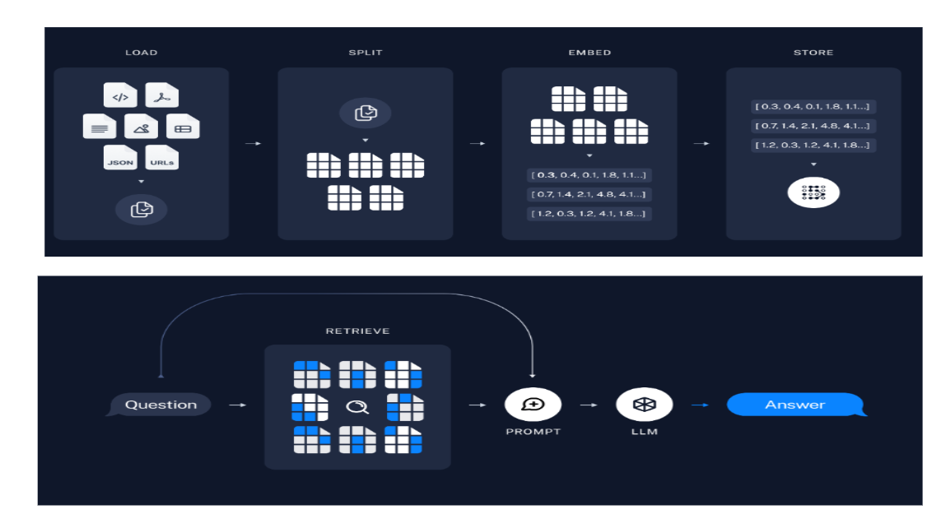
How RAG Chatbots Work?
Two Parts
A process flow that illustrates how large language models (LLMs) are used in a retrieval-based system. The process is divided into two main parts: information processing and storage (top section) and answering user queries (bottom section).

Slide 10
Top Section: Information Processing and Storage
1. Load
In this stage, data in various formats (e.g., text documents, PDFs, JSON files, URLs) is loaded into the system. This data is prepared to be processed in a way that the model can later understand.
2. Split
The loaded data is split into smaller chunks. This means that large documents are divided into more manageable and processable pieces. For example, a long text might be split into paragraphs or sentences

Slide 11
Top Section: Information Processing and Storage
3. Embed
The split data chunks are transformed into embeddings, which are numerical vectors representing the meaning of the data. Each piece of data is represented by a vector.
4. Store:
The embedded vectors are stored in a database or a vector storage system. This storage is later used to quickly retrieve information that is relevant to a specific query.

Slide 12
Bottom Section: Answering User Queries
1.Retrieve
When a user asks a question, the system retrieves the most relevant embeddings (vectors) from the stored database. This involves selecting data chunks that are most likely to answer the question based on their meaning.
2. Prompt and LLM
The retrieved information is provided to the large language model (LLM) as a "prompt" (input). The model then processes this information to generate an answer.
3. Answer:
The LLM generates a response based on the prompt, and this answer is provided to the user.

Slide 13
Advantages of RAG Chatbots
More Accurate Responses:
RAG chatbots can provide more accurate and up-to-date responses compared to chatbots built solely on language models. This is because the language model constantly refers to the knowledge base for current information.
Broader Information Scope:
By accessing a specific dataset, the chatbot can offer a wider range of information beyond the training data.
Learning and Adaptability:
RAG chatbots can adapt to new information as the knowledge base is updated, making them more flexible and long-lasting.

Slide 14
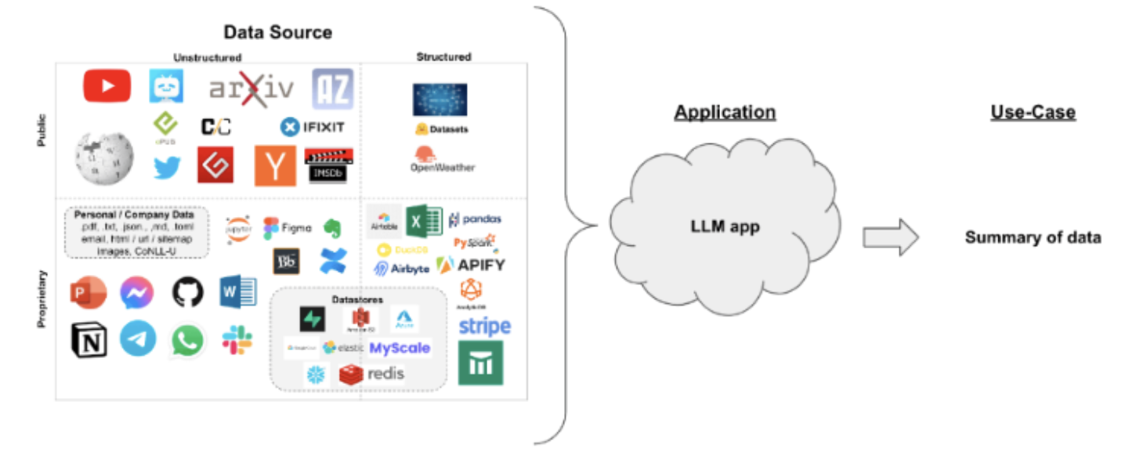
Langchain Applications (Summarization For Big Data)

Slide 15
LangChain Summarization: Getting the Essence of Text
LangChain is a comprehensive library for interacting with large language models (LLMs) and offers powerful tools to summarize text leveraging the power of LLMs.

Slide 16
How LangChain Summarization Works
LangChain summarization leverages the natural language understanding and text generation capabilities of LLMs to condense lengthy text into shorter and more concise summaries. Here are the key steps involved:
Text Input: The text to be summarized is provided to LangChain.
Prompt Creation: LangChain crafts a prompt, which is a set of instructions specifically for the LLM to perform the summarization task. The prompt can include parameters like summary length, style, and focus area.
LLM Interaction: The prompt is sent to the LLM, which processes the text, understands its content, and generates a summarized version.
Summary Output: The summary generated by the LLM is returned to the user or to another LangChain component.

Slide 17
Types of Summarization in LangChain
LangChain offers various summarization methods to address different summarization needs:
Extractive Summarization: The summary is created by selecting sentences or phrases from the original text.
Abstractive Summarization: The summary is written by the LLM, which understands the original text and generates its own sentences.
Summarization Chains: Chains that consist of a series of steps are created to enhance the summarization process. These chains can involve adding additional information, combining different summarization techniques, or formatting the summary in a particular way.

Slide 18
Overview
A central question for building a summarizer is how to pass your documents into the LLM's context window. Two common approaches for this are:
Stuff: Simply "stuff" all your documents into a single prompt. This is the simplest approach (see here for more on the create_stuff_documents_chain constructor, which is used for this method) or
load_summarize_chain(llm, chain_type="stuff")
Map-reduce: Summarize each document on it's own in a "map" step and then "reduce" the summaries into a final summary (see here for more on the MapReduceDocumentsChain, which is used for this method) or
load_summarize_chain(llm,chain_type="map_reduce")
Refine : The refine documents chain constructs a response by looping over the input documents and iteratively updating its answer. For each document, it passes all non-document inputs, the current document, and the latest intermediate answer to an LLM chain to get a new answer. You can use code
load_summarize_chain(llm, chain_type="refine")

Slide 19
Option 1. Stuff
When we use load_summarize_chain with chain_type="stuff", we will use the StuffDocumentsChain.w
The stuff documents chain ("stuff" as in "to stuff" or "to fill") is the most straightforward of the document chains. It takes a list of documents, inserts them all into a prompt and passes that prompt to an LLM.
This chain is well-suited for applications where documents are small and only a few are passed in for most calls.

Slide 20
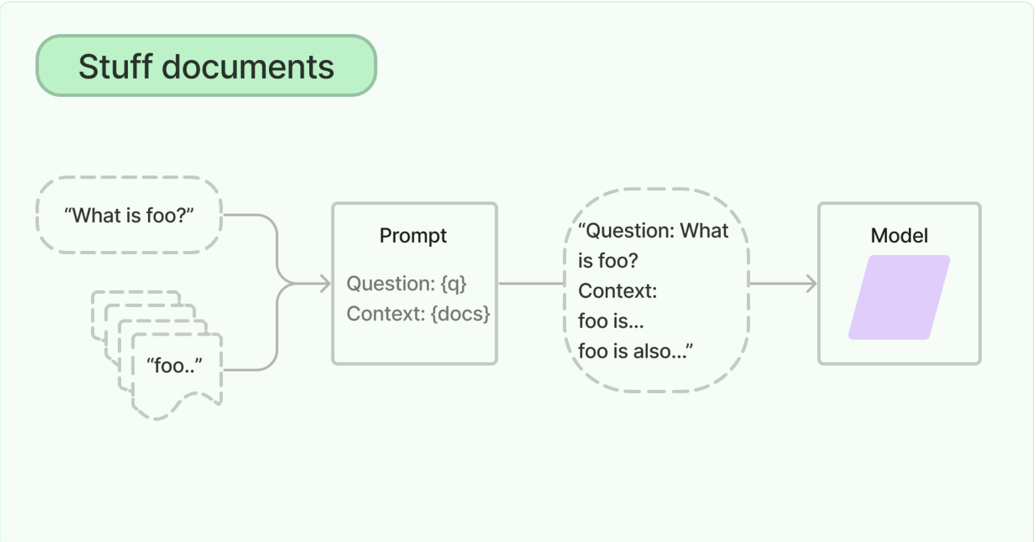

Slide 21
Option 2. Map reduce
The map reduce documents chain first applies an LLM chain to each document individually (the Map step), treating the chain output as a new document. It then passes all the new documents to a separate combine documents chain to get a single output (the Reduce step). It can optionally first compress, or collapse, the mapped documents to make sure that they fit in the combine documents chain (which will often pass them to an LLM). This compression step is performed recursively if necessary.

Slide 22
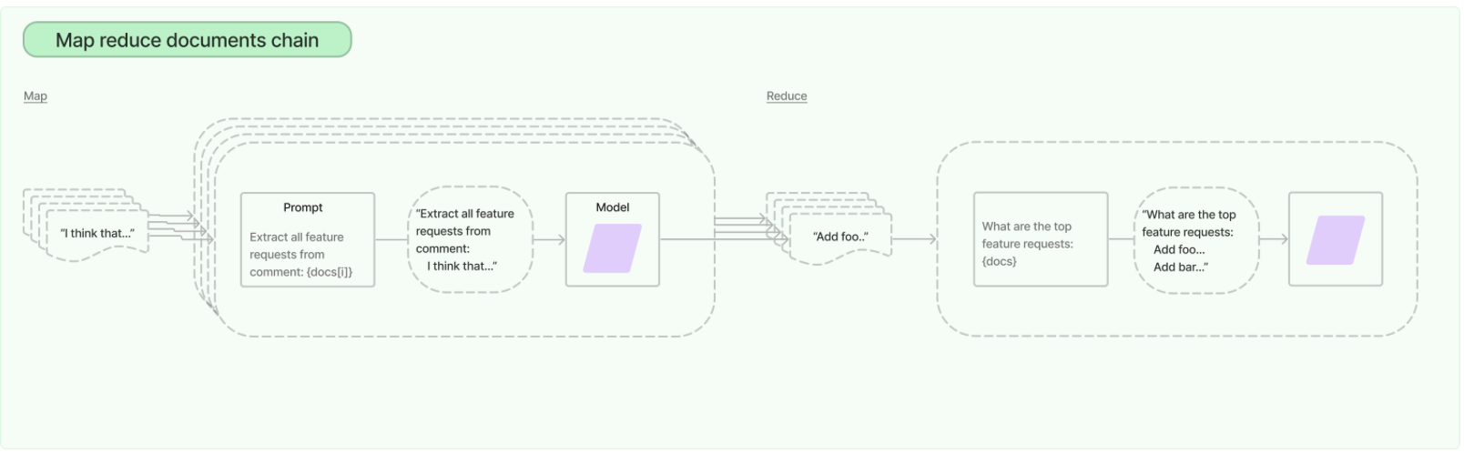

Slide 23
Option 2. Refine
The refine documents chain constructs a response by looping over the input documents and iteratively updating its answer. For each document, it passes all non-document inputs, the current document, and the latest intermediate answer to an LLM chain to get a new answer.
Since the Refine chain only passes a single document to the LLM at a time, it is well-suited for tasks that require analyzing more documents than can fit in the model's context. The obvious tradeoff is that this chain will make far more LLM calls than, for example, the Stuff documents chain. There are also certain tasks which are difficult to accomplish iteratively. For example, the Refine chain can perform poorly when documents frequently cross-reference one another or when a task requires detailed information from many documents.

Slide 24
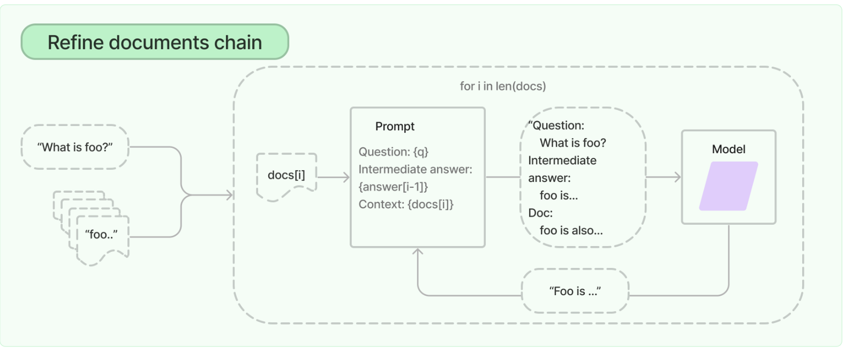

Slide 25
Thanks For Your Time…

