Slide 1
DCN420 Term Project – Scripting
Simulating API in packet tracer
Presented by Siddharth Pradipbhai Dhanak, Oluwadamilola Ogundipe, Mariam Odutayo

Slide 2
Project Overview
Project Type: Scripting from Packet Tracer Controller
Objective: Simulate real-world SDN controller scripting using Python and mock APIs
Tools Used:
Python 3
requests library
JSONPlaceholder API
Techniques: REST API usage, data simulation, mock controller logic

Slide 3
Scripts
Tickets Handling
Inventory management
Flow Analysis and
Update Network-wide settings

Slide 4
Ticket Handeling
Function: Simulates ticket creation, listing, and status updates
Tools: Python + requests + mock POST/PUT endpoints
Techniques:
Parameterized functions
REST API with JSON payloads
Output mimics controller ticket behavior

Slide 5
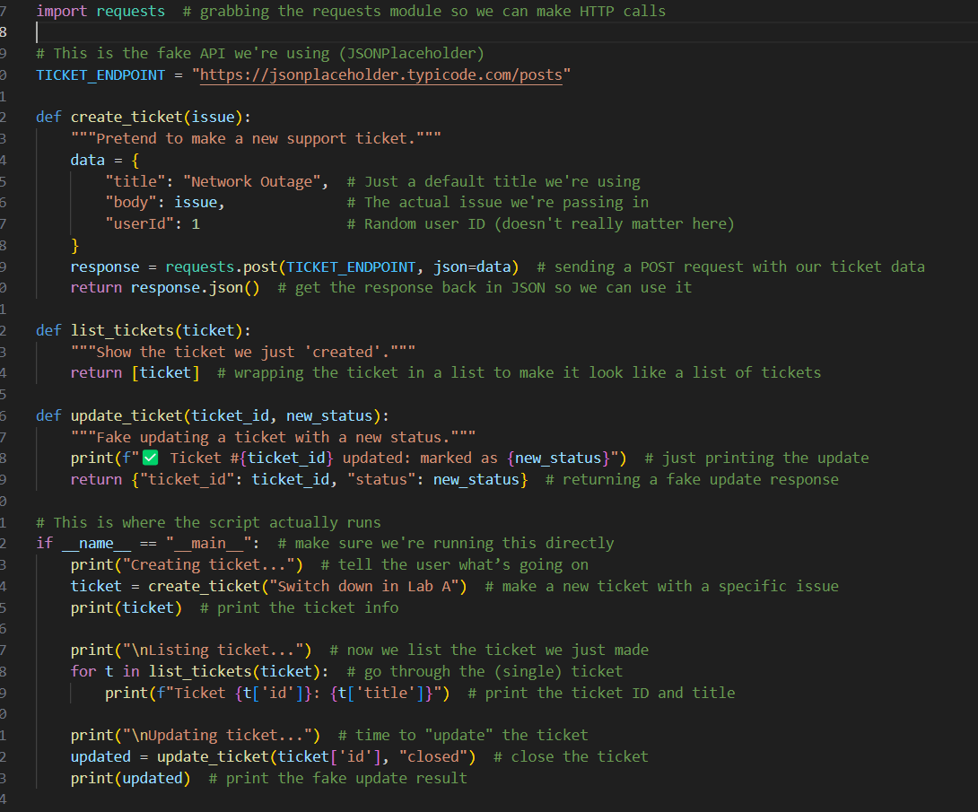
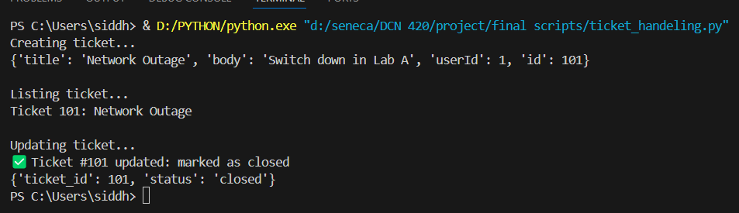
Output and code of ticket handling

Slide 6
Inventory management
Function: Retrieves simulated network device inventory
Tools: Python + requests
Technique: GET request to mock endpoint returns 10 fake devices
Displays: ID, hostname, device type, and operational status

Slide 7
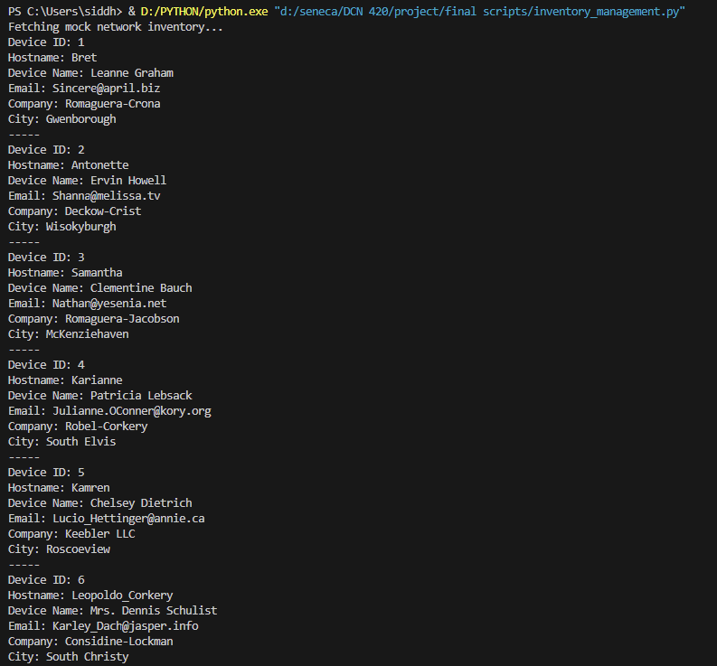
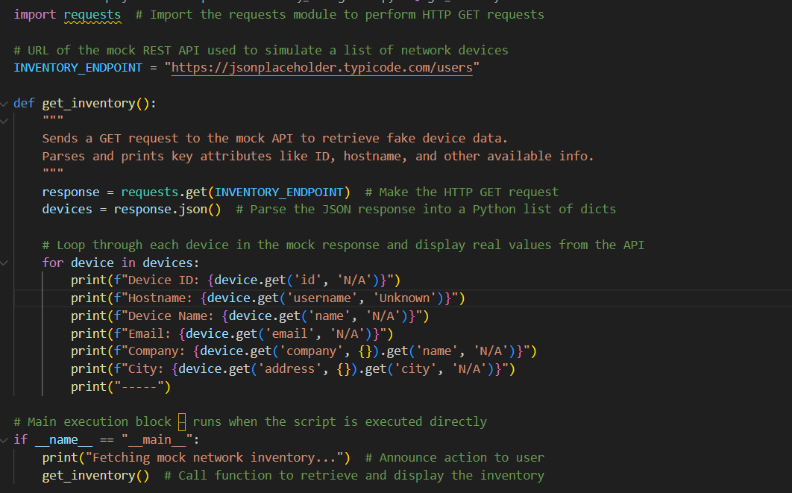
Output and code of inventory management

Slide 8
Flow Analysis
Function: Traces a simulated packet flow between two IP addresses
Tools: Pure Python (no external API needed)
Technique: Static data represents device hops
Output: Shows device-to-device flow across interfaces

Slide 9
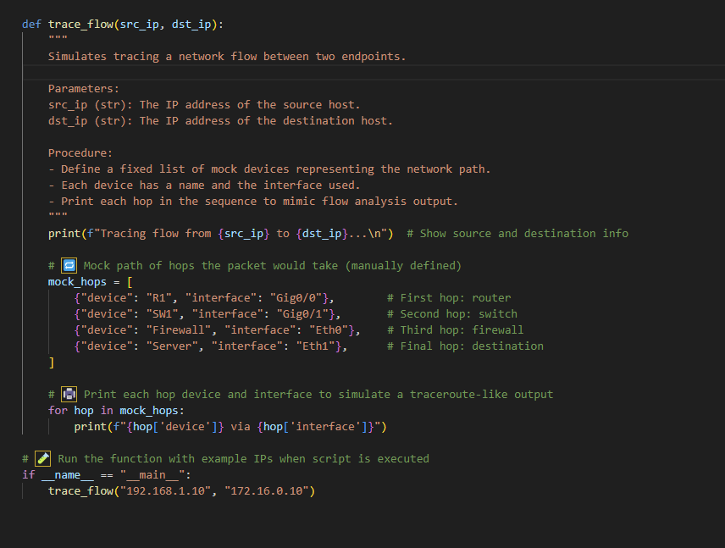
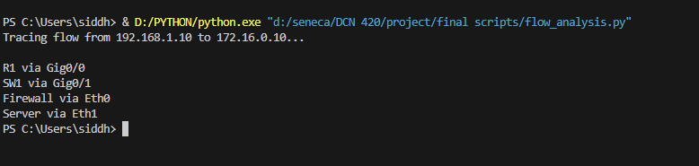
Output and code of Flow analysis

Slide 10
Network-Wide Settings Update Script
Function: Simulates sending SYSLOG and NTP settings
Tools: Pure Python
Technique: Function takes IPs as parameters
Prints a simulated success message like a controller would

Slide 11
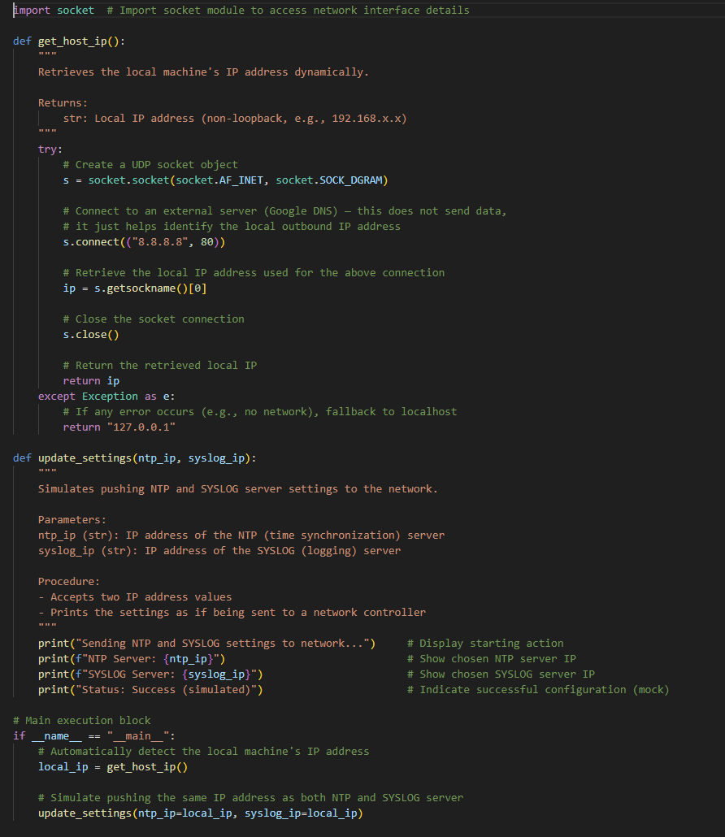
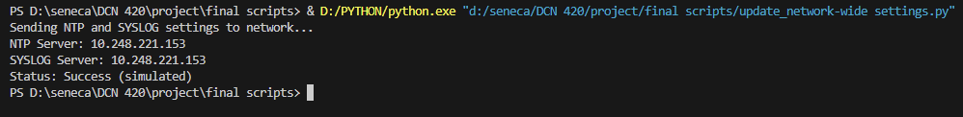
Output and code of Network wide settings

Slide 12
Device & Host Config Script
Function: Displays static configurations for routers and hosts
Technique: Hardcoded values simulate real output
Device Info: hostname, model, running config
Host Info: IP address, MAC, connected interface

Slide 13
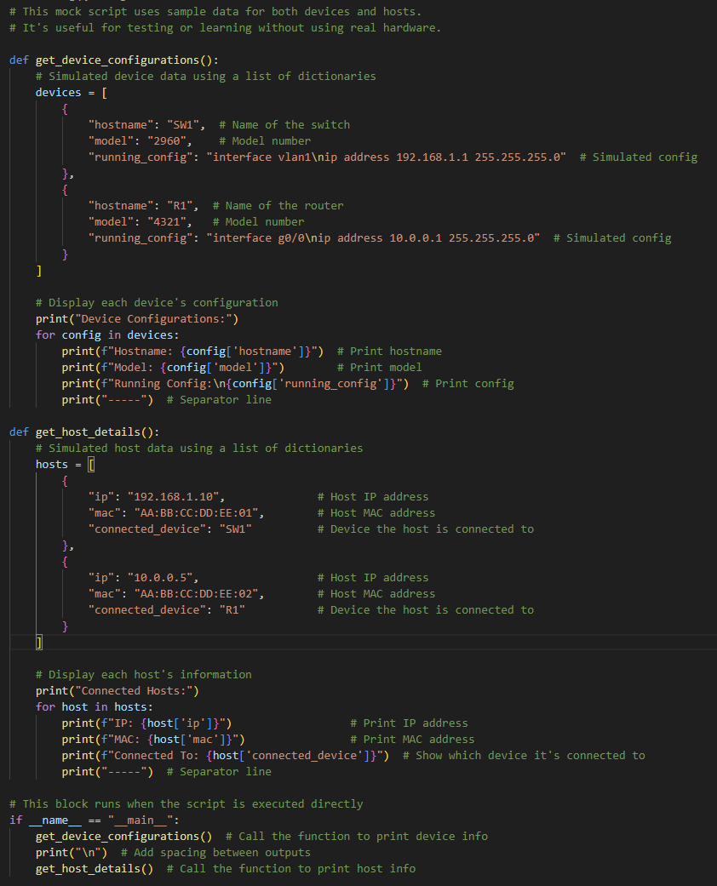
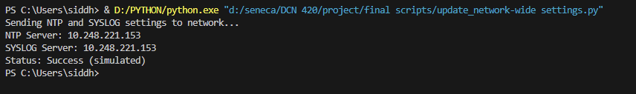
Code and output for Device and host configuration

Slide 14
Techniques & Tools Summary
Techniques Used:
REST API call simulation (POST, GET, PUT)
Static data modeling
Structured function-based design
Tools Used:
Python 3
-equests module
JSONPlaceholder mock API

Slide 15
Challenges & Solutions
Challenge: Packet Tracer doesn’t support live Python-API scripting
Solution: Used print-based mocks with external APIs
Challenge: PUT/DELETE limitations with mock API
Solution: Simulated confirmation messages

Slide 16
Thank you !
Presented by Siddharth Pradipbhai Dhanak, Oluwadamilola Ogundipe, Mariam Odutayo

