Slide 1
Netflix Content Trends Analysis
Using Data Science for Strategic Streaming Insights
Testimony Omokhafe | Data Scientist

Slide 2
Project Overview
Analyzed Netflix content using Python, pandas, NLP, and ML
Explored EDA, classification, and clustering techniques
Focused on Type, Country, Genre, Language, Description
Goal: Extract trends & enable strategic automation

Slide 3
Dataset Summary
Source: Netflix Movies & TV Shows (~8,800 titles)
Features: Title, Description, Type, Country, Date Added
Also used: Rating, Duration, Genre, Cast

Slide 4
Key Insights – Content Distribution
TV Shows: ~30%, Movies: ~70%
Top countries: US, India, UK
Growth in international content

Slide 5
Ratings & Age Demographics
TV-MA and TV-14 dominate
Limited family/kids content
Audience skew: young adults and mature viewers

Slide 6
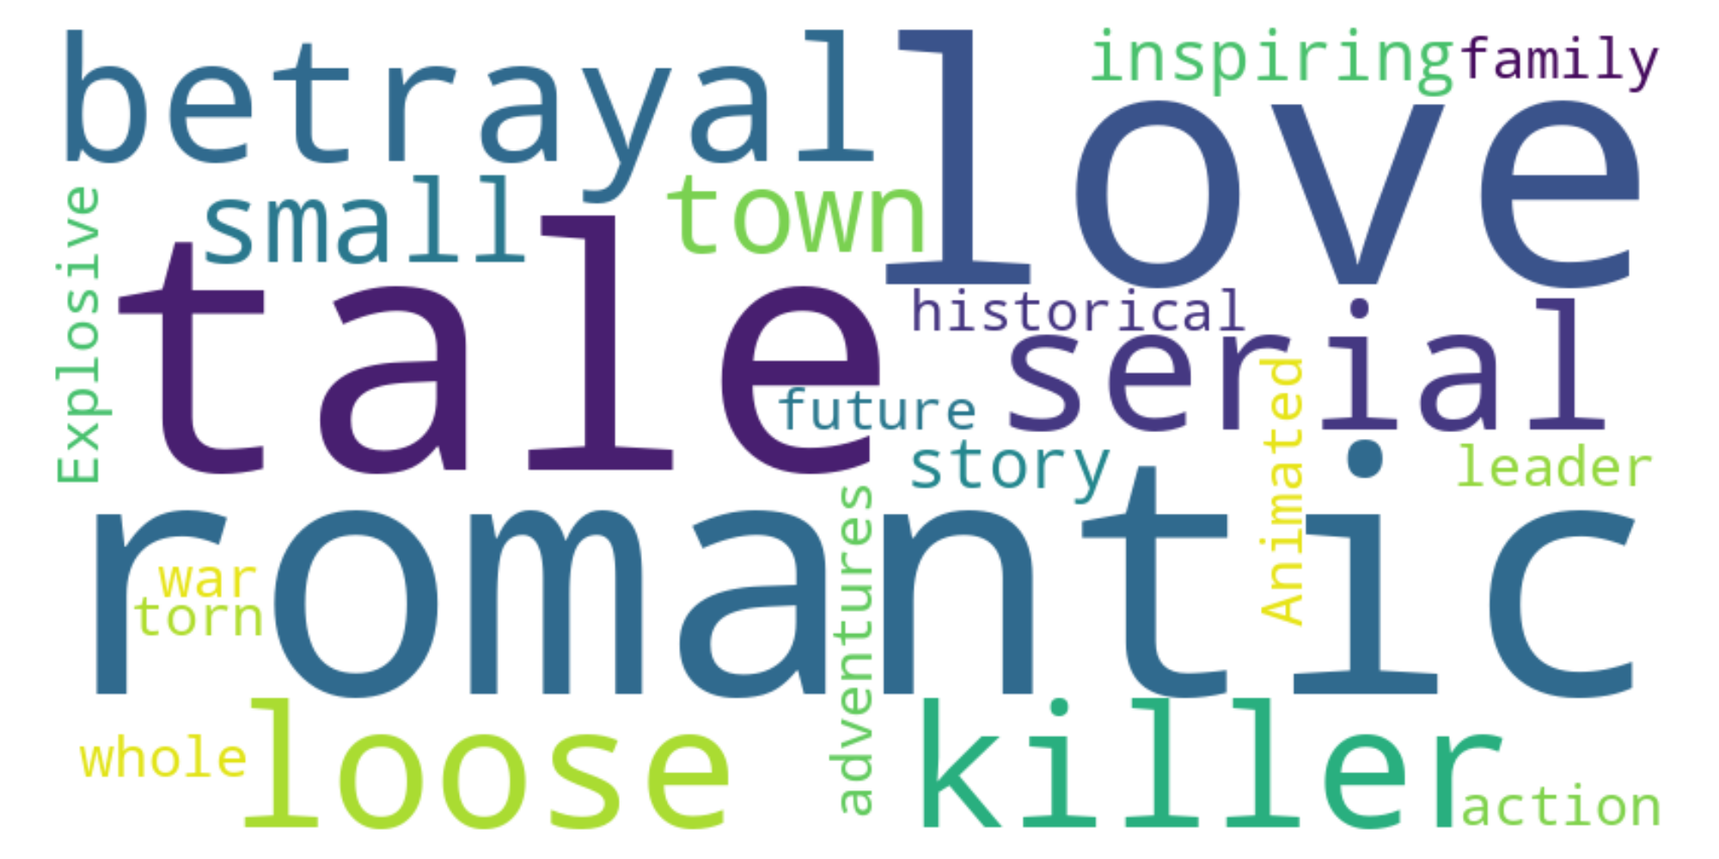
Genre & Theme Trends
Top Genres: Dramas, International Movies, Comedies
Common themes: Love, Crime, Friendship, Mystery
Word Clouds reveal dominant keywords

Slide 7
Classification Model (Supervised ML)
Task: Predict Movie vs TV Show from description
Initial model: Naive Bayes (Accuracy ~79%)
Improved model: Logistic Regression (Accuracy ~87%)
Use case: Automate metadata classification

Slide 8
Clustering Model (Unsupervised ML)
Used KMeans on TF-IDF of descriptions
Identified 5 unique thematic clusters
Clusters: Romance, Crime, Documentary, Action, Kids
Useful for marketing segmentation and recommendations

Slide 9
Business Applications
Invest in popular genres and themes
Enhance personalization with ML insights
Optimize regional content strategy
Support content acquisition and SEO with trend data

Slide 10
Deployment & Future Work
Deploy classification & clustering models
Build dashboards for content teams
Generate insight reports by genre/region
Integrate with recommender systems

Slide 11
Let’s Connect!
Testimony Omokhafe | Data Scientist
linkedin.com/in/testimonyomokhafe
Available for Data Science roles & collaborations
Open to ML/NLP consulting or freelance projects

