Slide 1
Netflix Content Trends Analysis
Using Data Science for Strategic Streaming Insights
Testimony Omokhafe | Data Scientist

Slide 2
Project Overview
Analyzed Netflix content using Python, pandas, NLP, and ML
Explored EDA, classification, and clustering techniques
Focused on Type, Country, Genre, Language, Description
Goal: Extract trends & enable strategic automation

Slide 3
Dataset Summary
Source: Netflix Movies & TV Shows (~8,800 titles)
Features: Title, Description, Type, Country, Date Added
Also used: Rating, Duration, Genre, Cast

Slide 4
Key Insights – Content Distribution
TV Shows: ~30%, Movies: ~70%
Top countries: US, India, UK
Growth in international content

Slide 5
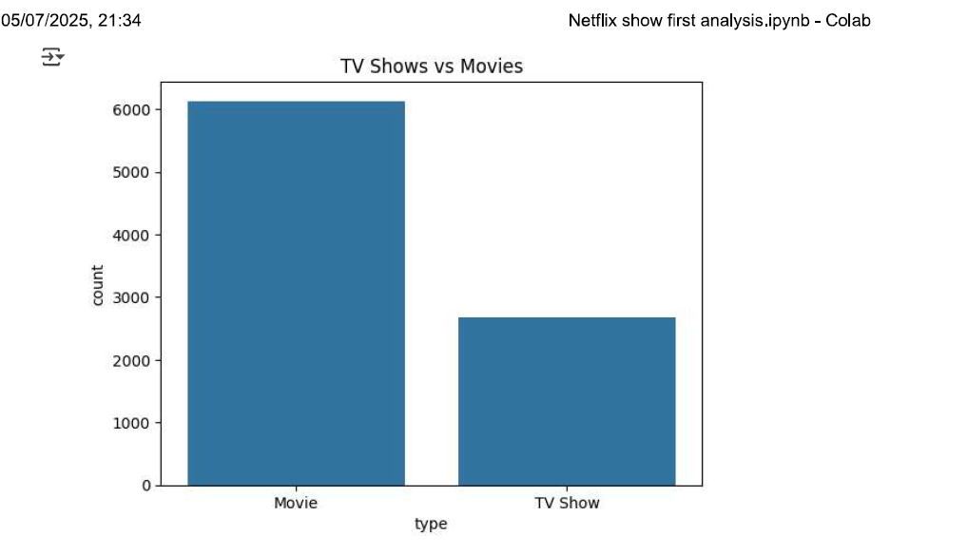
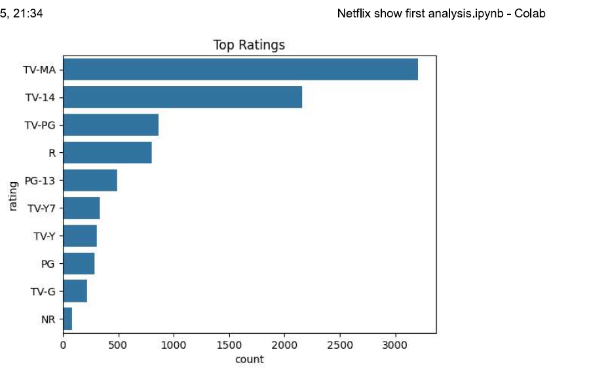
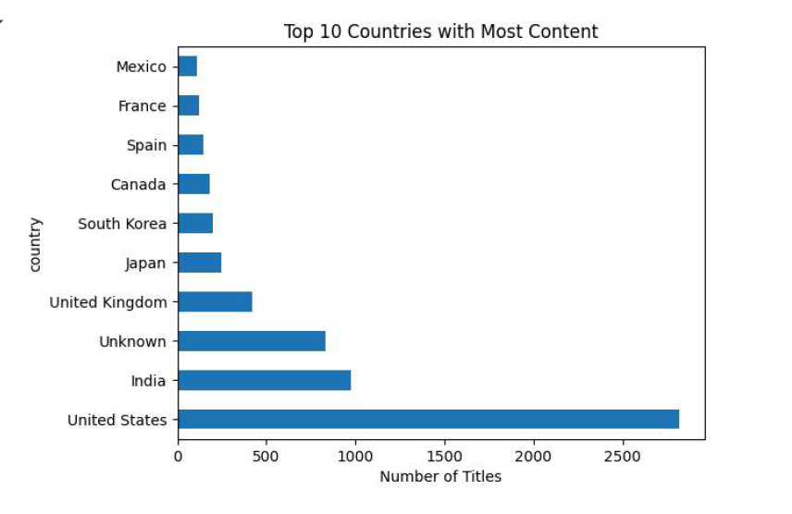

Slide 6
Ratings & Age Demographics
TV-MA and TV-14 dominate
Limited family/kids content
Audience skew: young adults and mature viewers

Slide 7
Genre & Theme Trends
Top Genres: Dramas, International Movies, Comedies
Common themes: Love, Crime, Friendship, Mystery
Word Clouds reveal dominant keywords

Slide 8
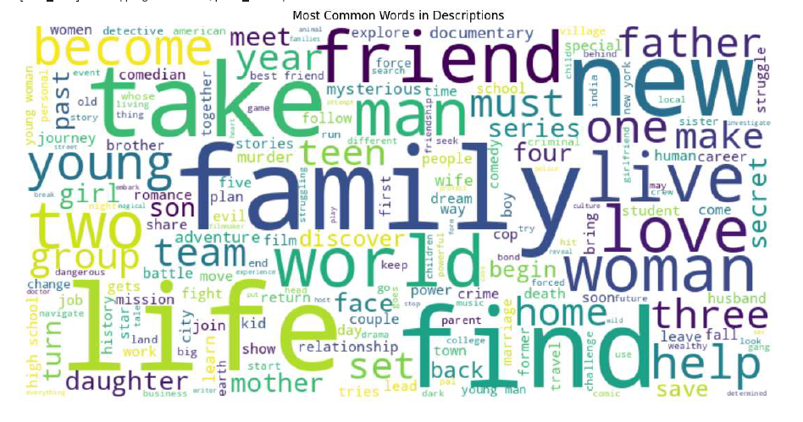

Slide 9
Classification Model (Supervised ML)
Task: Predict Movie vs TV Show from description
Initial model: Naive Bayes (Accuracy ~79%)
Improved model: Logistic Regression (Accuracy ~87%)
Use case: Automate metadata classification

Slide 10
Clustering Model (Unsupervised ML)
Used KMeans on TF-IDF of descriptions
Identified 5 unique thematic clusters
Clusters: Romance, Crime, Documentary, Action, Kids
Useful for marketing segmentation and recommendations

Slide 11
Business Applications
Invest in popular genres and themes
Enhance personalization with ML insights
Optimize regional content strategy
Support content acquisition and SEO with trend data

Slide 12
Deployment & Future Work
Deploy classification & clustering models
Build dashboards for content teams
Generate insight reports by genre/region
Integrate with recommender systems

Slide 13
Tee Khafe | Data Scientist
www.linkedin.com/in/tee-khafe-6788a0237
Available for Data Science roles & collaborations
Open to ML/NLP consulting or freelance projects

