Slide 1
Exploratory Data Analysis of Melanoma Dataset in R
Author: Tee Khafe
Context: Statistics for AI and Data Science
Objective: Investigate clinical melanoma data to identify prognostic factors influencing patient survival using R.

Slide 2
Dataset Description
Source: University of Odense, Denmark (1962–1977)
Sample Size: 205 patients
Variables:
- Time (survival in days)
- Status (alive, died from melanoma, died from other causes)
- Sex (Male, Female)
- Age
- Year of surgery
- Tumor Thickness (mm)
- Ulceration (present/absent)

Slide 3
Demographics Summary
Sex Distribution:
- Female: 126 (61.5%)
- Male: 79 (38.5%)
Age Range: 4 to 95 years
Ulceration:
- Absent: 115 patients
- Present: 90 patients

Slide 4
Key Descriptive Statistics
Time (survival):
- Mean: 2153 days
- Median: 2005 days
- Range: 10 to 5565 days
Thickness (mm):
- Mean: 2.92
- Range: 0.10 to 17.42
Status:
- Alive: 134
- Died from Melanoma: 57
- Died from other causes: 14

Slide 5
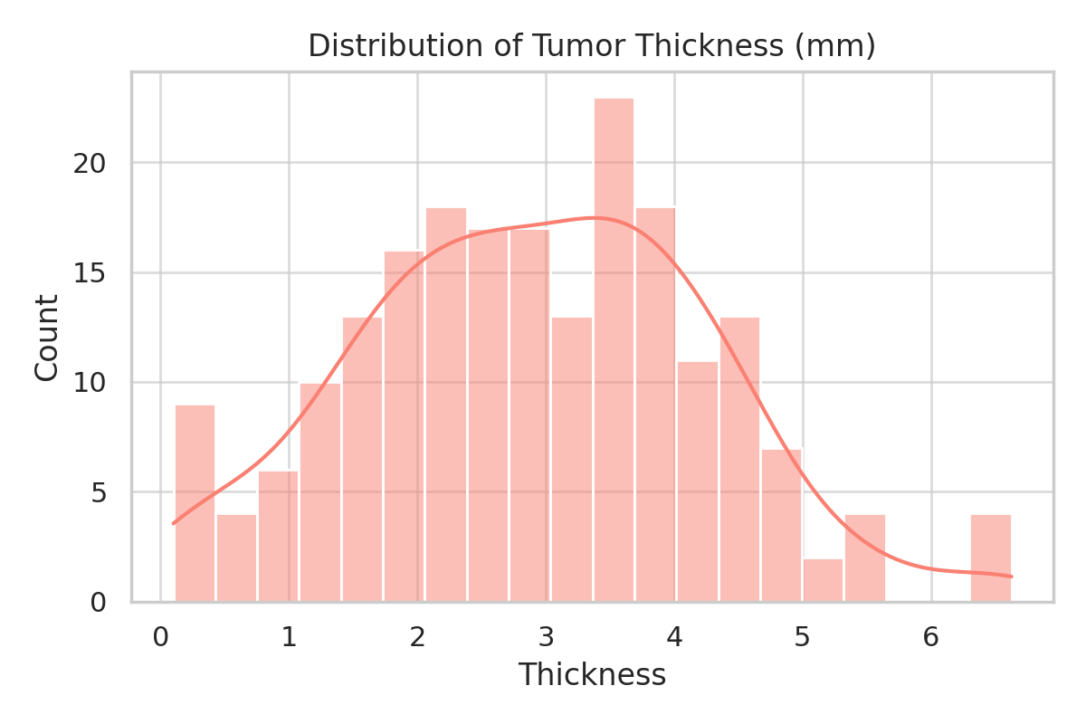
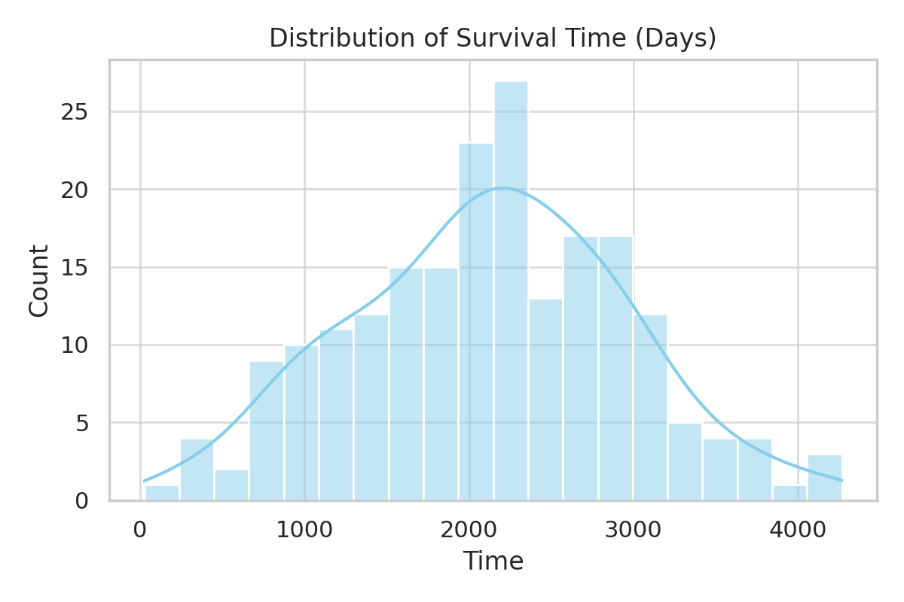
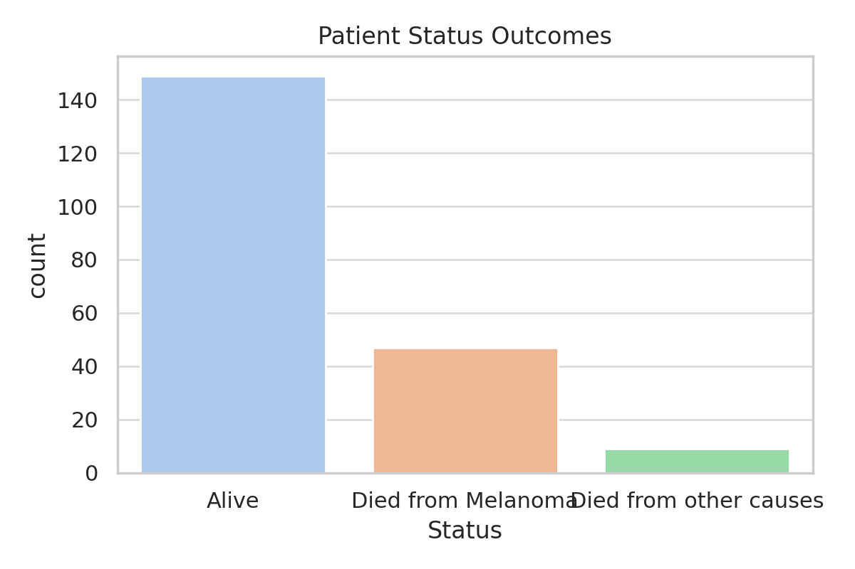
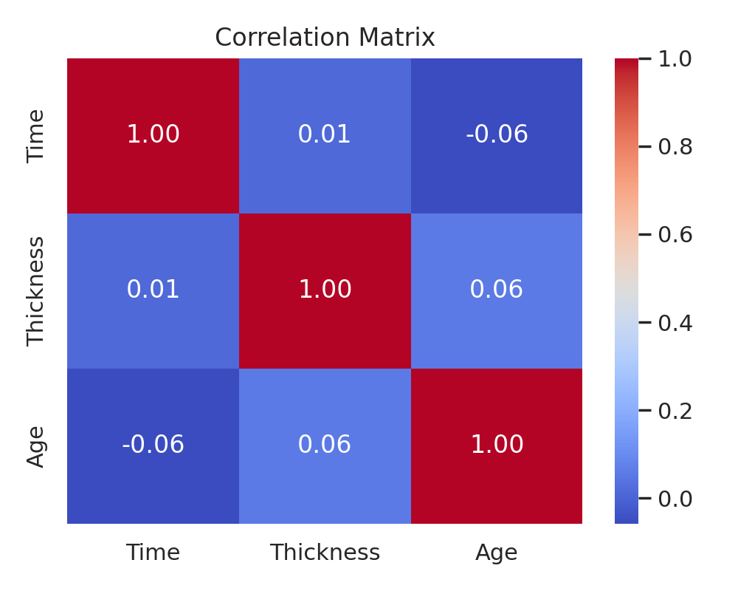

Slide 6
Correlation Analysis
Time ~ Thickness: -0.235 (weak negative)
Time ~ Age: -0.301 (weak negative)
Thickness ~ Age: +0.212 (weak positive)
Interpretation:
- Older patients and those with thicker tumors had shorter survival times
- Elderly patients tended to present with thicker tumors

Slide 7
Regression Summary
Time vs Thickness:
Model: Thickness = 4.26 - 0.00062 * Time
Time vs Age:
Model: Age = 62.11 - 0.00448 * Time
Thickness vs Age:
Model: Age = 48.97 + 1.197 * Thickness

Slide 8
Gender-Based T-Tests and ANOVA
Significant Differences (p < 0.05):
- Time (p = 0.0386)
- Thickness (p = 0.0101)
No Significant Difference:
- Age by gender (p = 0.3408)

Slide 9
QQ Plot Observations
Time: Normally distributed across genders
Age: Normally distributed
Thickness: Not normally distributed

Slide 10
Clinical Insights
Surgery improves outcomes (most patients survived)
Older patients and ulcerated tumors linked to worse prognosis
Ulcer presence = fewer survival days
Status & sex have measurable impact on outcomes

Slide 11
Recommendations & Limitations
Recommendation: Surgery should be encouraged based on survival gains
Limitation:
- Small sample size (205 patients over 15 years)
- No control group (patients who didn’t undergo surgery)
- Uneven distribution over time limits trend analysis

Slide 12
Tools & References
Tools Used: R, RStudio, Tidyverse, ggplot2
Sources:
- Canadian Cancer Society (2024)
- American Cancer Society (2023)
- GBD Study (2016), Wickham et al. (2019), RStudio Team (2020)

Slide 13
Thank You / Q&A
Questions welcome!
Report & code available on request
Connect with me to collaborate on health data science projects

