Slide 1
Survey Tool
Focusing HR to understand employees

Slide 2
Company - HR
Decides the question for Survey
Survey is defined and Published
Each survey will have its own link
Survey access is defined
Employee see the survey
Fills & submits the survey
Survey 1 → 0 to 2 years of experience
Survey 2 → women of 5 to 10 years of experience

Slide 3
All the models are suggestive in nature
app name → data_collect
List of Models
There users and users have departments and have teams
Login & authenticate using default User model
Model as EmployeeInformation
Email id
Foreign Key - User
Name
Employee Number / Id
Department
Team
Reports_to ( Foreign Key →User )
Reports_to_email_id
creator_user → ( yes or no )

Slide 4
→ SurveyDefined
Survey Name
Number of Questions
SelectedQuestions( many to many field with QuestionsWithOptions)
→ QuestionsWithOptions
Question → textfield
Options →
enter_answer →
→ SurveyServedtoEmp
SurveySelected ( ForeignKey → Survey_defined)
Employeess_Category ( HR,Engineering, finance) → CharField
→ SurveySubmittedbyEmp
SurveySelected ( ForeignKey → Survey_defined)
EmployeeSelected (ForeignKey→ UserInformation)
Question(ForeginKey - QuestionsWithOptions)
Answer ( Answer given by the user ) → Textfield

Slide 5
HR flow
Homepage
Signup / Logins
Assume No survey has been given
he/she will select from template
Assign the survey to set of employees
Select a department
Engineering
Sales
Marketing
CXO
HR
Employee Flow
Homepage
Employes logs in
Sees the survey

Slide 6
HR flow
Homepage
Signup / Logins
Assume No survey has been given
he/she will select from template
Assign the survey to set of employees
Select a department
Engineering
Sales
Marketing
CXO
HR
User Model
SurveyDefined
QuestionsWithOptions
SurveyServedtoEmp
EmployeeInformation Model

Slide 7
Employee Flow
Homepage
Employes logs in
Sees the survey
Click and fill the survey
User Model - Authentication
EmployeeInformation Model - Department
SurveySubmittedbyEmp

Slide 8
Homepage
Signup / Logins
he/she will select from template
Assign the survey to set of employees
User clicks on SignUp/Login
Logo
SignUp / LogIn

Slide 9

Homepage
Signup / Logins
he/she will select from template
Assign the survey to set of employees
Logo
SignUp / LogIn
SignUp Now
Email id
Provide your email id
Password
Give a Strong Password
Submit
NOTE: In the backend, we need to use the User model. It has 3 fields -> username, email-Id & password.
Use the same value for username & email id & save it

Slide 10
Homepage
Signup / Logins
he/she will select from template
Assign the survey to set of employees
/template_selection /
Logo
Email id
Following is the list of templates you can select and conduct your survey
Employee Engagement Survey - Pulse survey
Description: It helps in understanding the pulse of the employees across teams preview
Select >>>
2 Onboarding Survey
Description: It helps in understanding the onboarding process of the employees preview
Select >>>

Slide 11
Homepage
Signup / Logins
he/she will select from template
Assign the survey to set of employees
Logo
Email id
Selected Survey
Employee Engagement Survey - Pulse survey
Description: It helps in understanding the pulse of the employees across teams
Provide this Survey to following departments :
Select all the departments to which you want to float the survey :
Engineering
Finance
Marketing
On the selection of the department, the following screen has to be shown
Sales
Submit

Slide 12
Logo
Email id
Congratulations !!!!!
The survey is created and ready to be taken by employees
Selected Survey
Employee Engagement Survey - Pulse survey
Description: It helps in understanding the pulse of the employees across teams
Will be floated to following departments :
Engineering department

Slide 13
User → UserInformation Model
HR
Engineer
….
…. roles
Survey → SurveryType Model
Engagement measurement survey
Exit survey
Onboarding survey
Questions in the survey → Question Model
Multiple
Open ended question
Likert scale quest
…..
Survey_answers → SurveyAnswerModel
Survey ( ForeignKey)
UserInformation( UserInformation Model)
Question
Answer

Slide 14
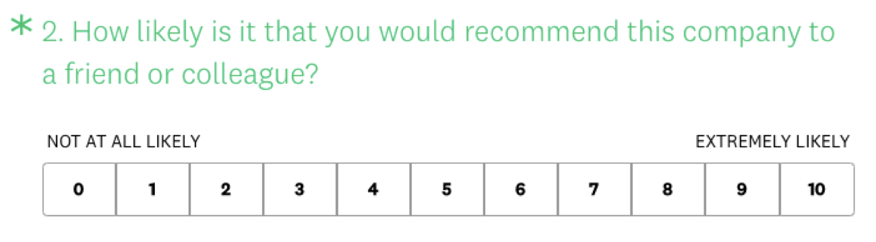
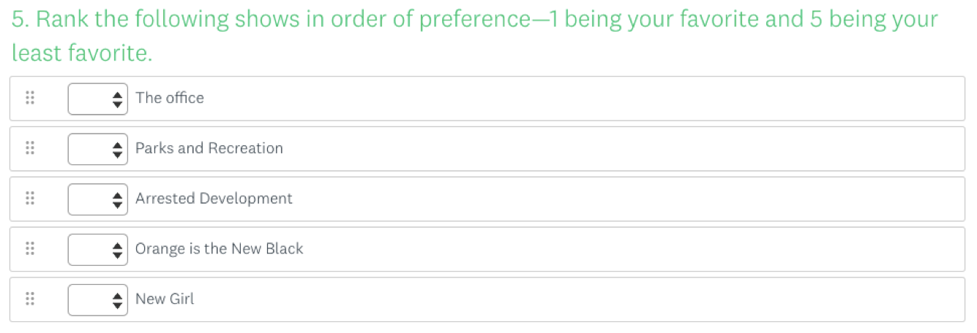
Types of question that are done:
Dropdown
Descriptive / Open ended
Types of questions to be done :
Multiple select - checkbox based
Select one - Radio button based
NPS
Ranking -
Here the user will rank the options
So , you can give dropdown for each option , but we need to validate that same number is not there for more than one option before submit

Slide 15
Part - 2
We need to modify most of the screens.
Have given changes for all the screens

Slide 16
< Some image here >
NOTE:
We will assume that only people who wants to create survey is going to signup , others will just login
It can be HR , team leader or someone at the CXO levels.
Signup Now
Email id
Password
Signup Now
/user_app/

Slide 17
NOTE:
User can select
“From Scratch” → where user adds the question by himself
Any other option → it is already existing template, we have to load that for user
ImpactSignals
<Current_user_email id >
Logout
Select a Survey
From Scratch
Pulse Survey
OnBoarding Survey
ABC - Template
XYZ- Template
/survey_app/

Slide 18
ImpactSignals
<Current_user_email id >
Logout
Create from scratch
→
Design the Survey
→
Preview the Survey
→
Collect
→
Analyse Results
NOTE:
When User selects → “From Scratch”
Survey - Name
Survey Description
Next >>

Slide 19
ImpactSignals
<Current_user_email id >
Logout
Create from scratch
→
Design the Survey
→
Preview the Survey
→
Collect
→
Analyse Results
NOTE:
When User clicks on the button “Add Question” , the following options will be shown to the user
Survey Name : < Given name >
Survey Description : < Given Description >
Add Question

Slide 20
ImpactSignals
<Current_user_email id >
Logout
Create from scratch
→
Design the Survey
→
Preview the Survey
→
Collect
→
Analyse Results
NOTE:
When User clicks on the button “Add Question” , the following options will be shown to the user
Survey Name : < Given name >
Survey Description : < Given Description >
Add Question
Select any of the following :
Dropdown
Radio Button
NPS
Check box
Descriptive / Open Ended

Slide 21
ImpactSignals
<Current_user_email id >
Logout
Create from scratch
→
Design the Survey
→
Preview the Survey
→
Collect
→
Analyse Results
NOTE:
Once the user writes the question & options in the given area , he/she can use “Add This” button to add the question to the questionnaire
Survey Name : < Given name >
Survey Description : < Given Description >
Add Question
Dropdown
Add Question
Add options with comma as the separator
Add this

Slide 22
ImpactSignals
<Current_user_email id >
Logout
Create from scratch
→
Design the Survey
→
Preview the Survey
→
Collect
→
Analyse Results
NOTE:
Once the user writes the question & options in the given area , he/she can use “Add This” button to add the question to the questionnaire
Survey Name : < Given name >
Survey Description : < Given Description >
Add Question
Dropdown
< user should be able to edit this and add his question >
Option1, option 2, option 3, option 4
Add this

Slide 23
ImpactSignals
<Current_user_email id >
Logout
Create from scratch
→
Design the Survey
→
Preview the Survey
→
Collect
→
Analyse Results
NOTE:
Once the user writes the question & options in the given area , he/she can use “Add This” button to add the question to the questionnaire
Survey Name : < Given name >
Survey Description : < Given Description >
Q1 : How was the work last week ?
( All the given values for the question has to be shown here in dropdown )
Add Next Question

Slide 24
ImpactSignals
<Current_user_email id >
Logout
Create from scratch
→
Design the Survey
→
Preview the Survey
→
Collect
→
Analyse Results
Survey Name : < Given name >
Survey Description : < Given Description >
Preview to Publish >>
Q1 : How was the work last week ?
( All the given values for the question has to be shown here in dropdown )
NOTE:
Now user will see the first added question and there will be option to add more question
Add Next Question
Select any of the following :
Dropdown
Radio Button
NPS
Check box
Descriptive / Open Ended

Slide 25
Similarly user can add as many questions as they want

Slide 26
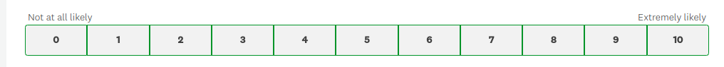
ImpactSignals
<Current_user_email id >
Logout
Create from scratch
→
Design the Survey
→
Preview the Survey
→
Collect
→
Analyse Results
Survey Name : < Given name >
Survey Description : < Given Description >
Q1 : How was the work last week ?
Q2 Would you recommend this workplace to a friend or family member ?
Q2 Comments regarding the choice made in last question ?
( All the given values for the question has to be shown here in dropdown )
Next >>

Slide 27
ImpactSignals
<Current_user_email id >
Logout
Create from scratch
→
Design the Survey
→
Preview the Survey
→
Collect
→
Analyse Results
Survey Name : < Given name >
Survey Description : < Given Description >
Collect the Responses through :
Email
Slack
MS Teams *
Next >>

Slide 28
ImpactSignals
<Current_user_email id >
Logout
Create from scratch
→
Design the Survey
→
Preview the Survey
→
Collect
→
Analyse Results
Survey Name : < Given name >
Survey Description : < Given Description >
Collect the Responses through : Email
Added a new question ->
Is the survey Anonymous
Save the response of the question in the models SurveryDefined
Is the survey Anonymous : Yes / No
Collect the Responses from :
Give email ids :
< give a list of email addresses with comma separated >
OR
Select the candidates by
Department
Location / Office / Email Lists
Engineering
Finance
Marketing
Sales
Next >>

Slide 29
ImpactSignals
<Current_user_email id >
Logout
Create from scratch
→
Design the Survey
→
Preview the Survey
→
Collect
→
Analyse Results
Survey Name : < Given name >
Survey Description : < Given Description >
Survey Link : website_name/survey_app/<unique_alphanumberic>/
Generate and assign a unique alphanumeric , to add to the part of link.
Save the alphanumeric link as part of SurveyDefined model in a new field
Collect the Responses through :
Email
Department
Collect the Responses from :
Engineering
Click to see Results

Slide 31
ImpactSignals
<Current_user_email id >
Logout
List of survey’s assigned to you
Survey Name 1
Survey Description 1
Submitted response on <dd/mm/yy - hh:mm>
Survey Name 2
Survey Description 2
Take this
Survey Name 3
Survey Description 3
Take this

Slide 32
ImpactSignals
<Current_user_email id >
Logout
Survey Name
Survey Description Survey Description Survey Description Survey Description Survey Description
Anonymous Survey : Yes
Q1
Q2
Q3
Submit Response

Slide 33
ImpactSignals
<Current_user_email id >
Logout
Thanks for taking part in the survey
<survey name >.
Your responses are recorded at < time of save of the response >

Slide 34
New Models & edits to old models
New Models:
CompanyInfo(models.Model)
company_name : TextField
company _address : TextField
Company_business : TextField
Department_info(models.Model)
Department_name : TextField
Departement_description: TextField
company_parent : ForeignKey(CompanyInfo)
Locations_info(models.Model)
location_name : TextField
company_loc_parent : ForeignKey(CompanyInfo)
Models to edit :
EmployeeInfo(models.Model)
company_employer : ForeignKey(CompanyInfo), null=True
Add the above field to the EmployeeInfo model

Slide 36
After the survey is floated by the HR and the survey being filled by employee,
The HR should be able to see the answers filled by the employee
The next screens are only available for the survey creator

Slide 37
ImpactSignals
<Current_user_email id >
Logout
List of surveys created by you
Survey Name
Survey Type
Survey Stage
Number of people finished survey
Survey Name 1
Survey Description 1
Anonymous
Served
38/62
See Results
Survey Name 2
Survey Description 2
-
Non- Anonymous
Design
See Results

Slide 38
ImpactSignals
<Current_user_email id >
Logout
Survey Name :
Survey Description :
Anonymous Survey : Yes
If the survey is Anonymous, then in column 1, we will be showing the 1,2,3,... and so on , just numbers
And whenever we serve this in the frontend - we will need to just randomise the order !!!
 | Q1 - <Question > | Q1 - <Question > | Q1 - <Question > | Q1 - <Question > | Q1 - <Question > | Q1 - <Question >
1
2
3
4
5

Slide 39
ImpactSignals
<Current_user_email id >
Logout
Survey Name :
Survey Description :
Anonymous Survey : No
If the survey is Non-Anonymous, then in column 1, we will be showing the user-id/ email id
 | Q1 - <Question > | Q1 - <Question > | Q1 - <Question > | Q1 - <Question > | Q1 - <Question > | Q1 - <Question >
1
2
3
4
5

