Slide 1
Microprocessor System Design
Introduction

Slide 2
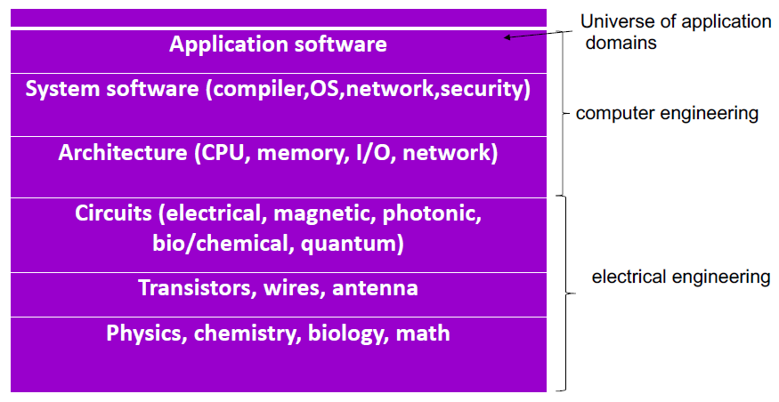
Modern computer systems

Slide 3
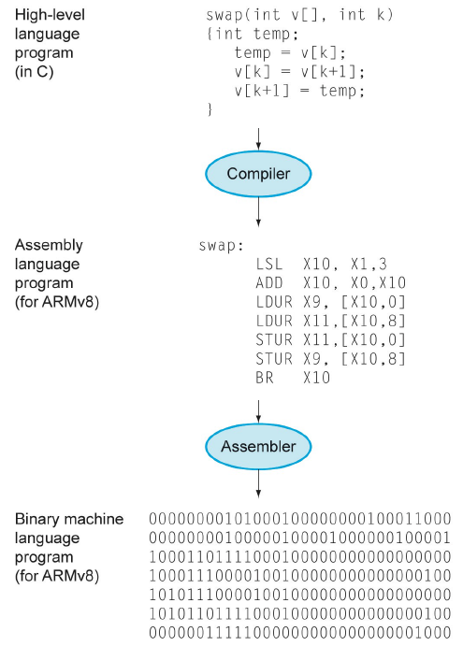
High-Level Language down

Slide 4
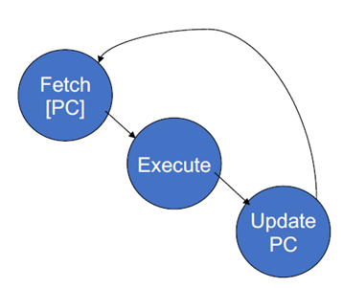
The basics of all computers
Fetch instruction from address in Program Counter (PC)
Execute instruction
Update PC to point to next instruction

Slide 5
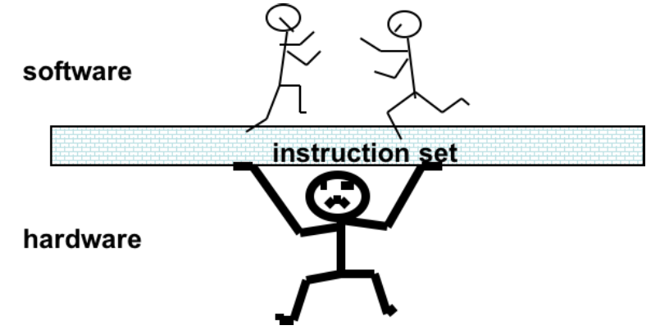
Instruction Set Architectures (ISAs)
Set of operations visible to the programmer
ISA is the contract between the SW and HW

Slide 6

Different Types of ISAs
CISC (Complex Instruction Set Computer)
RISC (Reduced Instruction Set Computer)
DSPs (Digital Signal Processors)
RISC has the following key features:
  A fixed (32-bit) instruction size with few formats;
    CISC processors typically had variable length instruction sets with many formats.
  A load–store architecture where instructions process data only on registers.
    CISC processors typically allowed values in memory to be used as operands in data processing instructions.

Slide 7
RISC Architecture
Hard-wired instruction decode logic
  CISC processor used large microcode ROMs to decode their instructions
Pipelined execution
  CISC processors allowed little, if any, overlap between consecutive instructions (though they do now)
Single-cycle execution
  CISC processors typically took many clock cycles to completes a single instruction
→ Simple is beauty
Compiler plays an important role

Slide 8
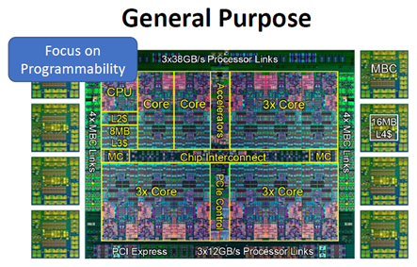
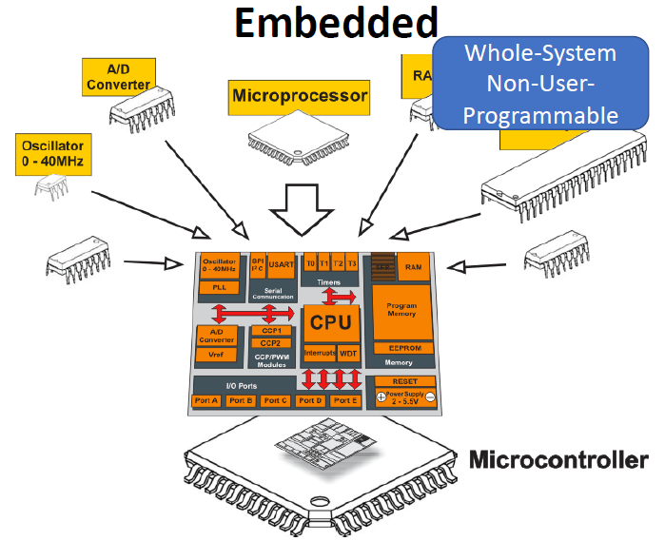
General Purpose Processor vs Embedded Processor

Slide 9
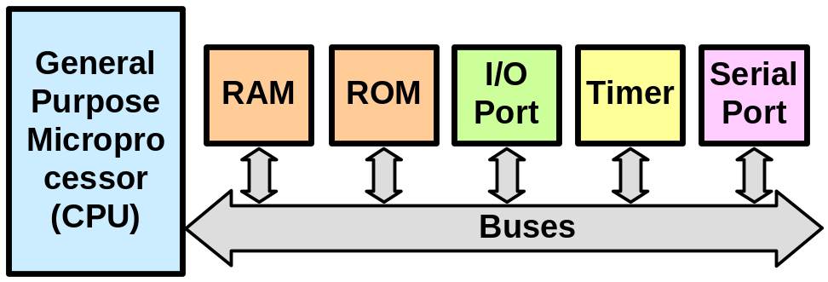
Characteristics of General-purpose Processors
High-performance
Need to run “anything” relatively well
Less energy constrained
“Limitless” Memory
Large number of registers
Deep cache hierarchy
Deep Pipelines
Hardware floating point
Multicore

Slide 10
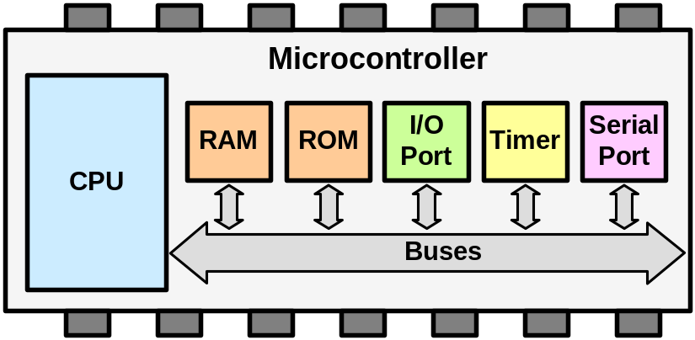
Characteristics of Embedded Processors
Limited ability
Inexpensive
Low-energy
“Limited” Memory
Few registers
Silicon devoted to many Peripherals
An embedded processor is also called a microcontroller (MCU).

Slide 11
MCU Overview
1/24/2018
Richard Kuo
Adjunct Assistant Professor

Slide 12
Outline
What is a MCU ?
Where are MCU used ?
ARM Cortex-M series Brief

Slide 13
What’s the MCU ?
MCU or uC is the abbreviation of the microcontroller.
A microcontroller is a small computer on a single integrated circuit (IC) that contains a processor core, memory (SRAM, programmable ROM) and programmable input/output interfaces.
MCU are categorized in 3 groups by its data-bit width
  8-bit
  16-bit
  32-bit

Slide 14
The basic components of a MCU
A MCU consist of a processor core, memory and I/O interfaces
Chip
CPU
Memory
Interfaces
GPIO
Flash
ROM
ADC
CPU
PWM
SRAM
UART
I2C
APB Bridge
I2C
SPI
AHB
APB

Slide 15
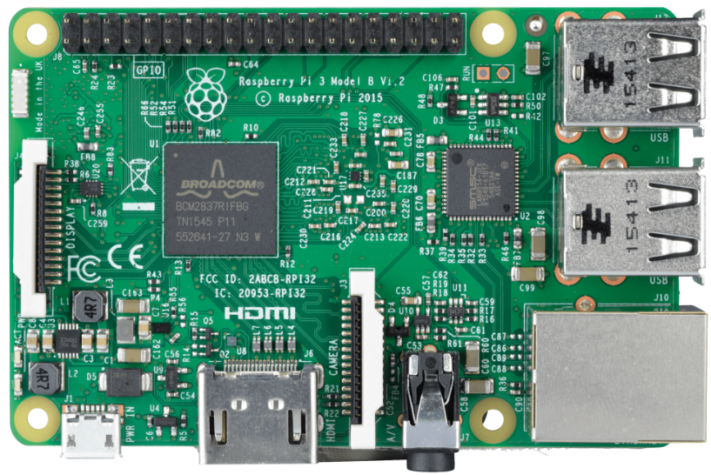
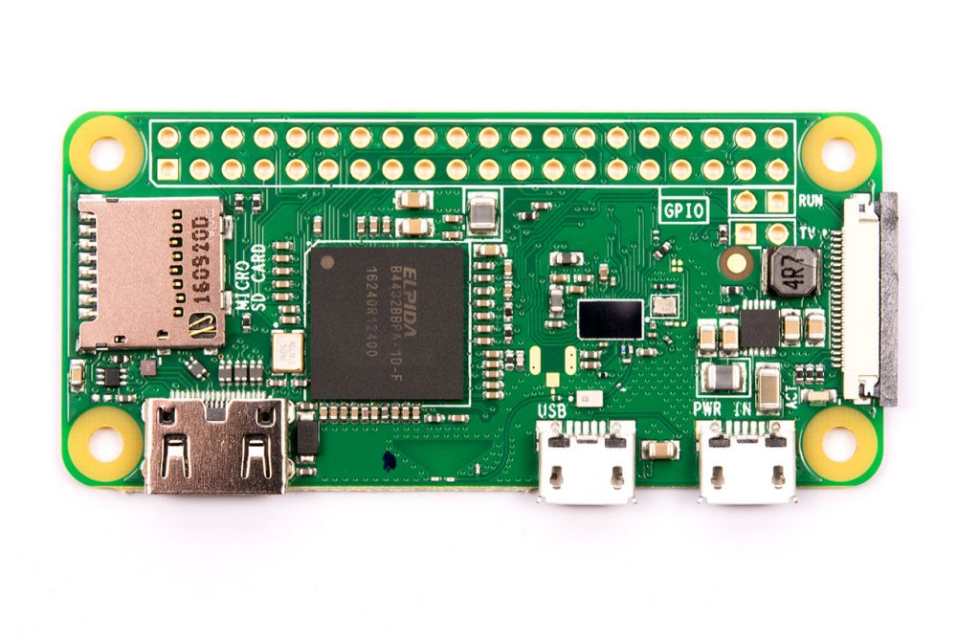
Raspberry Pi
A 1.2GHz 64-bit quad-core ARMv8 CPU
802.11n Wireless LAN
Bluetooth 4.1 Bluetooth Low Energy (BLE)
1GB DRAM
4 USB ports
40 GPIO pins
Full HDMI port
Ethernet port
Combined 3.5mm audio jack and composite video
Camera interface (CSI)
Display interface (DSI)
Micro SD card slot (now push-pull rather than push-push)
VideoCore IV 3D graphics core
Raspberry Pi 4
Raspberry Pi zero

Slide 16
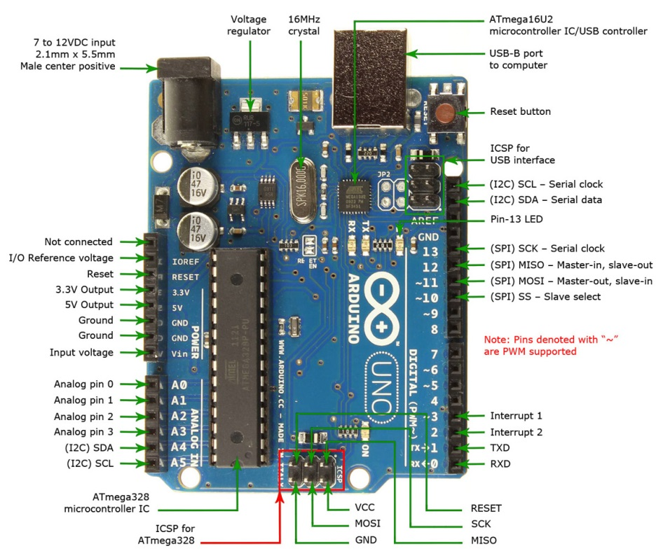
Atmel Arduino UNO
ATmega328 16-bit AVR CPU @16MHz
32KB Flash ROM (0.5KB used by bootloader)
2KB SRAM
EEPROM 1KB
6 Analog I/O pins
20 Digital I/O pins (6 PWM pins)
40mA on I/O pins
Board Input Voltage : 7~12V
Chip Operating Voltage : 5V

Slide 17
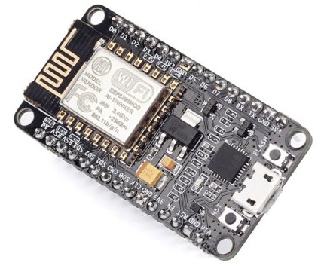
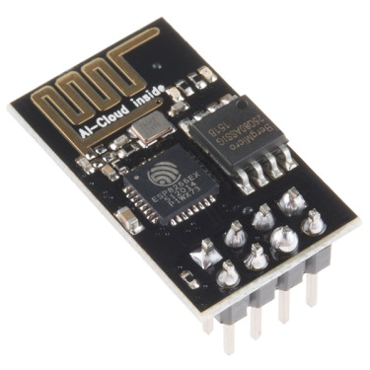
NodeMCU/ ESP8266
32-bit Tensilica Xtensa LX106 RISC CPU @80MHz
64KB I-RAM & 96KB D-RAM
External QSPI Flash 512KB ~ 4MB (up to 16MB)
802.11 b/g/n WiFi
Support STA/AP/STA+AP modes
Built-in TCP/IP protocol stack，support multiple TCP Client links
Support Socket AT commands
Support 16 GPIO pins (I2S with DMA)
Support SPI, I2C
Support UART interface
Support one 10-bit ADC
Support Smart Link networking
Support OTA firmware upgrade
Low Power operation
3.3V operating voltage
●

Slide 18
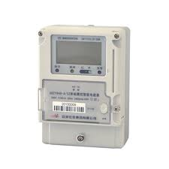
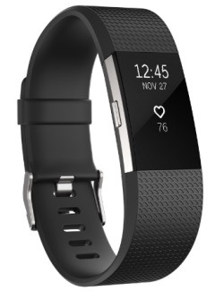
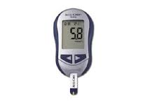
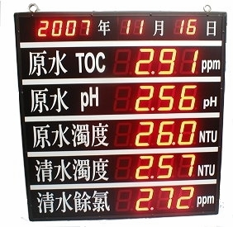
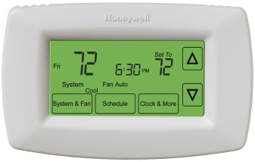
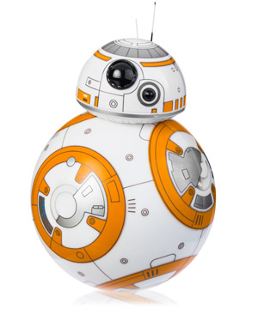
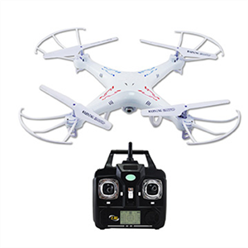

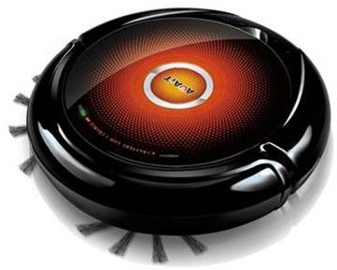
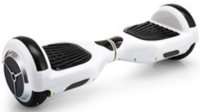
Where are MCU used ?
Microcontrollers Are Everywhere !

Slide 19
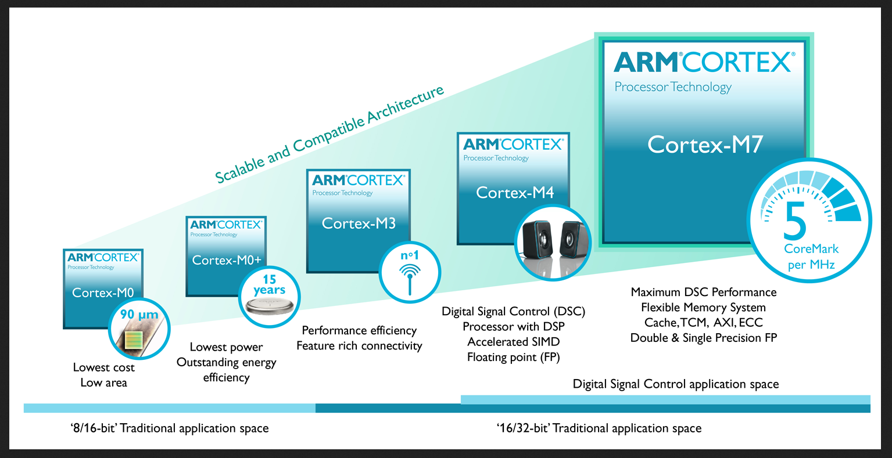
ARM Cortex-M Family of 32-bit Processors
(Courtesy of ARM)

Slide 20
Cortex-M Series CPU core
Lowest Power and Area
  Cortex-M23 : TrustZone in smallest area, lowest power
  Cortex-M0+ : Highest energy efficiency
  Cortex-M0 : Lowest cost, low power
Performance efficiency
  Cortex-M33 : Flexibility, control and DSP with TrustZone
  Cortex-M4 : Mainstream control and DSP
  Cortex-M3 : Performance efficiency
Highest performance
  Cortex-M7 : Maximum performance, control and DSP
Ref: https://www.arm.com/products/processors/cortex-m

Slide 21
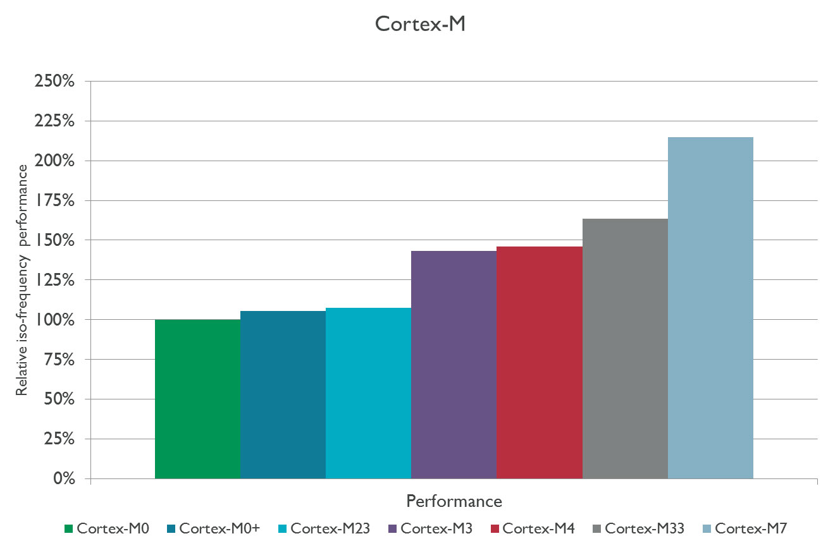
Cortex-M Performance Comparison

Slide 22
Instruction Set
Two instruction sets:
  ARM
    Standard 32-bit instruction set
  THUMB
    16-bit compressed form
    Code density better than most CISC
Features:
  Load/Store architecture
  3-address data processing instructions
  Conditional execution

Slide 23
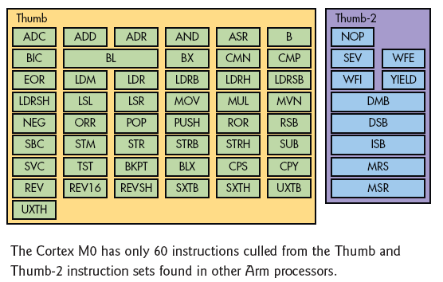
Cortex-M0 Instruction Sets

Slide 24
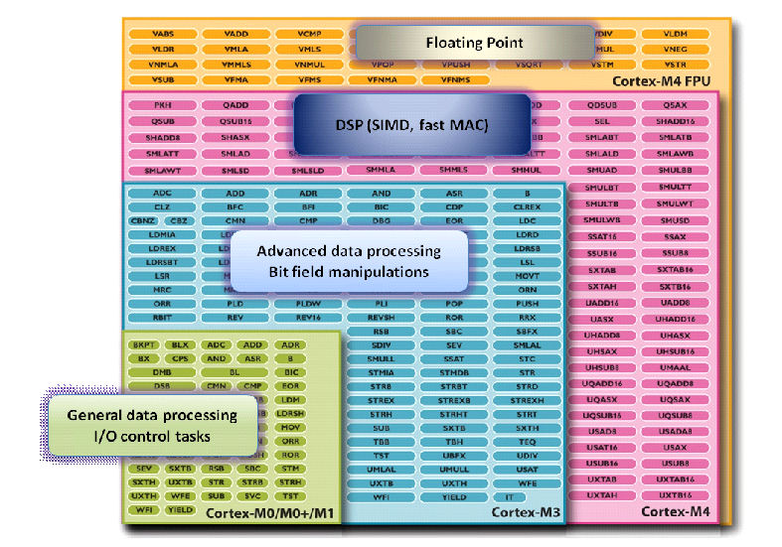
Cortex-M Instruction Sets

