Slide 1
NuMicro SDK &
Keil MDK
3/6/2017
Richard Kuo
Assistant Professor

Slide 2
Outline
SDK Installation
Open Keil Project
Keil MDK Configuration
SWD Interface
Keil Debug Session
ICP & ISP mode Programming

Slide 3
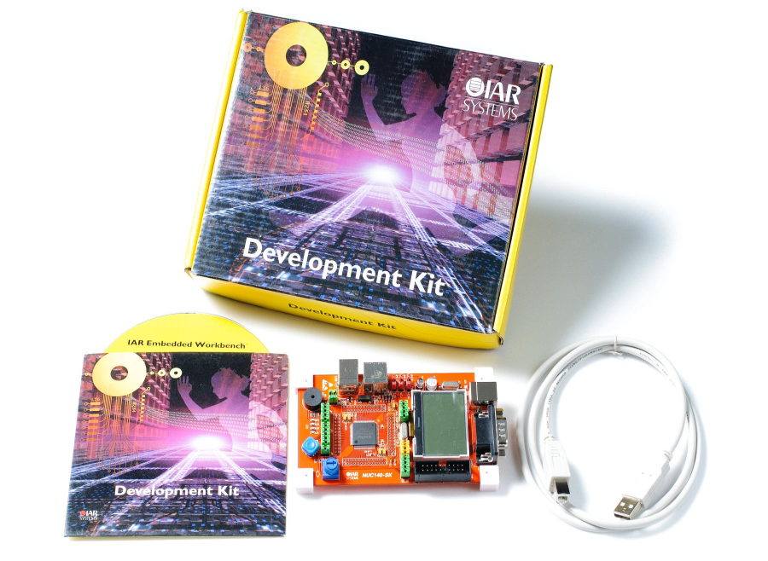
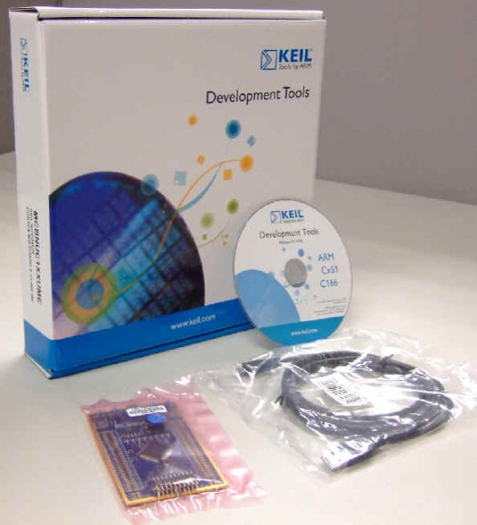


3rd Party Development Tools

Slide 4
SDK Installation
  Tools (Keil MDK, Nu-Link USB Driver, NuMicro BSP)
  IDE : ARM Keil MDK https://www.keil.com/demo/eval/arm.htm
    MDK524a.exe (run to install)
ICE : NuLink Driver
  Nu-Link_Keil_Driver_V3.02.6990 (unzip & run to install)
  BSP : MCU device driver & sample code
  Nu-LB-NUC140_BSP3.00.004_v1.4.5 (original BSP)
115/11/07

Slide 5
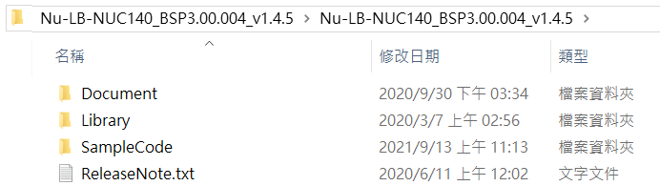
BSP – Basic Software Package
libraries used by sample code
sample code for reference
115/11/07

Slide 6
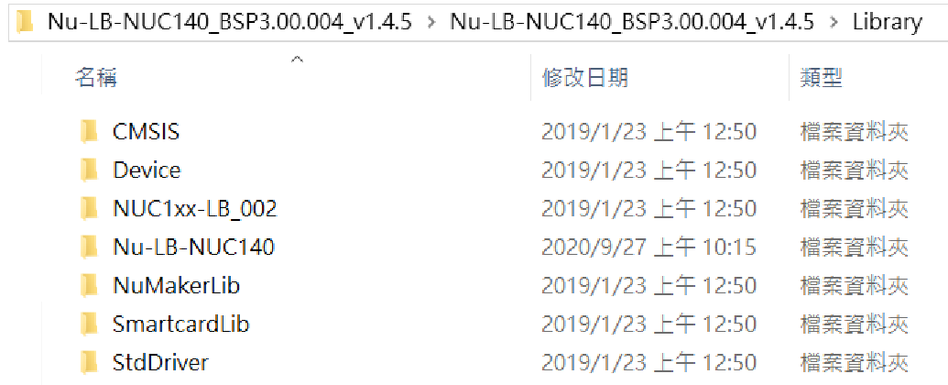
Library folder
For ARM CPU (Cortex-M0, M4, …)
For MCU series (NCU100series.h)
For NUC140 onboard device (7-seg, 3x3 keypad, …)
For sensors (MPU6050, …) & peripherals (LCD)
For MCU standard interface (I2C, SPI, UART, ADC, PWM, GPIO, …)
115/11/07

Slide 7
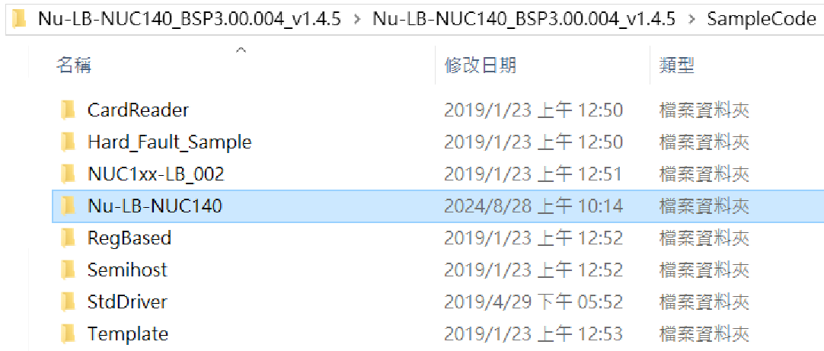
SampleCode folder
For NUC140 Learning Board
115/11/07

Slide 8
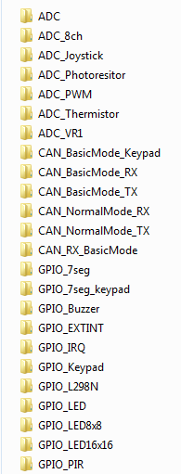
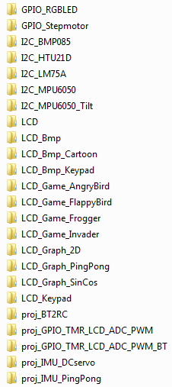
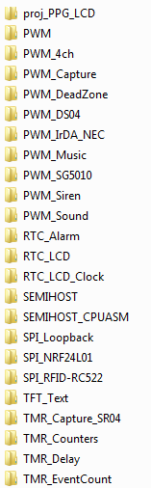
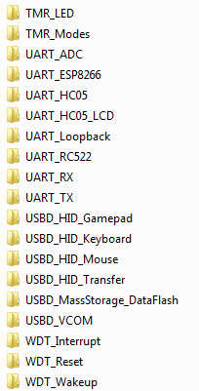
Sample code directory
Nu-LB-NUC140_BSP3.00.004_v1.4.5\SampleCode\Nu-LB-NUC140
115/11/07

Slide 9
Pick one sample code
double click to enter the directory
115/11/07

Slide 10
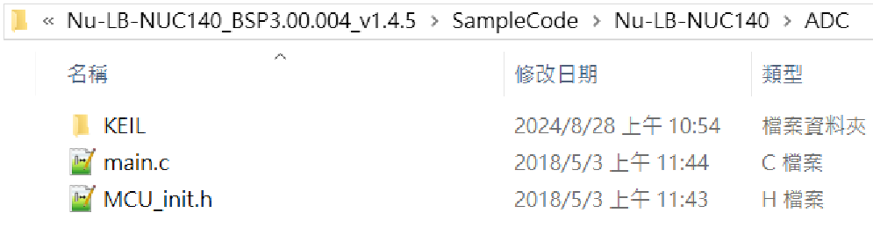
Sample Code Folder
Double click to enter Keil directory
115/11/07

Slide 11
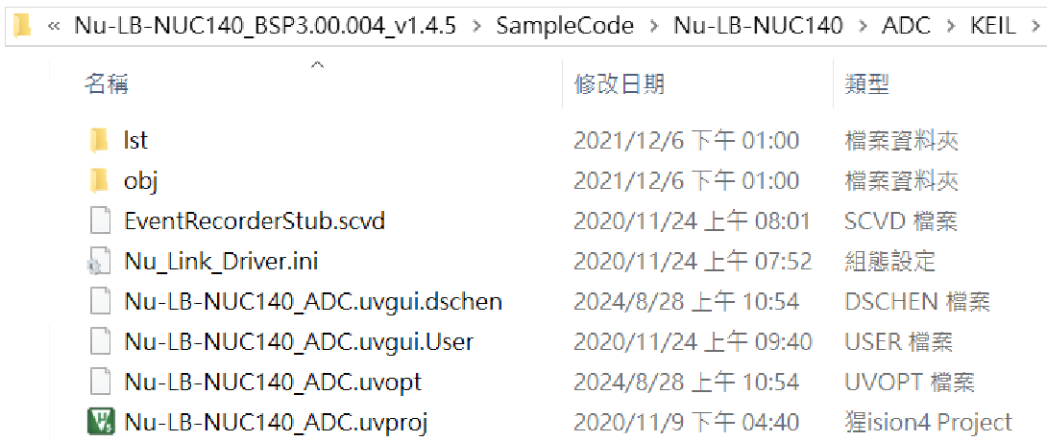
Sample Code Folder
Double click to start Keil project
115/11/07

Slide 12
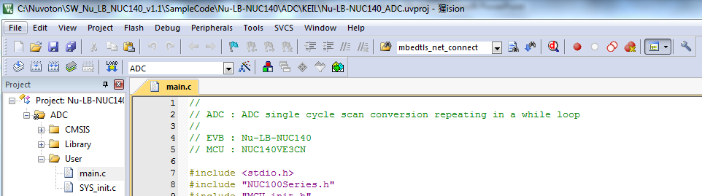
Keil IDE (Integrated Development Environment)
Save File
Build
Download
Debug
Session
Tool
Configuration
Source Code
View
Rebuild
File Hierarchy
View
115/11/07

Slide 13
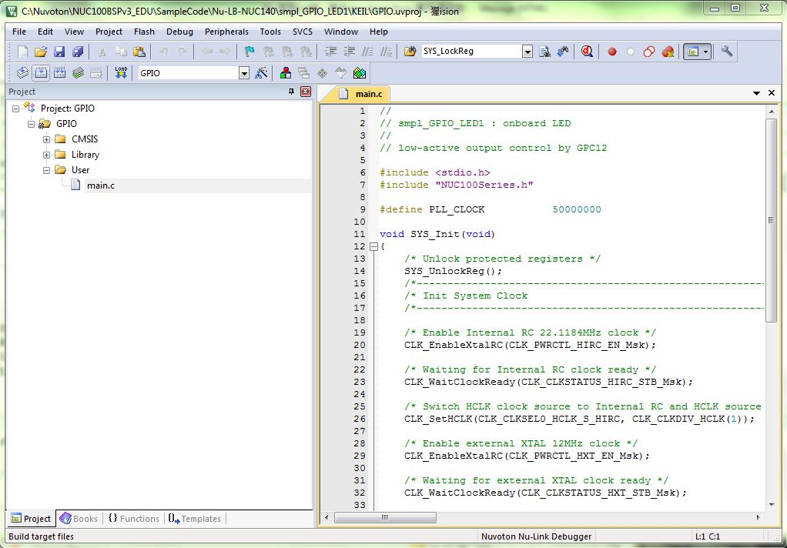
Keil Configuration
Options for Target…
Either way can do Configuration.
Flash > Configure Flash Tools…

Slide 14
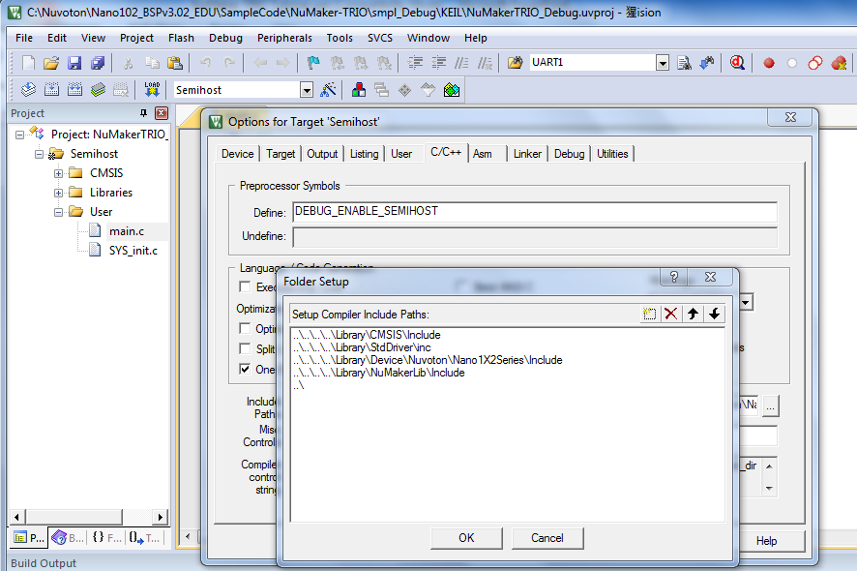
Keil Configuration
Click to add extra library path
Library path setting
115/11/07

Slide 15
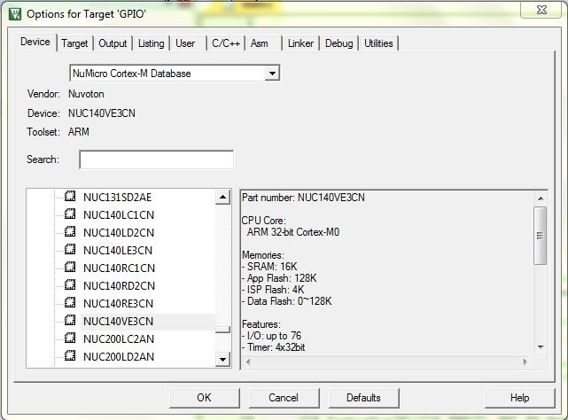
Keil Configuration

Slide 16
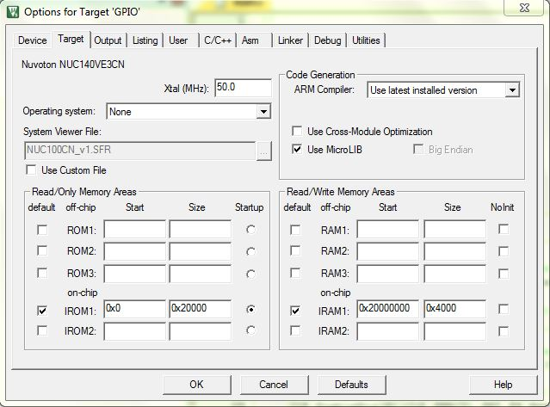
Keil Configuration
Just to confirm device is correct
ROM=128KB
SRAM=16KB
ROM base address
SRAM base address
No change needed here !

Slide 17
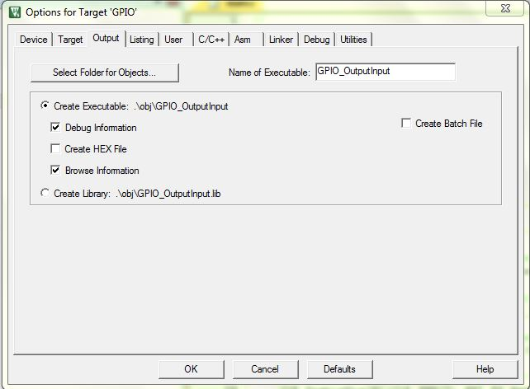
Keil Configuration
No change needed here !

Slide 18
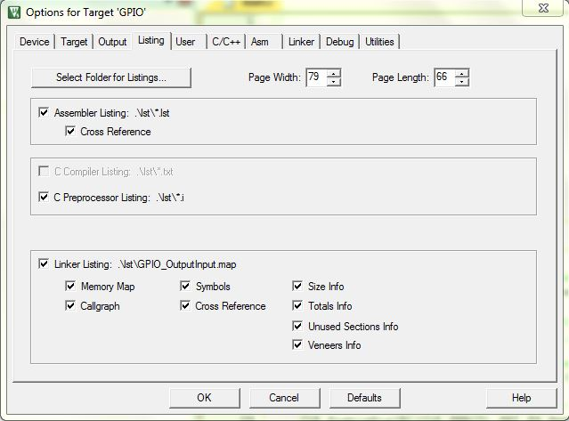
Keil Configuration
No change needed here !

Slide 19
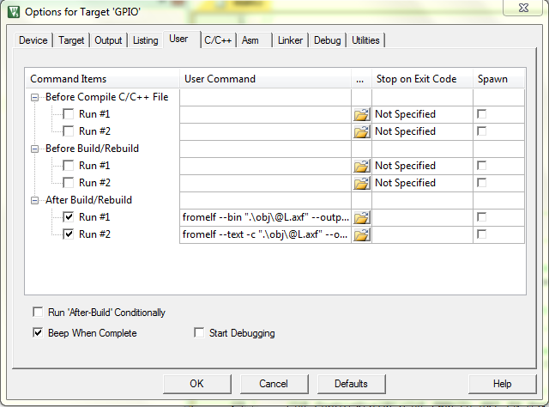
Keil Configuration
No change needed here !

Slide 20
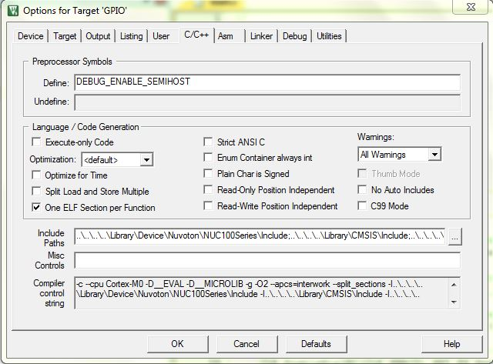
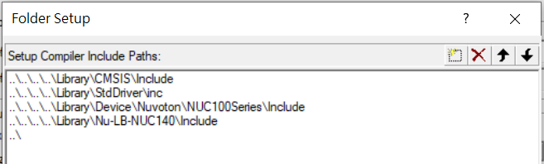
Keil Configuration
SEMIHOST debug mode
for using printf
Click to add extra include path

Slide 21
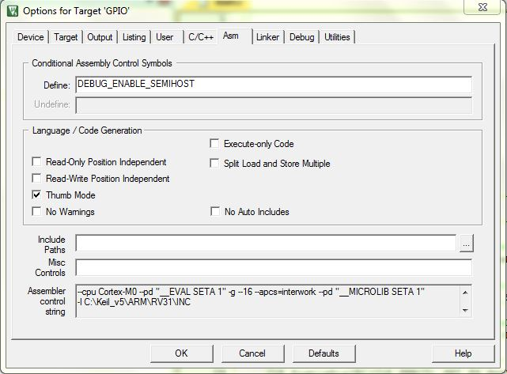
Keil Configuration
SEMIHOST debug mode
for using printf
No change needed here !

Slide 22
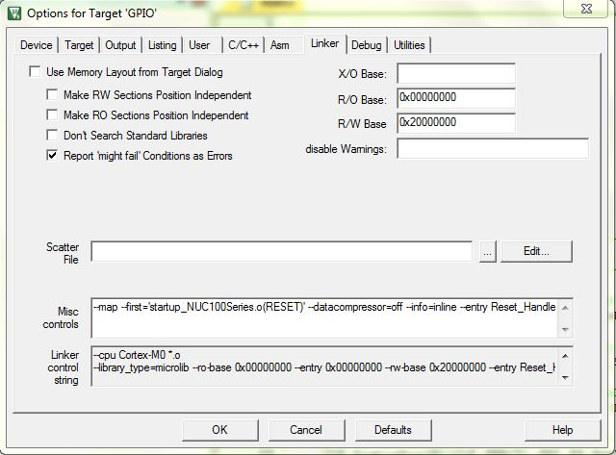
Keil Configuration
No change needed here !

Slide 23
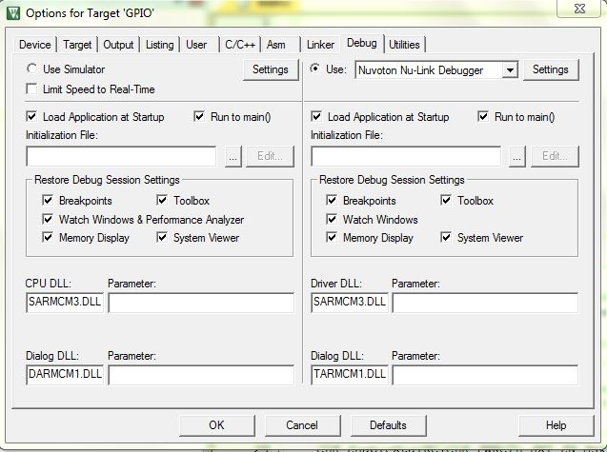
Keil Configuration
must use Nu-Link Debugger
If you see no Nu-Link Debugger here, then you need to reinstall
Nu-Link ICE driver

Slide 24
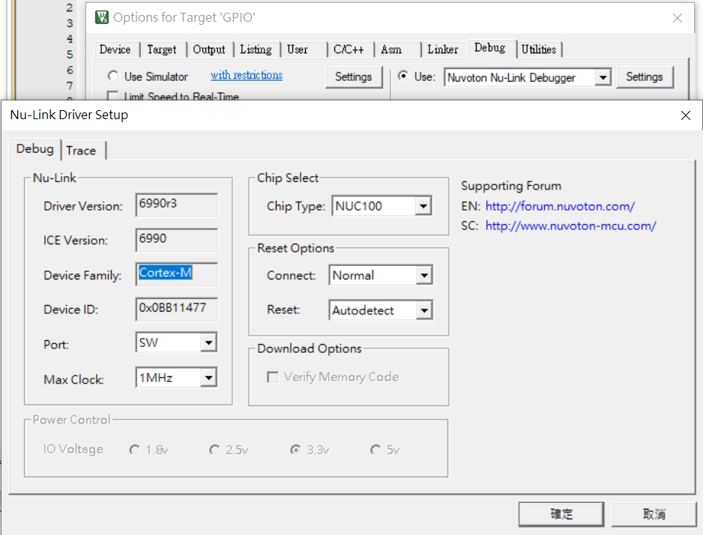
Keil Configuration
must select correct
device series
NUC100 is for NUC140, …
Nano100 is for Nano102, 112

Slide 25
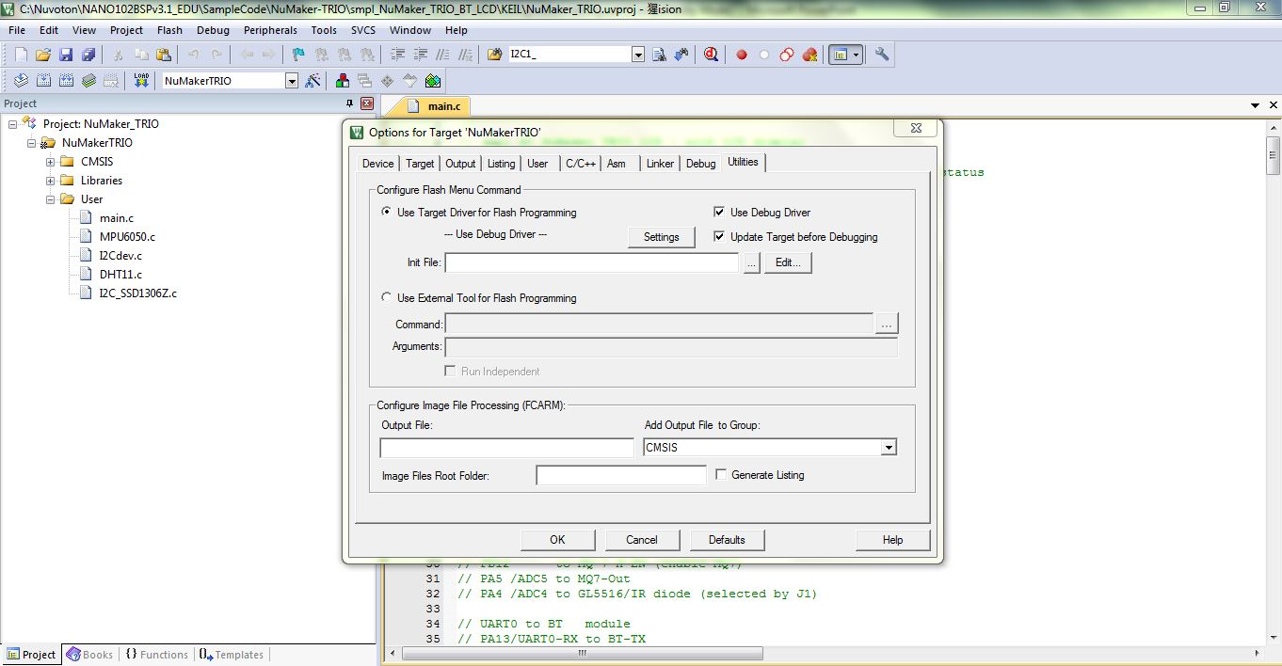
Keil Configuration

Slide 26
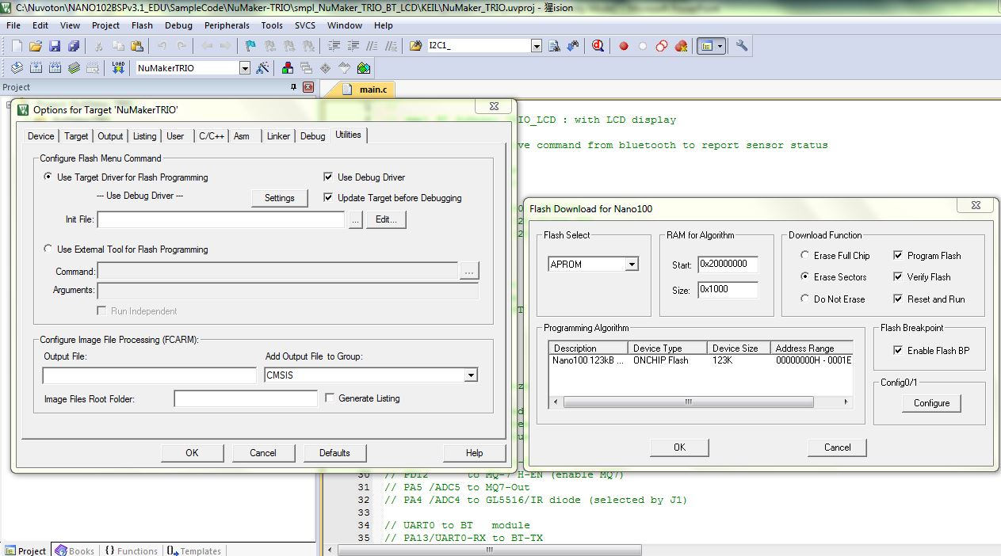
Keil Configuration

Slide 27
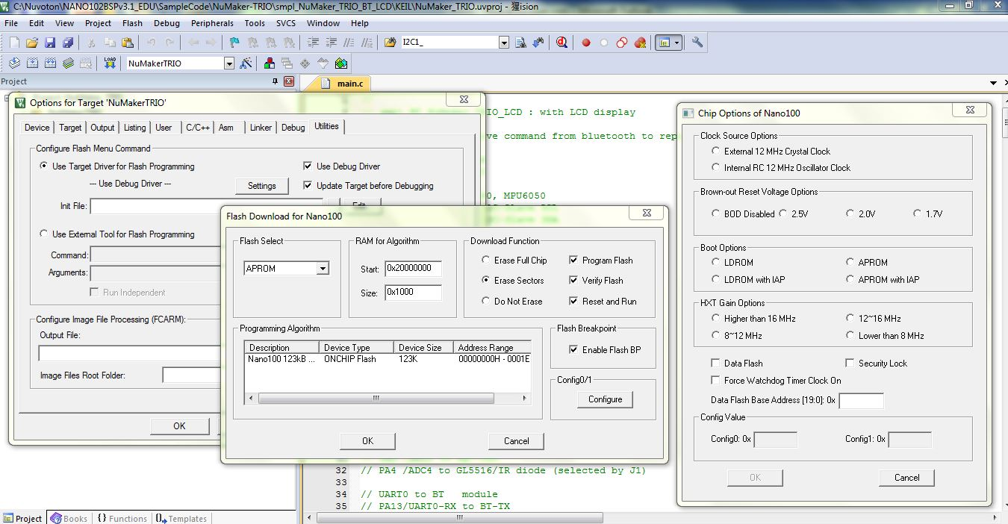
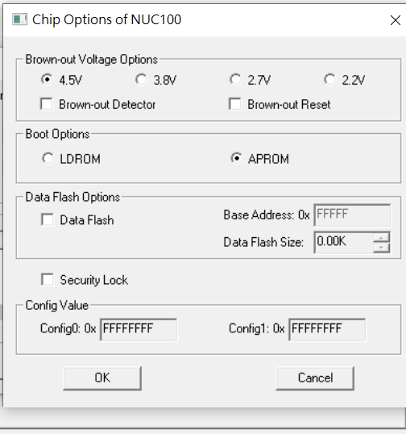
Keil Configuration

Slide 28
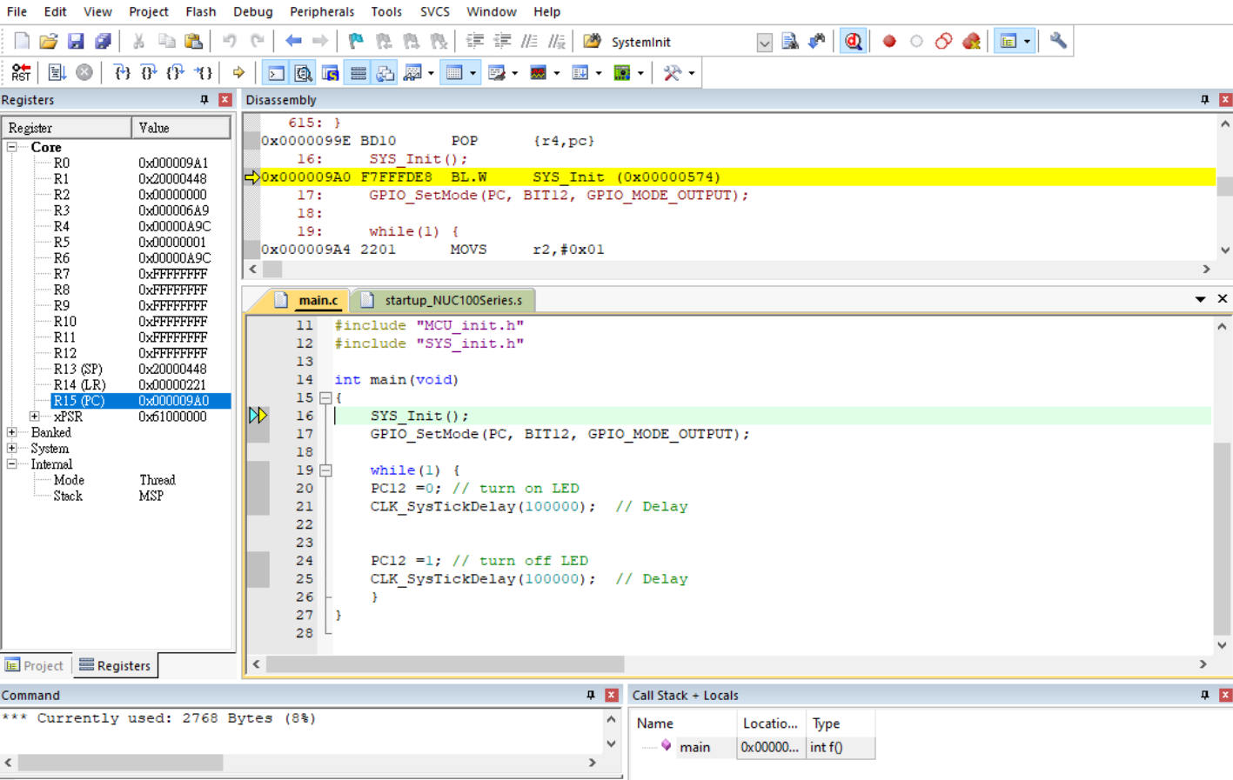
Debug Session
Disassembly Window
Program counter

