Slide 1
Nu-LB-NUC140
Introduction
3/2/2017
Richard Kuo
Assistant Professor

Slide 2
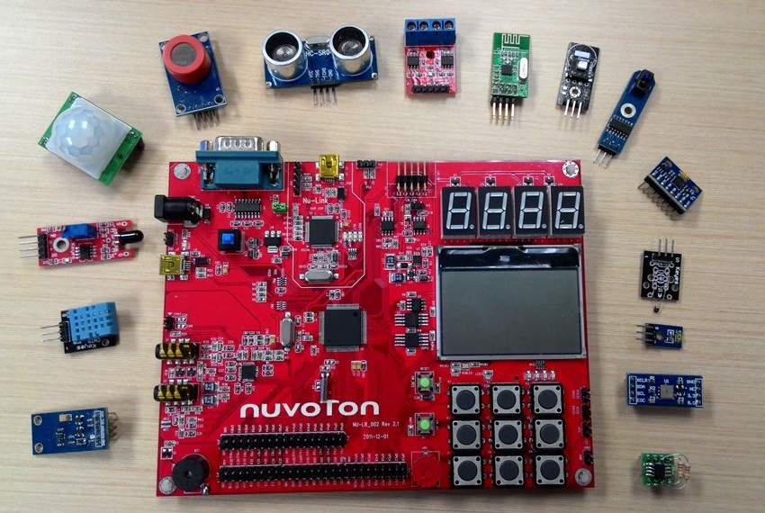
Learning Board : Nu-LB-NUC140

Slide 3
NuMicro Learning Board Intro
Learning Board Introduction
Learning Board Pin used and its function
Learning Board Schematics

Slide 4
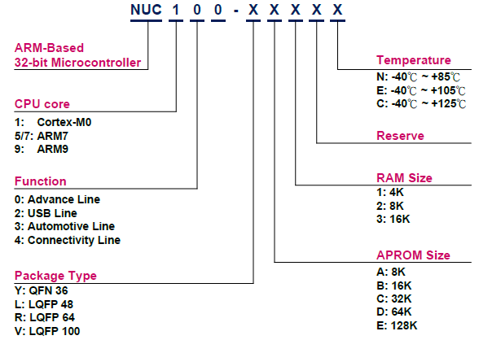
NUC140 – Product Naming
115/11/08

Slide 5
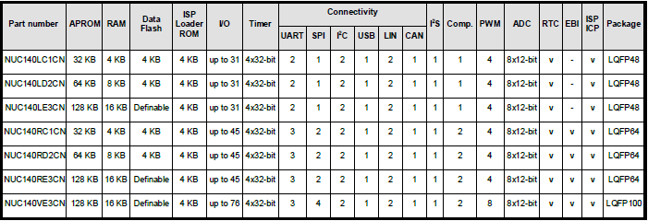
NUC140 Series Product
115/11/08

Slide 6
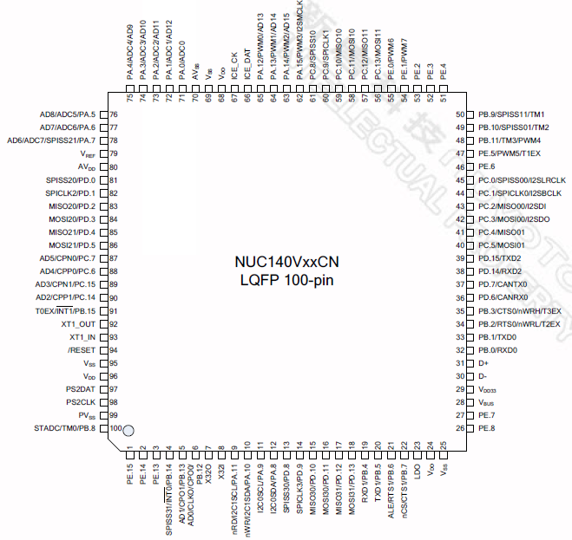
NUC140 LQFP-100

Slide 7
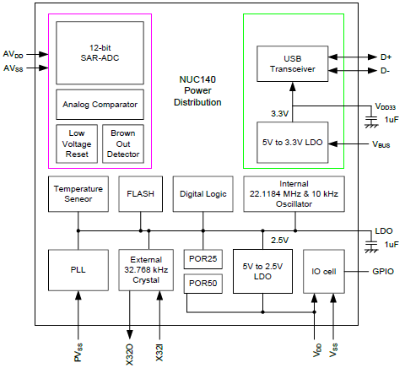
NUC140 Power Distribution
115/11/08

Slide 8
System Reset
nRESET pin Reset
Power-on Reset (POR)
Low Voltage on Reset pin (LVR)
Brown-out Detector Reset (BOD Reset)
Watch Dog Timer Reset (WDT Reset)
CPU Reset
System Reset

Slide 9
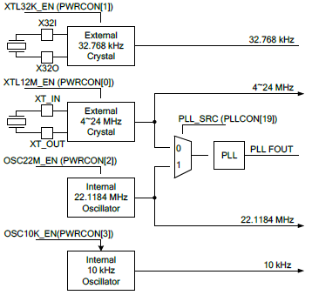
NUC140 Clock Generator Block

Slide 10
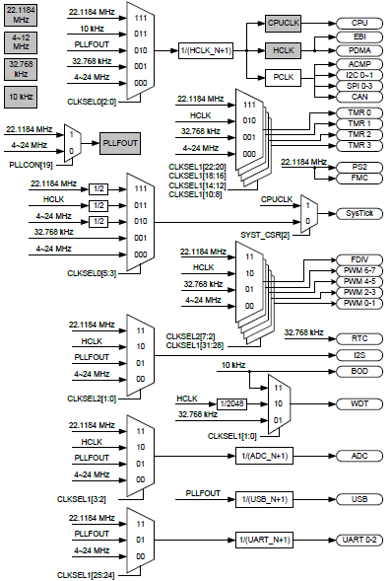
115/11/08

Slide 11
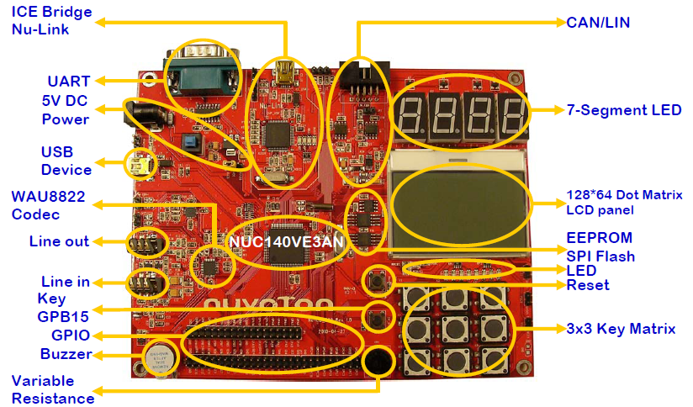
Nu-LB-NUC140 Learning Board
Learning Board Supply Voltage is +5 Volt

Slide 12
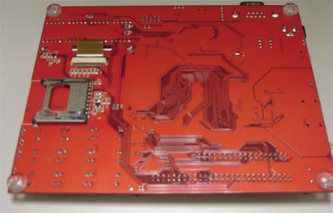
Nu-LB-NUC140 Learning Board (bottom view)
SD Card

Slide 13
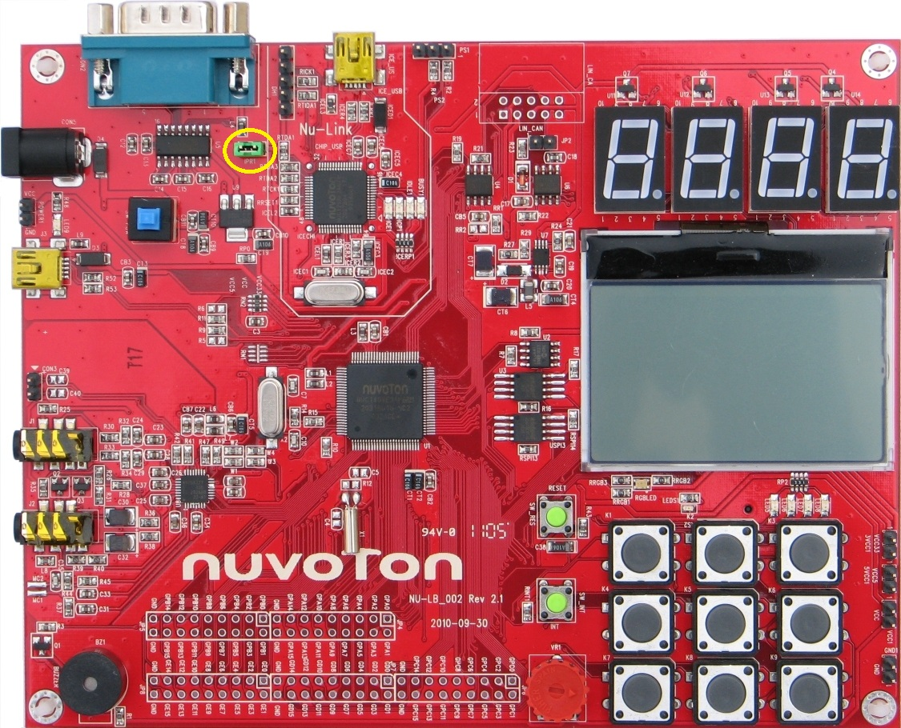
Power Connectors
Nu-Link miniUSB port
(+5V from PC USB port)
DC+5V
power supply
DC supply
to NuLink
Vcc & Gnd pins
USB2.0 supply +5V
Power
Switch
Vcc33
Vcc5
Vcc
Gnd
supply voltage to external devices

Slide 14
Peripheral Connectors & Buttons
CAN2.0
RS232
USB2.0 to PC
Speaker : Con3
earphone : J1
Reset
LEDs
mic : J2
SW Int
VR

Slide 15
Pin named by GPIO groups

Slide 16
Pin named by GPIO groups A~E
Learning Board pins are named into 5 groups : GPA, GPB, GPC, GPD, GPE
Pins named by PA, PB, PC, PD, PE with a pin no.0~15
  PA, PB, PC, PD, PE as its defined port name in the C code
To connect to external sensors / circuits, you can jump wire from these pins to the external devices

Slide 17
Learning Board Schematics
7-segment schematic
64x128 LCD schematic
RGB LED schematic
Keypad & SW_INT schematic
UART/RS232 schematic
I2C & Buzzer schematic
SPI schematic
PS2 & ADC schematic
I2S schematic
CAN＆LIN schematic
SD card schematic

Slide 18
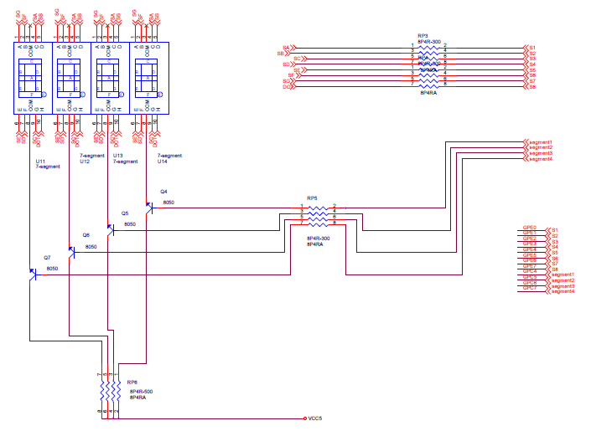
7 segment schematic
GPE0~7, GPC4~7

Slide 19
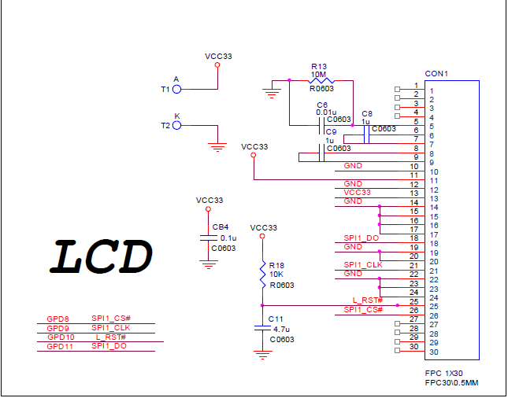
64x128 LCD schematic
GPD8~11

Slide 20
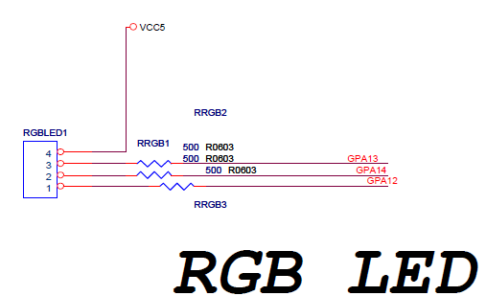
RGB LED schematic
GPA14 control Blue color
GPA13 control Green color
GPA12 control Red color
Output low to enable R/G/B LEDs

Slide 21
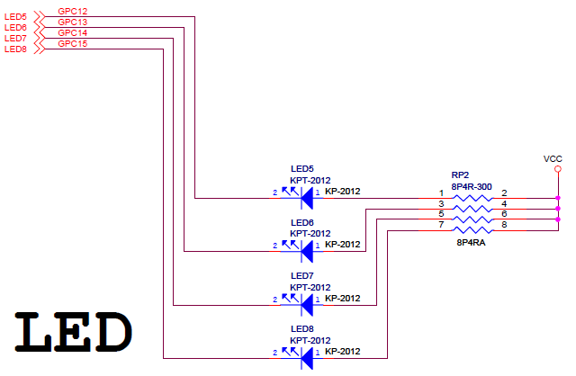
Red LED schematic
GPC12,13,14,15
(output low to enable LED)

Slide 22
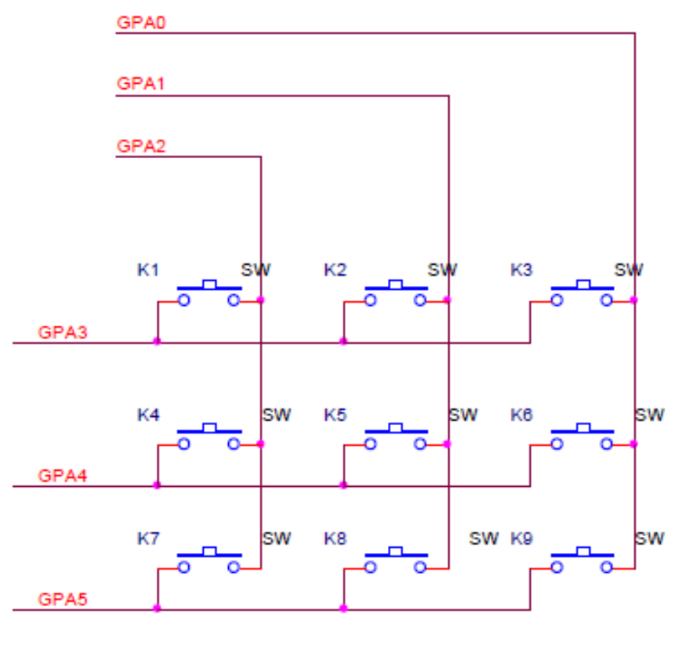
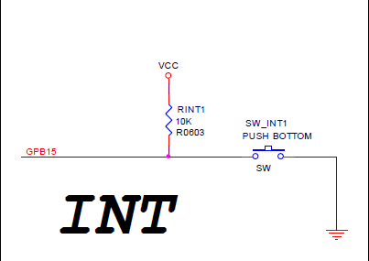
Keypad & SW_INT schematic
GPA0~5
GPB15

Slide 23
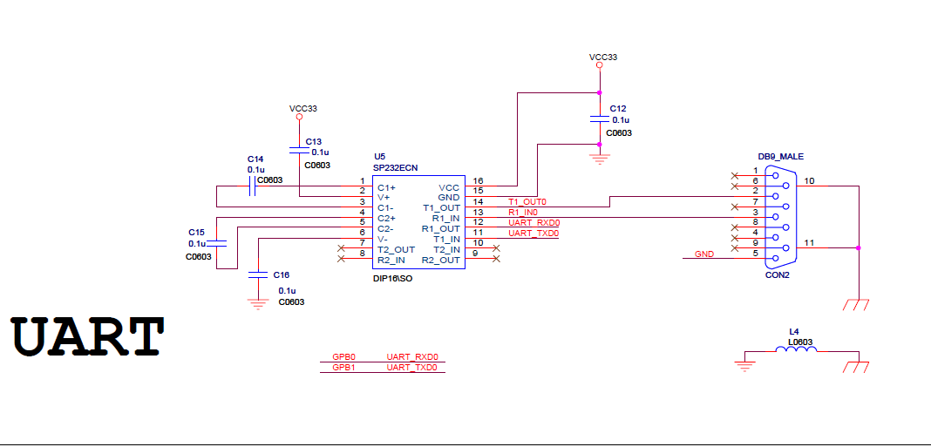
UART/RS232 schematic
GPB0,1

Slide 24
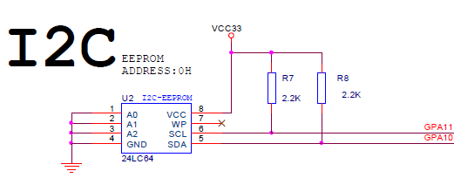
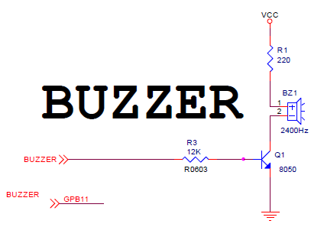
I2C & Buzzer schematic
GPA10,11
0 ohm
GPB11

Slide 25
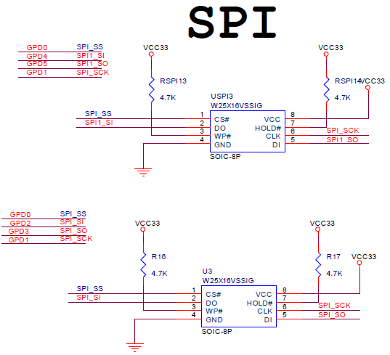
SPI schematic
GPD0~5

Slide 26
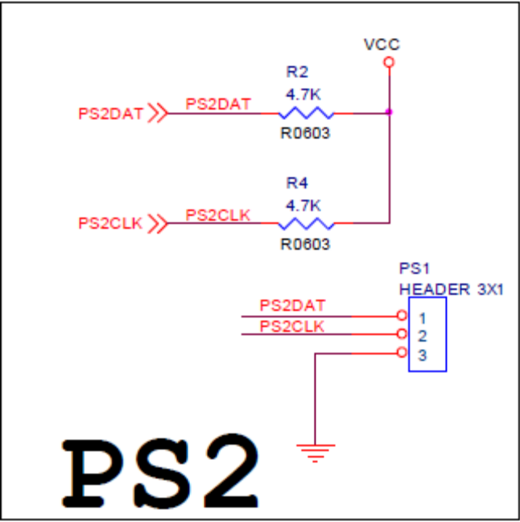
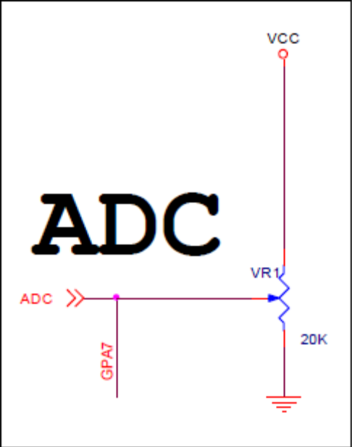
PS2 & ADC schematic
GPA7

Slide 27
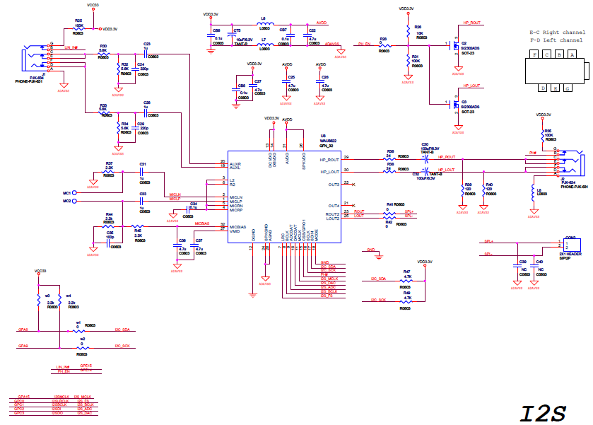
I2S schematic
GPA8,9
GPA15
GPC0~3

Slide 28
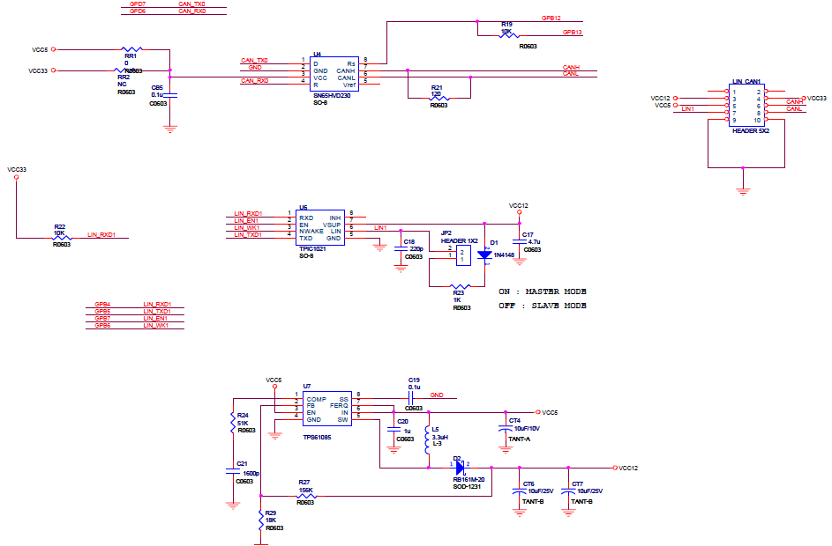
CAN＆LIN schematic
CAN : GPD6,7
LIN : GPB4~7

Slide 29
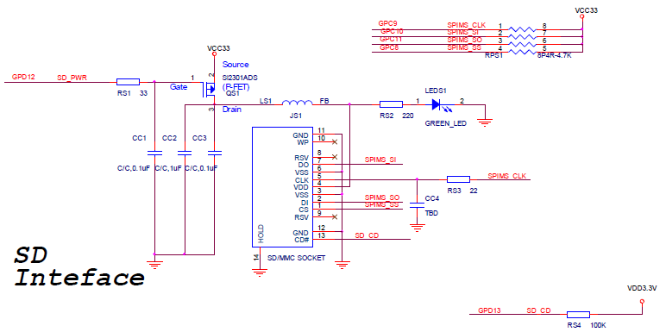
SD card schematic
GPD12,13
GPC8~11

