Slide 1
Lab 2
LED & KEYPAD & 自建專案

Slide 2
建立一個類似 Sample Code 的新專案

Slide 3
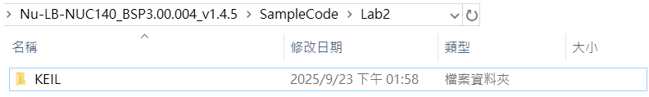
新增資料夾
在 SampleCode 目錄裡新增一個資料夾 Lab2，裡面再新增一個資料夾 KEIL。

Slide 4
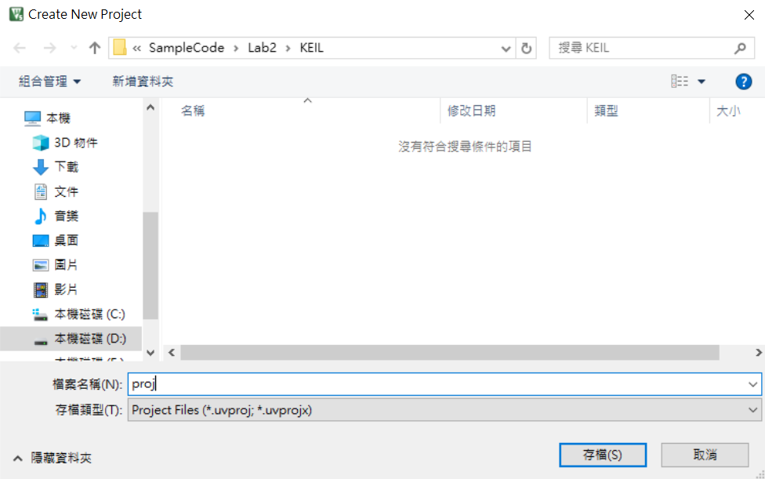
開啟 uVision5 > Project > New uVision Project
選擇剛建立的資料夾 KEIL, 並給予新專案名稱 proj.

Slide 5
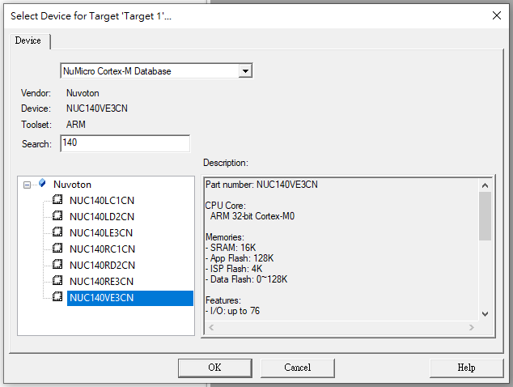
選擇Device
NuMicro Cortex-M Database
選擇NUC140VE3CN

Slide 6
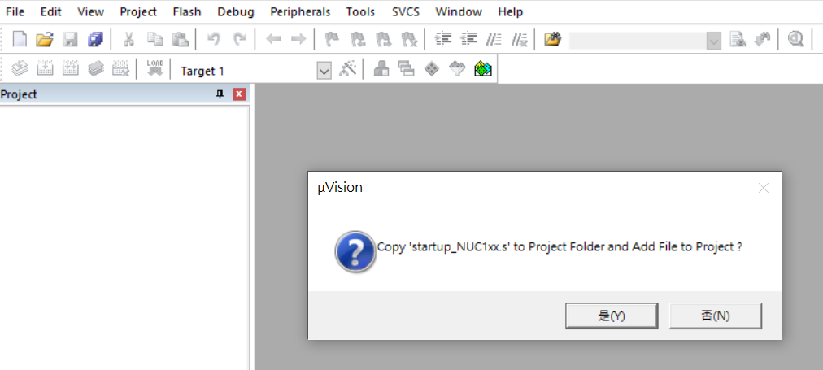
選“否(N)”, 因為後面會自行加入 startup_NUC100Series.s

Slide 7
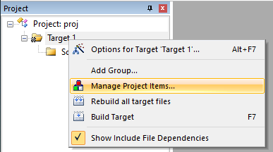
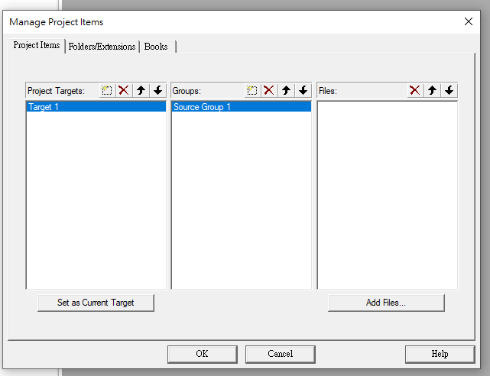
新增Group
右鍵Target 1 → Manage Project Item…

Slide 8
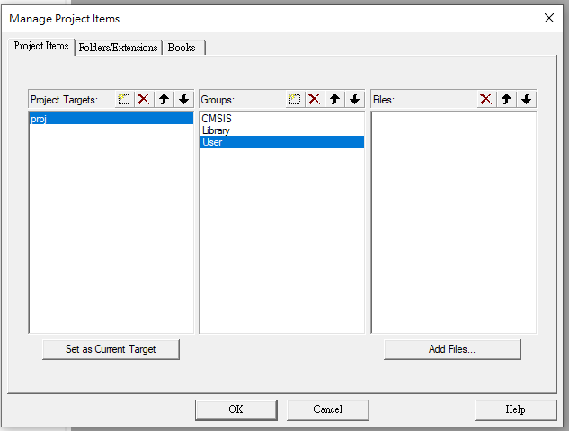
新增Group
在Target 1 按兩下, 將名稱改為 proj
新增三個Groups
CMSIS
Library
User

Slide 9
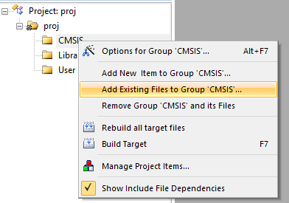
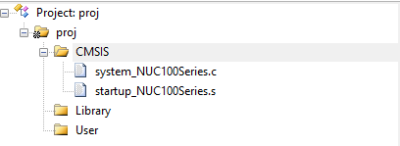
新增檔案至CMSIS
system_NUC100Series.c
Library\Device\Nuvoton\NUC100Series\Source
startup_NUC100Series.s
Library\Device\Nuvoton\NUC100Series\Source\ARM

Slide 10
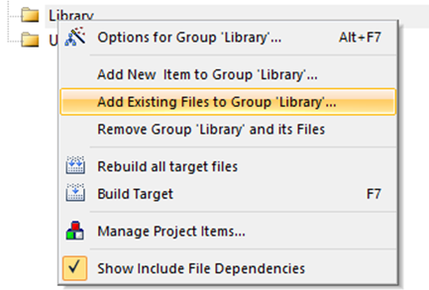
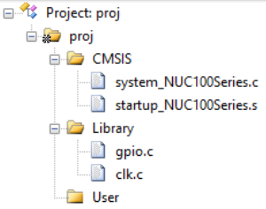
新增檔案至Library
gpio.c
Library\StdDriver\src
clk.c
Library\StdDriver\src

Slide 11
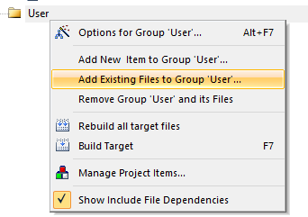

新增檔案至User
SYS_init.c
Library\Nu-LB-NUC140\Source

Slide 12
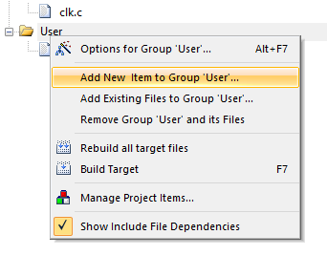
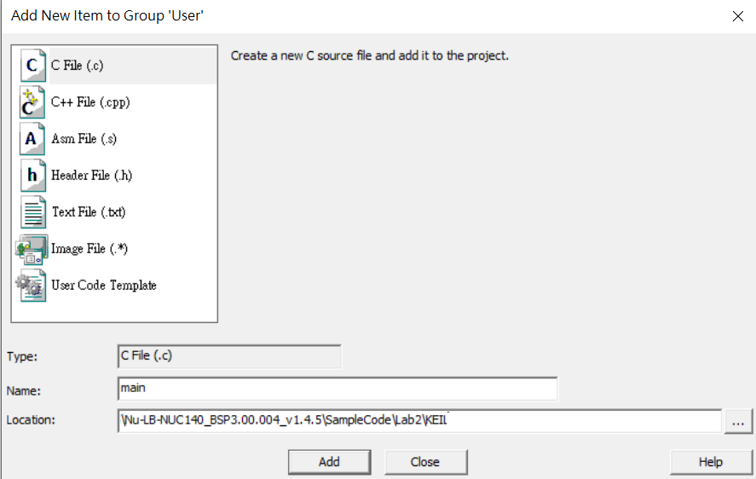
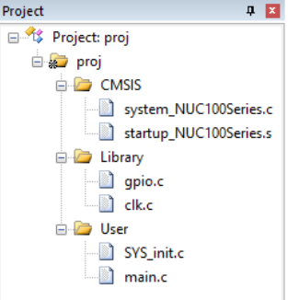
新增 main.c 至User
Location 選擇到KEIL資料夾

Slide 13
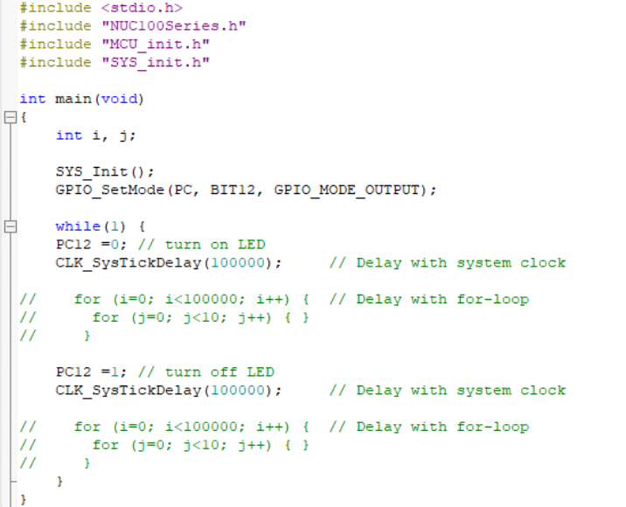
main.c

Slide 14
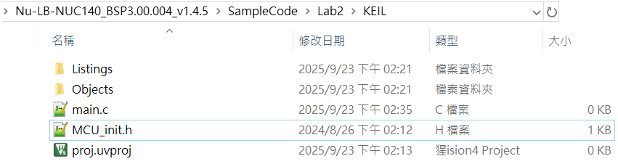
MCU_init.h
//Define Clock source
#define MCU_CLOCK_SOURCE
#define MCU_CLOCK_SOURCE_HXT // HXT, LXT, HIRC, LIRC
#define MCU_CLOCK_FREQUENCY 50000000 //Hz
//Define MCU Interfaces

Slide 15
Project Configuration
The following are some important settings that you need to do.
You can also refer to“2_SDK_Keil_MDK.ppt”for more details.

Slide 16
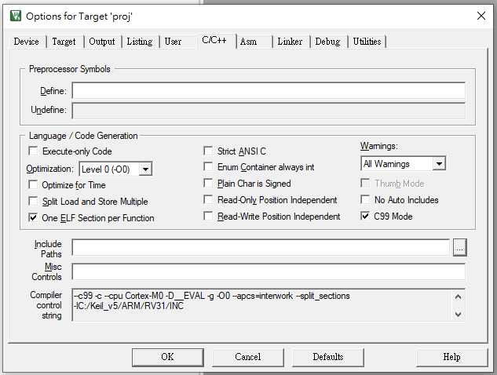
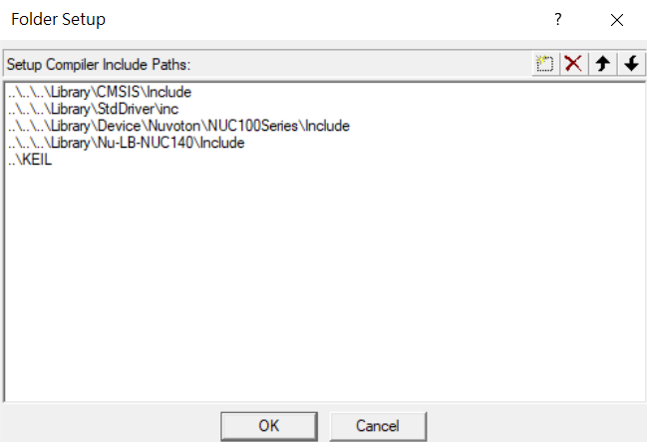
Configure ->C/C++ ->Include Paths

Slide 17
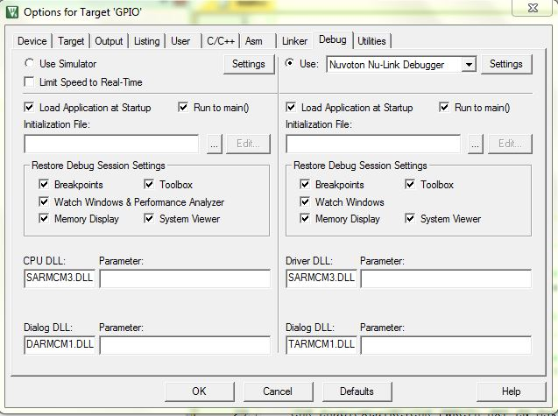
Configure ->Debug
must use Nu-Link Debugger
If you see no Nu-Link Debugger here, then you need to reinstall
Nu-Link ICE driver

Slide 18
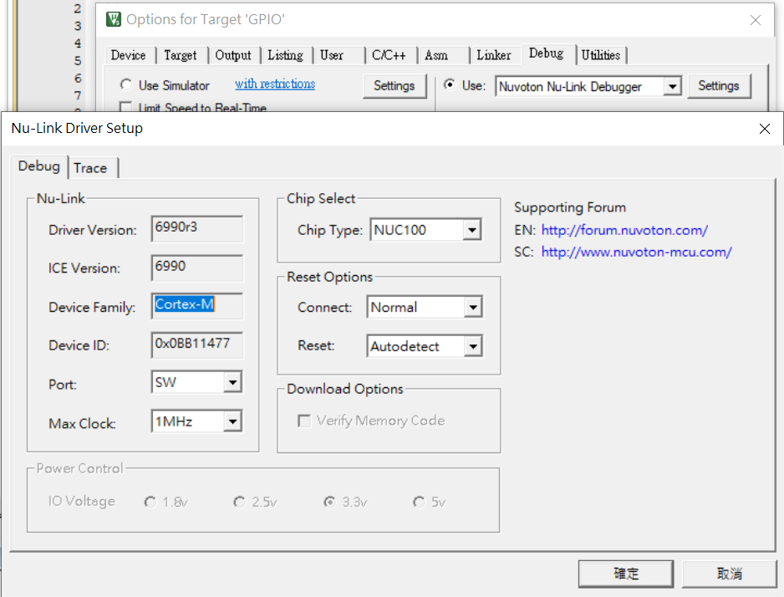
Configure ->Debug
must select correct
device series
NUC100 is for NUC140, …
Nano100 is for Nano102, 112

Slide 19
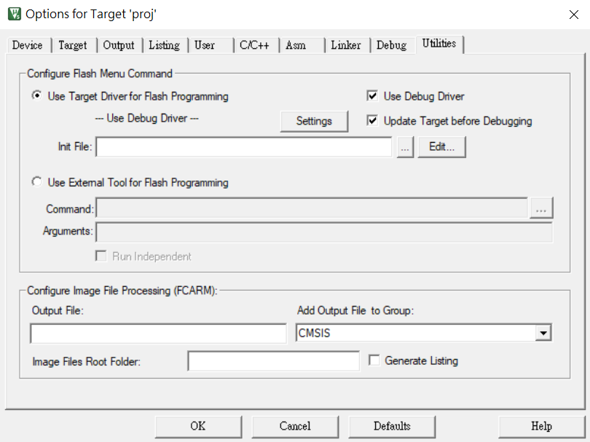
Configure ->Utilities

Slide 20
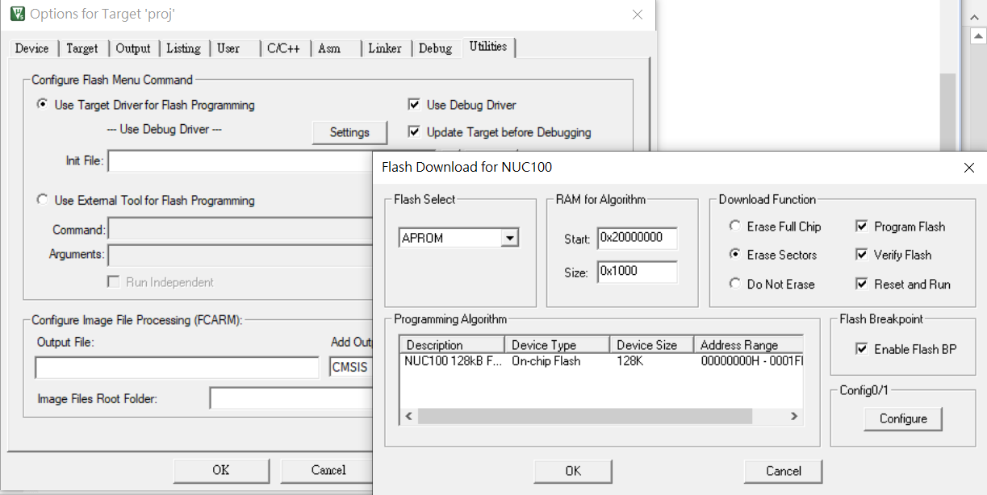
Configure ->Utilities
must be set, otherwise you won’t see the program running

Slide 21
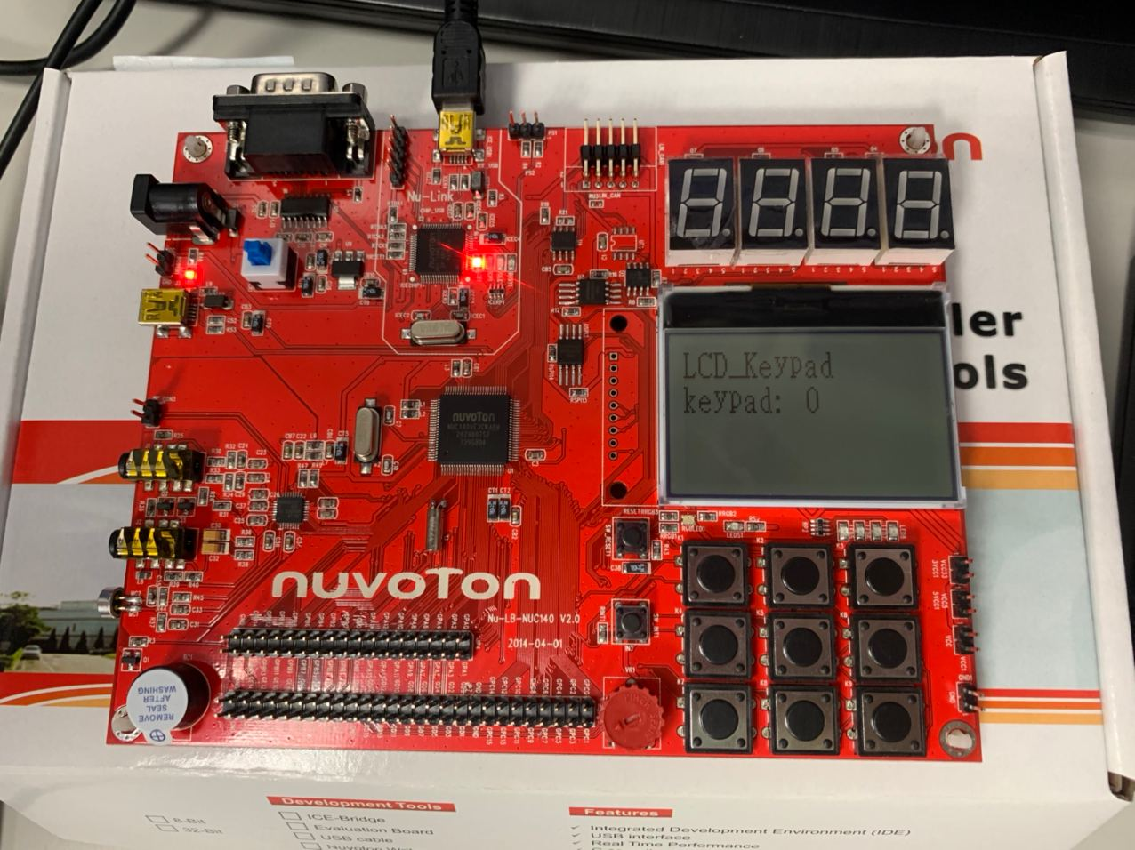
連接開發板

Slide 22
實驗
Hint: Yon can also make use of projects “GPIO_LED” and “GPIO_Keypad” for this lab.

Slide 23
Lab2.1
用LED搭配按鍵分別顯示每個學號的二進位
Ex:D0987654
按鍵1顯示第一個學號數字 0, (以LED全亮代替)
按鍵2顯示第二個學號數字 9 = 1001₍₂₎
按鍵3顯示第三個學號數字 8 = 1000₍₂₎
…
1
2
3
4
5
6
7
( 備註: 按住按鍵, 執行上述動作. 放開按鍵, 停止動作. )

Slide 24

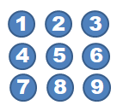
Lab2.2
按鍵1左向右跑的旋轉跑馬燈
按鍵2=flash
按鍵3右向左跑的旋轉跑馬燈
( 備註: 按住按鍵, 執行上述動作. 放開按鍵, 停止動作. )

