Slide 1
Lab 1
Assembly Codes

Slide 2


Lab1.1
Define an array with 10 unsigned integers a_{i} (0 ≦ i ≦ 9) in assembly code.
Write an assembly program that calculates the sum of the square of these 10 unsigned integers.
The result sum is saved in register R4.

Slide 3
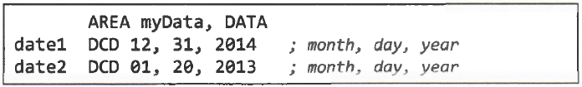
Lab1.2
Assume two dates are stored in memory as follows.
Write an assembly program to compare these two dates.
If date1 comes before date2, set register R0 to 1; otherwise, set R0 to -1.

Slide 4
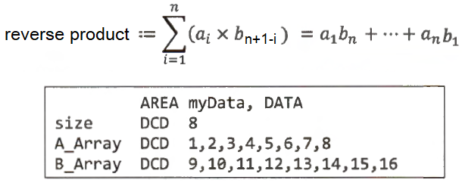
Lab1.3
Write an assembly program that calculates the reverse product of two integer vectors of the equal number of elements.
The reverse product is saved in register R4 and is defined as:

