Slide 1
UNITED STATES HISTORY I
Final Project: Five Key Topics in American History
Cristopher Saravia Medina
US History I • Fall 2024

Slide 2
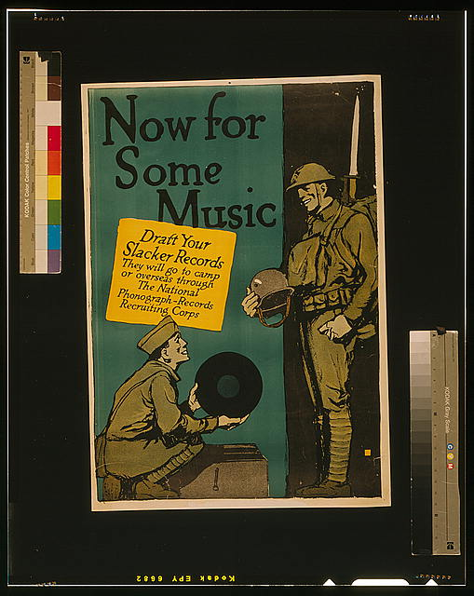
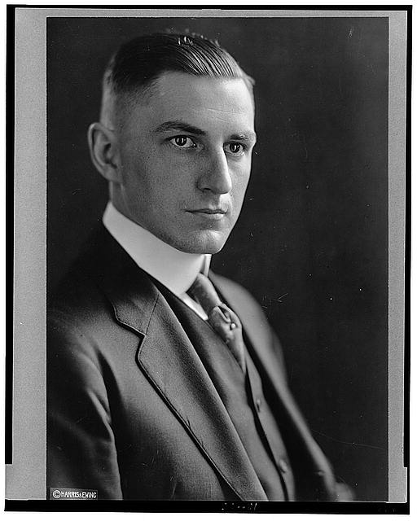
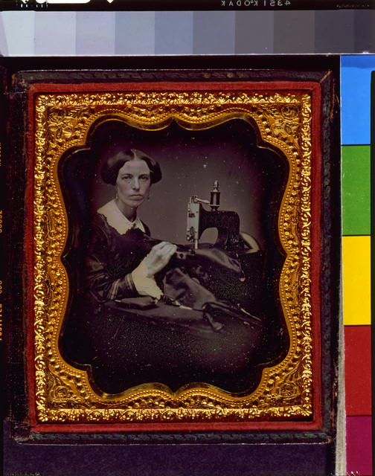
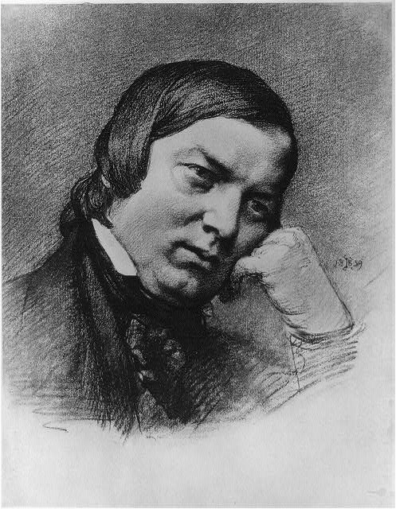
TOPIC 1
Colonial America: Life in the Colonies
KEY FACTS
★ The 13 colonies were split into three groups: New England, Middle, and Southern colonies. Each region had its own economy and lifestyle.
★ New England made money through fishing and shipbuilding. Southern colonies grew cash crops like tobacco using enslaved African workers.
★ Religion was super important - Puritans came to Massachusetts for religious freedom and built strict communities based on their beliefs.
★ Colonial society had a clear class system: wealthy landowners at the top, farmers in the middle, enslaved people at the bottom.
★ The Great Awakening (1730s-1740s) was a religious movement that brought colonists together and made them question authority.
US History I • Cristopher Saravia Medina • Topic 1 of 5

Slide 3
TOPIC 1
What I Learned: Colonial America
📚 What I Learned
🔍 Additional Research
Learning about colonial America helped me understand how the United States began and why different regions developed so differently.
→ Indentured servants made up about 50% of all European immigrants to the colonies - they worked 4-7 years for free passage to America.
→ The average colonial family had 7-10 children because so many died young from disease.
→ Colonial women had almost no legal rights - married women couldn't own property or sign contracts.
→ The slave population grew from about 7,000 in 1680 to over 300,000 by 1750, mostly in the South.
• I learned that geography really shaped how people lived - the rocky soil in New England meant they couldn't farm much, so they turned to the ocean instead.
• It was eye-opening to see how slavery was built into the Southern economy from the very start, not something that came later.
• The Puritans were way stricter than I thought - they could punish you just for missing church!
• I now understand why the colonists felt so independent - they were basically running their own communities for over 100 years.
Reflection & Research • Topic 1 • Cristopher Saravia Medina

Slide 4
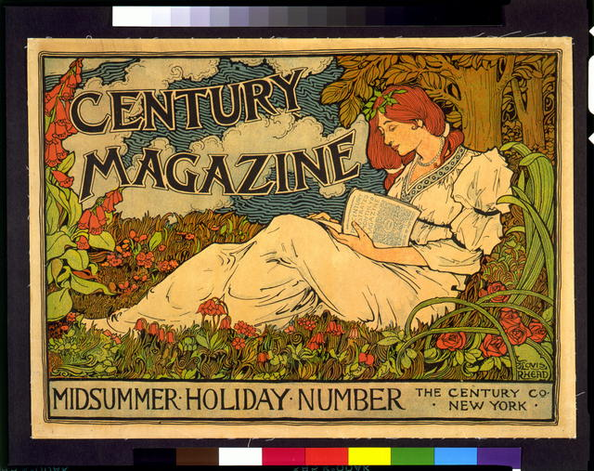
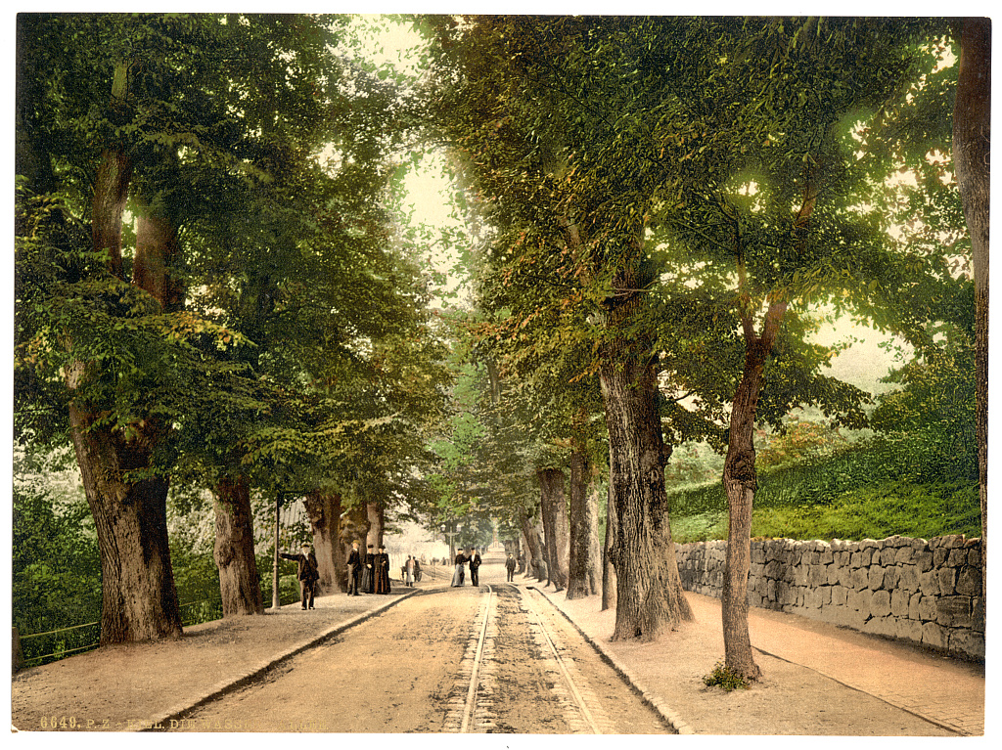
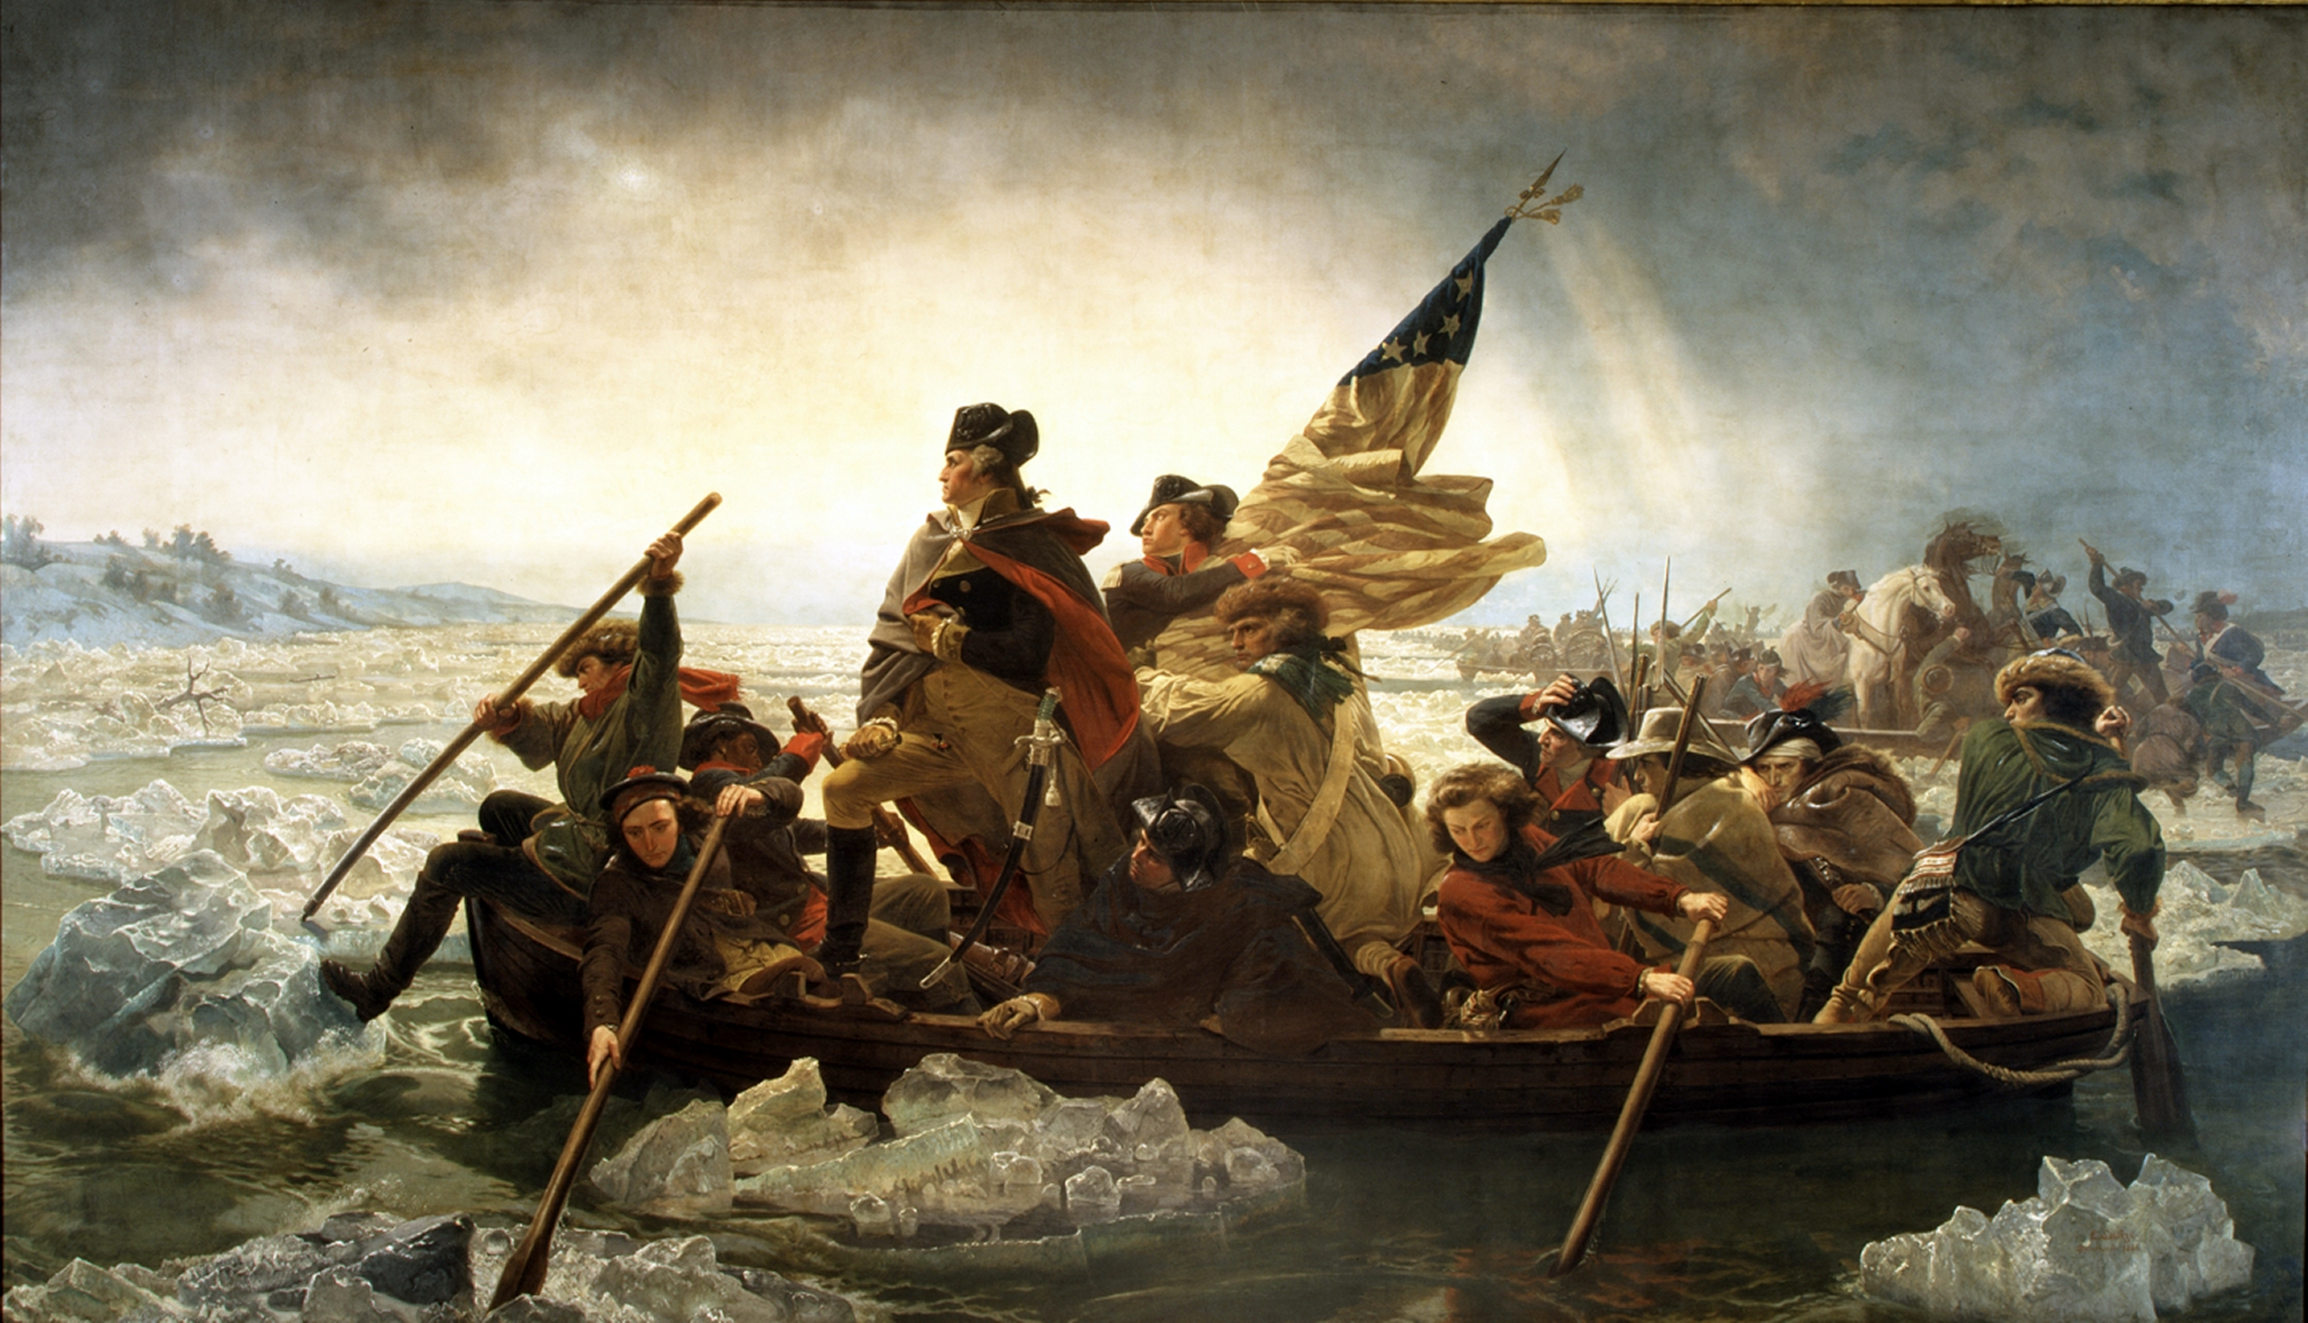
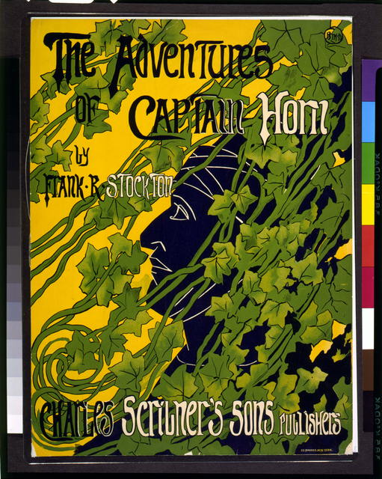
TOPIC 2
The American Revolution (1775-1783)
KEY FACTS
★ The Revolution happened because colonists were fed up with "taxation without representation" - Britain taxed them without giving them a voice.
★ Key events: Boston Massacre (1770), Boston Tea Party (1773), and the harsh Intolerable Acts that punished Massachusetts.
★ Thomas Jefferson wrote the Declaration of Independence in 1776, proclaiming all men are created equal with rights to life and liberty.
★ George Washington led the Continental Army through eight hard years, including the freezing winter at Valley Forge.
★ France joining our side in 1778 was a game-changer - they gave us soldiers, money, and ships that helped win at Yorktown.
US History I • Cristopher Saravia Medina • Topic 2 of 5

Slide 5
TOPIC 2
What I Learned: American Revolution
📚 What I Learned
🔍 Additional Research
Studying the Revolution showed me that freedom isn't free - regular people made huge sacrifices to create our country.
→ Only about 3% of colonists actually fought in the Continental Army at any given time.
→ More soldiers died from disease and cold than from actual combat during the war.
→ Women like Deborah Sampson disguised themselves as men to fight, and others like Molly Pitcher helped on battlefields.
→ The war cost Britain so much money that it contributed to their own economic problems for decades.
→ About 5,000 Black soldiers fought for the Continental Army, with some earning their freedom for serving.
• I didn't realize how close we came to losing the war. Washington's army was broke, starving, and outnumbered most of the time.
• The Declaration's words about equality were revolutionary for that time, even if they didn't apply to everyone yet.
• It's crazy that a bunch of farmers and merchants actually beat the world's most powerful military.
• I learned that not everyone supported independence - about 1/3 of colonists were Loyalists who wanted to stay British.
Reflection & Research • Topic 2 • Cristopher Saravia Medina

Slide 6
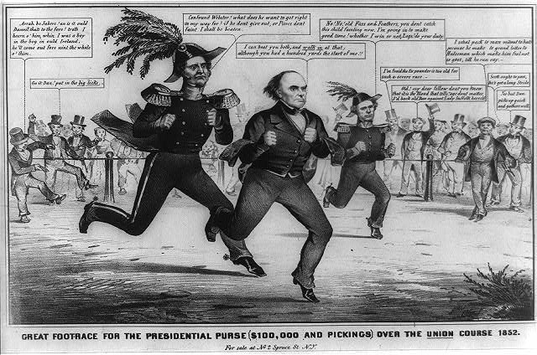
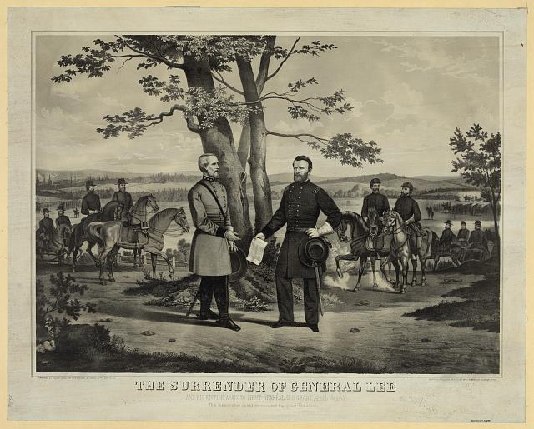
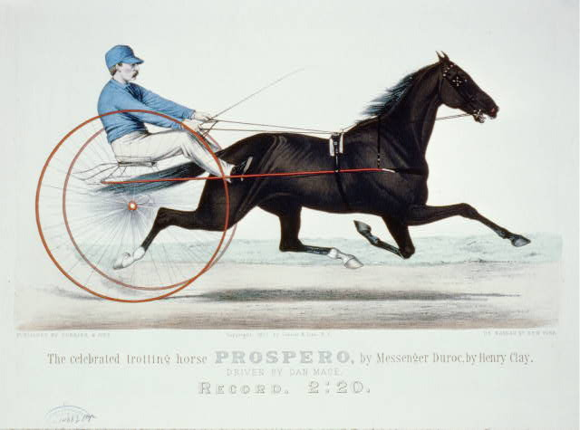
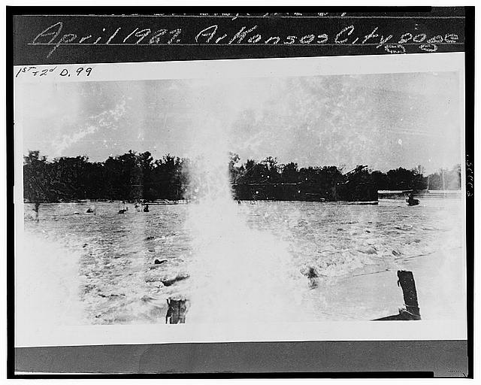
TOPIC 3
The Civil War (1861-1865)
KEY FACTS
★ The war started when Southern states left the Union to keep slavery. They feared Lincoln would end their way of life.
★ The North had more people, factories, and railroads. The South had experienced military leaders defending their homeland.
★ Lincoln's Emancipation Proclamation (1863) freed enslaved people in rebel states and let Black men join the Union Army.
★ The Battle of Gettysburg (July 1863) was a turning point - the Union won and stopped the South from invading the North.
★ The war ended when General Lee surrendered to General Grant at Appomattox in April 1865. Lincoln was killed days later.
US History I • Cristopher Saravia Medina • Topic 3 of 5

Slide 7
TOPIC 3
What I Learned: The Civil War
📚 What I Learned
🔍 Additional Research
The Civil War taught me that our country almost tore itself apart over slavery, and the effects of that division lasted for generations.
→ The Civil War was the first war to be extensively photographed, changing how people saw the horrors of combat.
→ About 180,000 Black soldiers served in the Union Army, making up roughly 10% of Union forces by war's end.
→ Clara Barton, who later founded the Red Cross, worked as a nurse and brought supplies directly to battlefields.
→ The South's economy was devastated - Confederate money became worthless and many plantations were destroyed.
→ Lincoln's assassination made him a martyr and complicated the process of bringing the nation back together.
• I was shocked to learn that about 620,000 soldiers died - more Americans than in all other U.S. wars combined until Vietnam.
• The Emancipation Proclamation was as much a military strategy as a moral decision - it prevented Europe from helping the South.
• I understand now why this is called the first 'modern war' - new weapons made it incredibly deadly.
• Learning about the draft riots showed me that not everyone in the North supported the war or ending slavery.
Reflection & Research • Topic 3 • Cristopher Saravia Medina

Slide 8
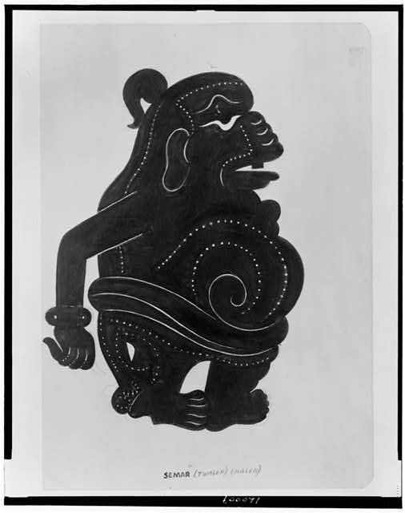
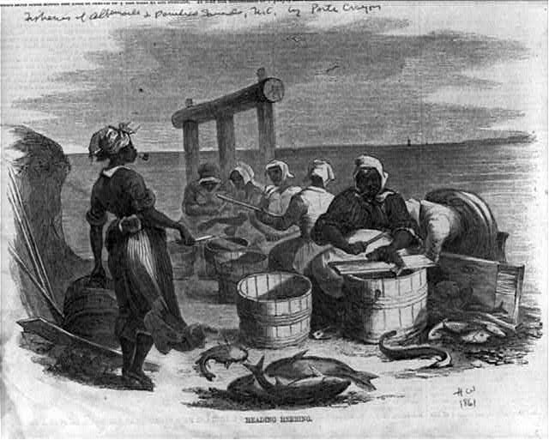
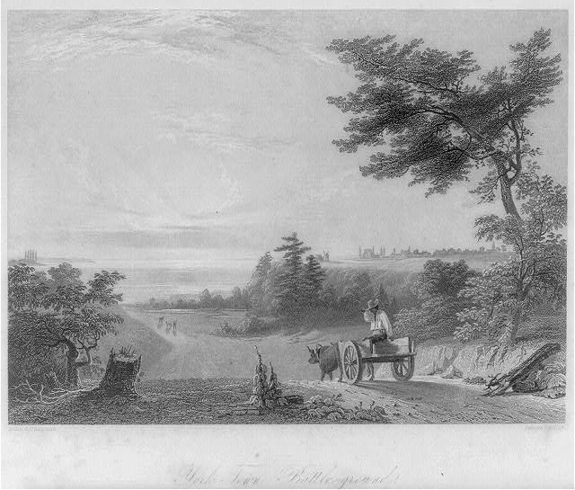
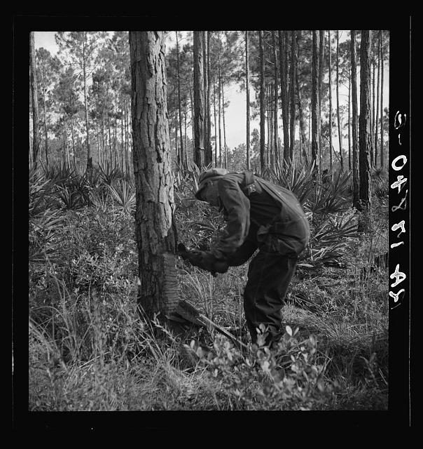
TOPIC 4
Reconstruction Era (1865-1877)
KEY FACTS
★ Reconstruction was the time after the Civil War when the government tried to rebuild the South and help 4 million freed Black Americans.
★ Three amendments were added: 13th (ended slavery), 14th (citizenship & equal rights), 15th (voting rights for Black men).
★ The Freedmen's Bureau helped former slaves with food, schools, and jobs, but it didn't get enough funding.
★ Black Americans made real progress - they voted, held political office, started businesses, and built schools.
★ Reconstruction ended in 1877 after a political deal. Southern states quickly passed Jim Crow segregation laws.
US History I • Cristopher Saravia Medina • Topic 4 of 5

Slide 9
TOPIC 4
What I Learned: Reconstruction
📚 What I Learned
🔍 Additional Research
Reconstruction showed me a time of real hope and progress for Black Americans that was sadly crushed by racism and politics.
→ Hiram Revels of Mississippi became the first Black U.S. Senator in 1870, taking Jefferson Davis's old seat.
→ The Ku Klux Klan formed in 1866 and used violence and terror to stop Black people from voting or holding office.
→ Sharecropping trapped many freed people in cycles of debt that kept them working on the same plantations.
→ The Compromise of 1877 gave Republican Rutherford B. Hayes the presidency in exchange for ending Reconstruction.
→ Black literacy rates rose from about 5% in 1870 to over 30% by 1880 thanks to schools built during Reconstruction.
• I was amazed to learn that over 2,000 Black men held public office during Reconstruction, including U.S. Senators.
• The Freedmen's Bureau schools were incredibly important - they taught reading to people who had been forbidden to learn.
• It's frustrating that so much progress was undone so quickly once federal troops left the South.
• I now see how the failures of Reconstruction led directly to 100 years of segregation and civil rights struggles.
Reflection & Research • Topic 4 • Cristopher Saravia Medina

Slide 10
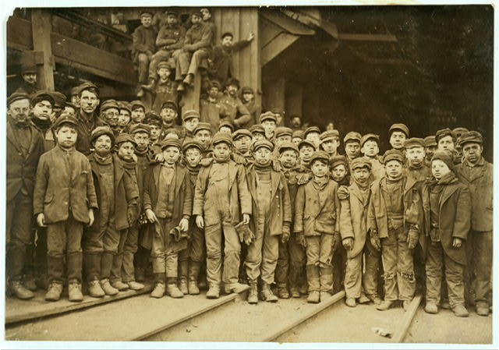
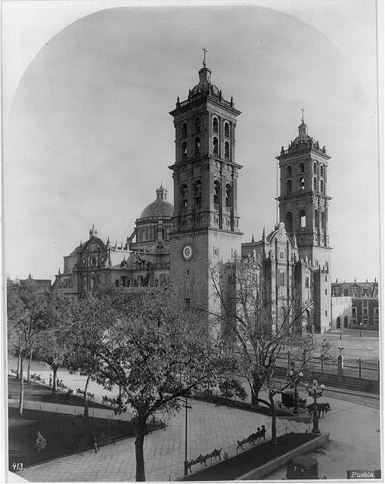
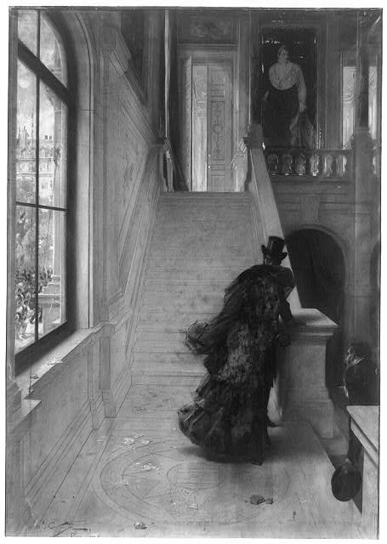
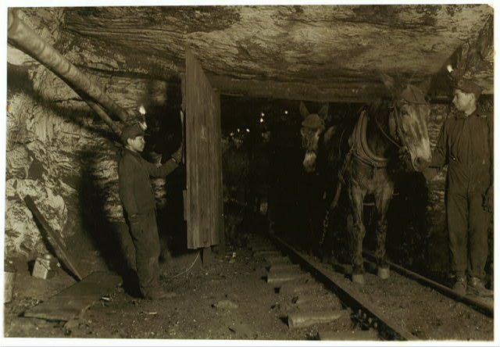
TOPIC 5
Industrialization in America (1870s-1900s)
KEY FACTS
★ After the Civil War, America changed from a farming country into an industrial giant with factories everywhere.
★ Amazing inventions changed life: Bell's telephone, Edison's light bulb, and Carnegie's steel production.
★ The Transcontinental Railroad (finished 1869) made coast-to-coast travel possible in days instead of months.
★ Factory workers had it rough: 12-16 hour days, low pay, and dangerous machines. Even young kids had to work.
★ Workers started forming labor unions and went on strikes demanding better pay, shorter hours, and safer conditions.
US History I • Cristopher Saravia Medina • Topic 5 of 5

Slide 11
TOPIC 5
What I Learned: Industrialization
📚 What I Learned
🔍 Additional Research
Industrialization showed me how progress came at a huge cost to workers, especially immigrants and children who had no protections.
→ By 1900, about 2 million children under 16 worked in factories, mines, and mills across America.
→ Andrew Carnegie's steel company made him the richest man in America - worth about $380 billion in today's money.
→ The Haymarket Riot of 1886 in Chicago turned violent and set back the labor movement for years.
→ Chinese immigrants built much of the Transcontinental Railroad but faced severe discrimination and the Chinese Exclusion Act.
→ The average factory worker made about $400-$500 per year while working 60+ hours per week with no vacation.
• I was disturbed by how young the child workers were - some factory kids were only 5 or 6 years old.
• The 'robber barons' like Carnegie and Rockefeller got incredibly rich while their workers barely survived.
• I understand now why labor unions were so important - without them, workers had no power to demand better treatment.
• It's interesting how this period created both amazing inventions and terrible inequality at the same time.
Reflection & Research • Topic 5 • Cristopher Saravia Medina

Slide 12
Works Cited
MLA Format Citations
1. Foner, Eric. Give Me Liberty!: An American History. 6th ed., W.W. Norton & Company, 2020.
2. History.com Editors. "American Revolution History." History, A&E Television Networks, 29 Oct. 2009, www.history.com/topics/american-revolution.
3. National Archives. "The Emancipation Proclamation." National Archives, U.S. National Archives and Records Administration, www.archives.gov/exhibits/featured-documents/emancipation-proclamation.
Cristopher Saravia Medina • US History I • Final Project

