Slide 1

LU6 Pipelines
Pipelines help us chain the steps for processing data
P131

Slide 2
What is a pipeline A pipeline in Machine learning is a way to chain multiple data processing and modeling steps into a single, reusable workflow.
Combines preprocessing (e.g., scaling, imputation) and modeling steps into one object.
Helps avoid data leakage by ensuring that preprocessing happens within cross-validation folds.
Makes your code cleaner, more organized, and repeatable.

Slide 3
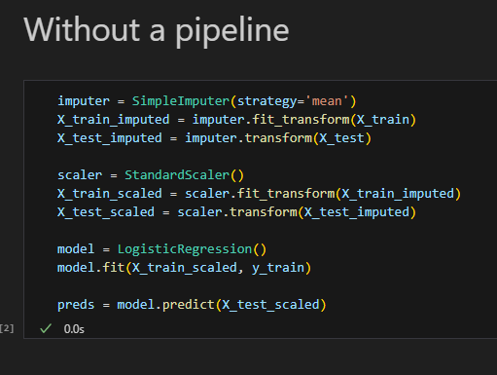
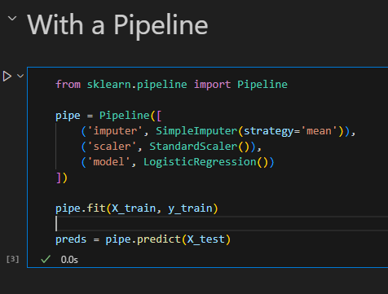
So, we go from:
This
To this

Slide 4
Why Use Pipelines? Pipelines simplify machine learning workflows by combining preprocessing and modeling steps into one consistent and reusable process.
Cleaner Code: Keep all steps in one object instead of scattered functions.
Prevents Data Leakage: Ensures transformations are applied only to training data during fitting.
Reusable & Consistent: You can easily reuse the pipeline for new data or in production.
Seamless with Grid Search: Combine with GridSearchCV to tune preprocessing and model hyperparameters together.

Slide 5
Pitfalls of Using Pipelines Pipelines are powerful, but they have limitations and caveats you need to be aware of to use them effectively.
Custom transformers must follow a strict interface
implement fit() and transform() methods.
Harder to debug.
Pure Python functions or custom logic must be wrapped in a transformer class
Some models don’t play well with all preprocessing, and may not be improved by the same transformations as others.
E.g scaling may cause issues with decision trees.
GridSearch can become very slow when searching over multiple pipelines and model params.

Slide 6
Activity
pipelines activity.ipynb
Use a pipeline to impute and scale data and then train a model on the iris dataset.
Use the same pipeline with a different model for a comparison
Create a custom transformer to add to your pipeline.

Slide 7
Planning a Pipeline Before building a pipeline, you should analyze your data and identify what preprocessing and modeling steps are necessary — and in what order.
Do you have missing values?
Add an imputer step (SimpleImputer, KNNImputer)
Are the features on different scales?
Add a scaler (StandardScaler, MinMaxScaler)
Do you need to create or transform features?
Add a custom transformer or FunctionTransformer
Do you need to encode categorical variables?
Use OneHotEncoder or OrdinalEncoder
Are there features to drop or select?
Add a feature selector (SelectKBest, custom logic)
Which model(s) do you want to use?
Choose estimator(s) appropriate for the task
How will you evaluate performance?
Accuracy? F1? Cross-validation?

Slide 8
Power of a Pipeline With pipelines, you can chain everything — cleaning, engineering, modeling, even basic visualizations and evaluation — into one reusable workflow.
Task | How to Include It in a Pipeline
Imputation | SimpleImputer, KNNImputer, etc.
Scaling | StandardScaler, MinMaxScaler
Feature engineering | Custom transformer or FunctionTransformer
Encoding categoricals | OneHotEncoder, OrdinalEncoder
Feature selection | SelectKBest, PCA, RFE, etc.
Modeling | Any sklearn estimator
Model evaluation | Use cross_val_score() or GridSearchCV
Analysis / logging | Custom transformers that log or plot data

Slide 9
Activity
Take your notebook from Task 1 and see how much you can put in a pipeline.

