Slide 1
Says
I really like playing hangman
I spend all day dealing with people and I am tired of them by the end
My partner would like to play hangman
Thinks
People exhaust me
Am I getting better at playing this game?
Doesn’t like repeating words that he’s already guessed
User
Mikey
Does
Goes to work
Deals with people all day
Feels
Tired of dealing with people
Joy at solving hangman puzzles
There isn’t enough words in the word list

Slide 2
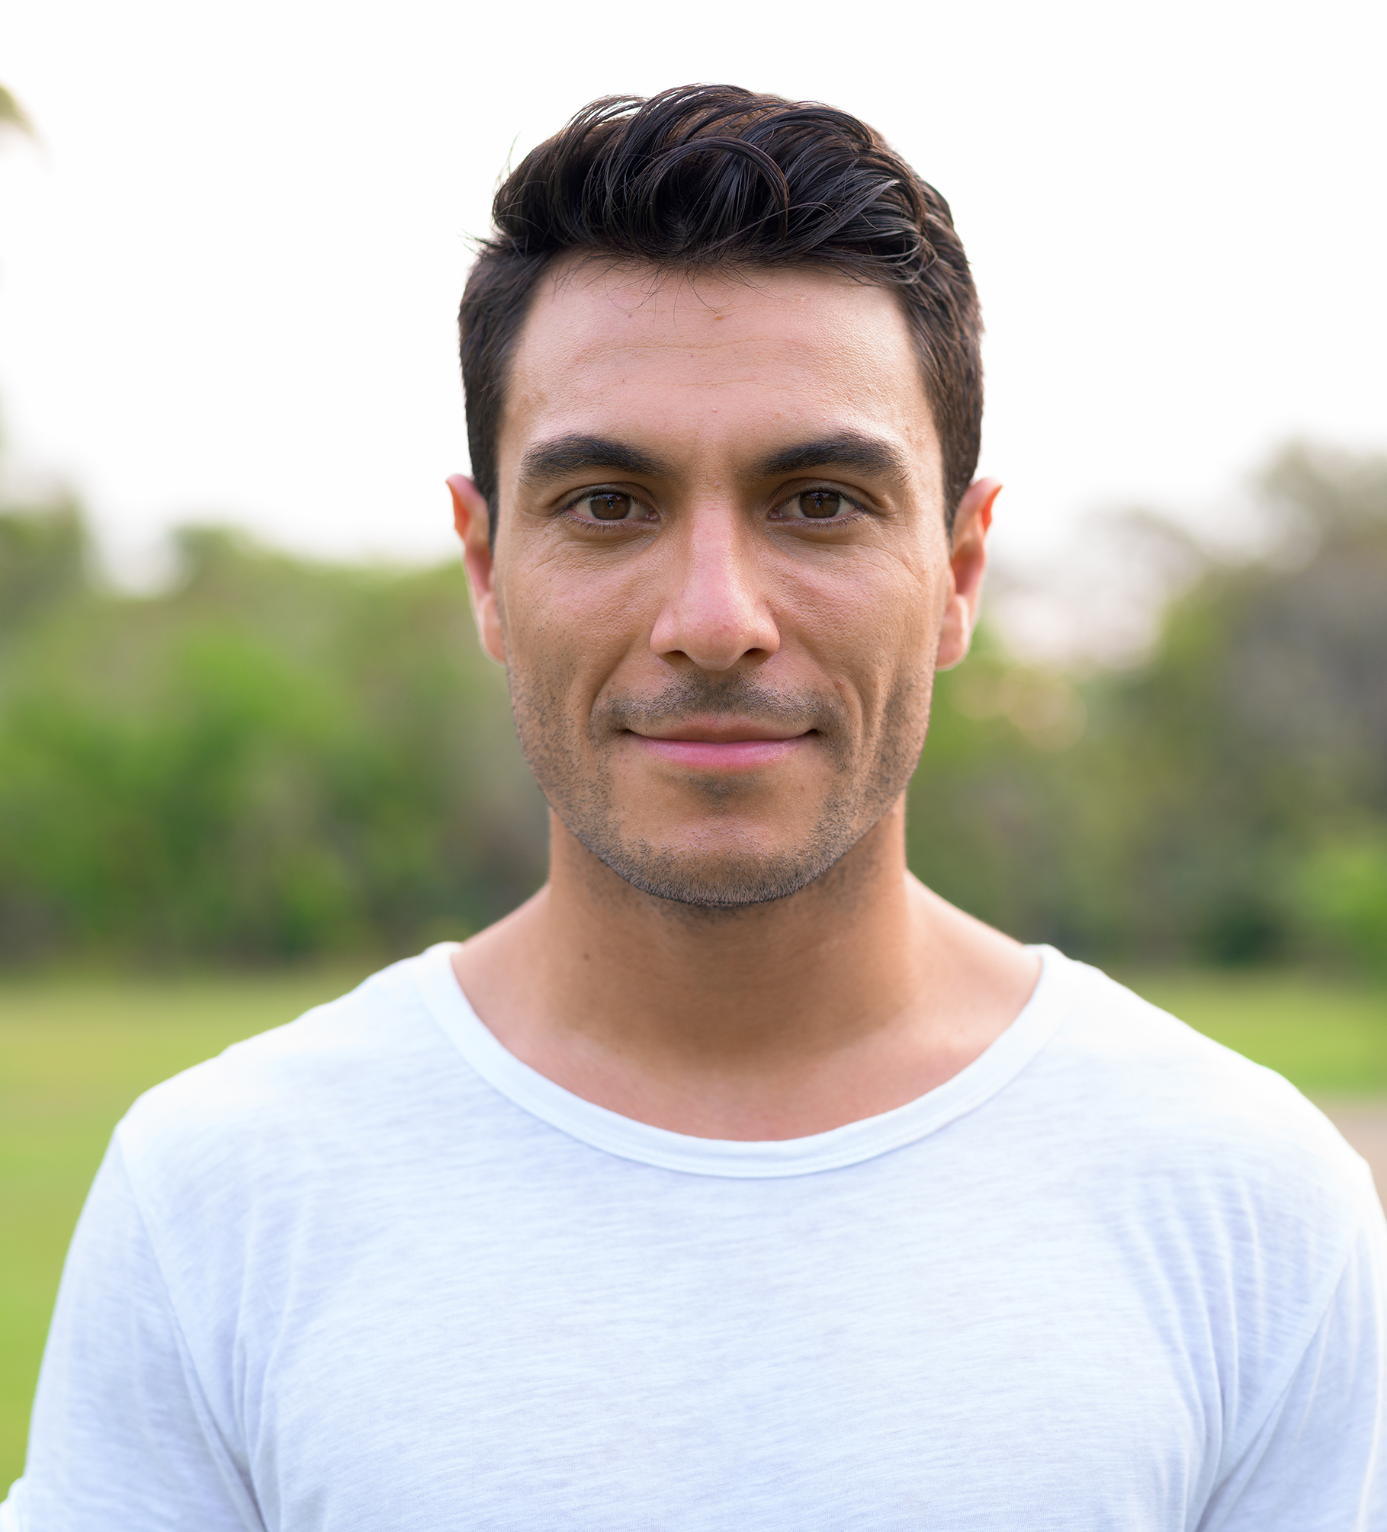
Mikey
Age | 30
Education | Secondary School
Gender | Male
Ethnicity | German
Family Status | Single
Occupation | Customer Support
Motivations
Personality
Low-stress
Relaxation
Challenge
Openness
Conscientiousness
Extraversion
Agreeableness
Neuroticism
Goals
Buy a unit
Travel to see Alestorm live
Relax
Physical Environment
Unit at home
Frustrations
Being talked out by the end of the day
Wanting to play hangman, but not with people
Alestorm doesn’t tour Australia
Social Environment
Expectations
No interested in interacting with people.
Play hangman on my laptop computer
A large number of words
Intuitive design
Profile
Technology Environment
Mikey works in customer support which tires him of social interactions. He want to relax without socialising.
He like the low-stakes challenge of hangman
Windows Laptop
Basic ICT knowledge

