Slide 1
Says
Thinks
User
Does
Feels

Slide 2
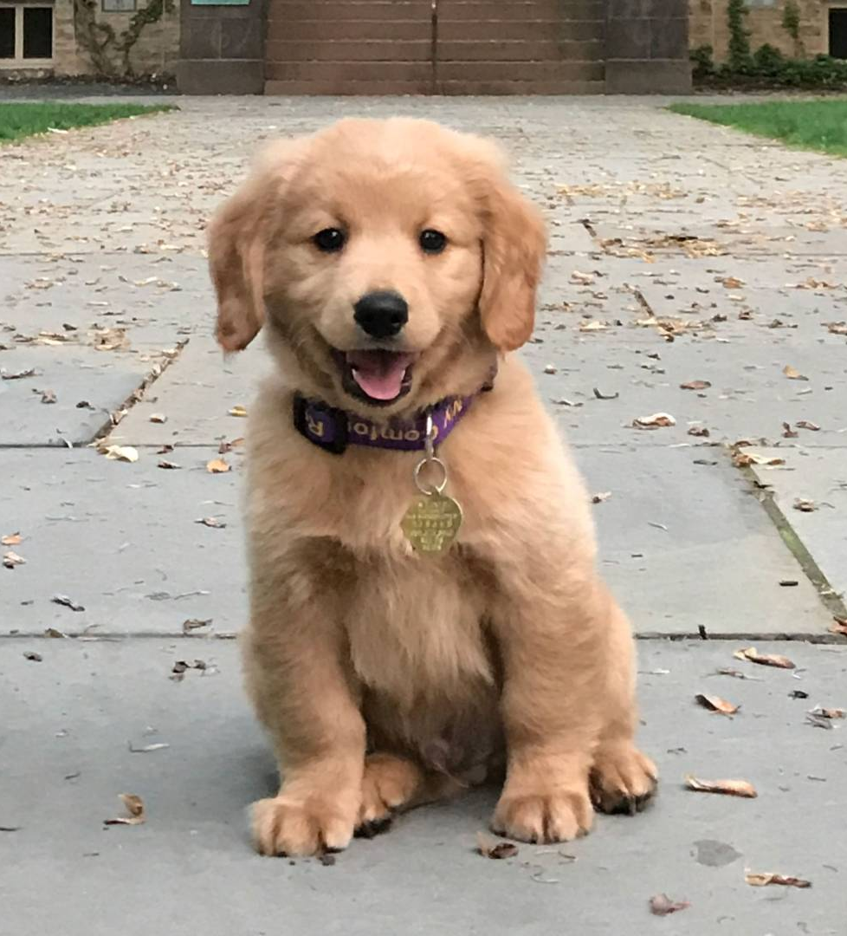
<<Name>>
Age
Education
Gender
Ethnicity
Family Status
Occupation
Motivations
Personality
Openness
Conscientiousness
Extraversion
Agreeableness
Neuroticism
Goals
Physical Environment
Frustrations
Social Environment
Expectations
Profile
Technology Environment

