Slide 1
HOOK
Lesson 2
Exploring Our Data
Steam Data Stories
Notes:
The second Hook lesson and our first code. We open the Steam data in marimo, check its size and data types, see reactive cells in action and explore with the table viewer. About 60 minutes: 5 min hook, 10 min notebooks and cells, 15 min loading and checking the data, 15 min reactive cells, 15 min table viewer and Your data story.

Slide 2
In this lesson we will learn
Learning intentions
​how marimo notebooks and cells work
​how to load the Steam dataset with Polars
​how to check the size, columns and data types of a DataFrame
​how marimo's reactive cells update automatically
​how to explore data with marimo's table viewer
Notes:
Read the intentions aloud. Today is about getting comfortable in marimo: every later lesson builds on this notebook.

Slide 3
Terminology
New terms
​notebook – a file where we write code in small blocks called cells and see each cell's result straight away.
​cell – one block of code in a notebook, which we can run on its own.
​DataFrame – a table of data with rows and columns, stored in our code.
​CSV – comma-separated values: a plain text file where each line is one row and the values are separated by commas.
Notes:
Seven new terms today, split over two slides. Each comes up as we use it, so a quick read-through is enough.

Slide 4
Terminology
New terms
​shape – the number of rows and the number of columns in a DataFrame.
​schema – the name and data type of every column in a DataFrame.
​reactive – describes a notebook where changing a cell automatically re-runs every cell that uses its variables.
Notes:
Reactive is the big new idea today. Ask students to guess what it might mean before reading the definition.

Slide 5
REMEMBER
​We met the Steam dataset on paper. Now it's time to open it.
​Code lets us check every row in seconds and repeat every step exactly. We'll use Polars to load the data and marimo to run our code.
Notes:
Ask: how many games are in our dataset? (10,250.) What does one row represent? (One game.) Why not just open it in a spreadsheet? (Code checks every row and repeats every step exactly; and we never save over the original CSV.)

Slide 6
Notebooks and cells
​We try something, look at the result, then decide what to try next.
Notes:
Notebooks are great for exploring data because each cell's result appears straight away.

Slide 7
Open our notebook
Why
terminal
​marimo notebooks are saved as ordinary Python files. clean_steam.py is the one we made when we set up, and we'll use it to explore and clean our data.
1 marimo edit clean_steam.py
Steps
​open steam_data_stories in VS Code and open a new terminal
​check the prompt starts with (.venv)
​the notebook opens in a browser tab, with one empty cell
Notes:
Check every terminal shows (.venv) first. If not, close it and open a new one, as we did when we set up.

Slide 8
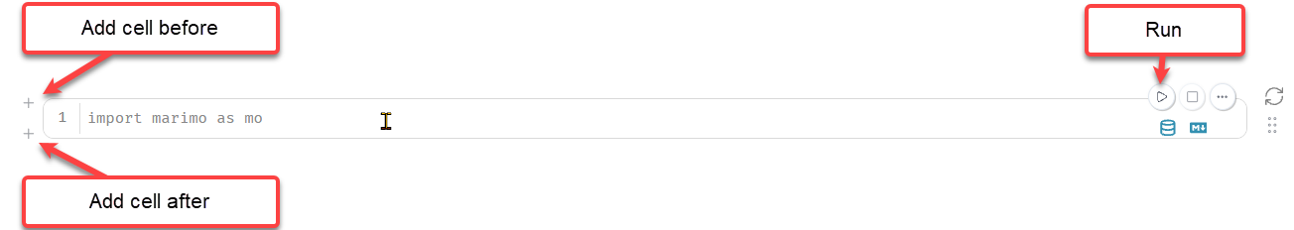
Working with cells
​run a cell with its ▶ button or Ctrl+Enter (Cmd+Enter on a Mac)
​Shift+Enter runs a cell and starts a new one below it
​add a cell with the + button above or below a cell
​a cell's output appears below its code, and marimo saves automatically
Notes:
Model each one on the projector. Point out where the output appears: directly below the cell's code.

Slide 9
Reopening a notebook
Tip
​When we reopen a notebook, marimo shows our code but doesn't run it, so none of the outputs appear. Press Ctrl+Shift+R (Cmd+Shift+R on a Mac) to run all stale cells: every cell that hasn't been run yet.
Notes:
Students will need this at the start of every lesson from now on.

Slide 10
Import Polars
​Importing loads a library so our notebook can use its commands.
Notes:
We always put imports in the first cell, so anyone reading our notebook can see which libraries it needs.

Slide 11
Import Polars in the first cell
Why
clean_steam.py — first cell
​Before we can use Polars, we have to import it. Imports always go in the first cell, so anyone reading our notebook can see which libraries it needs.
1 import polars as pl
​Nothing appears, and that's what we want: importing just makes the library ready.
Predict
What it does
​What do you think will appear when we run this cell?
​line 1 → imports Polars with the short name pl, so we type pl instead of polars
Notes:
PRIMM: most students predict some output. If a cell shows a red ModuleNotFoundError, Polars isn't installed in the virtual environment, so go back to installing the libraries.

Slide 12
Load the data
​Polars stores a table of data in a DataFrame: rows and columns, like a spreadsheet, but in our code.
Notes:
Our data is in steam_games.csv, inside our data folder.

Slide 13
Read the CSV into a DataFrame
Why
clean_steam.py — new cell
​Polars' read_csv reads steam_games.csv into a DataFrame. We call it games, because each row is one game.
1 games = pl.read_csv("data/steam_games.csv")
2 games
Predict
​What will appear below the cell when we run it?
What it does
​line 1 → reads every row of steam_games.csv into a DataFrame called games
​line 2 → shows games: marimo displays the value of a cell's last line
Notes:
PRIMM: predict, run, investigate. A file not found error usually means the CSV isn't in the data folder or has been renamed by the browser.

Slide 14
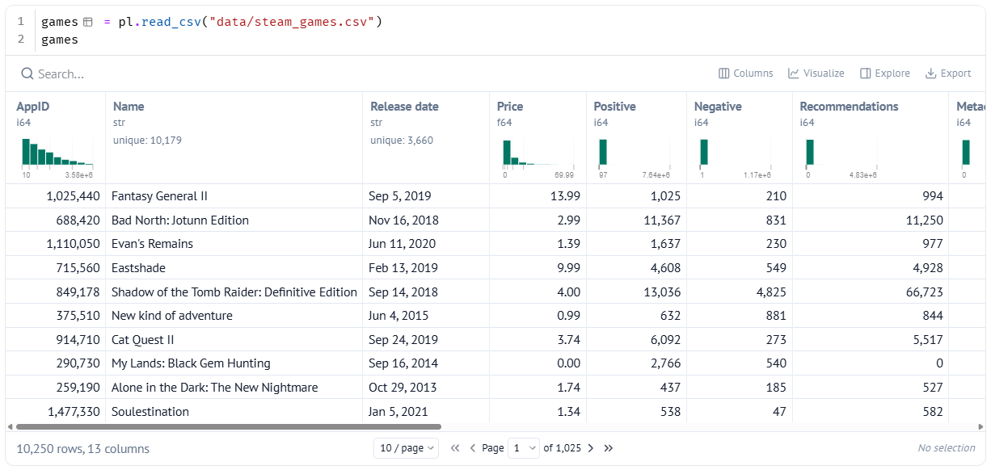
Our data in marimo's table viewer
​marimo shows the DataFrame as an interactive table, with a summary chart at the top of each column.
Notes:
Remind students what CSV means: comma-separated values, a plain text file where each line is one row. It's one of the most common ways to share data, because almost any program can read it. We'll explore this table properly at the end of the lesson.

Slide 15
How big is our data?
​Rows tell us how many games we can compare; columns tell us how many facts we have about each.
Notes:
A DataFrame's shape gives us both numbers at once.

Slide 16
Check the shape
Why
clean_steam.py — new cell
​A DataFrame's shape gives us the number of rows and the number of columns at once.
1 games.shape
​10250 rows and 13 columns: 10,250 games, with 13 facts about each.
What it does
Predict
​this cell uses games, which we made in a different cell
​once a cell creates a variable, every other cell can use it
​What two numbers do you expect to see?
Notes:
PRIMM: students who remember the dataset should predict 10,250 games and 13 columns.

Slide 17
What kind of data is in each column?
​A column's data type decides what we can do with it: we can add up numbers, but not text.
Notes:
Before we use any column, we check its data type with the DataFrame's schema.

Slide 18
Check the schema
Why
clean_steam.py — new cell
​The schema shows the name and data type of every column, so we can check what kind of values each one holds before we use it.
1 games.schema
Predict
​What data type do you think Release date will have?
Notes:
PRIMM: the predict question sets up the surprise on the next slide.

Slide 19
The schema runs off the edge
​the whole schema is on one line, so it runs off the right edge
​we can scroll across, but it's hard to read
​it would be easier with each column on its own line
Notes:
Ask: can you see every column's data type? (No, only the first few.) How could we show each column on its own line? Students know for loops and dictionaries from the Turtle course.

Slide 20
One column per line
Why
clean_steam.py — change existing cell
​The schema works like a dictionary: column names are the keys and data types are the values. items() gives each pair, so a for loop can print one column per line.
1 for name, dtype in games.schema.items():
2 print(name, dtype)
​13 lines, from AppID Int64 to Support email String.
Predict
​What will appear below the cell? How many lines?
What it does
​line 1 → loops through each column's name and data type
​line 2 → prints them on one line
Notes:
This changes the existing schema cell. Remind students that print output appears below the cell.

Slide 21
What the schema tells us
​Release date is a String, not a date: Polars stored the dates as text
​we can't sort text dates into the right order or work out a game's year
​we'll need to fix this column in Behind the Scenes
Notes:
This is the first clue that real data is messy. Ask students to add it to their list of strange things for the Your data story task.

Slide 22
Three data types we'll meet again and again
Data type | What it holds | Example column
​Int64 | ​whole numbers | ​Positive
​Float64 | ​numbers with a decimal point | ​Price
​String | ​text | ​Name
Notes:
Ask for another example of each from the schema. For instance, Negative is Int64 and Developers is String.

Slide 23
Reactive cells
​When we change a cell, marimo automatically re-runs every cell that uses its variables.
Notes:
We'll store a number in one cell, then use it in another cell to decide how many rows to show.

Slide 24
Store a number in its own cell
Why
clean_steam.py — new cell
​We'll store a number in one cell, then use it in another cell to decide how many rows to show.
1 sample_size = 5
What it does
​line 1 → creates a variable called sample_size that holds the number 5
Notes:
Keep this quick: the interesting part is the next cell.

Slide 25
Use it to show the first rows
Why
clean_steam.py — new cell
​The head method shows the first few rows of a DataFrame. Here it shows the first sample_size rows of games.
1 games.head(sample_size)
​The head cell re-runs by itself and shows ten rows.
Predict
​Change sample_size to 10 and run that cell. What will happen to this cell?
Notes:
PRIMM step 4: students change 5 to 10 in the sample_size cell, not this one. marimo knows the head cell uses sample_size, so we never have to remember which cells to re-run.

Slide 26
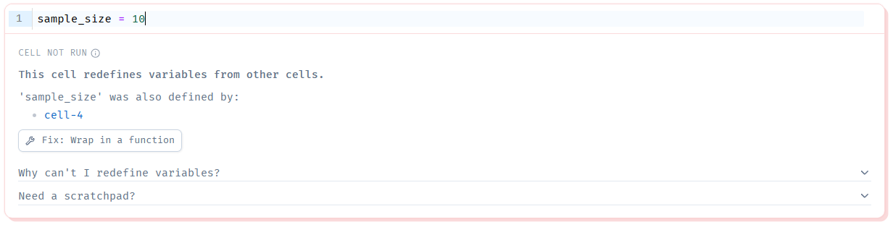
One variable, one cell
Reading the error
​CELL NOT RUN → marimo has refused to run this cell
​This cell redefines variables from other cells. → it creates a variable another cell already creates
​'sample_size' was also defined by: cell-4 → the variable, and the cell that made it first
​Fix: Wrap in a function → don't use it: it hides the problem
Notes:
Have students add a new cell with sample_size = 10 to see this. Reactivity only works if marimo knows exactly which cell creates each variable. The fix: hover over the new cell and click the delete (bin) button, then change the original cell instead.

Slide 27
Changing a variable in another cell
Watch out
​In a normal Python program we often write games = games.head(). In marimo that creates games in a second cell, which breaks the rule. Instead, we give the new version a new name, such as first_games = games.head().
Notes:
We'll use this pattern a lot when we clean our data, so make sure students see why.

Slide 28
Exploring with the table viewer
​To explore the whole dataset, we bring the full games table back right here.
Notes:
The table from loading games is now far up the notebook, and head only shows a few rows.

Slide 29
Show the whole table again
Why
clean_steam.py — new cell
​A cell's output is the value of its last line, so a cell holding just games shows the whole DataFrame. It doesn't create a variable, so marimo is happy for it to be in another cell.
1 games
​All 10,250 games appear in the table viewer below the cell.
Notes:
Some students worry this breaks the one variable, one cell rule. It doesn't: showing a variable isn't creating it.

Slide 30
What the table viewer can do
​scroll across all 13 columns; page buttons move through the rows
​sort by a column, by clicking its heading
​search for a value, using the search box above the table
​see a summary of a column, such as its smallest and largest values
Notes:
Demonstrate each feature on the projector before students try the modify tasks.

Slide 31
Explore with the table viewer
PRIMM
​Sort by Price, highest then lowest. What do the games that cost 0 have in common?
​Search for Hollow Knight. How would we work out what share of its reviews are positive?
​Sort by Metacritic score. Are the games scoring 0 really that bad?
Notes:
Hollow Knight has 403,641 positive and 12,305 negative reviews. For task 3, don't give the answer yet: we look into those 0 scores next lesson. Free games really do cost 0.

Slide 32
CHECK YOUR UNDERSTANDING
​Where does a marimo cell's output appear?
​What does games.shape tell us about our data?
​Why is it a problem that Release date is a String?
​What does it mean that marimo is reactive?
​Why does marimo refuse to run a second cell that creates sample_size?
Notes:
Cold-call or use mini whiteboards.
Answers:
1. Below its code.
2. The number of rows (10,250 games) and columns (13).
3. We can't sort text dates into the right order or work out which year a game came out.
4. Changing a cell automatically re-runs every cell that uses its variables.
5. Each variable can only be created in one cell, otherwise marimo can't tell which value it should have.

Slide 33
Your data story
​For each of your three questions from your story angles, write down which columns could help answer it.
​For each of those columns, write down its data type and two or three example values.
​Note anything that looks strange: empty values, impossible numbers, or numbers stored as text.
In my_data_story.md, add the heading
## Exploring the data
Notes:
Students use the table viewer for this. The strange things they note are clues for Behind the Scenes.

