Slide 1
BEHIND THE SCENES
Lesson 6
Fixing Our Data
Steam Data Stories
Notes:
Today we fix the problems we found when we asked our question, so our story notebook can start from clean data. About 60 minutes: 5 min hook, 15 min dates, 15 min missing values, 15 min repeated names and saving, 10 min Your data story.

Slide 2
In this lesson we will learn
Learning intentions
​how to turn text into dates with str.to_date
​how to turn values that mean "missing" into nulls
​why we identify games by AppID, not name
​how to save our clean data
Notes:
Read the intentions aloud. Point out that all four are about trust: if the data is wrong, every chart built on it is wrong.

Slide 3
Terminology
New terms
​format code – a pattern such as %b %d, %Y that tells Polars how dates are written in text.
​Parquet – a file format for tables that saves each column's data type along with the data.
Notes:
Only two new terms today. Students met null in the privacy and ethics lesson, so check they remember it: a null means the value is missing.

Slide 4
REMEMBER
​We found two problems when we asked our question
​Release date is text, so it sorts alphabetically. Most Metacritic score values are 0, which really means "no score".
Notes:
Ask: why does it matter that dates are text? (They sort alphabetically, so Apr comes before Feb, and we can't pull out the year.) Why do the 0s matter? (They drag down every average.)

Slide 5
Text into dates
​Our story looks at change over time, so Release date has to behave like a real date.
Notes:
Start marimo with marimo edit clean_steam.py and press Ctrl+Shift+R to run the earlier cells.

Slide 6
First try: let Polars guess the format
Why
clean_steam.py — new cell
​str.to_date turns text into dates. We try it on its own first to see whether Polars can work out how our dates are written. with_columns keeps every column and changes just one, and a new name, dated, keeps selected unchanged.
1 dated = selected.with_columns(
2 pl.col("Release date").str.to_date(),
3 )
4 dated
Predict
​Will Polars be able to work out how our dates are written? What will dated look like?
Notes:
Model the thinking: we don't know whether Polars can guess the format, so we try the simplest thing first. Have students predict before running. Most will expect it to work.

Slide 7
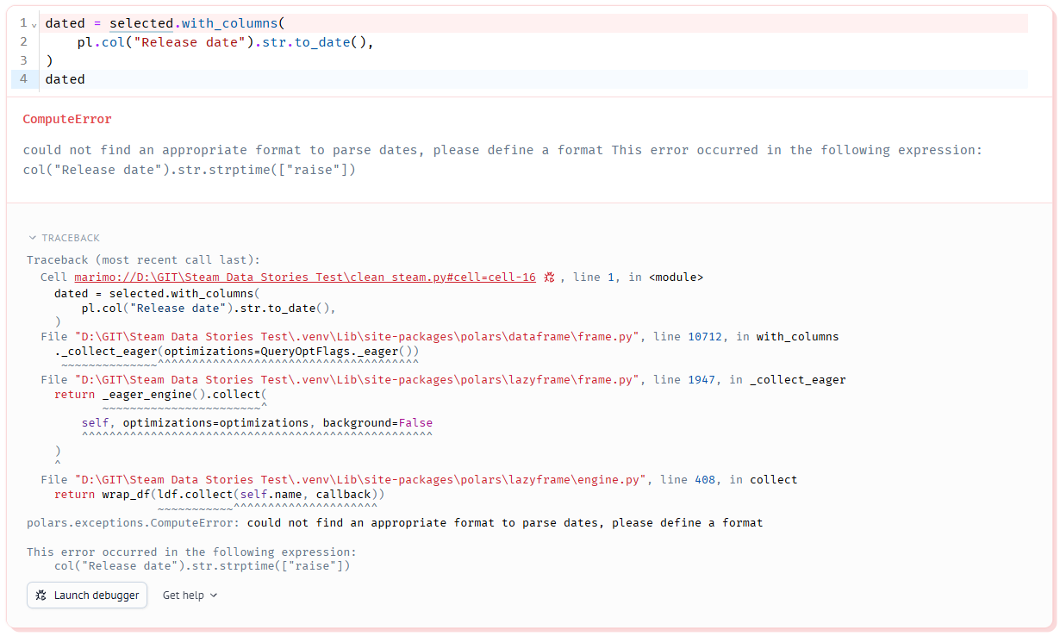
Polars can't guess our date format
Reading the error
​ComputeError → Polars couldn't finish a calculation
​could not find an appropriate format to parse dates → it couldn't work out how our dates are written, so we must tell it
​following expression → the part of our code it was working on: our Release date line
​Traceback → the first line points to our cell; the rest is inside Polars, so we can ignore it
Notes:
Walk through the error in parts, as on the site. Stress that reading errors is a skill: type, message, then where. The traceback below our cell is Polars' own code, so students can skip it.

Slide 8
Describing our dates with a format code
​Polars recognises 2017-02-24, but our dates look like Feb 24, 2017.
Part of the date | Format code | Example
​short month name | ​%b | ​Feb
​day of the month | ​%d | ​24
​four-digit year | ​%Y | ​2017
Notes:
Everything that isn't a format code, like the space and the comma, has to match the text exactly. So Feb 24, 2017 has the format %b %d, %Y. Ask: what would the format be for 24/02/2017? (%d/%m/%Y)

Slide 9
Tell Polars the format
What it does
clean_steam.py — change existing cell
​line 2 → turns the text in Release date into dates using the format %b %d, %Y
​the new column has the same name, so it replaces the old one
1 dated = selected.with_columns(
2 pl.col("Release date").str.to_date("%b %d, %Y"),
3 )
4 dated
Notes:
Students change the existing cell, not add a new one. Point to the title: change existing cell. PRIMM: predict, then run.

Slide 10
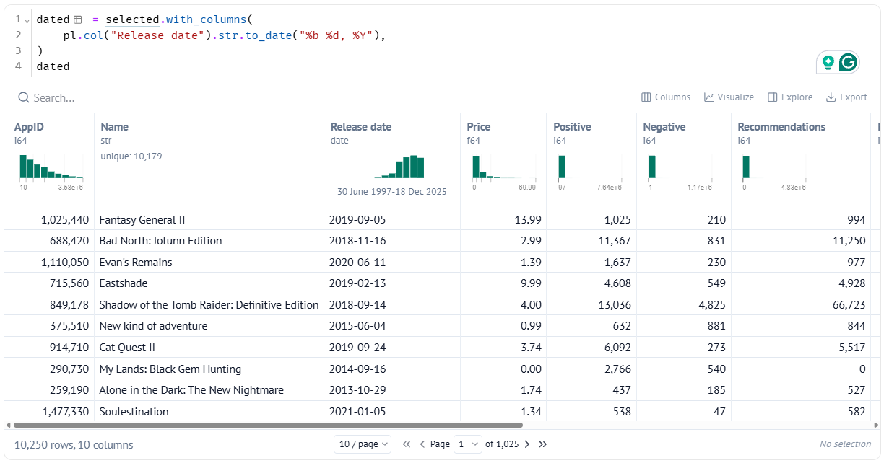
Every date converted
​Release date now holds real dates
​its data type is date
​all 10,250 dates converted
Notes:
Point to the data type under the column name. If even one row had been written differently, Polars would have stopped with an error, which proves every date uses the same format.

Slide 11
Check the dates sort properly
clean_steam.py — new cell
1 dated["Release date"].min(), dated["Release date"].max()
​30 June 1997 and 18 December 2025. As text, the "smallest" was Apr 1, 1999.
​Why: If they're real dates, the smallest should be the oldest game and the largest the newest. So we ask for the min and max and check they make sense.
Notes:
This is a habit worth naming: after every fix, check it worked.

Slide 12
Values that mean "missing"
​7,317 games have a Metacritic score of 0. Scores go from 1 to 100, so 0 means "no score".
Notes:
Remind students that a null means a value is missing. If we leave the 0s in, they drag down every average.

Slide 13
Is 0 a real value?
Column | Is 0 real? | Why
​Price | ​yes | ​free games really do cost $0
​Recommendations | ​yes | ​a game can really have no recommendations
​Metacritic score | ​no | ​scores go from 1 to 100, so 0 means "no score"
Notes:
Think aloud through each row before showing the answers. Ask students to decide first. This is the judgement call the warning later talks about.

Slide 14
Turn the 0s into nulls
Why
clean_steam.py — new cell
​replace swaps every 0 for None, which Polars stores as a null. Then null_count counts the nulls in every column, so we can check that exactly 7,317 values changed and nothing else did.
1 clean_games = dated.with_columns(
2 pl.col("Metacritic score").replace(0, None),
3 )
4 clean_games.null_count()
Predict
​Which columns will have nulls after this cell, and how many?
Notes:
PRIMM: predict which columns will have nulls and how many.

Slide 15
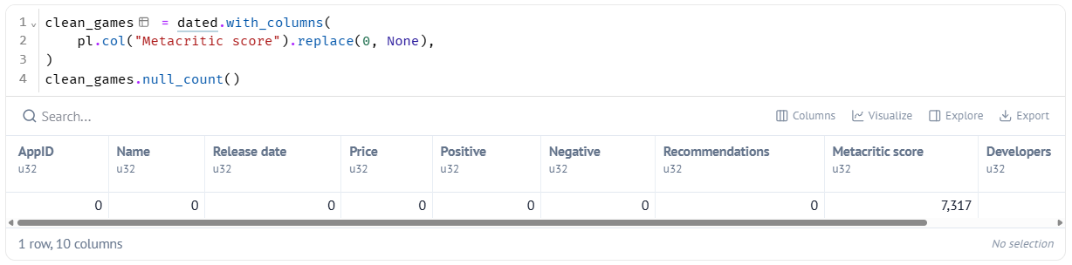
The hidden gaps are now real gaps
​Every column has 0 nulls, except Metacritic score, with 7317.
Notes:
Polars skips nulls when it works out mean and median, so averages now only use games that were actually reviewed.

Slide 16
Cleaning is a judgement call
Judgement call
​We decided 0 means "missing" for Metacritic score but not for Price. Decisions like this change our results, so good data scientists write them down where others can see them. That's what the Your data story section is for.
Notes:
Link to the Your data story task at the end: students will record every cleaning decision starting with I decided.

Slide 17
Repeated names
​Two games can share a name, but never an AppID. Let's check.
Notes:
If some games share a name, any step that picks a game by its name could pick the wrong one.

Slide 18
Find the names that appear more than once
clean_steam.py — new cell
1 clean_games.filter(pl.col("Name").is_duplicated()).sort("Name")
​Why: is_duplicated marks every row whose Name appears more than once. Sorting by Name puts rows with the same name next to each other so we can compare them.
Predict
​How many rows do you think share their name with another row?
Notes:
Predict: how many rows will share a name? Most guess very few.

Slide 19
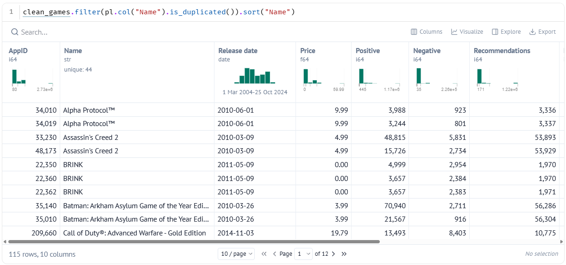
115 rows share a name
​the two Alpha Protocol™ rows have the same release date and developer
​but different AppIDs and different review counts
​some games have more than one Steam store page, such as a special edition
Notes:
These aren't mistakes. Each row is a real store page with real reviews, so we don't delete them.

Slide 20
So how do we tell them apart?
Name
AppID
​Alpha Protocol™ matches two rows
​filtering by name could count the game twice
​never use it to identify one game
​34010 and 34019 are different
​filtering by AppID always gives exactly one row
​use it whenever we need one particular game
Notes:
This is the key message the walkthrough asked for: the way to deal with repeated names is to identify games by AppID. We keep the rows; we change how we identify games.

Slide 21
Check every AppID really is different
Why
clean_steam.py — new cell
​AppID only works as an identifier if no two rows share one. is_unique marks each AppID that appears once, and all gives True only if every row passed.
1 clean_games["AppID"].is_unique().all()
​The output is True: every row has its own AppID.
Notes:
Ask what would have happened if this was False. (We'd have true duplicates to investigate.)

Slide 22
Save our clean data
Why
clean_steam.py — new cell
​Our story goes in a new notebook. Rather than repeat every cleaning step there, we save the result. Parquet remembers each column's data type, so our dates stay dates and our nulls stay nulls.
1 clean_games.write_parquet("data/clean_games.parquet")
Notes:
Check the new file appears in the data folder in VS Code's Explorer.

Slide 23
Re-run the saving cell after changes
Remember
​If we change any cleaning cell later, the Parquet file won't update by itself. Run the saving cell again so our story notebook gets the new version.
Notes:
This catches students out in the story notebook lessons: their charts don't change after a fix because they forgot to re-save.

Slide 24
CHECK YOUR UNDERSTANDING
​Why did str.to_date() fail the first time?
​What is the format code for Feb 24, 2017?
​Why do we change 0 to null for Metacritic score but not for Price?
​Two rows are called Alpha Protocol™. How do we tell them apart?
Notes:
Cold-call or use mini whiteboards.
Answers:
1. Polars couldn't work out how the dates were written, so we had to give it a format code.
2. %b %d, %Y
3. A Metacritic score of 0 is impossible (scores go 1–100), so it means missing; a price of 0 is real (free games).
4. By AppID: 34010 and 34019. We always identify a game by its AppID, not its Name.

Slide 25
Your data story
​For each column your question needs, write down whether 0 is a real value or means "missing", and why.
​Write down every cleaning decision made while cleaning the data, and why. Start each one with "I decided…".
​Write down one thing about the data that your audience should know, because it limits what you can claim.
In my_data_story.md, add the heading
## Clean data
Notes:
Give the last 10 minutes. The I decided list becomes the How I got my data part of their finished story.

