Slide 1
RISING INSIGHTS
Lesson 9
Bar Charts and Histograms
Steam Data Stories
Notes:
The first charting lesson in Rising Insights. Today we turn our group summaries into charts with Plotly Express. About 60 minutes: 5 min hook, 5 min importing Plotly, 15 min bar chart, 15 min histogram, 10 min comparing two groups, 10 min Your data story.

Slide 2
In this lesson we will learn
Learning intentions
​how to draw a bar chart with Plotly Express
​how to draw a histogram to see how values are spread out
​how to compare groups of different sizes with percentages
Notes:
Read the intentions aloud. Point out the third one: it's about fairness, which matters every time we compare groups.

Slide 3
Terminology
New terms
​histogram – a chart that splits values into equal ranges and draws a bar for how many values land in each one.
​bin – one of the equal ranges of values that a histogram counts.
Notes:
Two new terms. Students will see bins in action shortly, so keep this brief and come back to it when we change nbins.

Slide 4
REMEMBER
​A table of numbers makes our audience do the work
​When we summarised groups, Indie games had a median review score of 86.5% and other games 83.2%. Today we turn those summaries into charts.
Notes:
Ask: if you showed a friend our per_group table for two seconds, what would they remember? A good chart makes the finding obvious in one look. Plotly Express charts are interactive: we can hover to see exact values and drag to zoom.

Slide 5
Importing Plotly Express
​Plotly Express is a library, just like Polars, so our notebook must import it before any cell can draw a chart.
Notes:
Start marimo with marimo edit steam_story.py and press Ctrl+Shift+R (Cmd+Shift+R on a Mac) to run the earlier cells.

Slide 6
Add Plotly to our imports
Why
steam_story.py — change first cell
​We add Plotly Express to the cell that already imports Polars, rather than making a new cell.
1 import plotly.express as px
2 import polars as pl
What it does
​line 1 → imports Plotly Express with the short name px, which is what everyone who uses Plotly calls it
Notes:
Students change the first cell, not the last one. Point to the title: change first cell. A common mistake is adding the import at the bottom of the notebook.

Slide 7
Keep imports together
Tip
​Keeping all our imports in the first cell means anyone reading our notebook can see every library it needs in one place. We sort them in alphabetical order, so they're easy to scan.
Notes:
That's why plotly comes before polars: p-l before p-o.

Slide 8
Bar charts
​A bar chart compares one number across groups, using the height of each bar.
Notes:
Ask: where have you seen bar charts before? Most students will have seen them in maths and science.

Slide 9
When to use a bar chart
When to use it
​we have one number for each group, such as a count, a median or a total
​we want to compare the groups
​bars are easy to read: our eyes compare heights that start from the same line
​not for how values inside a group are spread out, or change over many years
Notes:
Every chart type today gets a When to use it slide. Students will need these when they choose a chart for their own question.

Slide 10
Our first bar chart
steam_story.py — new cell
1 px.bar(
2 per_group,
3 x="Group",
4 y="Median review score",
5 title="Median review score of Indie and other games",
6 )
​Why: per_group has one median per group: just what a bar chart needs.
Predict
​What will the chart look like? Which bar will be taller, and by how much?
Notes:
PRIMM: predict, run, investigate. Line 2 uses the per_group DataFrame we made when summarising groups. Line 6 closes the brackets; the chart is the last value in the cell, so marimo shows it. Group goes along the x-axis and Median review score up the y-axis.

Slide 11
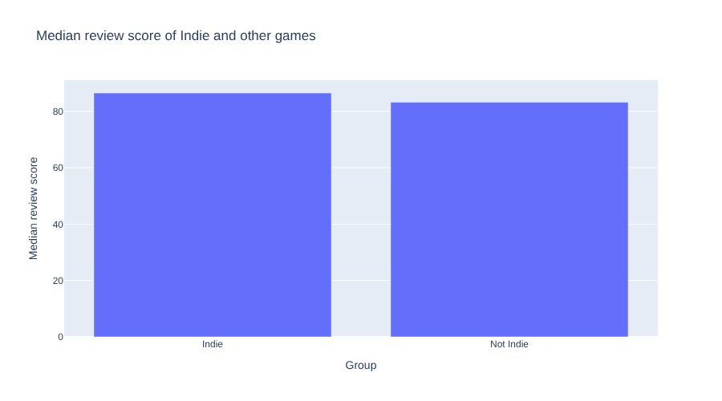
Two bars, almost the same height
​hover over a bar to see its exact value
​drag across the chart to zoom in; the Reset axes (house) button zooms out
​the gap between 86.5 and 83.2 is real, but hard to see
​both bars start from 0, so they look the same
Notes:
Let students hover and zoom on their own chart. Then ask: does this chart make the difference obvious? (No.) A bar chart is good for showing that two groups are similar. To show how they differ, we need a chart that shows more of the data.

Slide 12
Modify: a bar chart of prices
PRIMM
​Change per_group to prices.
​Change "Median review score" to "Median price".
​Change the title to match.
Notes:
The prices table was made when we compared means and medians. Check students also update the title: a chart about prices with a title about review scores is a common slip.

Slide 13
Histograms
​A median is one number for a whole group. A histogram shows how all the values are spread out.
Notes:
Recap the terms: a histogram splits values into equal ranges called bins, and draws a bar for how many values land in each bin.

Slide 14
When to use a histogram
When to use it
​we have one number column and want to see the shape of its values
​where most values are, whether they're bunched up or spread out
​whether there's a long tail on one side
​it checks whether a median or mean tells the whole story
​not for comparing a single number across groups; that's a bar chart's job
Notes:
Contrast with the bar chart slide: a bar chart has one number per group; a histogram uses every value in a column.

Slide 15
A histogram of every review score
Why
steam_story.py — new cell
​We don't set y, because a histogram counts the rows for us. nbins=45 gives bins about 2 points wide: narrow enough to see the shape, wide enough that each bin has plenty of games.
1 px.histogram(
2 scored,
3 x="Review score",
4 nbins=45,
5 title="Review scores of all games",
6 )
Predict
​Where will most of the bars be? Will the chart look the same on both sides?
Notes:
We start with every game in scored so we can see the shape before splitting it by group. Ask: why is there no y? (The histogram counts rows for us.)

Slide 16
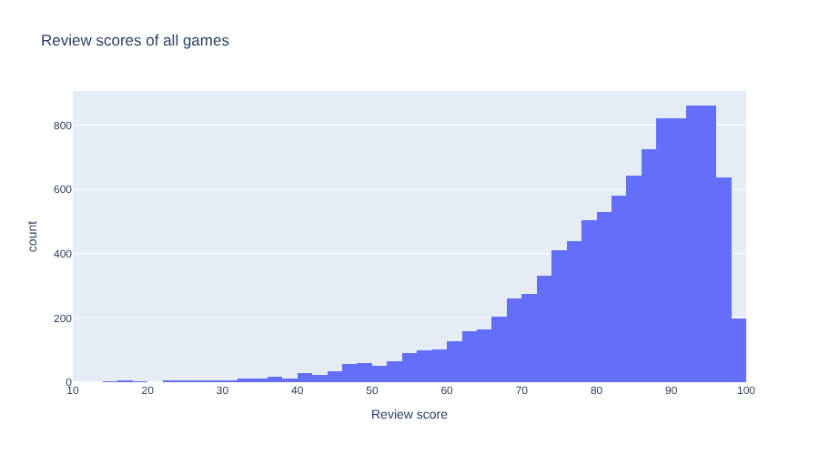
Most games score between 75 and 95
​very few games score below 50
​the bars climb slowly from the left
​then they drop sharply just before 100
​this is skewed data, with the long tail on the low side
Notes:
Link to when we compared means and medians: prices were skewed too, but with the long tail on the high side. Ask: which side is the tail on here? (The low side.)

Slide 17
Modify: change the number of bins
PRIMM
​Change nbins=45 to nbins=10.
​Then change it to nbins=200.
​Which shows the shape best?
Notes:
With 10 bins the shape is too blocky; with 200 the bars get thin and jumpy because each bin holds few games. 45 is a good middle ground.

Slide 18
Comparing two groups
​We have 6,243 Indie games but only 4,007 other games, so the Indie bars would be taller just because there are more of them.
Notes:
Ask: how could we make the comparison fair? Lead students towards percentages of each group.

Slide 19
When to split a histogram by group
When to use it
​we want to know whether two groups' values are spread out differently
​not just whether their averages differ
​use percentages whenever the groups are different sizes
​otherwise the bigger group will always look taller
Notes:
This is the fix for the problem on the previous slide.

Slide 20
Split the histogram by group
Why
steam_story.py — new cell
​We add three things to our histogram to compare the groups fairly.
1 px.histogram(
2 scored,
3 x="Review score",
4 color="Group",
5 barmode="overlay",
6 histnorm="percent",
7 nbins=45,
8 title="Review scores of Indie and other games",
9 )
What it does
​line 4 → a colour for each group
​line 5 → bars on top of each other
​line 6 → each bar as a % of its own group
Notes:
PRIMM: predict first. Ask which group students expect to have taller bars at the high end. The other lines are the same as our first histogram.

Slide 21
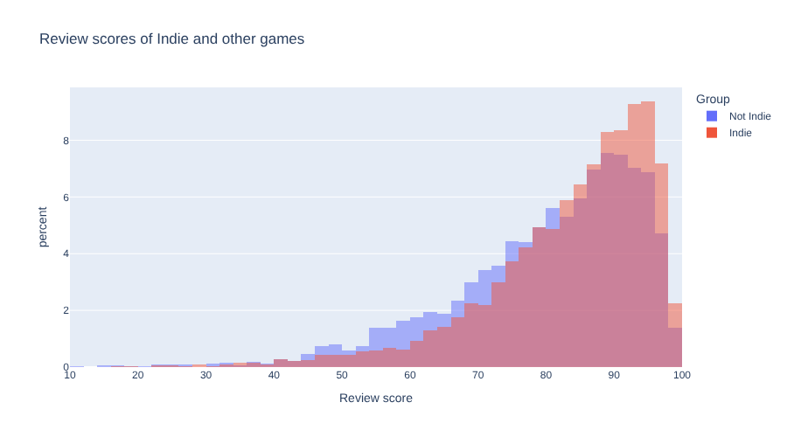
Now the difference is clear
​the Indie bars are taller from about 85 up
​a bigger share of Indie games get very high scores
​the other games have more of their bars between 45 and 80
​much more convincing than two bars of the same height
Notes:
Compare with the bar chart: same data, but this chart shows the difference. That's the key message: the right chart makes the finding obvious.

Slide 22
Modify: remove the percentages
PRIMM
​Remove the histnorm="percent" line.
​What changes?
​Why is that less fair?
Notes:
Without percentages the y-axis shows counts, and the Indie bars look taller almost everywhere just because there are more Indie games.

Slide 23
Click the legend
Tip
​Click Indie or Not Indie in the legend to hide that group, and click again to bring it back. It's a quick way to look at one group at a time.
Notes:
Have students try it now on their split histogram.

Slide 24
CHECK YOUR UNDERSTANDING
​When should we use a bar chart?
​Why doesn't a histogram need a y value?
​Our bar chart made 86.5 and 83.2 look almost the same. Why?
​Why did we use histnorm="percent" to compare the groups?
Notes:
Cold-call or use mini whiteboards.
Answers:
1. When we have one number for each group, such as a count or median, and want to compare the groups.
2. It counts the rows in each bin for us.
3. Both bars start from 0, so a small gap is hard to see. Bar charts are good at showing groups are similar.
4. There are 6,243 Indie games but only 4,007 others, so counts would make the Indie bars taller just because there are more of them.

Slide 25
Your data story
​Draw a bar chart that compares the groups in your question. Does it show the difference clearly, or do the bars look the same?
​Draw a histogram of the most important number column in your question. Describe its shape in one sentence.
​If your question compares groups of different sizes, split the histogram by group using percentages. Record what it shows.
In my_data_story.md, add the heading
## First charts
Notes:
Give the last 10 minutes. Students whose groups are similar sizes can skip the percentages, but should say why.

