Slide 1
RISING INSIGHTS
Lesson 11
Trends and Relationships
Steam Data Stories
Notes:
Today we look at change over time with a line chart, and at whether two number columns are related with a scatter plot. About 60 minutes: 5 min hook, 10 min summarising by two columns, 20 min line chart, 15 min scatter plot and causation, 10 min Your data story.

Slide 2
In this lesson we will learn
Learning intentions
​how to summarise by two columns at once
​how to show a trend over time with a line chart
​how to look for a relationship with a scatter plot
​why a relationship doesn't prove that one thing causes another
Notes:
Read the intentions aloud. The last one is the big idea of the lesson; it applies well beyond data science.

Slide 3
Terminology
New terms
​trend – a change over time, such as review scores rising year after year.
​scatter plot – a chart that draws one dot for each row, using one number column for x and another for y.
Notes:
Two new terms. Ask students for an everyday trend they know, such as phone prices or temperatures.

Slide 4
OUR NEXT QUESTION
​Has the gap between Indie and other games always been there, or is it new?
​So far we've compared the groups across all years at once. We'll also ask: do more expensive games get better reviews?
Notes:
Take a quick vote: has the gap always been there? Record the vote and come back to it after the line chart.

Slide 5
Summarising by two columns
​To see the trend, we need the median review score for each group in each year.
Notes:
Start marimo with marimo edit steam_story.py and press Ctrl+Shift+R (Cmd+Shift+R on a Mac) to run the earlier cells.

Slide 6
Group by year and group
steam_story.py — new cell
1 per_year_group = (
2 scored.filter(pl.col("Release year").is_between(2010, 2024))
3 .group_by("Release year", "Group")
4 .agg(pl.col("Review score").median().alias("Median review score"))
5 .sort("Release year", "Group")
6 )
7 per_year_group
​Why: We group_by two columns at once, Release year and Group, which gives one group for every combination, such as 2018 Indie and 2018 Not Indie. We keep only 2010 to 2024, then sort by year and group so the table reads in time order.
Notes:
PRIMM: ask students to predict how many rows the table will have before running. Line 1 opens a bracket and stores the result in per_year_group; line 6 closes it.

Slide 7
One row for each year and group
​The table has 30 rows: 15 years, with one row for each group in each year.
​line 2 → keeps games released from 2010 to 2024, using is_between
​line 3 → one group for each combination of Release year and Group
​line 4 → finds the median review score of each group
​line 5 → sorts the table by year, then by group
Notes:
Check predictions: 15 years times 2 groups is 30 rows. Students who predicted 15 forgot that each year has two groups.

Slide 8
Why 2010 to 2024?
Tip
​years before 2010 have very few games, so their medians could be thrown off
​2025 isn't finished in our data, and has far fewer games than 2024
​leaving these years out means every point is based on plenty of games
Notes:
Link back to when we counted games per year. A median from a handful of games could jump around by chance.

Slide 9
Trends over time
​A line chart joins one point to the next, which shows how something changes over time.
Notes:
Ask: where have you seen line charts? (Weather, stock prices, population.) What do they all have on the x-axis? (Time.)

Slide 10
When to use a line chart
When to use it
​the x-axis is time, such as years or months
​we want to show a trend: rising, falling or staying the same
​one line per group shows whether the gap has changed over time
​not for groups that don't follow on from each other, like genres
Notes:
Add this to the chart table from last time: how does something change over time? Line chart, px.line.

Slide 11
Draw one line for each group
steam_story.py — new cell
1 px.line(
2 per_year_group,
3 x="Release year",
4 y="Median review score",
5 color="Group",
6 markers=True,
7 title="Since 2017, Indie games have reviewed better every year",
8 )
​Why: Time goes on the x-axis and the median review score on the y-axis, with one line per group. markers=True puts a dot on each year, so we can hover over a single year and read its value.
Notes:
PRIMM: predict, then run. Point out the headline title on line 7: we're already using what we learnt about titles that tell.

Slide 12
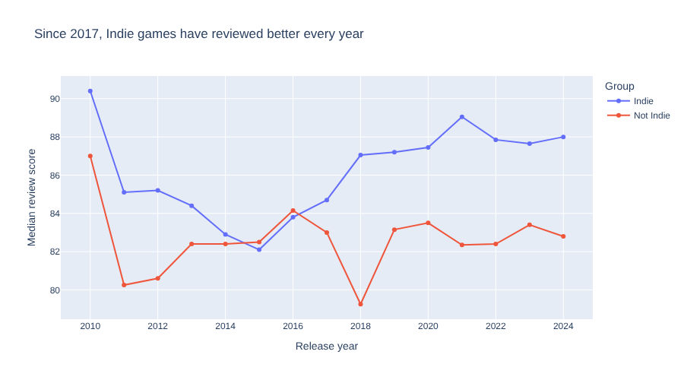
Indie games have reviewed better every year since 2017
​Indie in blue, Not Indie in red, from 2010 to 2024.
Notes:
Let students hover over the markers. Ask: what story does this chart tell that the bar chart couldn't? Then reveal the four findings on the next slide.

Slide 13
This chart tells us much more than our bar chart
​2010 to 2014: Indie games reviewed a little better
​2015 and 2016: the lines cross; other games were slightly ahead
​2017: the Indie line moves back in front, and stays there
​from 2018: the Indie line stays about 4 to 8 points above
Notes:
Go back to the vote from the start of the lesson. Was the gap always there? Not quite: it's been there every year since 2017.

Slide 14
SO WHAT?
​The gap isn't a lucky average
​Indie games have been ahead for eight years in a row. That makes it a much stronger piece of evidence for our story.
Notes:
Ask: why is eight years in a row stronger than one overall median? (One number could be a fluke; a pattern repeated every year is hard to explain away.)

Slide 15
Modify: games per year
PRIMM
​Change per_year_group to per_year.
​Change y to "Games".
​Remove the color line.
​Write a headline title for what the new chart shows.
Notes:
per_year was made when we summarised groups. Check that the new headline title states a finding, not just what the chart is.

Slide 16
Line charts are for time
Tip
​A line joins each point to the next, which tells our audience "these points follow on from each other". That makes sense for years or months, but not for groups like genres. For groups, use a bar chart or a box plot instead.
Notes:
Ask: why would a line between Action and Puzzle genres be misleading? (It suggests something in between them.)

Slide 17
Looking for a relationship
​Do more expensive games get better reviews? If the dots on a scatter plot form a slope, the two columns are related.
Notes:
Take another quick vote: do students think expensive games get better reviews?

Slide 18
When to use a scatter plot
When to use it
​we have two number columns and want to know whether they're related
​when one goes up, does the other tend to go up or down?
​each dot is one row, so we see every game, not just a summary
​not when either column is a group or a year
Notes:
For a group or a year, a bar chart or line chart suits better.

Slide 19
Price against review score
Why
steam_story.py — new cell
​We use scored, not a summary table, because we want one dot per game.
1 px.scatter(
2 scored,
3 x="Price",
4 y="Review score",
5 color="Group",
6 hover_name="Name",
7 opacity=0.4,
8 title="Expensive games don't get better reviews",
9 )
What it does
​line 5 → colour by group
​line 6 → name on hover
​line 7 → dots 40% solid
Predict
​Will the dots slope up, slope down, or neither?
Notes:
PRIMM: predict, run, investigate. Thousands of dots overlap, which is why we use opacity=0.4.

Slide 20
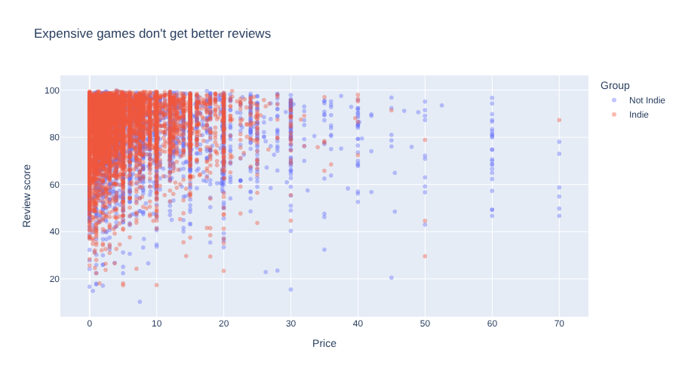
Expensive games don't get better reviews
​the dots don't slope up or down
​games at every price get scores from below 50 to almost 100
​in our data, price and review score aren't related
Notes:
Have students hover over the dots on the right to find the most expensive games and their scores. Revisit the vote.

Slide 21
A relationship isn't a cause
Watch out
​even when two things are related, it doesn't prove one causes the other
​our line chart doesn't prove being Indie makes a game better
​maybe Indie players are kinder reviewers
​maybe only the best Indie games reach 500 reviews
​we say "Indie games get better reviews", not "being Indie makes games better"
Notes:
This is the big idea of the lesson. Ask students for other explanations of the Indie gap. We only claim a cause when we have much stronger evidence.

Slide 22
CHECK YOUR UNDERSTANDING
​Why does per_year_group have 30 rows?
​Why did we leave out the years before 2010 and 2025?
​Why shouldn't we use a line chart to compare genres?
​Indie games get better reviews. Does that prove being Indie makes a game better?
Notes:
Cold-call or use mini whiteboards.
Answers:
1. 15 years (2010 to 2024), with one row for each of the two groups in each year.
2. Before 2010 there are very few games, and 2025 isn't finished, so their medians could be thrown off by a handful of games.
3. A line says the points follow on from each other, which makes sense for time but not for groups. Use a bar chart or box plot.
4. No. A relationship isn't a cause: maybe Indie players are kinder reviewers, or only the best Indie games reach 500 reviews.

Slide 23
Your data story
​If your question involves time, draw a line chart with a headline title. Record what the trend shows.
​Choose two number columns your question uses and draw a scatter plot. Are they related?
​Write down one other explanation for a pattern you've found, apart from the obvious one.
In my_data_story.md, add the heading
## Trends and relationships
Notes:
Give the last 10 minutes. The third task builds the habit from the warning: always look for another explanation.

