Slide 1
START
Before Lesson 1
Setting Up
Steam Data Stories
Notes:
Done before the first lesson. Today we install our tools, download the data and check everything works. About 60 minutes: 15 min installing Python and VS Code, 10 min project folder and virtual environment, 10 min libraries, 10 min data, 10 min first notebook, 5 min check. Have students follow each step in order and wait at each checkpoint.

Slide 2
On this page we will learn
Learning intentions
​how to install Python and VS Code
​how to create a project folder and a virtual environment
​how to install Polars, Plotly and marimo
​how to download the Steam data
​how to open our first marimo notebook
Notes:
Read the intentions aloud. Stress that if any step fails, the next one will too, so students should put a hand up straight away rather than skip ahead.

Slide 3
Terminology
New terms
​release candidate – a version of a program that's almost finished and being tested before its official release.
​PowerShell – the program VS Code uses for its terminal on Windows unless we choose another one.
​Command Prompt – an older Windows terminal program that can switch on a virtual environment without running a PowerShell script.
Notes:
Mac users can ignore PowerShell and Command Prompt. They only matter if a Windows terminal shows the running scripts is disabled error.

Slide 4
BEFORE WE START
​We'll work in a project folder on our own computer
​VS Code manages our files and marimo runs our code. Most steps are the same on Windows and macOS; where they differ, follow the steps for your computer.
Notes:
Ask who has Windows and who has a Mac, so you know who needs which instructions. Students who already have Python and VS Code can skip straight to creating the project folder.

Slide 5
Install Python and VS Code
​All our code is Python, and the libraries we use are Python libraries.
Notes:
Students who already have Python and VS Code can skip to Create the project folder.

Slide 6
Install Python from python.org
Windows
macOS
​check Settings → System → About → System type
​x64 → Windows installer (64-bit); ARM → Windows installer (ARM64)
​tick Add python.exe to PATH, then Install Now
​finishes with "Setup was successful"
​download the macOS 64-bit universal2 installer
​open the .pkg file and click Continue through each screen
​finishes with "The installation was successful"
​a Python folder opens in Finder, which we can close
Notes:
The most common Windows mistake is forgetting to tick Add python.exe to PATH. Walk around and check screens before students click Install Now. Downloads are at python.org/downloads.

Slide 7
Install VS Code and the Python extension
​Download and install VS Code from code.visualstudio.com.
​Windows with an ARM-based processor: choose the Arm64 download.
​Mac: drag Visual Studio Code into the Applications folder.
​In VS Code, click Extensions, search for Python and install the one by Microsoft.
Notes:
The Python extension is what lets VS Code create and use virtual environments, so check everyone has it before moving on.

Slide 8
Create the project folder
​Our data and both of our notebooks will live in one folder.
Notes:
Suggest the Documents folder so students can find it again next lesson.

Slide 9
Make and open steam_data_stories
​Create a folder called steam_data_stories somewhere easy to find, such as Documents.
​In VS Code, choose File → Open Folder… and open it.
​If VS Code asks whether we trust the authors, choose Yes.
​The Explorer panel now shows steam_data_stories with no files.
Notes:
Check the folder name is exactly steam_data_stories, with underscores. The Explorer panel showing the folder name in capitals is the checkpoint.

Slide 10
Create a virtual environment
​A virtual environment is a private copy of Python just for this project.
Notes:
The libraries we install go into the virtual environment rather than the computer's main Python, so different projects can't interfere with each other.

Slide 11
Create and switch on the environment
​Press Ctrl+Shift+P (Cmd+Shift+P on a Mac) and type Python: Create Environment.
​Choose Venv, then the Python version we installed.
​After a few seconds a .venv folder appears in the Explorer panel.
​Choose Terminal → New Terminal. The prompt starts with (.venv).
Notes:
Model this on the projector. The (.venv) at the start of the prompt means the virtual environment is switched on. That's the checkpoint for every student.

Slide 12
No (.venv) in the terminal
Watch out
​If the prompt doesn't start with (.venv), close the terminal with the bin icon and open a new one. Libraries installed without (.venv) go into the wrong Python, and marimo won't be able to find them.
Notes:
This is the cause of most ModuleNotFoundError problems later. If a new terminal still has no (.venv) on Windows, go to the next slide.

Slide 13
Running scripts is disabled (Windows)
terminal — error
1 Activate.ps1 cannot be loaded because running scripts is disabled
​Why: On some Windows computers, the new terminal shows this error instead of the (.venv) prompt.
​Activate.ps1 is the script that switches on our virtual environment in PowerShell
​the computer's settings don't let PowerShell run scripts, so the environment stays off
Notes:
Only some Windows computers do this, often school-managed ones. We don't change the computer's settings; we switch the terminal to Command Prompt instead.

Slide 14
Fix: use Command Prompt instead
​Press Ctrl+Shift+P, type Terminal: Select Default Profile and choose Command Prompt.
​Every new terminal now opens as Command Prompt instead of PowerShell.
​Close the terminal with the bin icon, then choose Terminal → New Terminal.
​The prompt starts with (.venv) and ends with our folder's path and a >.
Notes:
Command Prompt switches on the virtual environment without a PowerShell script, so no settings need changing.

Slide 15
Install the libraries
​marimo for notebooks, Polars for tables of data, Plotly for charts.
Notes:
Check every terminal shows (.venv) before anyone runs pip.

Slide 16
Install marimo, Polars, Plotly and NumPy
Why
terminal
​This installs marimo (our notebook), Polars (for tables of data), Plotly (for charts) and NumPy, which Plotly needs to draw charts from Polars data.
1 pip install marimo polars==2.0.0rc2 plotly numpy
​When it finishes, the last line starts with Successfully installed.
Notes:
Students type the command and press Enter. It can take a minute or two on school Wi-Fi. If anyone gets an error, check for (.venv) first.

Slide 17
Check marimo installed correctly
Why
terminal
​If marimo installed into our virtual environment, the terminal can find it and tell us its version.
1 marimo --version
​It shows a version number such as 0.25.1. Ours might be a little different.
Notes:
Any version number is fine. An error such as command not found means marimo went into the wrong Python: check for (.venv) and run pip again.

Slide 18
Why polars==2.0.0rc2?
Tip
​The ==2.0.0rc2 part asks for one exact version of Polars. rc stands for release candidate: a version that's almost finished and being tested before its official release. Polars 2.0 changes a few commands, and this course uses the new versions, so we all need the same one.
Notes:
Links back to the release candidate term. If students' code later behaves differently from the site, a different Polars version is one thing to check.

Slide 19
Download the data
​Our notebooks will look for the data in a folder called data inside our project.
Notes:
The download links are on the Setting Up page of the site.

Slide 20
Put the data in our project
​In the Explorer panel, hover over steam_data_stories, click New Folder and name it data.
​Download steam_games.csv and README.txt from the Setting Up page.
​Open Downloads in File Explorer (Finder on a Mac).
​Drag both files onto the data folder in VS Code. If asked, choose Copy.
Notes:
steam_games.csv is our classroom copy of the Steam data. README.txt explains where the data came from and includes its licence.

Slide 21
Check the file names
Watch out
​If we download a file more than once, the browser may rename it, such as steam_games (1).csv. Our code looks for steam_games.csv exactly, so rename the file or delete the extra copy.
Notes:
Ask students to check the Explorer panel now. This causes a file not found error next lesson if missed.

Slide 22
Our project folder now
Why
project folder
​Check the Explorer panel matches this. Both data files must be inside data, not loose in the project folder.
1 steam_data_stories/
2 .venv/
3 data/
4 README.txt
5 steam_games.csv
Notes:
Quick visual check around the room. A common mistake is dropping the files onto the project folder instead of the data folder.

Slide 23
Don't change steam_games.csv
Watch out
​steam_games.csv is our original data. If we open it in Excel or Numbers and save it, the program can quietly change values, such as turning dates into a different format. We'll only ever read it with code, and save our cleaned data as a new file.
Notes:
If a student has already opened and saved it in Excel, have them download a fresh copy.

Slide 24
Open our first notebook
​clean_steam.py is where we'll explore and clean our data.
Notes:
The last step: start marimo, see the empty notebook, then stop marimo properly.

Slide 25
Start marimo
Why
terminal
​This starts marimo and creates a new notebook called clean_steam.py, which we'll use to explore and clean our data.
1 marimo edit clean_steam.py
​The terminal shows Edit clean_steam.py in your browser and a browser tab opens.
Notes:
If no browser tab opens, students can copy the web address from the terminal into their browser.

Slide 26
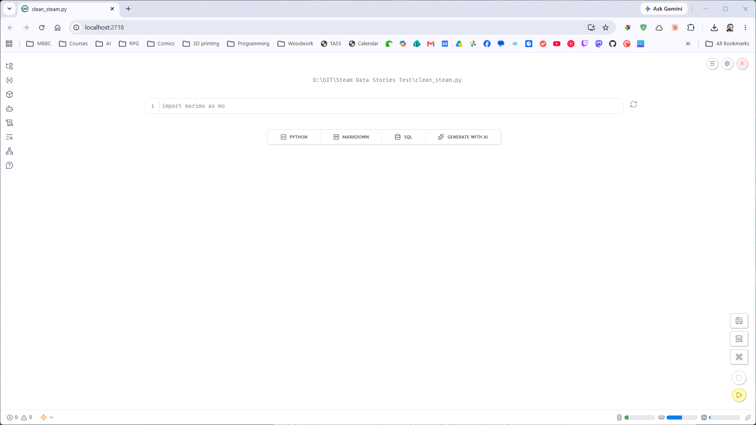
Our first, empty notebook
​A new, empty marimo notebook called clean_steam.py in the browser.
Notes:
This is the final checkpoint. Everyone should see this before stopping marimo.

Slide 27
Stop marimo
​Back in VS Code, click in the terminal and press Ctrl+C (also Ctrl+C on a Mac, not Cmd+C).
​marimo asks "Are you sure you want to quit? (y/N)".
​Type y and press Enter.
​The terminal shows the (.venv) prompt again.
Notes:
marimo asks first so we don't stop it by accident. Mac users often press Cmd+C out of habit, which copies instead.

Slide 28
Keep the terminal open
Watch out
​The notebook only works while marimo is running in the VS Code terminal.
​Closing the terminal or pressing Ctrl+C stops it.
​On a Mac, closing VS Code or pressing Cmd+Q also stops it.
​Our code is saved in clean_steam.py, so we can run the same command and carry on.
Notes:
Students will hit this the first time their notebook stops responding. The fix is always: open a terminal, check (.venv), run marimo edit clean_steam.py.

Slide 29
CHECK YOUR UNDERSTANDING
​What is a virtual environment, and why do we use one?
​How can we tell the virtual environment is switched on?
​Why must we never open and save steam_games.csv in Excel?
​Our marimo notebook stops responding. What's the most likely cause?
Notes:
Our computer is ready. Next, we find out what makes a good data story.
Answers:
1. A private copy of Python just for this project. Libraries go into it instead of the main Python, so projects can't interfere with each other.
2. The terminal prompt starts with (.venv).
3. Excel can quietly change values, such as dates, so our original data would no longer be the original.
4. marimo isn't running in the terminal any more (the terminal was closed or Ctrl+C was pressed). Start it again with marimo edit clean_steam.py.

