Slide 1
HOOK
Lesson 3
Asking a Question Data Can Answer
Steam Data Stories
Notes:
The third Hook lesson. We check which of our questions the data can actually answer, define the words in our example question, and use describe and value_counts to look for problems. About 60 minutes: 5 min hook, 10 min investigable questions, 10 min defining terms, 20 min checking against the data, 15 min refining and Your data story.

Slide 2
In this lesson we will learn
Learning intentions
​what makes a question investigable
​how to define the words in our question
​how to use describe and value_counts to check a question against the data
​how to refine a question that's too broad or can't be answered
Notes:
Read the intentions aloud. By the end, every student should have one final question for their data story.

Slide 3
Terminology
New terms
​investigable question – a question we can answer by collecting and analysing data, because it's specific, measurable and open.
​limitation – something our data or our decisions can't tell us, which we should mention when we tell our story.
​review score – the percentage of a game's reviews that are positive.
​refine – to change a question so the data can answer it, for example by narrowing it down or defining its words.
Notes:
Nine new terms today, split over two slides. These four are about questions; the next five are about statistics.

Slide 4
Terminology
New terms
​summary statistics – numbers that describe a whole column at once, such as its mean, median, smallest and largest values.
​mean – the average: the total of all the values divided by how many values there are.
​median – the middle value when all the values are sorted in order.
​standard deviation – a number that shows how spread out the values are from the mean.
​Series – a single column of a DataFrame.
Notes:
Students will have met mean and median in maths. Ask for a quick example: the median of 1, 3, 100 is 3, the mean is about 35.

Slide 5
REMEMBER
​We wrote three questions. Can our data actually answer them?
​A great question the data can't answer leads to a story with no evidence, and a story with no evidence isn't a data story.
Notes:
Recap: when we brainstormed story angles we wrote three questions, and when we explored our data we looked at the columns that might answer them. Ask one or two students to read out a question.

Slide 6
Investigable questions
​An investigable question is one we can answer by collecting and analysing data.
Notes:
Three features to remember: specific, measurable, open.

Slide 7
Good investigable questions are
​specific: it's clear exactly what we're looking at
​measurable: the answer comes from columns we actually have
​open: the answer isn't obvious before we look
Notes:
Ask students to hold up fingers 1, 2 or 3 for which feature is missing in each question on the next slide, before revealing the answers.

Slide 8
Which questions are investigable?
Question | Investigable? | Why
​What's the best game on Steam? | ​no | ​"best" isn't measurable; best for who?
​Are games getting more expensive? | ​almost | ​which games, and since when?
​Has the median price of Steam games changed between 2015 and 2024? | ​yes | ​specific, measurable with Price and Release date, and the answer isn't obvious
​Do people like Action games? | ​no | ​"like" isn't measurable as it stands
​Do Action games get a higher share of positive reviews than other games? | ​yes | ​uses Genres, Positive and Negative
Notes:
Cover the last two columns and let students decide first. Point out that the yes questions name real columns.

Slide 9
Some investigable questions about Steam
​Has the share of positive reviews changed for games released each year?
​Do free games get a higher share of positive reviews than paid games?
​Do games with more achievements get more recommendations?
​Which genre has the highest median price?
​Do games that Metacritic's critics liked also get good reviews from players?
Notes:
One more from the page: do publishers that release lots of games get better reviews than publishers with only one game? Ask which columns each question would need.

Slide 10
Write your own
PRIMM
​Write two more investigable questions about the Steam data.
​For each one, write down which columns would answer it.
Notes:
Give 3 minutes, then share a few. Check each against specific, measurable and open.

Slide 11
Defining our terms
​Even a specific question can hide a word that means different things to different people.
Notes:
We'll define the words in our example question.

Slide 12
OUR EXAMPLE QUESTION
​Do Indie games review as well as games from big studios?
​What exactly do "Indie games", "big studios" and "review as well" mean?
Notes:
Ask students how they'd measure each phrase with our 13 columns before showing the next slide.

Slide 13
What our words mean
​"Indie games" → games with Indie in their Genres: their makers call them Indie
​"games from big studios" → our data doesn't say how big a studio is, so we compare with every other game ("not Indie")
​"review as well" → the review score: the percentage of a game's reviews that are positive
Notes:
Comparing with every other game is a limitation: some not-Indie games come from small studios too, and we'll mention it in our story. Hollow Knight has 403,641 positive and 12,305 negative reviews, so its review score is about 97%. On Steam, developers choose their game's genres.

Slide 14
Do we have enough Indie games?
Why
clean_steam.py — new cell
​If only a handful of games were Indie, any difference we found could just be luck. So we check each game's Genres for the word Indie and count the matches.
1 games["Genres"].str.contains("Indie").sum()
​6243 are Indie, leaving 4,007 that aren't: plenty in each group.
Predict
​Out of 10,250 games, roughly how many do you think are Indie?
What it does
​line 1 → checks whether each Genres value contains Indie, then adds up how many do
Notes:
Start marimo with marimo edit clean_steam.py and press Ctrl+Shift+R (Cmd+Shift+R on a Mac) to run earlier cells. PRIMM modify: change Indie to another genre, such as Strategy or Simulation. How many games have that genre?

Slide 15
Counting with true and false
Tip
​str.contains gives true or false for each value. When we sum them, each true counts as 1 and each false counts as 0, so the total is the number of matches.
Notes:
This trick comes up again. Ask: what would we get if every game were Indie? (10,250.)

Slide 16
Checking our question against the data
​Do the columns we need hold useful values? Polars gives us two quick ways to check.
Notes:
First an overview of every column, then a closer look at one column.

Slide 17
Summary statistics for every column
Why
clean_steam.py — new cell
​We want a quick overview of every column: how many values are missing, and the typical, smallest and largest values. Strange numbers here are often the first sign of a problem.
1 games.describe()
Predict
​What kinds of numbers do you expect describe to show for each column?
What it does
​line 1 → calculates summary statistics for every column of games and shows them as a table
Notes:
PRIMM: predict, run, investigate.

Slide 18
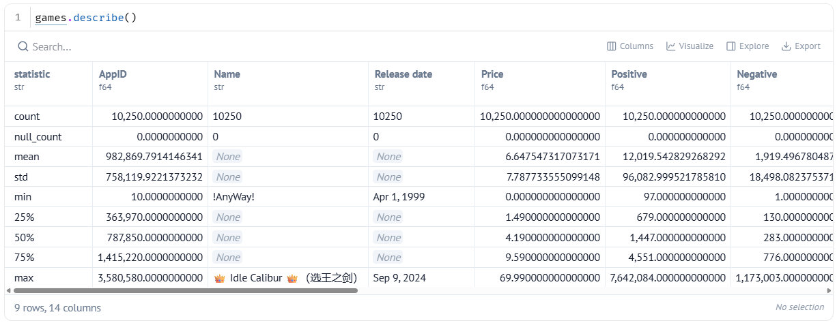
The output of describe
​One row for each statistic, one column for each column of games.
Notes:
Scroll across to show Price, Metacritic score and Release date, which we discuss next.

Slide 19
What each statistic tells us
Statistic | What it tells us
​count | ​how many values the column has
​null_count | ​how many values are missing
​mean | ​the average
​std | ​the standard deviation: how spread out the values are
​min and max | ​the smallest and largest values
​25%, 50%, 75% | ​the values a quarter, half and three-quarters of the way through, when sorted. 50% is the median.
Notes:
Link to the terms: mean, median and standard deviation. The 50% row is the median: the middle value.

Slide 20
What the numbers tell us
​Median Price is 4.19, mean about 6.65: a few expensive games pull the mean up.
​Median Metacritic score is 0. That's very unlikely: 0 probably means "no score".
​The Release date min is Apr 1, 1999 and max Sep 9, 2024: first and last alphabetically, because they're text.
Notes:
Point 1: the median gives a fairer picture of a typical game. Points 2 and 3 are jobs for when we fix our data. Ask: why would alphabetical order give the wrong oldest game?

Slide 21
What is a price of 4.19?
Tip
​our data came from the US Steam store, so every price is in US dollars
​Steam sets Australian prices separately
​prices were collected on one day, so games on sale show their sale price
​a price of 0 means the game is free to play
​in our story, we always say prices are in US dollars
Notes:
Price has no currency symbol, so we had to check where it came from. A median of US$4.19 is more in Australian dollars.

Slide 22
Count each Metacritic score
Why
clean_steam.py — new cell
​The Metacritic scores looked strange, so we count how often each value appears, most common first. That shows whether 0 is common or rare.
1 games["Metacritic score"].value_counts(sort=True)
Predict
​Which score do you think will be the most common?
What it does
​line 1 → picks Metacritic score, counts each different value, and sorts from most to least common
Notes:
PRIMM modify: change Metacritic score to Achievements and run it again. Is 0 a real value for achievements, or does it mean missing?

Slide 23
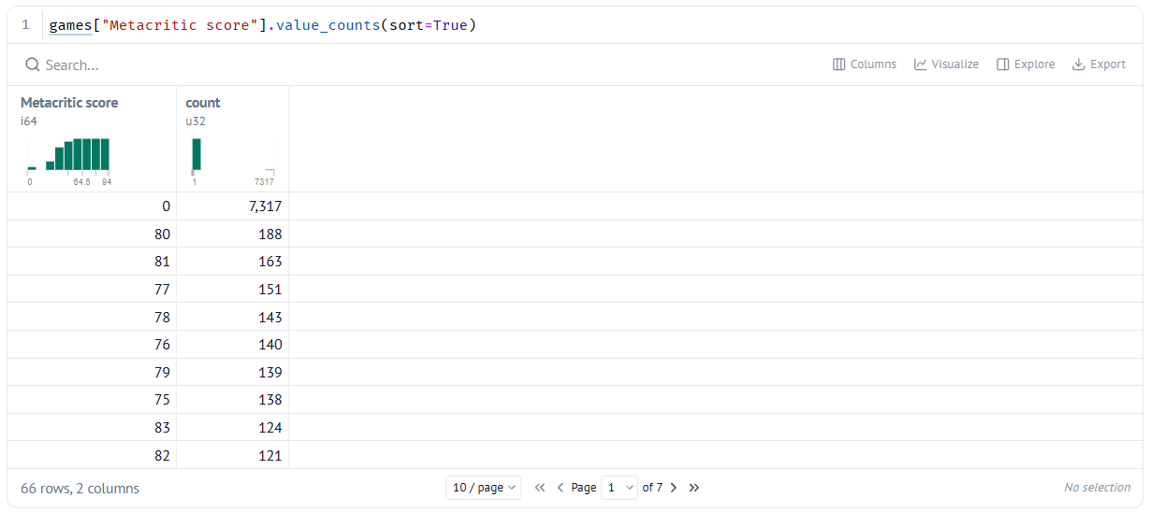
Most games have no Metacritic score
​0 is the most common score, with 7,317 games. Next is 80, with only 188.
Notes:
So about seven in ten of our games have no Metacritic score at all. That's fine for our example question, because we're using player reviews, not Metacritic. But a question that uses Metacritic score only has about three in ten of the games to work with.

Slide 24
Square brackets pick one column
Tip
​games["Metacritic score"] picks a single column from a DataFrame. A single column is called a Series. Many methods, like value_counts, work on a Series rather than a whole DataFrame.
Notes:
Link to the Series term. Ask: which other cell today used square brackets? (The Indie count, with games["Genres"].)

Slide 25
Refining our question
​If the data can't answer our question, we don't give up on it: we refine it.
Notes:
Three common fixes.

Slide 26
Three ways to refine a question
​narrow it down: "Are games getting more expensive?" → "Has the median price changed between 2015 and 2024?"
​swap in a column that works: if Metacritic score is missing, use Positive and Negative
​define the fuzzy words: "popular" → "has more than 10,000 recommendations"
Notes:
Ask students to apply one of these to a question from their own list.

Slide 27
OUR REFINED QUESTION
​Do Indie games get a higher review score than games that aren't Indie, and do they cost less?
​It's more precise, and every part of it can be measured.
Notes:
Compare with the original hook. Ask which columns each part uses: Genres, Positive and Negative for review score, Price for cost.

Slide 28
CHECK YOUR UNDERSTANDING
​What three features make a question investigable?
​Why do we compare Indie games with every other game rather than with big studios?
​The median Price is 4.19 but the mean is about 6.65. Why are they different?
​Why is a median Metacritic score of 0 suspicious?
Notes:
Cold-call or use mini whiteboards.
Answers:
1. Specific, measurable and open.
2. Our data doesn't say how big a studio is. That's a limitation we'll mention in our story.
3. A few expensive games pull the mean up, so the median gives a fairer picture of a typical game.
4. Half of these popular games scoring 0 is very unlikely. 7,317 games have 0, which really means no score.

Slide 29
Your data story
​Check each question is specific, measurable and open. Rewrite any that aren't.
​Write down what each fuzzy word means.
​Use describe, value_counts or str.contains on the columns each question needs. Is there enough real data?
​Refine any question the data can't answer.
​Choose one question, say why, and put it on its own line.
In my_data_story.md, add the heading
## Choosing a question
Notes:
Students work through all three questions from their story angles. Task 2 follows what we did for Indie and review as well. The final question goes on its own line so it's easy to find later.

