Slide 1
RISING INSIGHTS
Lesson 7
Making New Columns
Steam Data Stories
Notes:
The first Rising Insights lesson. We start a second notebook for our story and make three new columns: review score, release year and group. About 60 minutes: 5 min hook, 15 min new notebook, 15 min review score, 15 min years and groups, 10 min Your data story.

Slide 2
In this lesson we will learn
Learning intentions
​what the Rising Insights stage of our story does
​how to start a second notebook and load our clean data
​how to calculate a new column from other columns
​how to sort games into groups with pl.when
Notes:
Read the intentions aloud. Point out that cleaning is finished: from now on we're finding things out.

Slide 3
Terminology
New terms
​literal – a value written straight into our code, such as pl.lit("Indie"), that is the same for every row.
Notes:
Only one new term today. Contrast a literal with a column: pl.col("Genres") is different in every row, pl.lit("Indie") is the same in every row.

Slide 4
RISING INSIGHTS
​Our data is clean. Now we can start finding things out
​Each Rising Insights lesson adds one more piece of evidence to our story, building up to the Aha Moment.
Notes:
Link back to when we fixed our data and saved clean_games.parquet. Ask: what was the last thing we did in clean_steam.py? (Saved the clean data.)

Slide 5
The columns we need aren't in the data yet
Steam gives us
Our question needs
​the number of positive and negative reviews
​a full release date
​a list of each game's genres
​a review score
​a release year, to compare years
​a simple label: Indie or not
Notes:
Read across the rows: each column on the left becomes a new column on the right. We'll make all three today.

Slide 6
A new notebook
​From now on we'll work in steam_story.py, which starts from the clean data we saved.
Notes:
Keeping cleaning and storytelling in separate notebooks means each one stays short enough to follow.

Slide 7
Why two notebooks?
Data scientists keep cleaning separate
​each notebook has one job: cleaning, or telling the story
​our story starts from trusted data: every chart uses the same clean file
​our audience sees only the story: cleaning stays behind the scenes
​it's faster: loading the Parquet file beats repeating every cleaning step
Notes:
If we find another problem in the data later, we fix it in clean_steam.py, run its saving cell again, then re-run steam_story.py.

Slide 8
Start the second notebook
​If marimo is still running, click in the VS Code terminal and press Ctrl+C
​Type y and press Enter. The terminal shows the (.venv) prompt again
​Type marimo edit steam_story.py and press Enter
​A new browser tab opens with an empty notebook
Notes:
Check that steam_story.py appears in VS Code's Explorer panel. Circulate: some students will type the command in the wrong folder or without the venv active.

Slide 9
First, import Polars
Why
steam_story.py — first cell
​A new notebook knows nothing about the last one, so the first thing it needs is Polars.
1 import polars as pl
Notes:
Type it in the empty first cell and run it.

Slide 10
Load our clean data
Why
steam_story.py — new cell
​Our file is a Parquet file, so we use pl.read_parquet instead of pl.read_csv. We call it games because every later cell starts from it.
1 games = pl.read_parquet("data/clean_games.parquet")
2 games
​10250 rows and 10 columns, just like clean_games when we saved it.
Predict
​How many rows and columns will games have? What data type will Release date be?
Notes:
Have students check the column types: Release date is still a date, and the missing Metacritic scores are still nulls. Parquet kept all our cleaning work.

Slide 11
games in two notebooks
Good to know
​games in this notebook is our clean data, but games in clean_steam.py is the raw data. That's fine: each notebook has its own variables, so the two can't clash.
Notes:
Students sometimes worry they've overwritten their raw data. They haven't.

Slide 12
Calculating a review score
​900 positive and 100 negative, or 9,000 positive and 1,000 negative: both are liked by 90% of reviewers.
Notes:
Ask: which of those two games is better liked? (Neither: both 90%.) Raw review counts just tell us which games are most played. The review score lets us compare games of any size.

Slide 13
Work out the percentage of positive reviews
steam_story.py — new cell
1 scored = games.with_columns(
2 (pl.col("Positive") / (pl.col("Positive") + pl.col("Negative")) * 100)
3 .round(1)
4 .alias("Review score"),
5 )
6 scored.select("Name", "Positive", "Negative", "Review score")
​Why: Positive divided by the total reviews, times 100, rounded to 1 decimal place. with_columns keeps every column and adds one.
Notes:
PRIMM: predict, run, investigate. We round to 1 decimal place because more digits wouldn't change any comparison and would make the table harder to read. We only show four columns so we can check the calculation by eye.

Slide 14
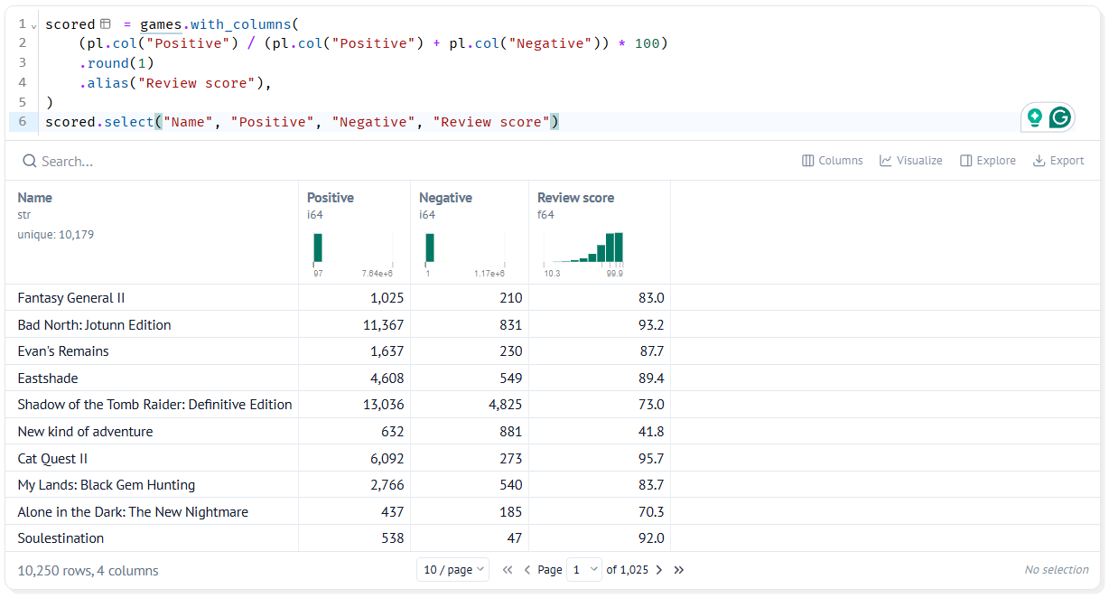
Every game has a review score
​Fantasy General II: 1,025 positive, 210 negative
​so its review score is 83.0
​every game has a score, because every game has at least 500 reviews
Notes:
Have students check the first row on a calculator: 1025 / (1025 + 210) × 100 = 83.0.

Slide 15
alias names a new column
Remember
​Without alias, the new column would take the name of the first column in the calculation, Positive, and replace it. alias gives it its own name.
Notes:
A good investigate question: what happens if we delete the alias line? (Positive gets replaced by the score.)

Slide 16
Years and groups
​Two more columns: the release year, and a group that labels every game Indie or Not Indie.
Notes:
We add these to the same with_columns as the review score, because they all describe the same games and belong in the same table.

Slide 17
Two more columns
Release year
Group
​our question asks whether Indie games have done better over time
​every single date would give thousands of tiny groups
​we use dt.year to pull the year out of a date
​the Genres column holds text like Action,Adventure,Indie
​a game is Indie if that text contains Indie
​we use pl.when to give each row one label if a test is true, another if not
Notes:
This is the why for the next cell. Students change the existing cell, not add a new one.

Slide 18
Add the year and the group
steam_story.py — change existing cell
1 scored = games.with_columns(
2 (pl.col("Positive") / (pl.col("Positive") + pl.col("Negative")) * 100)
3 .round(1)
4 .alias("Review score"),
5 pl.col("Release date").dt.year().alias("Release year"),
6 pl.when(pl.col("Genres").str.contains("Indie"))
7 .then(pl.lit("Indie"))
8 .otherwise(pl.lit("Not Indie"))
9 .alias("Group"),
10 )
11 scored.select("Name", "Review score", "Release year", "Genres", "Group")
​Why: We add the year and group to the same with_columns as the review score, because they all describe the same games and belong in the same table.
Notes:
Point to the title: change existing cell. PRIMM: before running, ask what the new Release year and Group columns will show. The highlighted lines are the new ones; the next slide explains them.

Slide 19
What the new lines do
​line 5 → gets the year from each Release date with dt.year, named Release year
​line 6 → pl.when works like if: does Genres contain Indie?
​line 7 → if it does, the value is pl.lit("Indie"), a literal
​line 8 → otherwise, Not Indie, like else in Python
​line 9 → names the column Group. Line 11 shows five columns
Notes:
Stress that pl.lit means the same text for every matching row, rather than a column name.

Slide 20
Add a Free column
PRIMM
​Add a column called Free that is True when Price is 0.
​Hint: we don't need pl.when, because a comparison already gives True or False.
Notes:
Answer: pl.col("Price") == 0 with .alias("Free"), added inside the same with_columns.

Slide 21
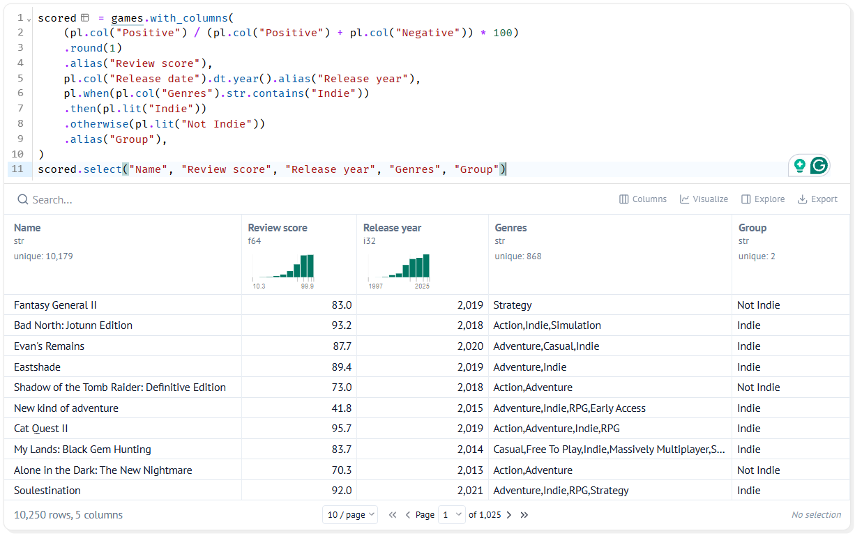
Every game has a year and a group
​every game now has a Release year and a Group
​games with Indie in their genres → Indie group
​every other game → Not Indie
Notes:
Ask students to look down the Genres and Group columns together and check a few rows.

Slide 22
Why a text label?
Design choice
​We could have made a True/False column instead. A text label like Indie or Not Indie is easier to read in tables, and it will appear in our chart legends without any extra work.
Notes:
We'll see this pay off when we make bar charts and histograms.

Slide 23
CHECK YOUR UNDERSTANDING
​Why do we use a review score instead of raw review counts?
​Why do we use pl.read_parquet in our story notebook?
​What happens if we leave out alias?
​What does pl.lit("Indie") mean?
Notes:
Cold-call or use mini whiteboards.
Answers:
1. Raw counts just tell us which games are most played. A percentage lets us compare games of any size.
2. Our clean data is saved as a Parquet file, which keeps our dates and nulls.
3. The new column takes the name of the first column in the calculation, Positive, and replaces it.
4. A literal: the same text, Indie, for every matching row, rather than a column name.

Slide 24
Your data story
​Write down one new column your question needs that isn't in the data, and how you could calculate it from the columns you have.
​Add it to the scored cell, run it, and check a few rows by hand to make sure the values are right.
​If your question compares groups, write a pl.when that labels each game with its group.
In my_data_story.md, add the heading
## New columns
Notes:
Give the last 10 minutes. Checking rows by hand is the habit to reinforce: a calculator check on two or three rows.

