Slide 1
AHA MOMENT
Lesson 14
The Aha Moment
Steam Data Stories
Notes:
The Aha Moment lesson: we design the one chart that answers our question, then add controls so our audience can explore. About 60 minutes: 5 min hook, 20 min designing the Aha chart, 25 min UI elements, 10 min Your data story.

Slide 2
In this lesson we will learn
Learning intentions
​what makes a good Aha Moment
​how to make one part of a chart stand out with colour
​how to add an annotation that points to our finding
​how to add a slider and a dropdown so our audience can explore
Notes:
Read the intentions aloud. The first three are about design; the last is about letting the audience check our finding for themselves.

Slide 3
Terminology
New terms
​UI element – a control, such as a slider or dropdown, that our audience can use to change what a notebook shows.
​range slider – a slider with two handles, used to choose a start value and an end value.
Notes:
Ask students where they've seen range sliders before (price filters on shopping sites are a good example).

Slide 4
REMEMBER
​Every part of our story has been building to this point
​The Hook asked the question, Behind the Scenes got the data ready, and Rising Insights collected the evidence. The Aha Moment is the one chart where our audience finally sees the answer.
Notes:
Ask students which insight they chose when they planned their own insights. For our example story it's the line chart of review scores over time: since 2017, Indie games have reviewed better every year.

Slide 5
A good Aha chart
​Right now our line chart shows the finding, but our audience still has to work it out. A good Aha chart:
​answers our question in one look
​uses colour to point at the part that matters, and grey for everything else
​says the finding in its headline title, and points to it with a note on the chart
Notes:
These three rules are the success criteria for today's Aha chart, and for the arc checklist when students present.

Slide 6
Making one line stand out
​In our first line chart, both lines are bright, so they both shout for attention. Our story is about Indie games.
Notes:
Start marimo with marimo edit steam_story.py and press Ctrl+Shift+R to run the earlier cells.

Slide 7
Our plan for the Aha chart
Colour
Annotation
​the Indie line is the only coloured line
​the other line turns grey
​it stays for comparison, but our eyes go to the colour
​a note on the chart, with an arrow
​it points at 2018
​that's where the gap jumps to 4 points or more and stays there
Notes:
An annotation is new vocabulary: a note on the chart that points at the exact spot our audience should look.

Slide 8
Three changes to our line chart
​We make the chart the same way as before, and store it in aha_chart, because we can only add an annotation to a chart we've stored.
​color_discrete_map sets the colour of each line
​labels gives the y-axis a name our audience understands
​add_annotation adds the arrow
Notes:
Point out the storing step: until now our chart cells ended with px.line(...). Now we keep the chart in a variable so we can add to it.

Slide 9
Our Aha chart
steam_story.py — new cell
1 aha_chart = px.line(
2 per_year_group,
3 x="Release year",
4 y="Median review score",
5 color="Group",
6 color_discrete_map={"Indie": "royalblue", "Not Indie": "lightgrey"},
7 markers=True,
8 labels={"Release year": "", "Median review score": "Positive reviews (%)"},
9 title="Since 2017, Indie games have reviewed better every year",
10 )
11 aha_chart.add_annotation(
12 x=2018,
13 y=87.05,
14 text="From 2018, Indie games stay about 4 to 8 points ahead",
15 ax=-120,
16 ay=-40,
17 )
18 aha_chart
Notes:
PRIMM: predict, run, investigate. Ask: which line will be coloured? What will the arrow point at? Walk through lines 6, 8 and 11 to 17: these are the new parts. Line 13's 87.05 is where the Indie line is in 2018; ax and ay are in pixels, and negative ay moves the text up.

Slide 10
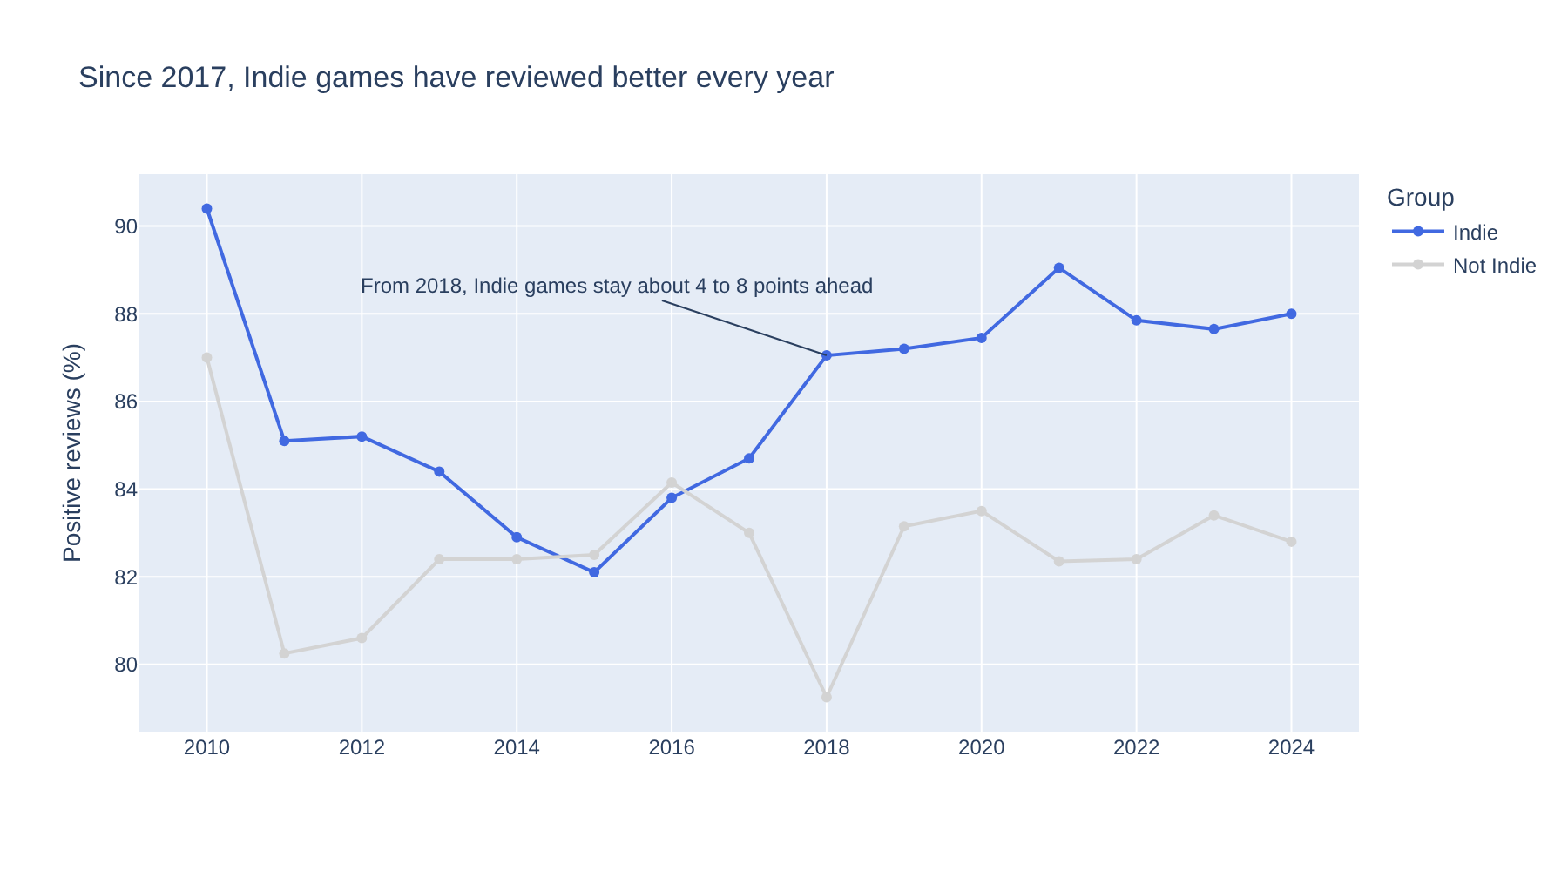
The finding is impossible to miss
​Same data as our first line chart, but our eyes go to the blue line, the title says what it shows, and the arrow shows where it starts.
Notes:
Put the first line chart up beside it if you can. Our audience doesn't have to work anything out.

Slide 11
Modify the Aha chart
PRIMM
​Change "royalblue" to another colour name, such as "darkorange".
​Change ax and ay to move the annotation's text to a clearer spot.
Notes:
Students who finish early can try other colour names. Remind them negative ay moves the text up and negative ax moves it left.

Slide 12
Where did 87.05 come from?
Tip
​It's the median review score of the Indie games from 2018, in the per_year_group table. We can also hover over the 2018 point to see it. An annotation's x and y use the same values as the chart's axes, so the arrow always points at the right spot.
Notes:
Students will need to find their own value for their own Aha chart, from their own table.

Slide 13
One colour, one message
Tip
​Colour is the first thing our eyes notice, so we use it for one thing only. If every line is bright, nothing stands out. Grey keeps the other lines for comparison, without pulling attention away.
Notes:
Ask: what would happen if we coloured both lines bright and added a third? (Nothing would stand out.)

Slide 14
Letting our audience explore
​"Does it still hold if I only look at recent years?" "What about prices?" Instead of a chart for every question, we give our audience controls.
Notes:
marimo calls these controls UI elements: sliders, dropdowns, buttons and text boxes.

Slide 15
Import marimo
Why
steam_story.py — change first cell
​UI elements are part of the marimo library, so we need to import it. Change the first cell, the one with our imports.
1 import marimo as mo
2 import plotly.express as px
3 import polars as pl
What it does
​line 1 → imports marimo with the short name mo, so we can use its UI elements
Notes:
Students change the first cell, not add a new one. A common mistake is adding the import at the bottom.

Slide 16
Two controls for our audience
​a range slider chooses a start year and an end year, so we can check the gap in recent years
​a dropdown chooses one option from a list: review scores or prices
​each dropdown option is a column name in scored, so we can use it straight in Polars
​every UI element has a value: what the audience has chosen right now
​years.value is like [2010, 2024]; measure.value is like "Review score"
Notes:
Make sure students understand value before the next slide: the whole technique depends on reading years.value and measure.value in another cell.

Slide 17
Make the control in one cell, use it in another
marimo rule
​A cell can't use the value of a UI element that it creates. marimo needs to know which cells to re-run when the audience moves a control. So we create both controls in one cell, without showing them, then show them in the cell that uses them.
Notes:
This keeps the controls right above the chart they change. Students who try to create and use a slider in one cell will get an error. Showing the controls in the same cell as the table and chart also keeps everything that belongs together in one spot, instead of the controls in one place and the chart somewhere else.

Slide 18
Create the controls
Why
steam_story.py — new cell
​We create the slider and the dropdown together, without showing them.
1 years = mo.ui.range_slider(
2 start=2010,
3 stop=2024,
4 value=[2010, 2024],
5 label="Years",
6 show_value=True,
7 )
8 measure = mo.ui.dropdown(
9 options=["Review score", "Price"],
10 value="Review score",
11 label="Measure",
12 )
What it does
​lines 1–7 → a range slider from 2010 to 2024, stored in years
​line 4 → both handles start at the ends
​lines 8–12 → a dropdown stored in measure, starting on Review score
Notes:
Nothing appears under the cell, and that's what we want: the last line is part of an assignment, so the cell has no output. Students often think it's broken.

Slide 19
Connecting the controls
​We make a table like per_year_group, called explore, with two changes:
​keep only the years between the slider's handles
​find the median of whichever column the dropdown has chosen
​mo.hstack puts things side by side: the slider and dropdown sit on one row
​mo.vstack puts things one under the other: the controls sit above the table
Notes:
Draw hstack and vstack as boxes on the board: a row of two boxes, inside a column with the table below.

Slide 20
Use the controls in our table
steam_story.py — new cell
1 explore = (
2 scored.filter(
3 pl.col("Release year").is_between(years.value[0], years.value[1])
4 )
5 .group_by("Release year", "Group")
6 .agg(pl.col(measure.value).median().alias("Median"))
7 .sort("Release year", "Group")
8 )
9 mo.vstack([mo.hstack([years, measure]), explore])
​Why: Line 3 uses years.value[0] and years.value[1]; line 6 uses measure.value.
Notes:
PRIMM: predict what will appear, then run. Line 3 keeps games between the start year and the end year. Line 6 finds the median of the chosen column and names it Median. Line 9 shows the controls side by side, above the table.

Slide 21
Move the slider and watch
​the slider and dropdown appear, with the explore table under them
​drag the slider's left handle to 2018
​the table changes straight away
​marimo is reactive: when years changes, it re-runs every cell that uses it
Notes:
Students met reactivity when they explored their data. This is the payoff: no button to press, the table just updates.

Slide 22
Chart the explore table
steam_story.py — change existing cell
1 explore = (
2 scored.filter(
3 pl.col("Release year").is_between(years.value[0], years.value[1])
4 )
5 .group_by("Release year", "Group")
6 .agg(pl.col(measure.value).median().alias("Median"))
7 .sort("Release year", "Group")
8 )
9 explore_chart = px.line(
10 explore,
11 x="Release year",
12 y="Median",
13 color="Group",
14 color_discrete_map={"Indie": "royalblue", "Not Indie": "lightgrey"},
15 markers=True,
16 title=f"Median {measure.value.lower()} of Indie and other games",
17 )
18 mo.vstack([mo.hstack([years, measure]), explore_chart, explore])
Notes:
PRIMM: predict, run, investigate. A line chart suits this for the same reason as our Aha chart. Line 14 uses the same colours, so Indie is always blue. Line 16 builds the title with an f-string from measure.value, and lower makes it lower case. Line 18 shows controls, then chart, then table.

Slide 23
Modify the controls
PRIMM
​Add "Recommendations" to the dropdown's options in the cell that creates the controls.
​What does the chart show when we choose it?
Notes:
Because each option is a column name in scored, adding a column name is all it takes.

Slide 24
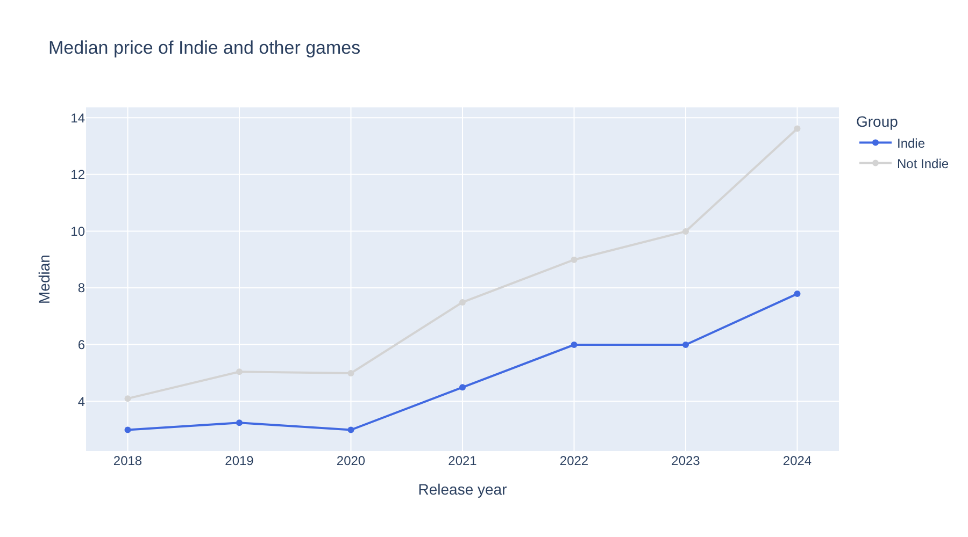
Slider at 2018 to 2024, dropdown on Price
​In 2024 a typical non-Indie game cost about US$13.60 and a typical Indie game US$7.79: much bigger than the $1.15 gap across all years.
Notes:
Exploring has found something new: prices of both groups have gone up since 2020, but the other games have gone up faster. The $1.15 is from when we summarised our groups. It's a good extra insight, but only once it's been checked.

Slide 25
Explore, then check
Watch out
​Controls make it easy to find patterns, and just as easy to find patterns that aren't real. Before anything we found by exploring goes into our story, we check it like our other insights: enough games in each group, the right average, and an honest claim.
Notes:
These are the checks from when we planned our own insights.

Slide 26
Two charts, two jobs
Aha chart
Explore chart
​designed
​we chose its years, colours, title and annotation
​tells our audience one thing
​every data story needs one
​for checking
​lets our audience ask their own questions
​a bonus
Notes:
Students who run short of time should prioritise the Aha chart over the explore chart.

Slide 27
CHECK YOUR UNDERSTANDING
​Why is the Not Indie line grey instead of another bright colour?
​Why do we store the chart in aha_chart before showing it?
​Why do we create the slider in one cell and use it in another?
​What is years.value when both handles are at the ends?
​We find a new pattern by exploring. What must we do before it goes in our story?
Notes:
Cold-call or use mini whiteboards.
Answers:
1. Colour should point at one thing. Grey keeps the other line for comparison without pulling attention away from the Indie line.
2. We can only add an annotation to a chart we've stored.
3. A cell can't use the value of a UI element it creates; marimo needs to know which cells to re-run when the control moves.
4. [2010, 2024]
5. Check it like our other insights: enough games in each group, the right average, and an honest claim.

Slide 28
Your data story
​Redesign your chosen insight as your Aha chart: one colour for what matters, grey for the rest, a headline title and an annotation. Write down the title and annotation text.
​Show your Aha chart to someone for five seconds, then ask what it shows. Record what they said, and what you changed.
​Add at least one UI element in the same cell as the table or chart it changes. Write down one thing you found by exploring, and whether it passed the checks.
In my_data_story.md, add the heading
## Aha Moment
Notes:
Give the last 10 minutes. The five-second test is the real measure of an Aha chart: if the viewer can't say the finding, the design needs work.

