Slide 1
BEHIND THE SCENES
Lesson 5
Choosing Columns and Rows
Steam Data Stories
Notes:
The first Behind the Scenes lesson. We cut our data down to the columns and rows our question needs. About 60 minutes: 5 min hook, 15 min choosing columns, 10 min choosing rows, 15 min combining conditions and the error, 5 min Indie games, 10 min Your data story.

Slide 2
In this lesson we will learn
Learning intentions
​why cleaning is the Behind the Scenes stage of our story
​how to keep only the columns we need with select
​how to keep only the rows we need with filter
​how to combine conditions with & and |
​how to find the Indie games
Notes:
Read the intentions aloud. Point out select is for columns and filter is for rows; students mix these up.

Slide 3
Terminology
New terms
​data cleaning – finding and fixing problems in data so we can trust the results.
​expression – a description of what to do with a column, such as pl.col("Price") > 0, which Polars works out for every row at once.
Notes:
Expression is the harder term. We'll see it in action when we filter rows.

Slide 4
BEHIND THE SCENES
​Our audience will never see this stage, but this is where we earn their trust
​If our data is wrong, every chart and every claim in our story is wrong too.
Notes:
Link back to when we removed the support emails: we already have public_games, with 12 columns and 10,250 rows. Our question only needs some of them. Smaller tables are easier to read and easier to check.

Slide 5
Choosing columns
​Our question: do Indie games get a higher review score than other games, and do they cost less?
Notes:
Start marimo with marimo edit clean_steam.py and press Ctrl+Shift+R (Cmd+Shift+R on a Mac) to run the earlier cells.

Slide 6
Which columns does our question need?
Column | Keep? | Why
​AppID | ​keep | ​the only column that's different for every game, to check for repeats
​Name | ​keep | ​so we can recognise each game
​Release date | ​keep | ​to see whether things change over time
​Price | ​keep | ​answers the "do they cost less?" part
​Positive and Negative | ​keep | ​we'll calculate each game's review score from them
​Recommendations | ​keep | ​another way to measure how popular a game is
Notes:
Go through the columns one at a time and ask students to decide before revealing the reason.

Slide 7
Which columns does our question need? (continued)
Column | Keep? | Why
​Metacritic score | ​keep | ​to compare critics' scores with players' reviews
​Developers | ​keep | ​so we can see who made each game
​Genres | ​keep | ​it tells us which games are Indie
​Achievements | ​leave out | ​the number of achievements doesn't help answer our question
​Publishers | ​leave out | ​we're using Genres to decide which games are Indie
Notes:
That leaves 10 columns. We'll use select to keep just those.

Slide 8
Keep only the columns we need
Why
clean_steam.py — new cell
​select keeps just the columns we list, in the order we list them. We store the result in a new variable, selected.
1 selected = public_games.select(
2 "AppID",
3 "Name",
4 "Release date",
5 "Price",
6 "Positive",
7 "Negative",
8 "Recommendations",
9 "Metacritic score",
10 "Developers",
11 "Genres",
12 )
13 selected
What we see
​10 columns instead of 12
​still all 10,250 rows
​so select never changes the number of rows: it only chooses columns
Notes:
PRIMM: ask students to predict how many rows and columns selected will have before running. We start from public_games, the version without support emails. Each cleaning step starts from the variable the step before made and gives its result a new name, so we can always look back at an earlier version.

Slide 9
Achievements and Publishers might suit your question
Your question
​Our example question doesn't need them, but your own question might. Do games with more achievements get more recommendations? Do games from publishers that release lots of games get better reviews? If your question uses them, add them to your select cell.
Notes:
Students will come back to this in Your data story at the end.

Slide 10
Choosing rows
​To keep only some rows, we use filter with a condition. Rows where the condition is True are kept.
Notes:
Our question is partly about price, so a good first question is: how many games cost money, and how many are free?

Slide 11
How many games cost money?
Why
clean_steam.py — new cell
​Free games might behave differently from paid games, so it's worth knowing how many there are. We keep only the rows where Price is more than 0.
1 paid_games = selected.filter(pl.col("Price") > 0)
2 paid_games.height
​The output is 8839. The other 1,411 are free.
Predict
​How many of our 10,250 games cost money?
Notes:
height gives the number of rows. Explain pl.col("Price"): it means the Price column, and it's an expression, a description of what to do with a column that Polars works out for every row at once. We'll use pl.col in almost every cell from now on.

Slide 12
Find the free games
PRIMM
​Change > 0 to == 0 to find the free games instead.
​How many are there?
Notes:
Answer: 1,411. Students can check: 8,839 + 1,411 = 10,250.

Slide 13
Combining conditions
​Paid games that are also very popular: Price more than 0 and Recommendations more than 10,000.
Notes:
A row has to pass two conditions at once. Python's symbol for and between Polars conditions is &. Tell students to type the next cell exactly as shown, even though it has a mistake.

Slide 14
First try: join the conditions with &
clean_steam.py — new cell
1 popular_paid = selected.filter(
2 pl.col("Price") > 0 & pl.col("Recommendations") > 10000
3 )
4 popular_paid.height
​Why: We say a game is very popular if it has more than 10,000 recommendations. A row has to pass both conditions, so we join them with &.
Notes:
Ask students to type it exactly as it is, then run it. Most will expect a number.

Slide 15
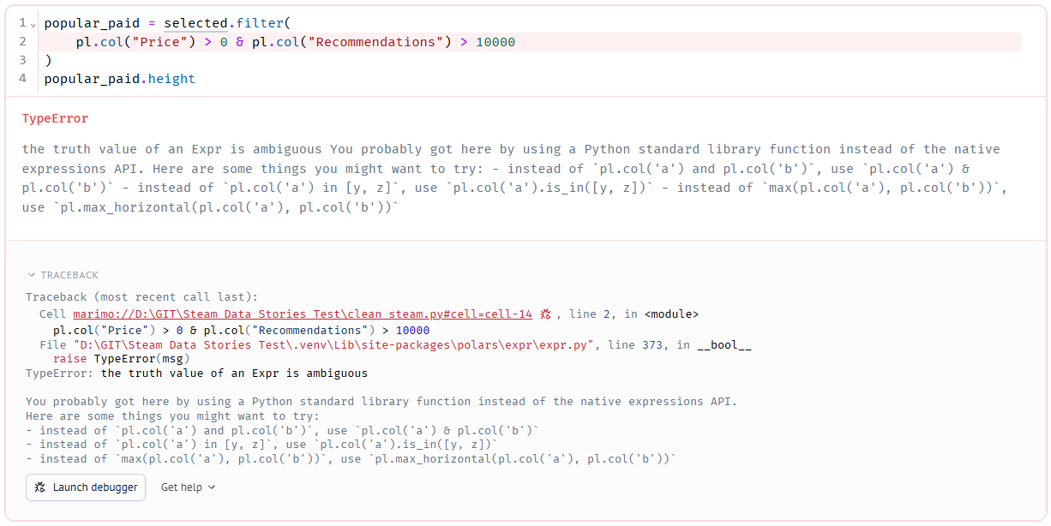
The truth value of an Expr is ambiguous
Reading the error
​TypeError → Python tried to treat an expression as a single True or False
​the truth value of an Expr is ambiguous → Python couldn't decide if it was True or False
​the highlighted line → line 2 of our cell caused the error
​the suggestions → common causes, such as and instead of &. We already use &, so it's something else
Notes:
Walk through the error in parts: type, message, where. The suggestions don't fit our case, which is a good lesson: suggestions are guesses.

Slide 16
Why it fails: the order Python works things out
​Python does & before >
​so it tried to work out 0 & pl.col("Recommendations") first
​which makes no sense
​fix: put each condition in its own brackets, so each comparison happens first
Notes:
Compare with BIDMAS in maths: brackets first. Draw the brackets on the board around each comparison.

Slide 17
Put each condition in its own brackets
clean_steam.py — change existing cell
1 popular_paid = selected.filter(
2 (pl.col("Price") > 0) & (pl.col("Recommendations") > 10000)
3 )
4 popular_paid.height
​The output is 1315: only 1,315 paid games have more than 10,000 recommendations.
​line 2 → each condition in its own brackets, joined with &
​a row is kept only if both conditions are True
Notes:
Students change the existing cell, not add a new one. Point to the title: change existing cell.

Slide 18
Three ways to combine conditions
Operator | Meaning | A row is kept when
​& | ​and | ​both conditions are True
​| | ​or | ​at least one condition is True
​~ | ​not | ​the condition is False
Notes:
Show students where | is on the keyboard (Shift and backslash).

Slide 19
Use & and |, not and and or
Watch out
​In normal Python we write and and or. Polars expressions need & and | instead, and each condition needs its own brackets.
Notes:
This is the most common filter mistake. Refer back to it whenever students hit the ambiguous error.

Slide 20
Free or very popular
PRIMM
​Change the code to find games that are free or have more than 100,000 recommendations.
​How many are there?
Notes:
They need |, Price == 0 and Recommendations > 100000, each in brackets. The page doesn't give the answer, so check it live.

Slide 21
Finding the Indie games
​We counted the Indie games with str.contains. Now let's keep them as their own DataFrame.
Notes:
Keeping them lets us look through them and check that our definition of Indie picks the games we expect.

Slide 22
Keep the Indie games
clean_steam.py — new cell
1 indie_games = selected.filter(pl.col("Genres").str.contains("Indie"))
2 indie_games
​Why: We use the same str.contains condition as before, but inside a filter, so we keep the rows instead of counting them.
Notes:
PRIMM: predict how many rows indie_games will have. Modify: put ~ in front of pl.col to find the games that aren't Indie. (10,250 − 6,243 = 4,007.)

Slide 23
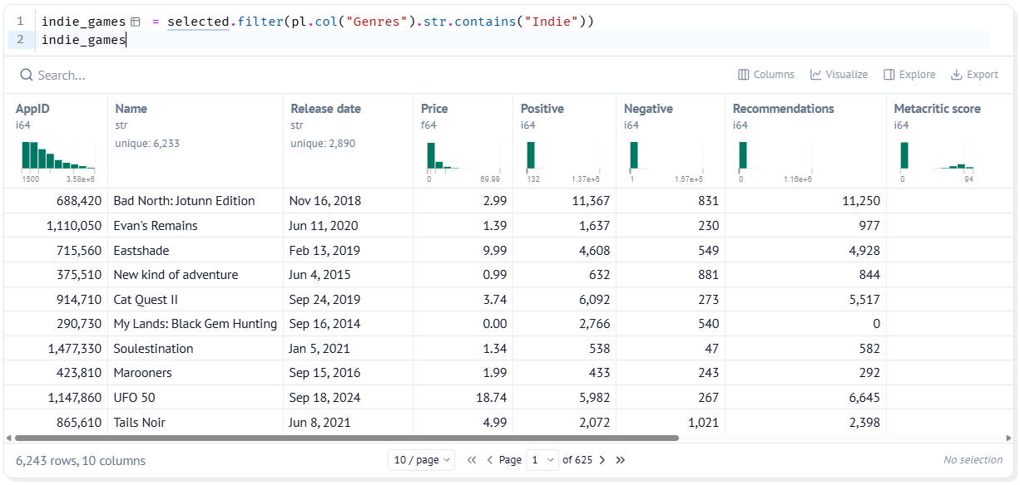
6,243 Indie games
​6243 rows
​matches our count from when we asked our question
​every row has Indie somewhere in its Genres
Notes:
Have students scroll across to the Genres column and check a few rows.

Slide 24
CHECK YOUR UNDERSTANDING
​Which method chooses columns, and which chooses rows?
​Why does select never change the number of rows?
​Why did our first & condition give a TypeError?
​Which operator keeps a row when at least one condition is True?
Notes:
Cold-call or use mini whiteboards.
Answers:
1. select chooses columns; filter chooses rows.
2. It only chooses which columns to keep; every row stays.
3. Python does & before >, so it tried 0 & pl.col("Recommendations") first. Each condition needs its own brackets.
4. | (or).

Slide 25
Your data story
​List the columns your question needs and why. If any aren't in selected, add them to the select cell. Don't remove any columns.
​Write a filter that finds the rows your question is about. Record the condition and how many rows it keeps.
​If your question compares two groups, write one filter for each group, and record how many rows are in each.
In my_data_story.md, add the heading
## Columns and rows
Notes:
Give the last 10 minutes. Remind students not to remove columns from select, because later lessons use them.

