Slide 1
RISING INSIGHTS
Lesson 8
Summarising Groups
Steam Data Stories
Notes:
Today we turn 10,250 rows into a few clear numbers our audience can understand, and get our first piece of evidence. About 60 minutes: 5 min hook, 15 min comparing our two groups, 15 min mean or median, 15 min games per year, 10 min Your data story.

Slide 2
In this lesson we will learn
Learning intentions
​how to split data into groups with group_by
​how to summarise each group with agg
​how to count rows with pl.len
​when to use the mean and when to use the median
Notes:
Read the intentions aloud. The last one is the big idea of the lesson: the average we choose changes the story we tell.

Slide 3
Terminology
New terms
​aggregate – to combine the values in a group into one number, such as a count, mean or median.
​skewed – describes data where a few values are much bigger or smaller than the rest, which pulls the mean away from the median.
Notes:
Check students remember mean (add up and divide) and median (the middle value when sorted) from maths.

Slide 4
REMEMBER
​Every game now has a review score, a release year and a group
​But a table of 10,250 games can't tell a story by itself. Our audience needs a few clear numbers.
Notes:
Link back to when we made new columns in steam_story.py. Ask: what numbers would our audience want to see? (How Indie games compare with the others; how many games came out each year.)

Slide 5
Split, apply, combine
​Every summary in this lesson follows the same three steps.
​split the rows into groups, such as Indie and Not Indie
​apply a calculation to each group, such as its median review score
​combine the answers into a new, much smaller table, with one row per group
Notes:
Act it out: split the class into two groups, each group works out its average age, then combine the answers on the board as a two-row table.

Slide 6
Comparing our two groups
​For each group: how many games, so we know if we can trust it, and its median review score, for a typical game.
Notes:
Start marimo with marimo edit steam_story.py and press Ctrl+Shift+R (Cmd+Shift+R on a Mac) to run the earlier cells. We use the median rather than the mean for now; we'll see why later.

Slide 7
Summarise each group
steam_story.py — new cell
1 per_group = (
2 scored.group_by("Group")
3 .agg(
4 pl.len().alias("Games"),
5 pl.col("Review score").median().alias("Median review score"),
6 )
7 .sort("Group")
8 )
9 per_group
​Why: For each group: how many games, and its median review score.
Notes:
PRIMM: ask students to predict how many rows per_group will have and which group will score higher, then run. The next slide explains each line.

Slide 8
Split, apply, combine in code
​line 2 → group_by splits the rows of scored by Group
​line 3 → agg, short for aggregate, applies calculations to each group
​line 4 → pl.len counts the rows in each group, named Games
​line 5 → the median Review score of each group
​line 7 → sorts by Group, because group_by doesn't keep any order
Notes:
Line 1 opens a bracket so our code can go over several lines; line 8 closes it. Line 6 closes agg, which combines the answers into one table.

Slide 9
Which group gets more recommendations?
PRIMM
​Add a line inside agg that works out the median Recommendations of each group.
​Which group gets more recommendations?
Notes:
Remind students to add an alias and a comma. The page doesn't give the answer, so check it live.

Slide 10
Our first piece of evidence
​The typical Indie game gets 86.5% positive reviews, compared with 83.2% for other games.
Group | Games | Median review score
​Indie | ​6243 | ​86.5
​Not Indie | ​4007 | ​83.2
Notes:
Point out the Games column first: both groups are big enough to trust. This sentence is a model for the finding students write in Your data story.

Slide 11
Mean or median?
​Do Indie games cost less? The two kinds of average don't always agree, so we'll work out both, side by side.
Notes:
We round the mean to 2 decimal places because prices are in dollars and cents.

Slide 12
Median and mean price of each group
steam_story.py — new cell
1 prices = (
2 scored.group_by("Group")
3 .agg(
4 pl.col("Price").median().alias("Median price"),
5 pl.col("Price").mean().round(2).alias("Mean price"),
6 )
7 .sort("Group")
8 )
9 prices
​Why: Both averages side by side, so we can see whether they agree.
Notes:
PRIMM: predict which will be bigger for each group, the mean or the median. Line 4 finds the median Price; line 5 finds the mean Price, rounded to 2 decimal places.

Slide 13
Indie games cost less by either measure
Group | Median price | Mean price
​Indie | ​3.84 | ​5.57
​Not Indie | ​4.99 | ​8.32
Notes:
Ask: what do you notice about the gap between the groups? Let students spot that the means are further apart than the medians before the next slide.

Slide 14
What currency are these prices in?
US dollars
​The data was collected from the US Steam store, on one day, so a game on sale that day shows its sale price. When we write about prices in our story, say they're in US dollars, so our audience doesn't read them as Australian dollars.
Notes:
A good example of a limitation students should mention in their story.

Slide 15
Look at the gap
​the median prices are only $1.15 apart
​the mean prices are $2.75 apart
​most games are cheap, but a few cost $60 or $70
​those few pull the mean up, and most of them aren't Indie games
Notes:
Ask: why would a handful of expensive games change the mean but hardly change the median? (The mean adds up every value; the median only cares about the middle one.)

Slide 16
When data is skewed, they tell different stories
Median
Mean
​describes a typical game
​for prices, it gives the fairer picture of what a typical game costs
​is pulled towards the few very large values
​here, a few $60 or $70 games
Notes:
Neither is wrong, but we need to choose the one that matches what we want to say, and tell our audience which one we used.

Slide 17
Other ways to summarise
Inside agg
​We can use mean, median, min, max and sum on any column, and pl.len() to count rows. We can use as many as we like, each with its own alias.
Notes:
Students will need these for their own questions.

Slide 18
Games per year
​We can group by any column. Before we compare years, we need to know how many games each year has.
Notes:
A year with only a few games can't tell us much. We sort by year so the table reads in time order.

Slide 19
Count and score the games in each year
steam_story.py — new cell
1 per_year = (
2 scored.group_by("Release year")
3 .agg(
4 pl.len().alias("Games"),
5 pl.col("Review score").median().alias("Median review score"),
6 )
7 .sort("Release year")
8 )
9 per_year
​Why: A year with only a few games can't tell us much, so we count them first.
Notes:
PRIMM: predict how many rows per_year will have. Compare it with per_group: only line 2 (Release year instead of Group) and line 7 (sort by Release year) are different.

Slide 20
Group by something else
PRIMM
​Change "Release year" on line 2 to "Metacritic score".
​What does the new table tell us?
Notes:
If students only change line 2, the sort on line 7 still says Release year, so ask them to predict what happens and fix it.

Slide 21
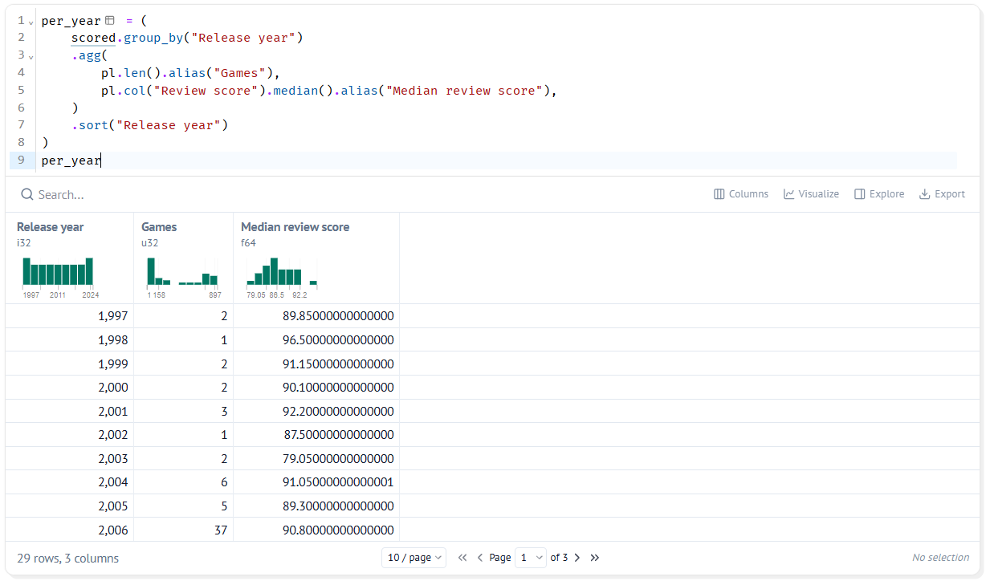
One row per year
​29 rows, from 1997 to 2025
​the busiest year is 2024, with 929 games
​2025 has only 424, less than half of 2024
​the years before 2006 have only a handful of games each
Notes:
The screenshot shows the first page of the table (1997 to 2006), where the small early years are. Have students page forward to the end to find 2024 and 2025.

Slide 22
Watch out for small groups
Watch out
​1998 has a median review score of 96.5, but that's from just 1 game. A summary of one or two games isn't evidence of anything. When we compare groups, we check the Games column first, and leave out groups that are too small.
Notes:
Ask: how many games would you want before you trust a year's median? There's no single right answer; the point is to check.

Slide 23
CHECK YOUR UNDERSTANDING
​What are the three steps of split, apply, combine?
​What does pl.len() count?
​Why are the mean prices further apart than the median prices?
​1998 has a median review score of 96.5. Why shouldn't we use it as evidence?
Notes:
Cold-call or use mini whiteboards.
Answers:
1. Split the rows into groups, apply a calculation to each group, combine the answers into one smaller table.
2. The number of rows in each group.
3. Prices are skewed: a few $60 or $70 games pull the mean up, and most of them aren't Indie.
4. It's from just 1 game. A summary of one or two games isn't evidence of anything.

Slide 24
Your data story
​Write a group_by that summarises the groups your question is about. Record the table it makes.
​Decide whether the mean or the median suits your question better, and write down why.
​Write one sentence that states a finding, using a number from your summary, like the Indie review score example.
In my_data_story.md, add the heading
## Summaries
Notes:
Give the last 10 minutes. Model sentence from the page: The typical Indie game gets 86.5% positive reviews, compared with 83.2% for other games.

